Slide 1
Critical Minerals and Science Collaboration Necessities for Achieving Carbon Neutrality
Dr Siddharth Saxena
Director Cambridge Central Asia Forum, Jesus College
National Facility Development Manager, Cavendish Laboratory, Dept of Physics University of Cambridge, Cambridge, United Kingdom
sss21@cam.ac.uk https://centralasia.group.cam.ac.uk/

Slide 2
Unique Selling Point
Access to vast materials and metals base, which are needed to drive the new era of electronics, refrigeration and energy-storage which underpin all other areas of technology
New industrial and sub sectors of global relevance have potential to be induced in/from Asia through deployment of new scientific ideas. E.g. Downstream potential of oil industry, mining, agro resources.

Slide 3
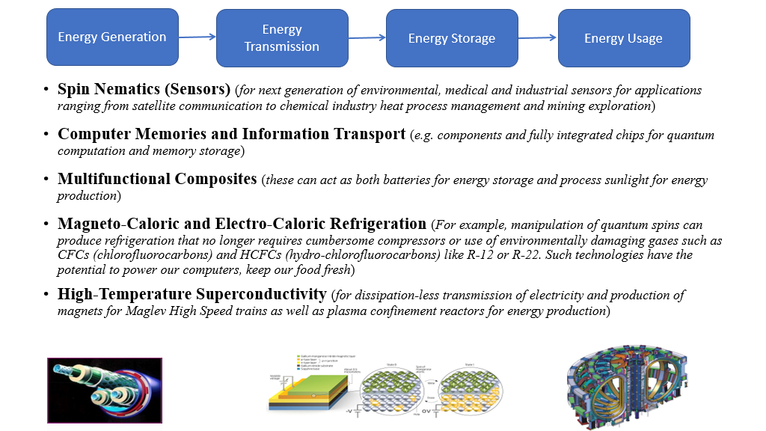

Slide 4
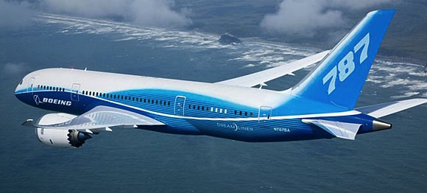
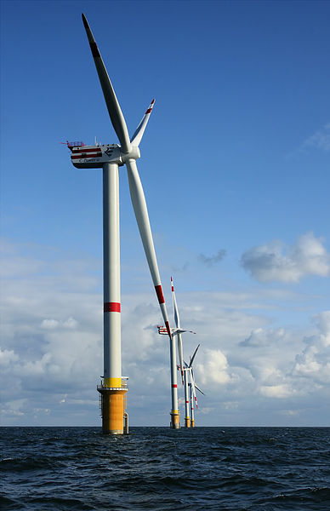
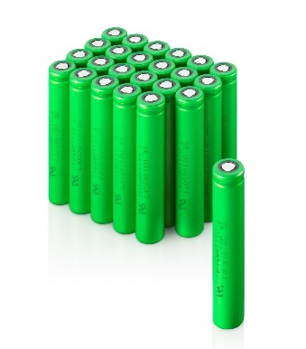
Materials are energy and energy is money
Energy input accounts for 1/3 cost of steel ($1/kg) and 1/2 cost of aluminum ($2.50/kg)
iPad
Cost: $500
Weight: 0.6 kg
$1,000/kg
Boeing 787-9
$243M 180,000kg
$1,500/kg
Wheat flour $1/kg
Honda Civic 1.8
$16,000
1,210 kg
$13/kg
Enercon E-126
7.58 MW
$10M
6,000 tons
$1.5/kg
Payback
in 3-4 years
at 10¢/kWh
Ground beef
$10/kg
Li-ion 18650 cell
$100/kg

Slide 5
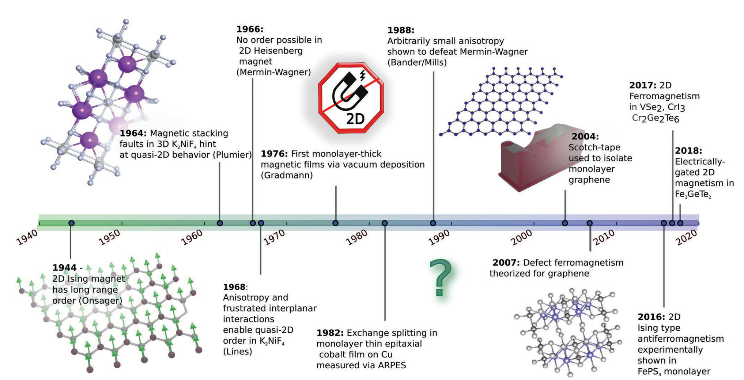
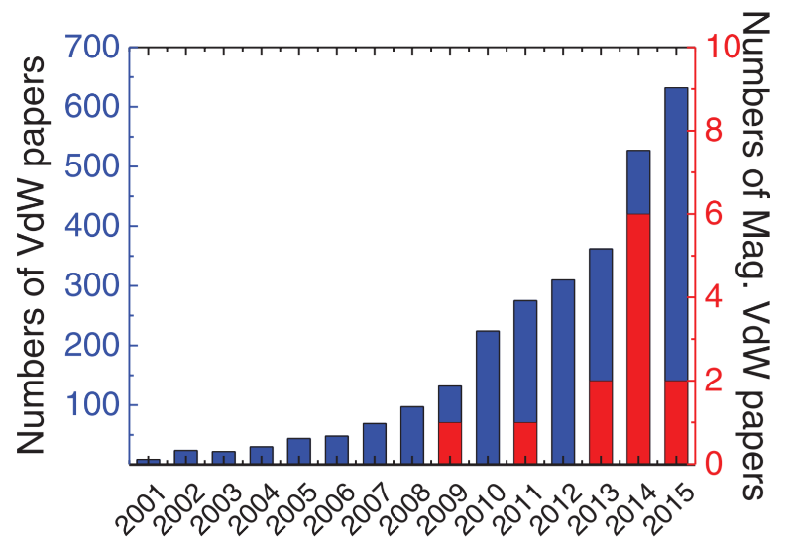
Low-dimensional Magnets
magnetic anisotropy
—— opens up an excitation energy gap
J.-G. Park, J. Phys.: Cond Mat (2016)
D. L. Cortie, et al., Adv. Funct. Mater. 1901414, 1 (2019).
5

Slide 6
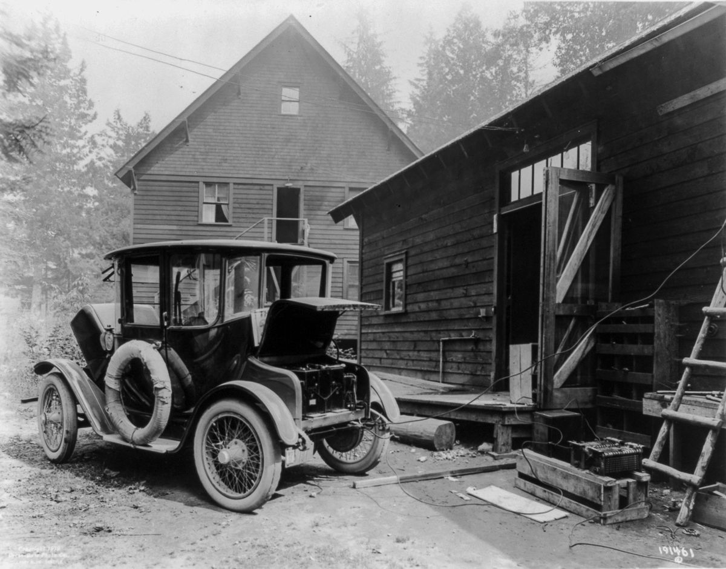
More Electric vehicles circa 1900 than Gasoline ones!
Electricity is the thing. There are no whirring and grinding gears with their numerous levers to confuse, no dangerous and evil-smelling gasoline and no noise.
Thomas Edison
Image: Library of Congress

Slide 7
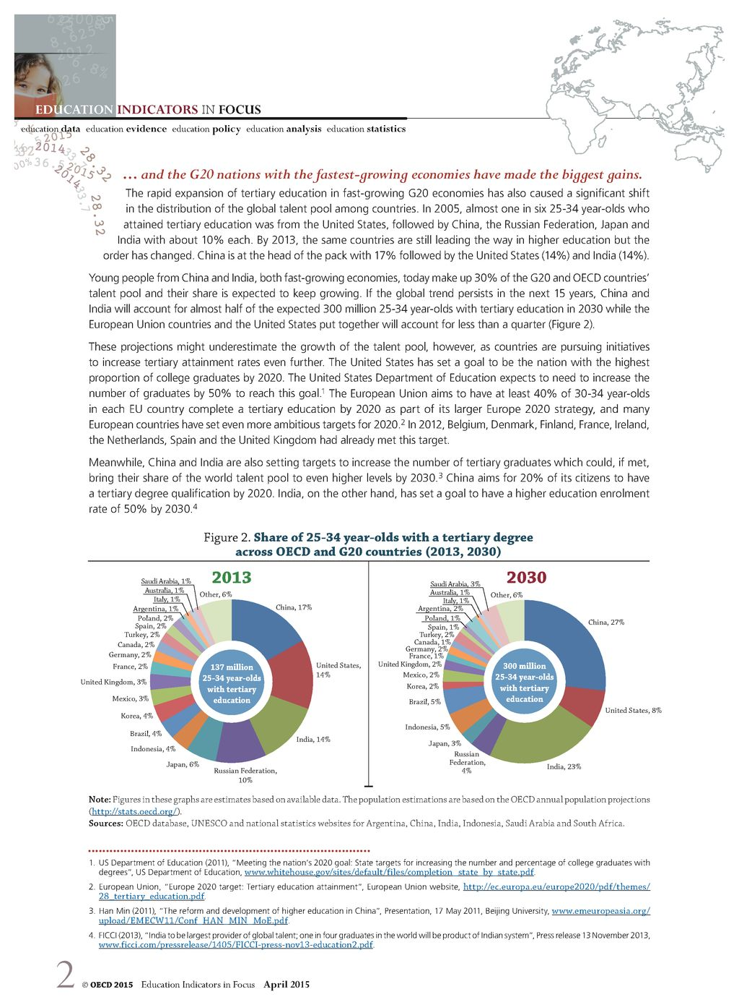

Slide 8
Algebra of Development
Science, Culture, Music (grasping principles of nature) --->
Engineering (application of science) --->
Technology and Innovation (making engineering useful for public good and/or commercial gain)
S S Saxena and Chokan Laumulin (PhD Thesis, University of Cambridge)

Slide 9
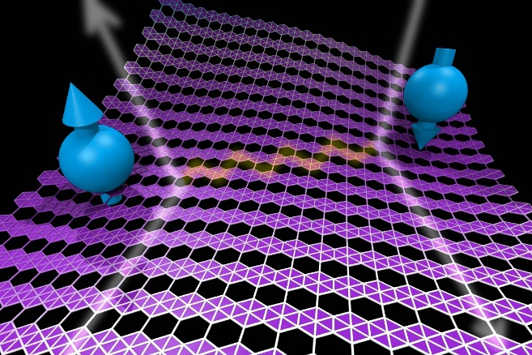
Why are we interested in quantum phases & phenomena in materials?
Fundamental Science
Observable Phenomena
Deployment of Science & Resulting Innovation
Net-zero future
Algebra of Development Green and Sustainable Development!

Slide 10
Proposition
While the Western technology giants have identified the potential and taken early risk in establishing basis of such technologies, they do not have either the raw-materials or human-capability to take it to the mass production
Current global production chains are too deeply entrenched and invested in ‘classical-technologies’ and will find it stifling to disrupt the current production
And.. no one single player is able to carry this forward alone, thus a South Eurasian platform has a low entry barrier and fast uptake promise

