Slide 2
COVID-19
impact on statistics
Peter Smeets
UNECE WP6. 17/19 June 2020

Slide 3
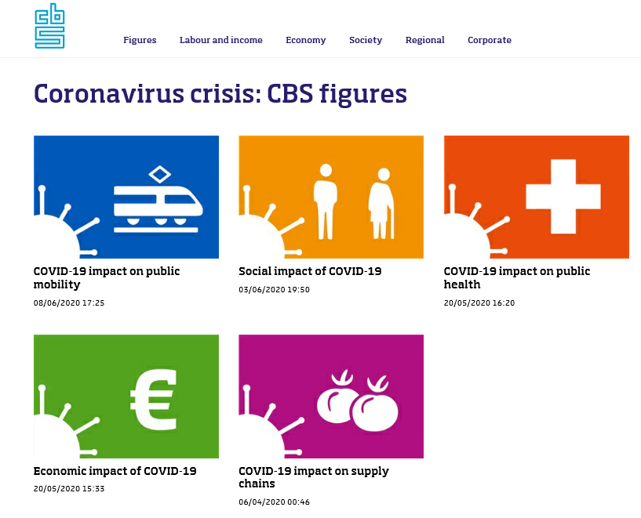
https://www.cbs.nl/en-gb

Slide 4
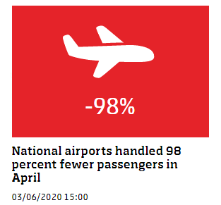
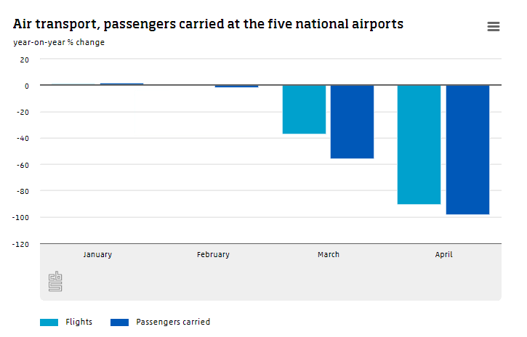

Slide 5
COVID-19 impact on public health
How many deaths are registered weekly in the Netherlands?
What is the number of deaths among people with long-term care?
What is the increase in employee sickness absence?
How many medical products are imported?
How many people are working in the care sector?
How many healthcare professionals are out of work?
Which healthcare professionals are most likely to be out of work?
What is the average distance to the nearest GP and hospital?
What is the difference in recent mortality between institutional and private households?
How many hospital beds are there in the Netherlands?
https://www.cbs.nl/en-gb/dossier/coronavirus-crisis-cbs-figures/covid-19-impact-on-public-health

Slide 6
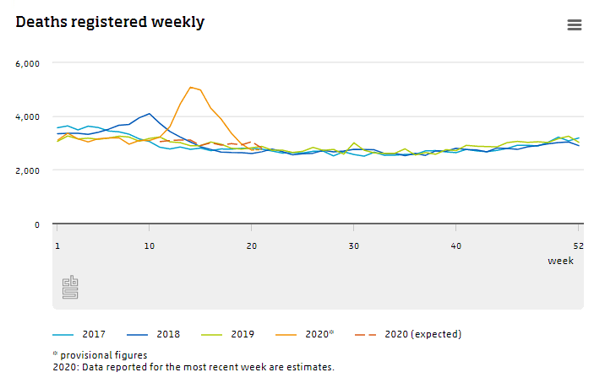
Mortality
“With a total of 36 thousand deaths over weeks 11 through 19, there were almost 9 thousand more deaths than normal, representing 32 percent excess mortality.”

Slide 7
Social impact of COVID-19
How is the labour participation rate developing at the moment?
How many job losses were recorded in April?
How many people were unemployed in April?
How many more unemployment (WW) benefits?
Which sector recorded the largest increase in number of unemployment (WW) benefits?
How is the crime rate developing?
What is the living situation of the elderly in the Netherlands?
By how much has the number of asylum requests decreased?
How much population growth was recorded over Q1 2020?
How much contact do people normally have with family, friends or neighbours?
Etc.
https://www.cbs.nl/en-gb/dossier/coronavirus-crisis-cbs-figures/social-impact-of-covid-19

Slide 8
Economic impact of COVID-19
How many entrepreneurs expect they will not survive the COVID-19 crisis?
How is retail turnover developing?
How many job losses were recorded in month M?
How many people were unemployed in month M 2020?
Which occupations have the most home-based workers?
How many residents of Belgium and Germany are employed in the Netherlands?
How many people work in culture, sports and recreation? Etc.

Slide 9
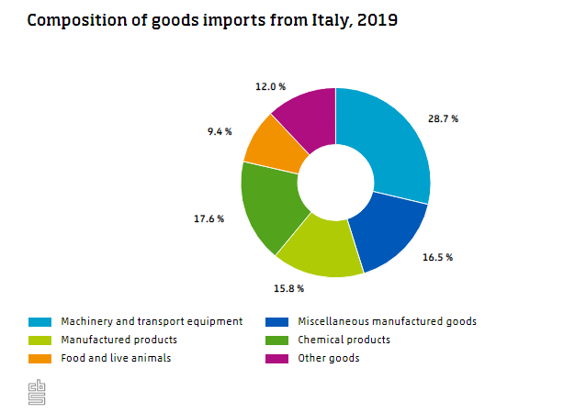
COVID-19 impact on supply chains
How much increase is seen in the retail turnover at Dutch supermarkets?
What are the Netherlands' top imports from China?
How much is imported into the Netherlands from Italy?
Which imported products are mostly from Italy?

Slide 10
Dashboard freight transport
the standard statistics are one month to a quarter behind.
There are no “rapid” indicators
There is a need for up-to-date transport data

Slide 11
How is goods transport developing?
In April 2020, there were fewer transport movements than one year previously. More information on a weekly basis can now be found on the new dashboard 'Snelle indicatoren Goederenvervoer’ (rapid indicators for goods transport). It shows the number of movements for inland shipping, aviation, rail, road and maritime transport. This dashboard was created in collaboration with the Netherlands Institute for Transport Policy Analysis (KiM), Panteia, Rijkswaterstaat, ProRail, the National Data Warehouse for Traffic Information (NDW), Schiphol, Royal Dirkzwager and the port companies of Amsterdam, Groningen, Moerdijk, Rotterdam and Zeeland.

Slide 12
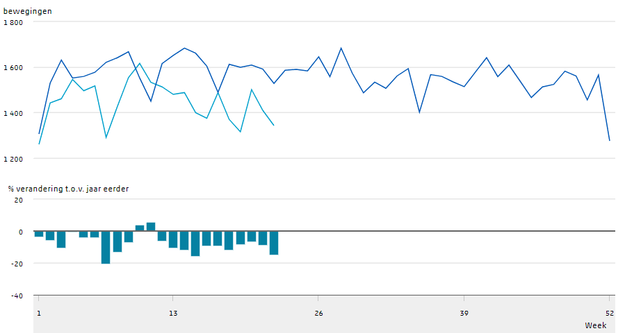
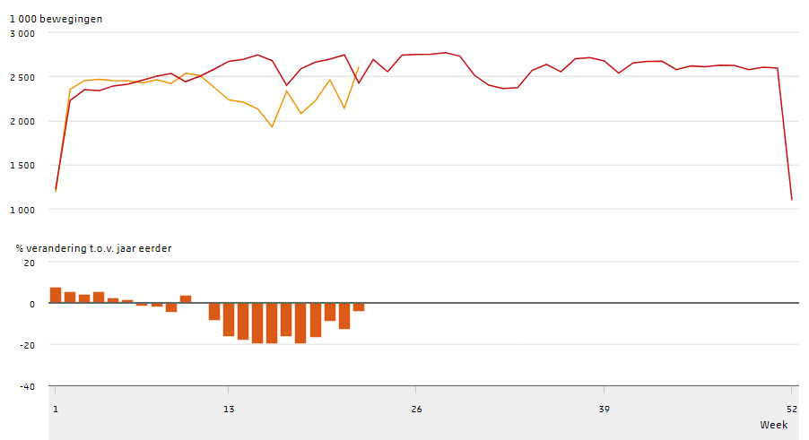
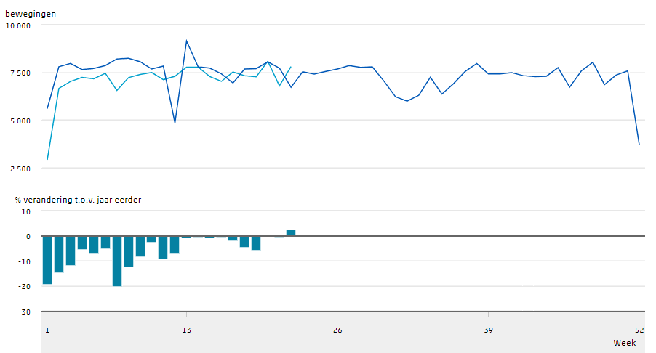
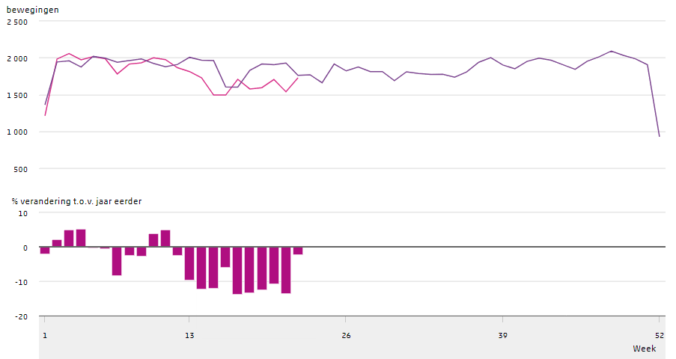
Number of movements in freight transport
road
maritime
iww
rail

Slide 13
Thank you for your attention

