Slide 1

Rural Access Index (RAI) / SDG 9.1.1
UNECE Meeting, 17th June, 2020
TRL Project Team: Robin Workman, Kevin McPherson, John Proust
Notes:
I’m going to present a brief overview of the Rural Access Index, or RAI. We recently undertook a project to refine the RAI methodology, which was funded by UK Aid through ReCAP, and conducted in collaboration with World Bank, who are the custodian of the SDG 9.1.1 indicator.
I’m going to start with an introduction, a brief history, the data sources required and how RAI is calculated.

Slide 2
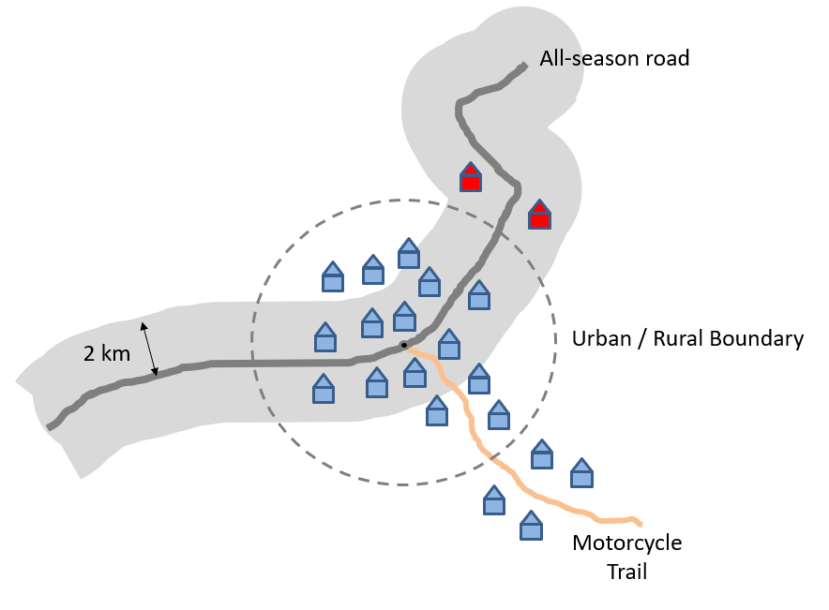
Definition
The Rural Access Index (RAI) is an indicator used to measure rural accessibility.
It is defined as “the proportion of the rural population who live within 2 km of an all-season road’.
An all-season road is defined as a road that is motorable all year by a four-wheeled vehicle, excluding short interruptions due to extreme weather events of up to a total of 7 days in a year.
Note that these do not have to be consecutive days.
Notes:
The RAI is defined as “the proportion of the rural population who live within 2 km of an all-season road”. An all-season road is one which is motorable all year by a four-wheeled vehicle, excluding short interruptions due to extreme weather events of up to a total of 7 days in a year.
The diagram shows an example of how RAI is measured … the road in dark grey is an all-season road, and the shaded light grey band around it represents the area which is 2 km from the road….. And the road in brown is not an all-season road (so it could be a motorcycle trail, for example).
The house symbols represent individual household units, and the pale yellow circle represents an urban area, so the population within that area are classified as urban population, and would not be included in an RAI calculation.
The six households outside the pale yellow area represents the total rural population. However, only the two households coloured in red are within 2km of the all-season road.
Since RAI is a proportional measure, in this case it would be 2 out of 6, or 33%.

Slide 3
Introduction
There is considerable evidence to show a high correlation between rural accessibility and poverty (Bird et al, 2010), i.e. that poverty is higher in countries with lower rural access, and so it is regarded as an important development indicator
This is more relevant for low and medium income countries, as many high income countries have RAI levels close to 100%
First defined and measured in 2006 (Roberts et al, 2006):
Used Living Standards Measurement Surveys (LSMS)
Reported on RAI in 64 countries
Notes:
So, why is the RAI important? …
It was designed as an indicator of rural accessibility, with the knowledge that poverty is often higher in countries with low access to rural areas.
There is evidence of significant correlation between accessibility and poverty, so it is regarded as an important development indicator.
Households in more remote areas have lower levels of market participation, and make less use of public services such as health and education which are underlying factors in poverty.

Slide 4
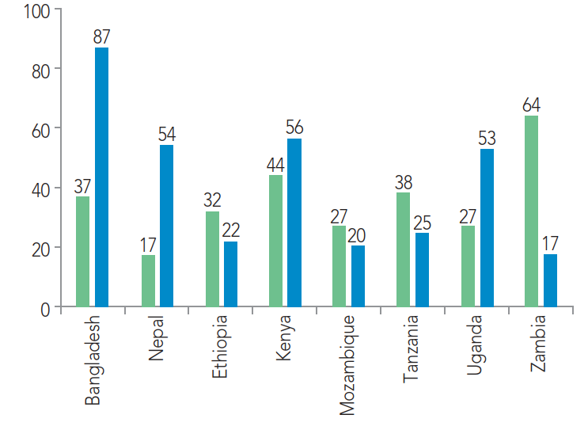
Brief History of the RAI
Geospatial methodology trialled in 2016 (World Bank, 2016)
Proposed a new approach using geospatial data
Piloted in 8 countries
Notes:
The RAI was originally defined in 2006 by the World Bank, in the report by Roberts et al. titled “RAI: A Key Development Indicator” using the World Bank Living Standards Measurement Surveys (LSMS).
At that time, there was no question in the LSMS that specifically asked ‘how far do you live from an all-season road?’ , so the RAI team tried to interpret other answers to estimate the RAI – such as “time taken to walk to the nearest bus stop or transport service”.
The Roberts report estimated RAI in 64 countries. It recommended, going forward, that RAI could be calculated by incorporating additional questions into household surveys, however, those recommendations were not taken up.
RAI was not formally measured again until a decade later, when World Bank developed a geospatial methodology and trialled it in 8 countries…… as shown here. …. However, the results were very inconsistent with 2006.

Slide 5
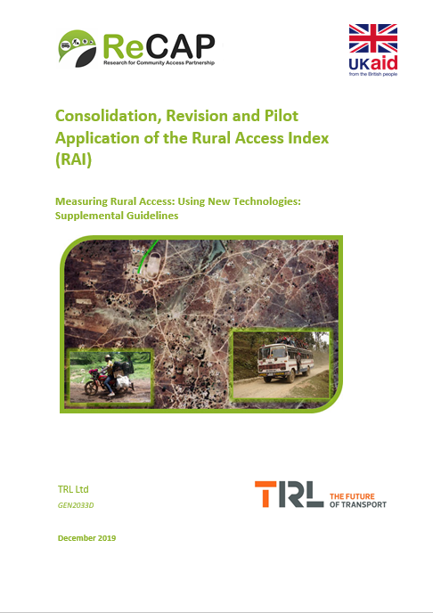
Current RAI project
Consolidation, Revision and Pilot Application of the RAI – Supplemental Guidelines (TRL, 2019)
Refined the 2016 methodology
Emphasised involvement of NSOs and government agencies
Included a QA process and related metadata
Introduced ‘accessibility factors’ in the event that road condition data is unavailable
Notes:
This led in 2019 to the current ReCAP project to revise, consolidate and pilot application of the RAI, with the aim to produce a more accurate, repeatable and sustainable way to measure it.
Supplemental Guidelines have been produced, which build on the 2016 methodology. These emphasised the involvement of NSOs and other government agencies, and how they need to coordinate to agree and produce an accurate measurement of RAI. The Guidelines also included a quality assurance process and established how metadata should be recorded and stored.

Slide 6
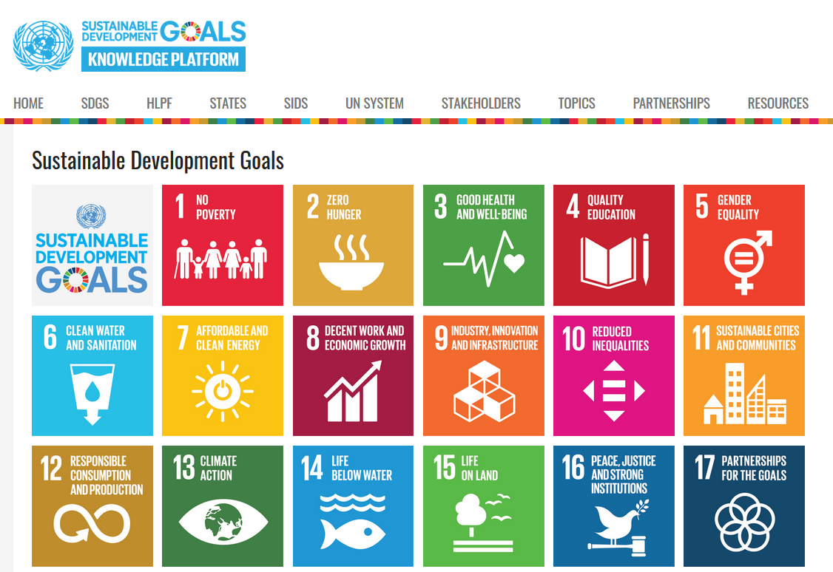
Introduction to the SDGs
RAI was included as SDG 9.1.1 in 2016
World Bank is the custodian, partners include UNECE, UNEP and ADB
promoted to Tier 2 in December 2018
objectives is to help achieve Tier 1 status
Goal 9 – Industry, Innovation and Infrastructure
Notes:
There is no specific Transport SDG, but transport is integrated into a number of the goals.
SDG 9.1.1 (which is the RAI), is the only rural transport indicator, so it is considered to be important by the donor community. RAI was adopted as SDG 9.1.1, using the World Bank 2016 methodology.
The World Bank is the Custodian of SDG 9.1.1 and there are currently three partners, who are UNECE, UNEP and the Asian Development Bank.
The RAI was adopted as a Tier 3 indicator in 2016; and promoted to Tier 2 in December 2018. We have identified at least 34 countries that have measured the RAI since 2016.
We have produced a Roadmap towards achieving Tier 1 status, requiring regular measurement in at least 50% of all UN countries, regionally represented. Tier 1 status would cement the indicator’s importance, and encourage countries to measure it along with other indicators as part of their rural development plans and strategies.

Slide 7
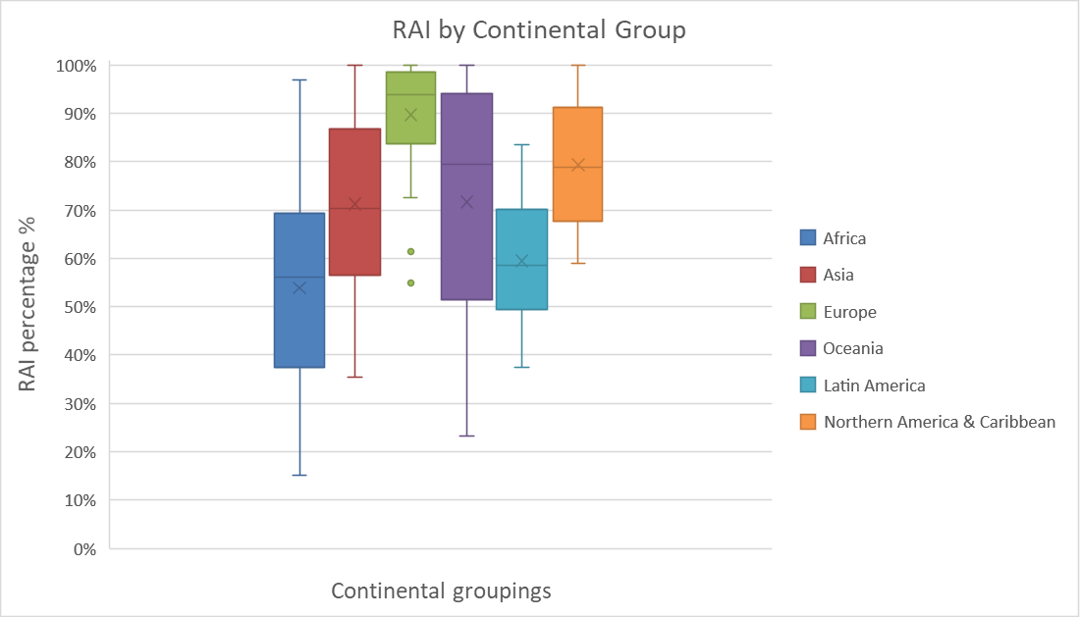
RAI Regional Relevance
RAI Absolute Numbers
 | Population (millions, 2019)
Region | Total | Rural | >2 km from all-season rd | RAI
Africa | 1,318 | 908 | 421 | 54
Americas | 1,057 | 223 | 71 | 68
Asia | 4,633 | 2,591 | 659 | 75
Europe | 757 | 191 | 20 | 90
Oceania | 37 | 13 | 7 | 42
World | 7,802 | 3,926 | 1,178 | 70
Notes:
This graph shows estimated RAI as calculated using open source data. It suggests that countries in different geographical regions currently have different ranges of RAI values.
We could also look at alternative groupings, and have recommended further research into how targets should be set.
In addition to the RAI percentage value, it is also important to consider the absolute numbers of people impacted by lack of all-season access.
RAI should be presented wherever possible as absolute numbers, for example if we say “there are 420 million people in Africa without access to an all-season road” it’s a much more powerful statement than “Africa has an RAI of 53%”.
Although much of Europe tends towards very high levels of RAI, it can be useful to identify local planning needs, especially in conjunction with other indicators.

Slide 8
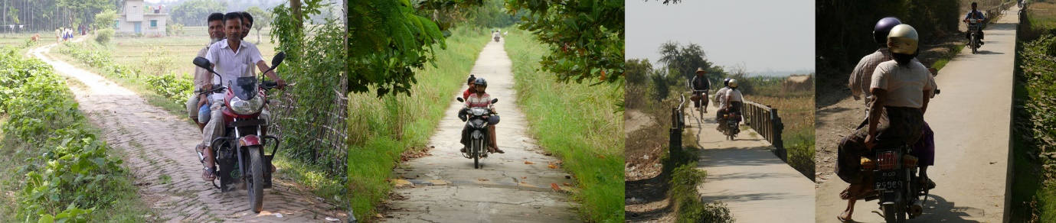
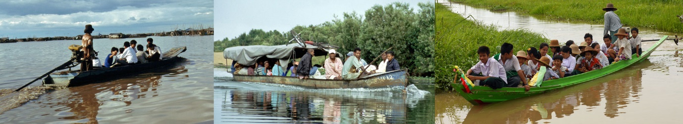
RAI as part of a Suite of Indicators
Other Supporting Indicators for Rural Access (from Sum4All GRA)
Notes:
RAI should not be considered alone, it needs to be considered as part of a suite of indicators.
The SuM4All Global Roadmap for Action (GRA) also defines a series of ‘Supporting Indicators’, in addition to RAI,.
This is important as it identifies Infrastructure Indicators, complemented by Service Indicators. RAI can also be measured at sub-national level and project level, which can be more useful for regional planning.
The project has also considered how intermediate transport modes can provide access and has made recommendations for secondary indicators, for example motorcycle tracks and navigable waterways.

Slide 9
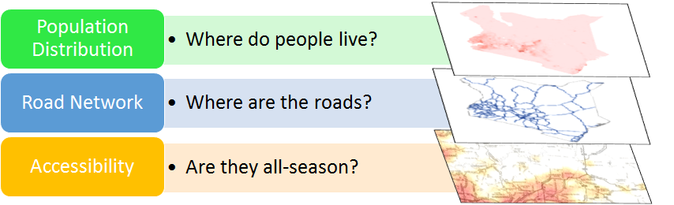
RAI Data Sources
RAI is essentially calculated through overlaying the above layers in a Geographic Information System (GIS) and applying standard GIS tools
But what are the sources for these data?
Notes:
RAI is essentially calculated through overlaying these 3 layers in a Geographic Information System (GIS),
The layers are Rural Population, Road Network and the All-season status of the roads.
It is possible to conduct this analysis on QGIS, which is open-source desktop software, and Annex B in the Supplemental Guidelines explains how to use QGIS to calculate RAI.
This is a relatively simple process, so long as the data is good….
So, what are the sources for these data?

Slide 10
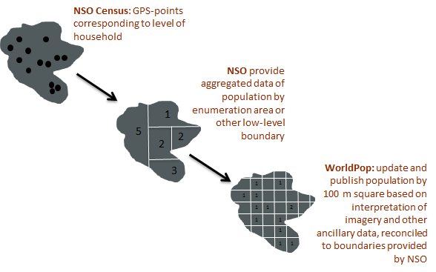
Population Distribution Data
WorldPop is the preferred source for population distribution data.
It uses latest national census data to produce aggregated population data at a 100 metre square resolution for use in a local GIS platform.
NSO should analyse and endorse WorldPop as an official source of data
WorldPop data should be reconciled with national statistics office data
Can be disaggregated to whatever level of detail the NSO can provide
Notes:
The first data source is population!
There is an open source data platform called WorldPop, which uses latest national census data projections to produce aggregated, 100 metre squares of population data that can be downloaded and used in GIS software.
It uses algorithms that analyses various data sources, including satellite imagery, to produce high resolution population mapping. The data is reconciled to openly available country census data, …….. It is important that the NSO should analyse and endorse WorldPop data as an official source of data for RAI.
The figure shows the process by which reconciliation and disaggregation may be achieved.
While the NSO may have population census data at the level of the household (first graphic on the left), this data could be sensitive, so it should be able to provide boundaries of enumeration areas along with aggregated population of those areas to WorldPop (second graphic), which results in a lower resolution of population distribution.
However, WorldPop can then re-run its population models to ensure that its data match those of the NSO at the level of enumeration area (third graphic) to provide the 100m x 100m square resolution.

Slide 11
Rural Urban Definition
There is no globally agreed definition of what is a rural area.
The Un Statistics Division advises each country should decide which areas are to be classified as urban and which as rural.
If in-country spatial boundaries of urban/rural areas exist, they should be used.
If not, then use boundaries from the Global Rural Urban Mapping Project (GRUMP) v1 Urban Extent Polygons.
UN Statistical Commission (March 2020) endorsed the DegUrba methodology for delineation of cities and urban and rural areas.
Notes:
The definition of rural areas is also important, as we are only concerned with the rural population….
Many indicators are dependent on the urban/rural boundary, but there is no globally agreed definition of ‘rural area’, ………so the UN advises that each country should decide which areas are to be classified as urban and which as rural. If in-country boundaries do not exist, then the GRUMP database should be used…..
The UN has recently developed the DegUrba Methodology to address this issue. We don’t yet know what the effect of DegUrba will have on RAI measurement, but probably in some countries it may increase, while in others it may decrease,
However, some issues remain, do all UN SDGs (and other non-SDG indicators) report using the same definitions of urban/rural; will there will be any harmonisation effort; and will UNSD provides advice to NSOs to reconcile national indicators. It is still too early to tell this….

Slide 12
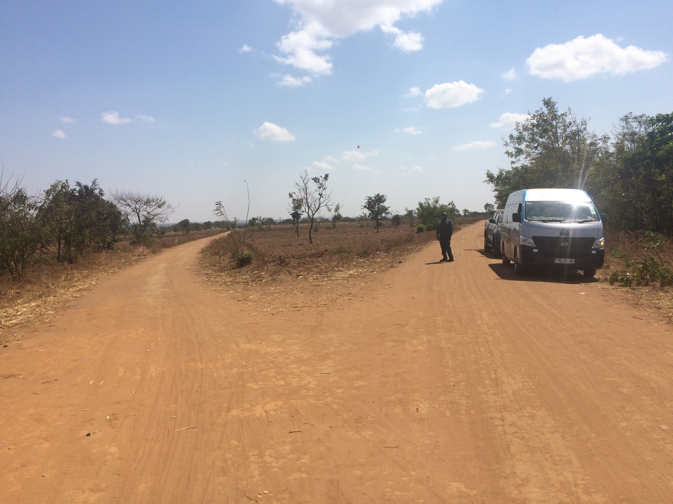
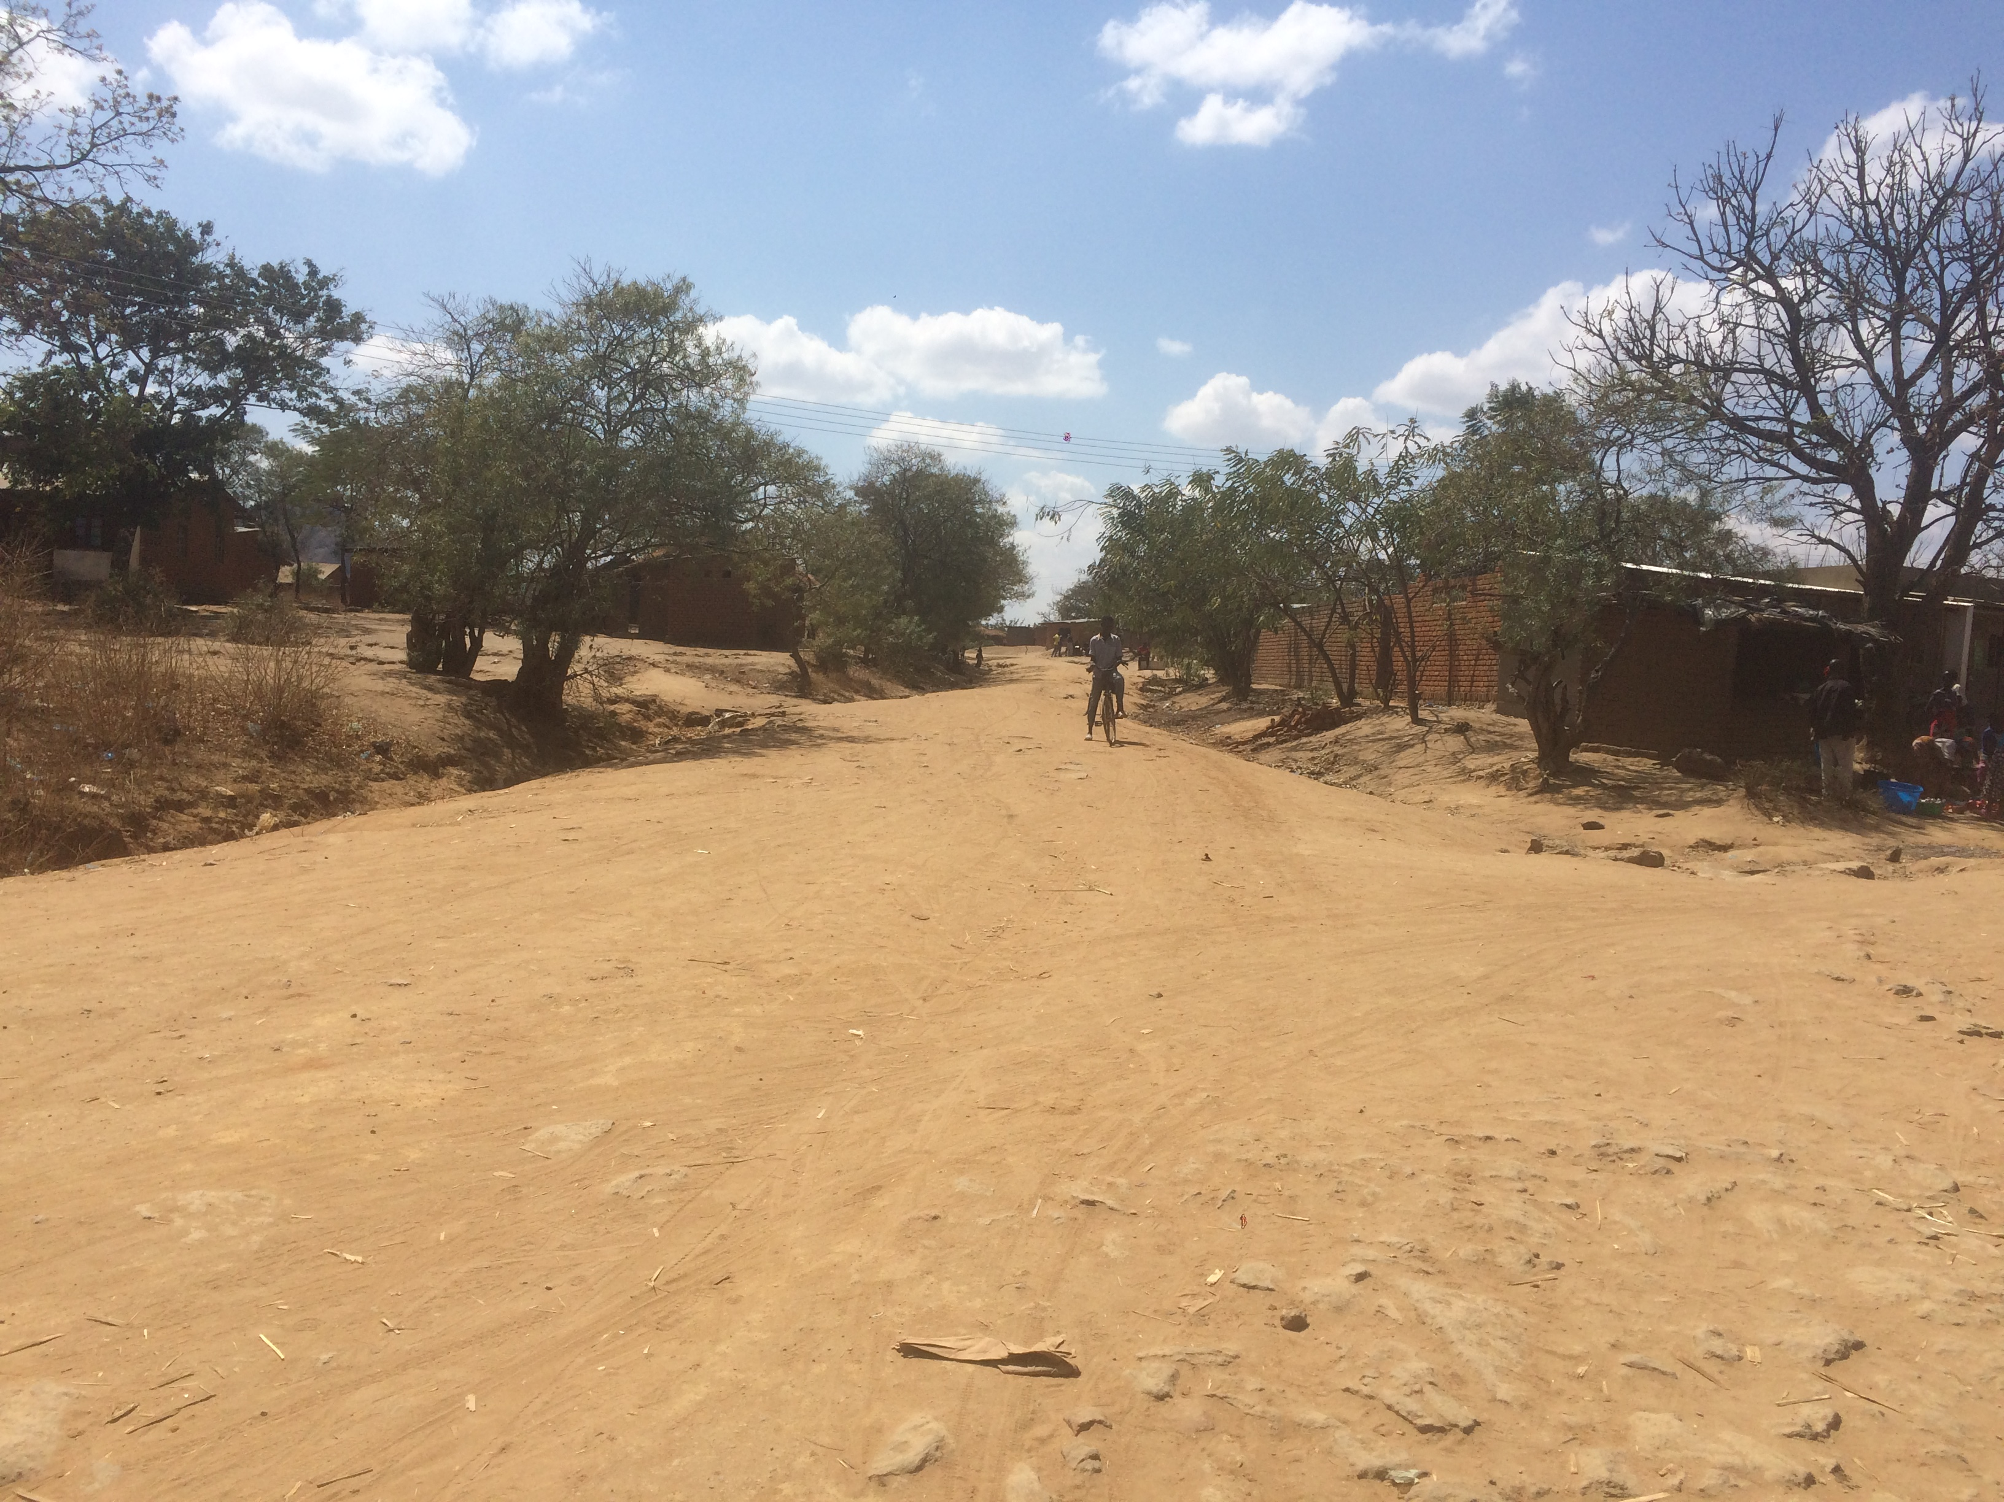
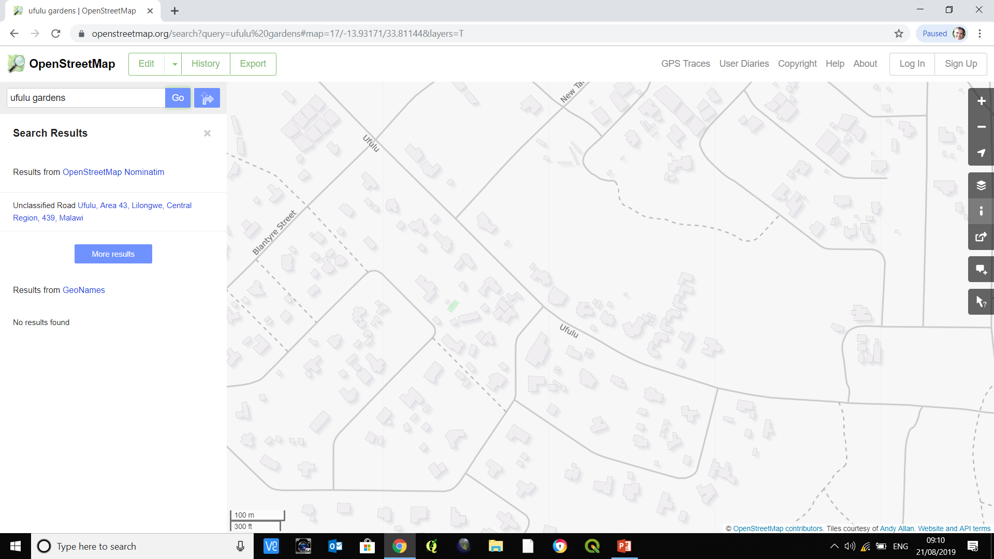
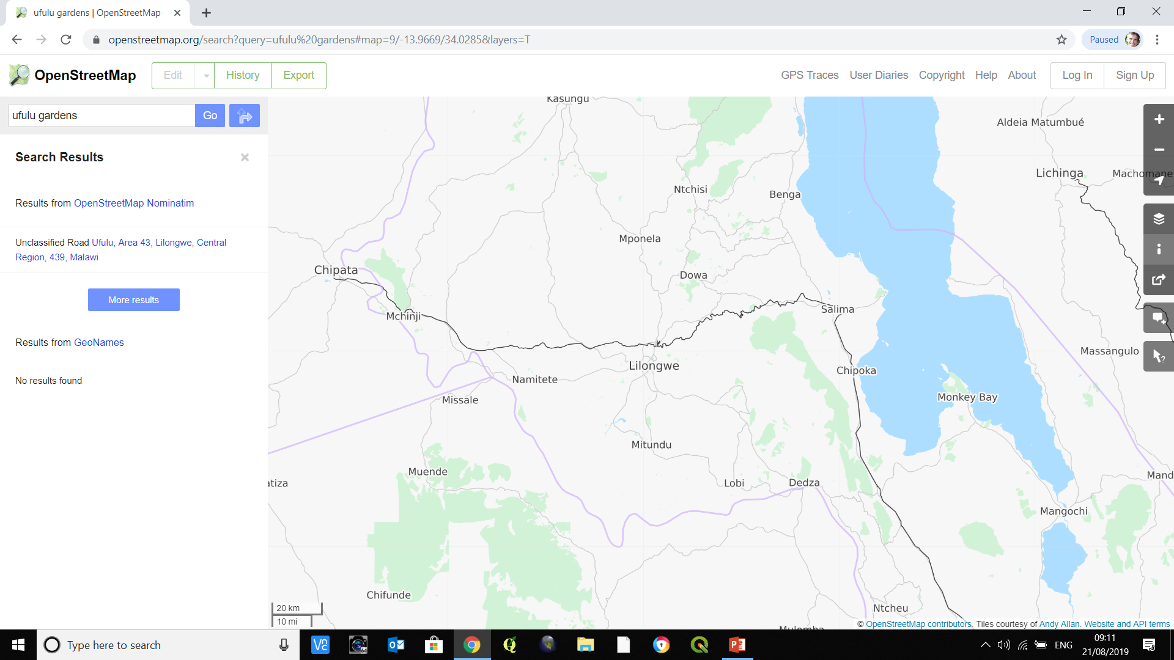
Road Network Data
Open Street Map
Roads and
Other Transport Infrastructure
Unclassified
Local
National
Buildings, including heath facilities, schools etc.
Notes:
Planning and management of roads in any country is usually divided among separate national and local agencies. Often there is no one agency responsible for collation of all data and mapping.
National roads agencies tend to have good electronic mapping with policies for updating, but rural road agencies tend to be less rigorous, plus the quality and completeness of mapping varies between countries.
Also, in many LMICs, there is a large and less well-defined unclassified road network, which nevertheless provides an important level of access to local communities. Some of the above roads are part of the classified national network; some are part of the local roads network; some are ‘unclassified’.
The preferred source of road network data is the official government network …….. The best alternative source of road network data is OpenStreetMap, which is a collaborative project to create a free editable map of the world using crowdsourcing.
OSM is much more than roads – it provides inventory and mapping of other transport infrastructure; as well as buildings including health facilities, schools etc.

Slide 13
Road Condition Data
All-Season Roads
All-season definition update
A road that it is likely to be impassable to the prevailing means of rural transport for a total of 7 days or more per year is not regarded as all-season.
2016 RAI Methodology used ‘condition’ as a proxy for ‘all-season’
  Paved road with IRI less than 6, and unpaved road with IRI less than 13.
  Paved road in excellent, good, or fair condition and unpaved road in excellent or good condition, when IRI data are not available, visually assessed.
Accessibility factors determine the likelihood of a road being all-season, using Surface Type, Climate and Terrain
Notes:
As well as the network location, we need to know the all-season status of the roads…..
The 2016 methodology used IRI or visual condition as a proxy to define all-season status, ……. As shown here….
The Supplemental Guidelines allow the use of condition data if available, but in many LMICs condition data is unlikely to be accurate or current…. and we don’t want to add the burden of collecting condition data purely for RAI…… if a significant burden is placed on road authorities to do this, it is likely that the data will either not be collected, or will be inaccurate…..

Slide 14
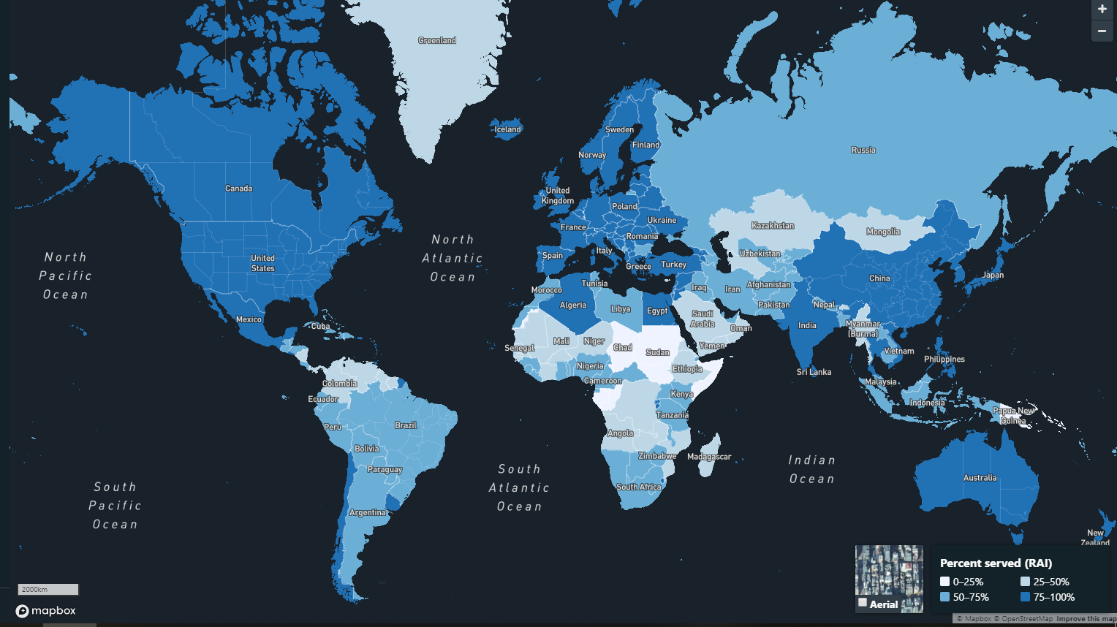
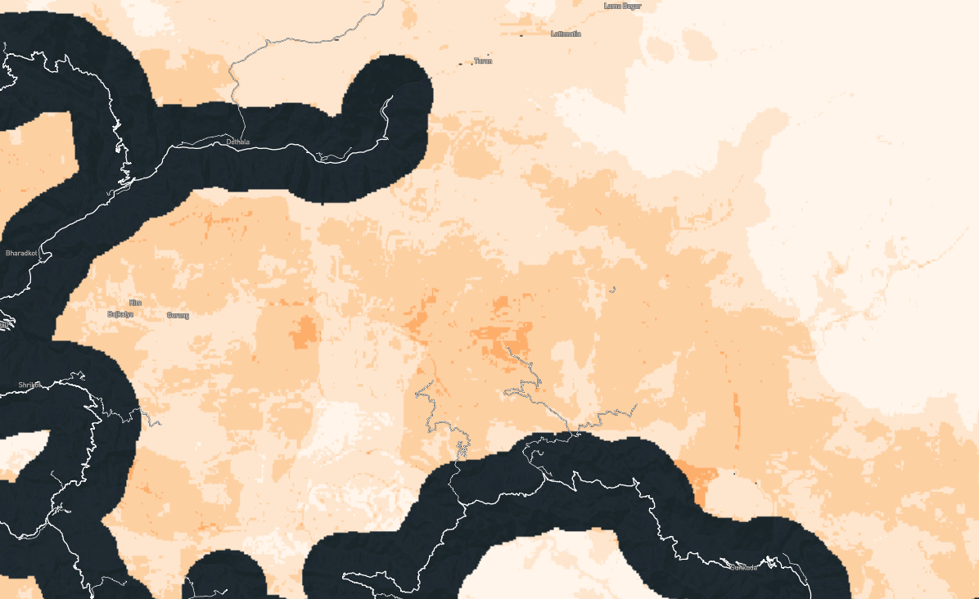
The RAI Measurement Tool
Tools are being developed to calculate RAI “automatically” from open source data
Any calculations will still require endorsement by the responsible agencies and by the NSOs
https://rai.azavea.com/
To be trialled on the UN Global Platform
Pocket of population not served
by access to an all-season road
Notes:
Finally, a tool has been developed to show RAI for the entire world, using open source data, to encourage awareness and engagement of NSOs and stakeholders with the RAI.
This is due to be incorporated into the UN Global Platform as a demonstration tool to motivate feedback and to allow countries to assess their potential for RAI measurement.
The longer term aim is for this tool to be developed so that countries can come to the site and carry out RAI measurements independently, but any calculations will still require endorsement by the responsible agencies

Slide 15
Notes:
Thank you for your attention.

