Slide 1
J15 LPG FILLING UNIT
Informal document GRSG-119-25
(119th GRSG, 6-9 October 2020 Agenda item 7a)
Introduction in R67 of a new profile as defined by ISO19825
Geneva 119 GRSG
Working document ECE/TRANS/WP.29/GRSG/2020/9

Slide 2
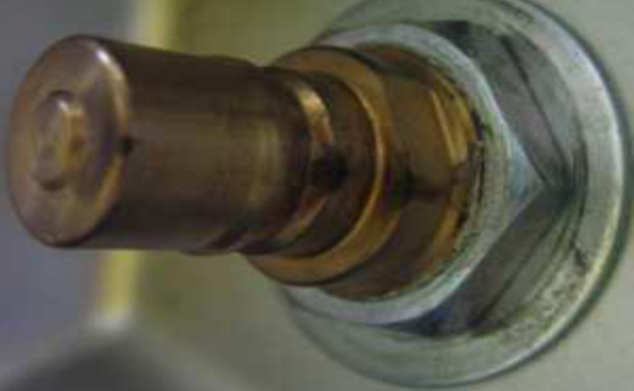
Overview of J15 filling unit
ISO 19825:2018 defines a new LPG filling unit denominated «J15» (together with a bigger one defined as «K15»).
This new profile was derived by an existing filling unit (Korea/Japan), well known in Asian markets, with several technical improvements.
ECE R67 should be updated in order to allow the use of this new connector, the same way as the existing ones
ECE/TRANS/WP.29/GRSG/2020/9

Slide 3
Main features and advantages of J15 filling unit/1
The main features of«J15» filling unit are:
One-hand operation
Safe in general for operators and suitable for self service.
Defined profile
No chance to couple J15 with nozzles dedicated to other gases/fuels
Defined spillage volume
Low spillage during disconnection, improved environmental and human health protection
Defined leak rate
Ensures tightness both during filling operations and when not connected to the nozzle
ECE/TRANS/WP.29/GRSG/2020/9

Slide 4
Main features and advantages of J15 filling unit/2
Durability
Robust and simplified design
Low connection and disconnetion forces
Suitable for self service
Male receptacle
Same concept as NGV1 filling unit (different profile)
In case of drop of refilling nozzle (female) no leakage parts affected
Good feedback from the market
Many years of use in asian markets
Reduced size
Suitable for a larger number of applications than «K15» (Euro) filling unit, especially in light duties vehicles and in aftermarket sector.
ECE/TRANS/WP.29/GRSG/2020/9

Slide 5
Safety and operation of J15 filling unit
Subjected to full class 1 pressure requirements
Tightness parts of the nozzle are less subjected to damage, due to male design of the receptacle
Long durability
Reduced dimensions
ECE/TRANS/WP.29/GRSG/2020/9

Slide 6
J15 profile
ECE/TRANS/WP.29/GRSG/2020/9

Slide 7
ECE R67 amendment proposal
After considering all the above mentioned advantages, ECE R67 should be updated to accomodate the following topics:
Introduction of J15 connector, in addition to the current filling units;
Rename of «Euro filling unit» as K15 to keep consistency with ISO19825.
ECE/TRANS/WP.29/GRSG/2020/9

Slide 8
Thank you !

