Slide 1
Working Party on Pollution and Energy (GRPE) Options for clarification documents
Note by the secretariat
Informal document GRPE-81-36
81st GRPE, 9-11 June 2020
Agenda item 3(a)
What to do with non-regulatory / non-resolution documents, eg. Clarification document of UNR WLTP
Turn it into “reference material”
Under WP.29 “Reference material” section
needs WP.29 endorsement
Under new GRPE sub section “Documents for reference only” as in GRE or GRB
Using GRPE informal document
Adopt it in GRPE report
- is part of an official document
Within UNR WLTP
- as introductory material (for information); e.g. UN Regulation No. 131

Slide 2
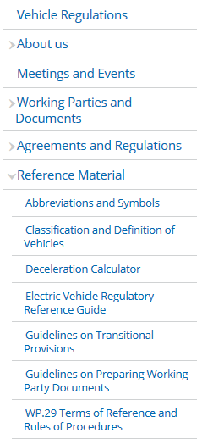
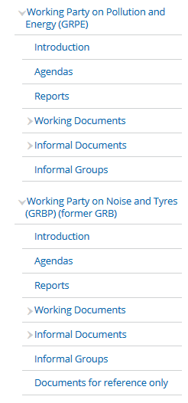
Working Party on Pollution and Energy (GRPE) Options for clarification documents
Note by the secretariat
Informal document GRPE-81-36
81st GRPE, 9-11 June 2020
Agenda item 3(a)
Turn it into “reference material”
Under WP.29 “Reference material” section
Cross cutting issues
needs WP.29 endorsement
Under new GRPE sub section “Documents for reference only” as in GRE or GRB
Using GRPE informal document

Slide 3
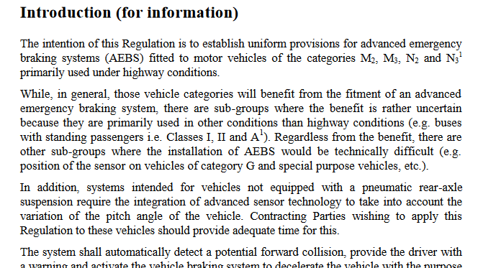
Working Party on Pollution and Energy (GRPE) Options for clarification documents
Note by the secretariat
Informal document GRPE-81-36
81st GRPE, 9-11 June 2020
Agenda item 3(a)
Adopt it in GRPE report
- is part of an official document
Within the UNR WLTP
- as introductory material (for information); e.g. UN Regulation No. 131 on AEBS

