Slide 1
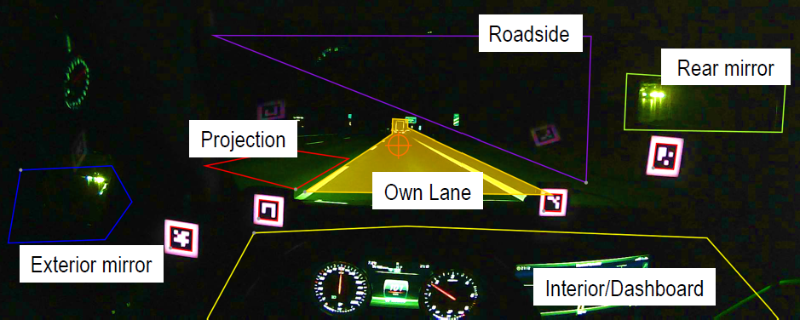
Driver Assistance Projections Informal Document to support ECE/TRANS/WP.29/GRE/2020/4
Submitted by the expert of OICA Informal document GRE-83-33 83rd GRE, 19-23 October 2020
agenda item 6.(a)
Review: Feedback from 82nd GRE
Standardization of symbols
To conduct further investigations on distraction
Further studies on flashing Driver Assistance Projections and distraction potential
Leibniz Universität Hannover

Slide 2
Standardization of Symbols
Driver Assistance Projections - Extension of the dashboard
Optional additional means to provide safety-related assistance to the driver
Define Pattern and Symbols - Standardize Symbols
Therefore proposed to have the similar approach as in UN R121: If own conception of a symbol, the design principles laid down in paragraph 4. of ISO 2575 „Road vehicles — Symbols for controls, indicators and tell-tales” shall be followed.
Approach in ECE/TRANS/WP.29/GRE/2020/4:

Slide 3
Leibniz Universität Hannover - Glück, Knöchelmann, Held
“Distraction potential of road projection
symbols”

Slide 4
Leibniz Universität Hannover - Glück, Knöchelmann, Held
“Distraction potential of road projection
symbols”

Slide 5
Thank you

