Slide 1
Transmitted by the IWG on DETA Informal document GRBP-71-03
(71st session of GRBP, 28-31 January 2020, agenda item 13) (document DETA-36-07e)
DETA
Database for the Exchange of Type Approval documentation

Slide 2
DETA – aim of the presentation
Promoting DETA and the usage of the system
Information for the competent authorities and manufacturers
  about the state of play,
  future developments and
  the advantages and possibilities of the system

Slide 3
DETA
Is the secure internet database to circulate approvals
and its attachments,
→ as required to be established by the UNECE,
according to the 1958 Agreement Revision 3.
More information also at
www.unece.org/trans/areas-of-work/vehicle-regulations/agreements-and-regulations/transmainwp29datasharing/deta-information.html

Slide 4
State of play
DETA is still under development but since May 2019 ready to be used for it base purpose:
→ exchanging UNECE approval documentation between the
Contracting Parties to the 1958 Agreement.
  23 Contracting Parties have notified their DETA Focal Point
  More than 400 approvals uploaded
  3 Manufacturer have access to DETA (their own approvals)

Slide 5
DETA - benefit
Easy and convenient exchange / storage of
→ type approval and additional documentation / information
→ urgent and quick information on
→ withdrawn certificates
→ non-compliant or hazardous products
  → falsified products and approval documentation
  → recalls

Slide 6
Rights of access
Explanation: R = read W = read + write + delete
 | CERT (communication on type approval) | TR (test report) | IF (information document) | OTHER (other documents)
Approval granting TAA (for granted approval) | W | W | W | W
CP applying the UN Reg. for which the approval was granted | R | R | R | R
CP applying UN Reg. 0 (access to the approvals of R0 and the annexed UN Regulations) | R | R | R | R
Other CP's to the 58 Agreement | R | - | - | -
Manufacturer *) (only for own approvals) | R | R | R | R
*) Manufacturers get access upon request to the DETA Administrator.

Slide 7
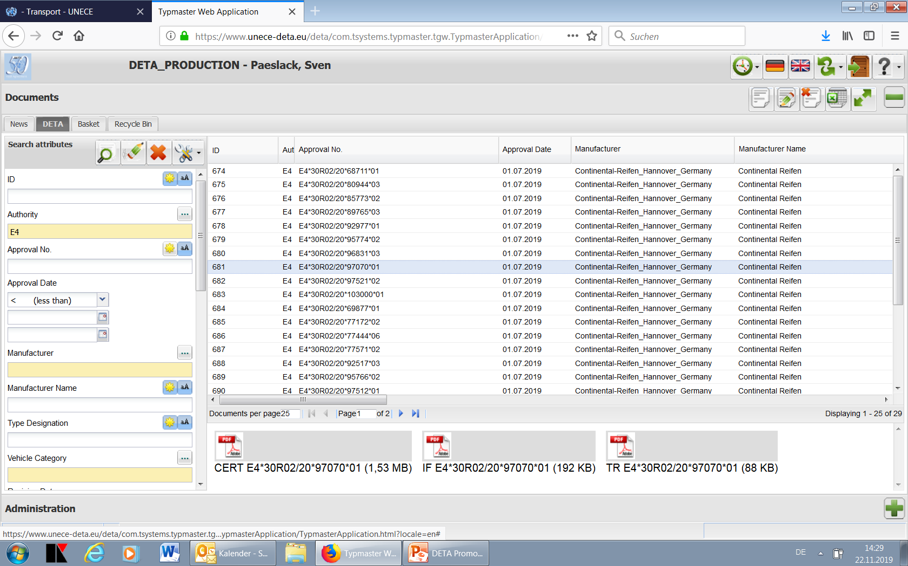
DETA – a screenshot
Attributes
List of approvals
Documents

Slide 8
State of play - Developments
implementation of DoC
(‘DoC’ is the Declaration of Conformance certifying to which UN Regulations and versions a single vehicle is approved at
the time of its production.)
implementation of UI
(‘UI’ is the Unique Identifier number assigned to an approval uploaded to DETA. A UI may replace the traditional E marking)
→ expected to be in production 2020 Q4
automated upload functionality
(for automated upload of type approvals by the approval authorities → essential functionality for TAA !)
→ 1st workshop in January 2020

Slide 9
How to join DETA – only a few steps
Notification of the ‘DETA Focal Point’ to UNECE Secretariat → by the heads of delegation of the CP’s at WP.29 (by e-mail: francois.guichard@un.org).
DETA Administrator will contact the DETA Focal Point for the user name and password to access DETA.
→ The ‘DETA Focal Point’ manage the access and user accounts within its CP or organisation.
Manufacturers should contact their TAA for forwarding
their request for access to the UNECE Secretariat.

Slide 10
DETA
Thank you for your attention
and
Please forward this information
to your approval authority!

