Slide 1
Submitted by the secretariat
Informal document WP.29-182-22
(182nd WP.29, 10-12 Nov. 2020 Agenda item 8.4)
UNECE WP.29/GR Virtual Meeting Survey
RESULTS

Slide 2
Survey info
Platform – MS Forms
13 Questions
Invitation was sent to 879 unique email addresses
First round – 24 September 2020
Second round – 3 November 2020
WP.29 session and 7 GR meetings covered
Total responses received – 196 (response rate 22.3%)

Slide 3
Question 1. - Attendance
Please indicate the meeting(s) that you attended:
*Added to the survey in October - survey re-sent only to unique participants

Slide 4
Questions 2&3. - Productivity
Overall, please tell us how productive the meeting was, using the scale below.
(0)
(11)
(68)
(88)
(27)
Delegates submitted an additional 171 comments, elaborating their position on meeting productivity aspects including:
We have been able to keep progressing proposals and agreements at both GR and WP.29 level despite not being able to meet face to face. In many ways the formal nature of GR and WP.29 meetings works very well when translated to being a virtual meeting, with people requesting the floor before speaking. ….While there are clearly benefits of meeting face to face and being able to talk through issues to resolve differences, the ability to attend meetings virtually is nevertheless a very valuable addition which has unfortunately been essential in order to continue to progress our work despite COVID-19. Finally there are additional benefits of the time savings, and reduced costs / environmental impacts through not travelling.
That there was no need to travel to Geneva. That I was able to attend without the constraints of a travel budget. Clear access to meeting materials.
The UN staff, as always, did an excellent organizational job, also with the on-line logistical challenges. There was less discussion than in-person meetings but the work was accomplished to the best extent possible. Of course, we can't have the usual discussions/negotiations in the Delegate Lounge but...... the business was accomplished.

Slide 5
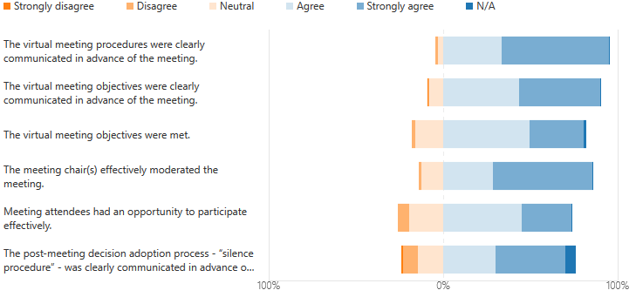
Questions 4&5. - Content and Organization
Please tell us your opinion on the following statements on the meeting's content and organization.
(65)
(119)
(84)
(91)
(96)
(60)
(56)
(111)
(88)
(55)
(58)
(77)

Slide 6
Questions 4&5. - Content and Organization
Delegates submitted an additional 68 comments, elaborating their position on the meeting content and organization aspects, including:
The virtual meeting provided a valuable opportunity for XXX* to provide input and keep abreast of the work being progressed by the GRPE informal groups. XXX* would welcome the opportunity to participate in future sessions virtually, as it is more difficult for XXX* to attend these meetings in person.
*country name removed for privacy reasons
I think the Chair, Secretary, and staff did all they could to make the meeting success, give the limitations of the situation. Nothing can replace face to face interaction for understanding, confidence, and trust.
What did not work in my opinion is the "taking the floor"; when in an active discussion, and many people raised their hands to take the floor, this has gone unnoticed most of the time.
The meeting chair did not see the chat, so he didn't notice always when someone raised its hand. The quality of documents on the screen was awful, absolutely impossible to read on a normal screen, therefore we opened documents directly from Unece website. In the case that there would be a readable document on the screen, in order to avoid switching between the document and the person talking, it is possible for participants to fix the screen (function to activate on webex) : this fonctionnality shall be explained to help participants.
One of the difficulties with the virtual format was when the group was not agreeing on a document. Then the inability to have "coffee break discussions" to try to reach a compromise was felt.
The time is limited, so we should have concentrated on the items easily to be adopted. A lot of time was spent to have discussion on the items that CP are difficult to reach agreement. With regard to difficult items, the Chair or the CP who proposes the proposal should organize another meeting in advance. Two hours meeting are only to adopt proposals.
Silence procedure is somehow dark in front of the actual voting in physical meetings; however, actual voting possibly it is too time consuming for virtual meetings and therefore, not recommended.

Slide 7
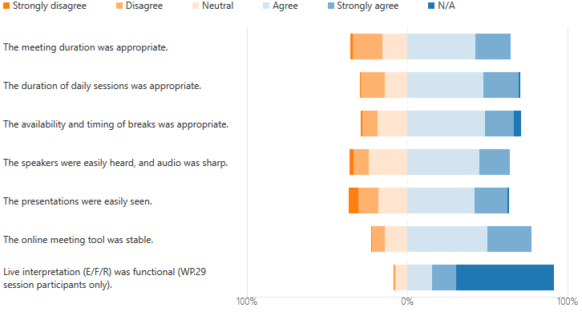
Questions 6&7. – Logistics and Facilities
Please tell us your opinion on the following statements on the meeting’s logistics, performance of technical facilities and online services.
(82)
(43)
(92)
(43)
(94)
(43)
(47)
(87)
(81)
(40)
(97)
(53)
(55)
(109)

Slide 8
Questions 6&7. – Logistics and Facilities
Delegates submitted an additional 61 comments, elaborating their position on the meeting content and organization aspects, including:
Clearly there are only about 3 hours a day in which participants from across the world can conveniently come together for these meetings, which is a limiting factor. However given the alternative of jet lag impacts of flying long haul it may be worth considering whether participants would be willing to participate for a longer period each day to allow more time for discussion.
The duration is enough for passing documents, but not for discussion. But, due to different time zones, I cannot see a better solution (in terms of timetable) that the one proposed by the secretariat.
Global participation leads to limitation for the schedule time possible. Limitation in meeting time as a consequence makes it nearly impossible to handle the topics and workload as normally done in a presence meeting.
I think the maximum that can be expected daily is 1/2 day given the time differences various delegates are operating in. Consideration might be given to extending meetings over two weeks in some cases to return to the total 1/2 day sessions that would normally occur. Presentations were easily seen unless delegates who were not presenting were also using video and/or hijacked the screen, but that is not within the Secretariat's control and in the later case was quickly remedied. And usually there was the option to have the document yourself instead of watching it on the screen.
There was difficulty with internet connection for some speakers. Also, it was not clear if others can hear you when you talk. However, in general it was a successful meeting.
The meeting could benefit from an update of its structure considering the different characteristics of distant-meetings (e.g. shorter duration, more frequent breaks, online cooperative tools, online voting tools etc...)
Total Meeting duration was too short, if such a tool is used on many sessions as there is too less discussion on new topics due to the time limitations. Face-to-Face meetings still necessary, but perhaps one session could be omitted and replaced by an online session (e.g. spring is "mask-to-mask" and fall is online). Online service should be provided in any case, an UN should look for proper equipment...
Meeting & daily session duration was appropriate as virtual meeting, but generally more time (as with the physical meeting in Geneva) is necessary.

Slide 9
Questions 8&9. – Proceedings
Please tell us your opinion on the following statements on the meeting’s proceedings
(53)
(54)
(62)
(44)
Delegates submitted an additional 57 comments, elaborating their position on meeting productivity aspects including:
The bi-lateral discussion aspects of what happens in-person does not seem possible. Obviously the usual camaraderie between delegates isn't possible either and we all are suffering in that regard. Most people don't show their faces during the meeting (for a variety of reasons) and this is very challenging, especially for the Chairman. This makes it impossible to 'get to know people'. Unless you already have established relationships, the experience feels very 'empty.’…
Yes - I did wonder if the situation was allowing the forum to achieve the best decision, or the full opportunity to close the subject. Nonetheless, results were achieved. I guess we need new solutions for new realities.
There will be great challenges to having productive multilateral conversations in these settings. It is important to acknowledge that key discussions on potentially contentious issues can be resolved during small conversations during the coffee break time in-person, and without those opportunities negotiations will be very challenging.
Chat was helpful for better communication than expected, but nothing substitutes the consensus building during coffee break in usual face-to-face meetings

Slide 10
Questions 10&11. – Effectiveness
(84)
(93)
(48)
(65)

Slide 11
Questions 12&13. – Effectiveness
What did you find most effective about the meeting? (131 responses)
(1) Time Management was very good (Thanks to the Chair and Secretary) (2) Many more delegates than normal could participate in the meetings (3) It is a very cost effective and efficient method.
The possibility of not delaying subjects because of COVID-19
Exchanging personal opinions through chatting without disturbing the progress of the meeting.
The ability to streamline the agenda to the more important items instead of packing up the meetings and sessions with many items on the agenda.
The document shared after the meeting with the list of adopted texts
It allows the work to continue, at some level, when otherwise in the current situation it would have halted for at least six months at this point. In the future, it may be interesting to consider some form of hybrid meeting, so those who travel extensive distances could at times chose to participate remotely as this would further goals like reducing greenhouse gas emissions, etc.
What did you find least effective about the meeting? (133 responses)
Informal contacts are essential for the development of the meetings. That is one of the most remarkable aspects of the several-day long meetings of WP.29. Such a big virtual meetings are excellent to inform, but not so efficient to discuss and reach consensus.
No possibility of face-to-face discussion
Difficulty to agree with different parties outside of official part as there was also lack of time to discuss.
Could not cover all the topics due to shortened duration. Some discussions had to be postponed or shortened because lack of time.
That you can't discuss the topics of debate in the coffee breaks with the other people who are at the meeting
Inability to discuss and resolve concerns with other delegations - it is so easy in a meeting room to have a coffee break or lunchtime chat to better understand another persons point of view.
Technical issues: audio quality of some speakers, non-muting of some inactive participants, presenting-quality of documents

Slide 12
Questions 14. – Overall impressions
We invite you to provide further feedback concerning your experience and impression with the virtual meetings of the World Forum and subsidiary GRs that you took part in. (80 responses)
Virtual meetings should be a tool, not an objective. In normal circumstances, it can be useful using alternatively with in-person meetings. But only in-person meetings allow informal discussions and flexibility. Therefore, I disagree with the fact that virtual meetings can substitue in-person meetings at 100%.
I would strongly urge UNECE to continue to offer hybrid / virtual meetings going forward as way of making accessing these negotiations more accessible particularly for countries who may not be able to afford the travel costs - and in light of the environmental benefits of reducing flights.
If you know already all participants, it makes the meeting easier. However, in the long run, it is indispensable to meet the people physically.
I think there could be a decision that future meetings will be virtual further in advance than they are currently. This would allow delegates to prepare differently, rather than hoping they would be attending a regular meeting and could speak to colleagues face-to-face. In all likelihood, all countries will not be free to attend until a vaccine is widely distributed there, which I understand could take months after a vaccine being approved. Thus designating meetings at least two months out as virtual seems reasonable.
Due to the situation, online meetings are fine in order to keep going with documents. Due to the minimized time for each session, it is not possible to discuss documents which need more explanations or agreements. Coffee breaks in Geneva are normally used to finish discussions and achieve some agreements.
I would like to make a suggestion, since virtual meeting have been successful. Once this COVID-19 pandemic is passed, only one in-person WP.29 and GR sessions per year could be scheduled. The rest of the sessions could be made as a virtual meeting (and just improving a few things of the virtual tools and procedures, they could become oficial virtual meetings)
The UN staff and the chair-people are doing their very best under very challenging circumstances. We all understand this and appreciate that business must go on. And thank you for seeking this feedback. it is very important. I think we all miss our 'Geneva experience'. (Note, I have been attending 4-6 meetings per year since 1995!) Thank you Walter!!

Slide 13
THANK YOU!
Dear Colleagues,
Thank you very much for taking part in the WP.29/GR virtual meeting survey. We very much appreciate your effort to provide detailed feedback and comments expressing your impressions and experiences concerning all aspects related to the running of online meetings that we have been compelled to switch to for the time being. Your many suggestions will help us in seeking solutions for some of the technical elements related to the running of meetings that have been identified to have room for improvement.
We also appreciate that many of you have approached the current situation as also an opportunity, with recommendations for modernizing the way business is done in WP.29 fora in general terms, having in mind the variety of considerations regarding participation in WP.29 and GR sessions of member States and Contracting Parties from around the world.
We look forward to welcoming you back in Geneva when circumstances permit. Until then we will continue to facilitate business continuity through online solutions and taking into account the feedback that you provided through this survey.
Thank you,
WP.29 secretariat

