Slide 1
Republic of Turkey
Ministry of Transport and Infrastructure
Directorete General for Regulation of Transport Services
Virtual meeting of the Friends of the Chair of WP.24
on the COVID-19 impacts on intermodal transport and logistics
26 June 2020
Dr Murat Korçak
Head of Logistics and Combined Transport Department
murat.korcak@uab.gov.tr

Slide 2
Session-3
Intermodal transport and sustainable logistics as part of economy recovery measures

Slide 3
New legislation for intermodal transport on incentives and promotions
There are two new legislation was drafted for the use of intermodal and combined transport activities and establishment of logistical centres.
The 90% of goods are being carried by road transport in Turkey.
Main Aim;
To transfer at least 30% of goods from road transport to combined transport.
Decrease the traffic burden,
Economical transport,
Road safety,
Environmental friendly and energy-efficient transport,
Infrastructure for sterilized transportation with logistical centres,
Enlargement due to Turkish Logistical Master Plan,
High standards in transportation with effective inspections.

Slide 4
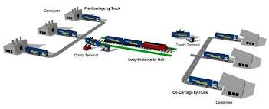
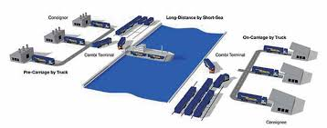
National Combined Transport Directive
Combined transport activity:
Long-distance with train or maritime
Short-distance with road tranport (maximum 100-150 km)

Slide 5
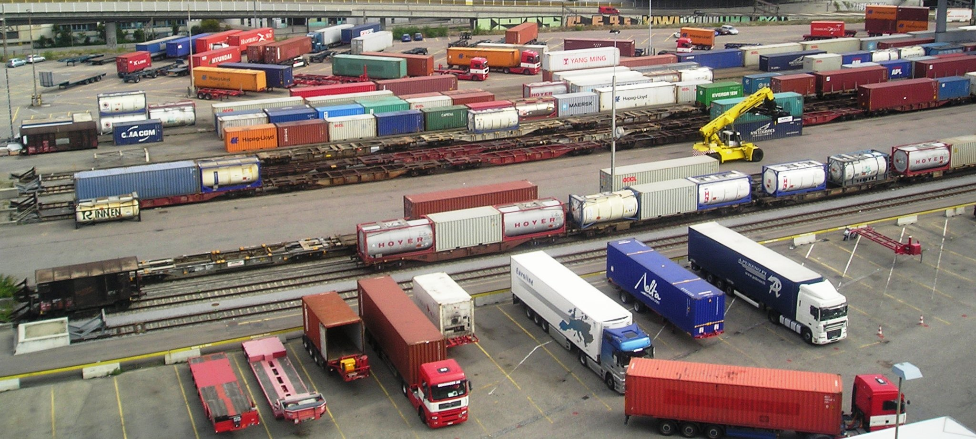
Combined Transport Directive
Combined transport centres would be established and certified

Slide 6
Combined Transport Directive incentives and promotions
Extention on certificates (20%-50%)
Discount on certificates (20%-50%)
Reimbursement from taxes (%2-%4)

Slide 7
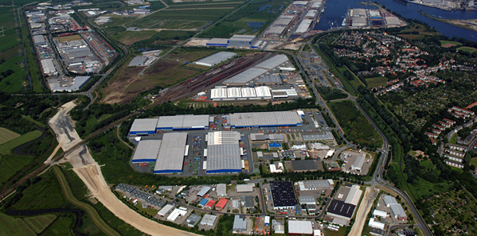
Logistical Centres Directive
Main Aim
To establish major logistical centres
Logistical Centres;
Turkish Logisical Master Plan
Max 30 km railway or port connection
Min 500.000 m² area,
Min 50 km distance with other Logistical Centres
Environmental friendly and energy-efficient transport,
Infrastructure for sterilized transportation,
Enlargement due to Turkish Logistical Master Plan.

Slide 8
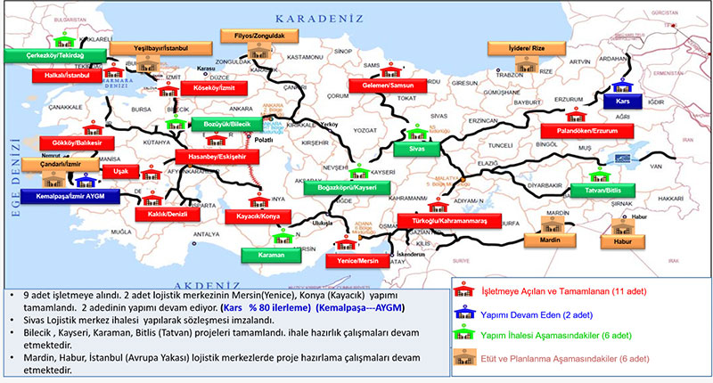
Logistical Centres in Turkey

Slide 9
Thank you for your attention….
murat.korcak@uab.gov.tr

