Slide 1
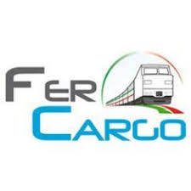
COVID-19 impacts on intermodal transport and logistics
UNECE WP.24, 26.06.2020

Slide 2
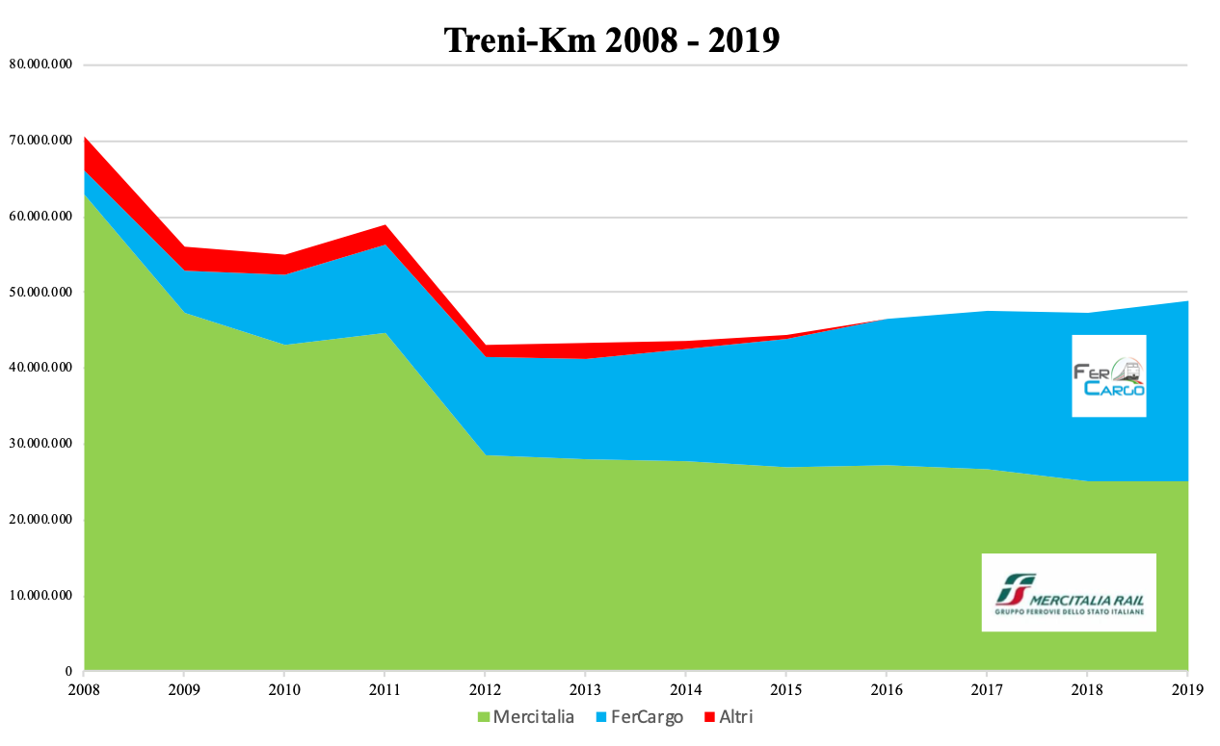
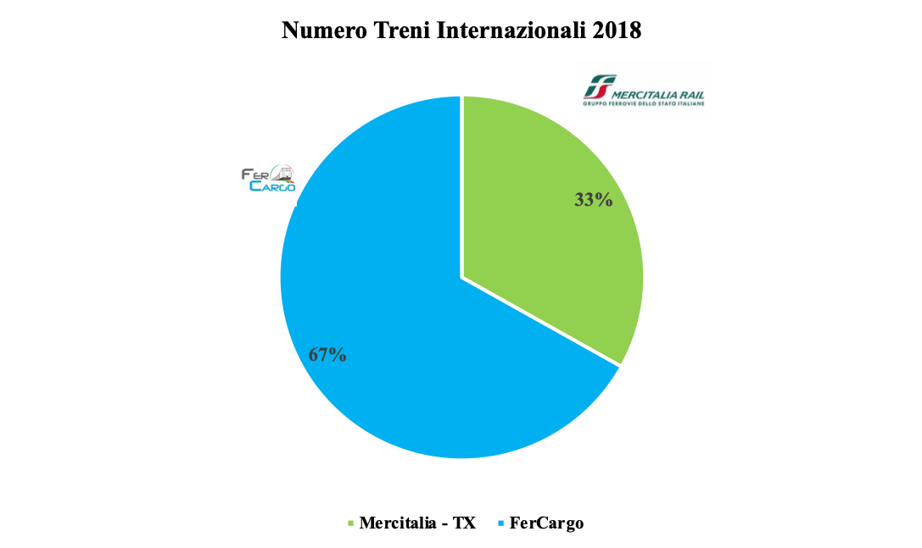
Market shares
Criticità
ed
Opportunità
Italian RUs belonging to FerCargo:
Adriafer
Captrain Italia
Compagnia Ferroviaria Italiana
DB Cargo Italia
Dinazzano PO
Ferrotramviaria
Ferrovie della Calabria
Fuorimuro
GTS Rail
Hupac
Interporto Servizi Cargo
InRail
Medway
OceanoGate
Rail Cargo Carrier Italia
Rail Traction Company
SBB Cargo Italia
- Sangritana

Slide 3
FerCargo is not only RUs

Slide 4
Impact of COVID-19 on RUs volumes
It was rather different over the months and the kind of products:
International intermodal rail transport suffered at least: March was ok, April dropped -25%, May level, June increased back to 90%
Conventional rail transport, both national and international, dropped immediately and remained in many cases close to zero until the second half of May
FerCargo RUs lost between 25% and 60% or more of their turnover depending on their portfolio
Additional costs and challenges came from the need to comply to more stringent safety regulations

Slide 5
Why intermodal worked better?
Road transport was, all at once, no longer able to cross the national borders
Intermodal has low personnel intensity per T in loading, unloading and travelling
The terminals found rapidly, reasonable ways to apply to the new rules and kept working
Even small quantities of a variety of goods coming from a variety of suppliers and addressed to a variety of markets can be easily packed into containers and switched to rail
Railways are much more used to apply a system of rules than road. Intermodal railways live in an even more standardised world. International, intermodal railways know no operational borders at all.

Slide 6
Problems…
Rules and regulations were different between Countries and between Regions. They were issued with no notice.
Crossing borders was at the end not easy, we had to stop interoperability
Until late April no availability of health protection devices
Operators requested very fast reactions as they tried to keep the frequencies even with low payloads, but we were not allowed to work with spare shift and reserves.

Slide 7
…and lessons learned
Have a good and trained Crisis Management Organisation
Have a good lobby connection, both for timely receiving information and in order to positively influence some operational regulations
Communicate a lot with your people on the field
Manage the Unions
Thank you for your attention!
Any questions?

