Slide 1
Event Data Recorder (EDR)
Informal document GRSG-116-42
(116th GRSG, 1-5 April 2019
Agenda item 17.)
GRSG-116 Agenda item 17

Slide 2
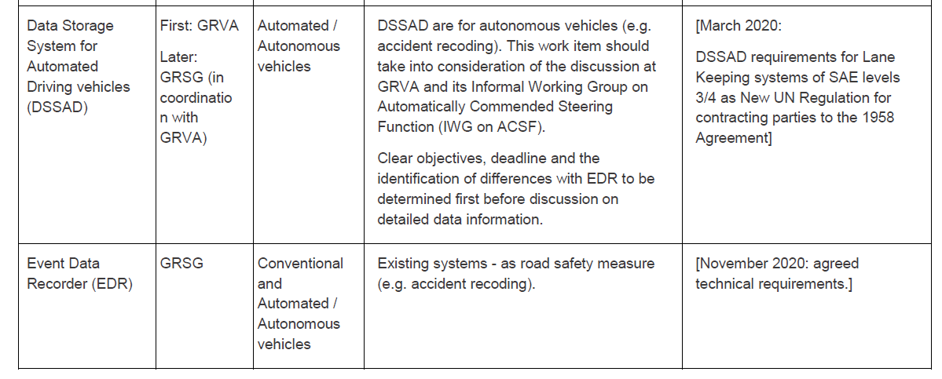
Background
WP.29-177-19 : Priorities in Framework document on automated/autonomous Vehicles
i. Event Data Recorder: [Description: TBD]
j. Data Storage System for Automated Driving vehicles (DSSAD): The automated vehicles should have the function that collects and records the necessary data related to the system status, occurrence of malfunctions, degradations or failures in a way that can be used to establish the cause of any crash.

Slide 3
Function (GRXX) | AD vehicles | Non-AD vehicles
Who is driving (GRVA) | DSSAD regulation No trigger Continuous storage Wide time-window OICA position: sufficient for ALKS All categories | NA
Accident reconstruction (GRSG) | EDR regulation With trigger Punctual storage Narrow time window OICA position: M1 N1 → based on US CFR HCV → to be defined
Clear
Differentiation
DSSAD - EDR
Target: 03/2020
Key:
ALKS: Automated Lane Keep System
HCV: Heavy Commercial Vehicles
DSSAD: Data Storage System for Automated Driving
Target: [11/2020]
Target: TBD

Slide 4
International Backgound on EDR
US: 2006(2012), 49 CFR 563, if fitted
Korea: 2008(2019), KMVSS Art. 56-2 (MOLIT Ord. 534/2018), if fitted
Japan: 2008(2015), J-EDR (Kokujigi 278/2008), if fitted for passenger cars <10 persons
Switzerland: 2012 (2015), VTS Art. 102, mandatory for vehicles with blue light and sirene
Uruguay: 2003 (2005), Decree 560/003 Art. 11, for dangerous goods vehicles
China: DRAFT GB mandatory for all passenger cars as of January 2021: EDR or alternative of a video camera recorder (dashcam). EDR comes in two phases. 1st phase ~ US EDR, 2nd phase including more data elements
EC: DRAFT GSR-2 as of ~2022 mandation of EDR
Standardization: SAE J1698 (US)
Note: List may not be exhaustive!

Slide 5
OICA Position for EDR
Support a GRSG/GRVA joint informal group on EDR/DSSAD
Support approach to produce UN regulation and GTR
Delivery of a UN regulation at next GRSG session (117th, Oct. 2019), based on US/Korea/Japan EDR for passenger cars considering minimal data for accident reconstruction based on existing systems
Delivery of harmonized provisions per a GTR
This approach would allow both, readiness for automated vehicles as well pursuing harmonization

