Slide 1
Transmitted by the Chair and Secretary of VIAQ
Informal document GRPE-78-29
78th GRPE, 8-11 January 2019
Agenda item 12
Status Report of the
VIAQ (Vehicle Interior Air Quality)
Informal Working Group
GENEVA, January 9th 2019
Chair: Andrey KOZLOV, Russian Federation
Co-Chair: Jongsoon LIM, The Republic of Korea
Secretary: Mark POLSTER, Ford

Slide 2
Background
During 173rd WP.29 session in Geneva (14-17 November 2017) Proposal for a new Mutual Resolution (M.R.3) for of the 1958 and the 1998 Agreements concerning Vehicle Interior Air Quality (VIAQ) was adopted (ECE/TRANS/WP.29/2017/136).
Final text of Mutual Resolution M.R.3 was published at UNECE site on 1 of November 2018 as the document ECE/TRANS/WP.29/1143
Notes:
2

Slide 3
ToR for the Second Stage
Terms of reference
Identify and collect the information and research data on interior air quality and its relevance for vehicles, taking into account the activities being carried out by various governments, and non-governmental organizations.
Identify and understand the current regulatory requirements with respect to vehicle interior air quality in different markets.
Identify, review and assess existing test procedures suitable for the measurement of harmful substance into the vehicle cabin (including test modes, sample collection methods and analysis methods, etc.)
Develop provisions and test procedures in a recommendation by including Part 3 in the Mutual Resolution No. 3.
Notes:
3

Slide 4
ToR for the Second Stage
Timeline
2018 2019 2020
1 2 3 4 5 6 7 8 9 10 11 12 1 2 3 4 5 6 7 8 9 10 11 12 1 2 3 4 5 6 7 8 9 10 11 12
WP.29
GRPE
VIAQ
180
181
182
76
77
78
79
80
81
VIAQ Madate
Informal
document
formal
document
11
12
13
14
15
16
17
18
19
20
21
Half of working items almost closed
Make a drafting grup
Develop provisions and harmonized test procedures.
VIAQ recommendation (a new part of M.R.3)
January 2020: Submit the draft document to GRPE
June 2020: Adoption of the draft document by GRPE
November 2020: Adoption of the draft document by WP.29
Notes:
4

Slide 5
VIAQ IWG Meetings since the last GRPE sessions
14th VIAQ IWG Meeting
  • Moscow, Russian Federation, November 7-8th 2018
  Two days
15th VIAQ IWG Meeting
  • Geneva, Switzerland, January 9th 2019
  • Half a day
Notes:
5

Slide 6
Working Items
Vehicle Category
Test Vehicle age/millage
Substances to be Measured
Meteorological Conditions
General Test Conditions
Test Modes
HVAC Modes
Test Procedure
Measurement Methods
Sampling Points
Sampling Method
Test Protocol
Notes:
6

Slide 7

Working Items
1. Vehicle Category
Category 1-1
Agreed Item
Notes:
7

Slide 8
Working Items
2. Test Vehicle age/millage
New cars from series production
Millage
3 000 -15 000 km
Agreed Item
Notes:
8

Slide 9
Working Items
3. Substances to be Measured
Formaldehyde СН₂О
Nitrogen dioxide NO₂
Nitrogen oxide NO
Carbon monoxide СО
Saturated hydrocarbons (С₂Н₆…С₇Н₁₆)
Methane CH₄
Carbon monoxide СО
Nitrogen oxide NO
Nitrogen dioxide NO₂
Formaldehyde СН₂О
Russian Standard
Agreed substances
Carbon monoxide СО
Nitrogen oxide NO
Nitrogen dioxide NO₂
Particulate matter (PM)
Korea
For discussion
(see VIAQ-13-04 and VIAQ-14-04)
Notes:
9

Slide 10
Working Items
4. Meteorological Conditions
ambient air temperature:
from -7°C to +30°C
relative humidity:
from 30% to 90%
atmospheric pressure
from 84.0 to 108.7 kPa
Agreed Item
Notes:
10

Slide 11
Working Items
5. General Test Conditions
Test road: straight road with the slope up to 6.0%.
No other vehicles with engine running or other sources of air pollution are permitted in the testing zone.
General inspection should be checked before testing.
Windows, doors and ventilation hatches should be closed.
HVAC outside flaps have to be closed.
A/C should be turned off.
Agreed Item
Notes:
11

Slide 12
Working Items
9. Measurement Methods
Substances | Proposed measuring methods | Type of analysis
CH₂O | High performance liquid chromatography (HPLC) UV detection | 1) Stationary analysis at the laboratory after preliminary air sampling to the cartridges
 | 2) Gas chromatography (GC) with nitrogen phosphorus detection (NPD), or mass spectrometer (MS) and capillary or packed columns | 2) Stationary analysis at the laboratory after preliminary air sampling to the cartridges
 | 3) Photo-electric colorimetric method | 3) On-line (express) analysis
NO, NO₂ | 1) Chemiluminiscence (CLD) | 1) On-line (express) analysis or stationary analysis at the laboratory after preliminary air sampling to the sealed bags
 | 2) High-sensitivity electrochemical detection (ECD) | 2) On-line (express) analysis
CO | 1) Infrared photoacoustic spectroscopy | 1) On-line (express) analysis
 | 2) Electrochemical detection (ECD) | 2) On-line (express) analysis
PM_{2,5} PM₁₀ | Light-scattering laser photometer need additional discussion | 1) On-line (express) analysis
Notes:
12

Slide 13
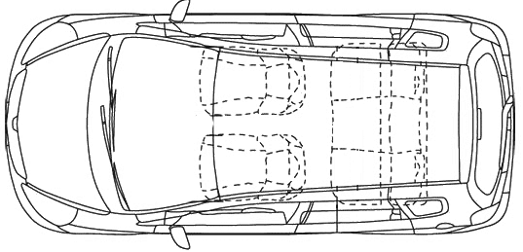
Working Items
10. Sampling Points
The point between headrests of front seats
Agreed Item
Notes:
13

Slide 14
Working Items
Test Modes Discussion
1. Idling Test
2. Constant Speed Test
  Movement at constant speed 50 km/h
  Movement at constant speed 90 km/h
  Movement at constant speed 130 km/h
3. Acceleration Test
  Acceleration from a speed of 60 km/h at wide opened throttle to 130 km/h and deceleration at closed throttle to 60 km/h repeated by 8 times
Notes:
14

Slide 15
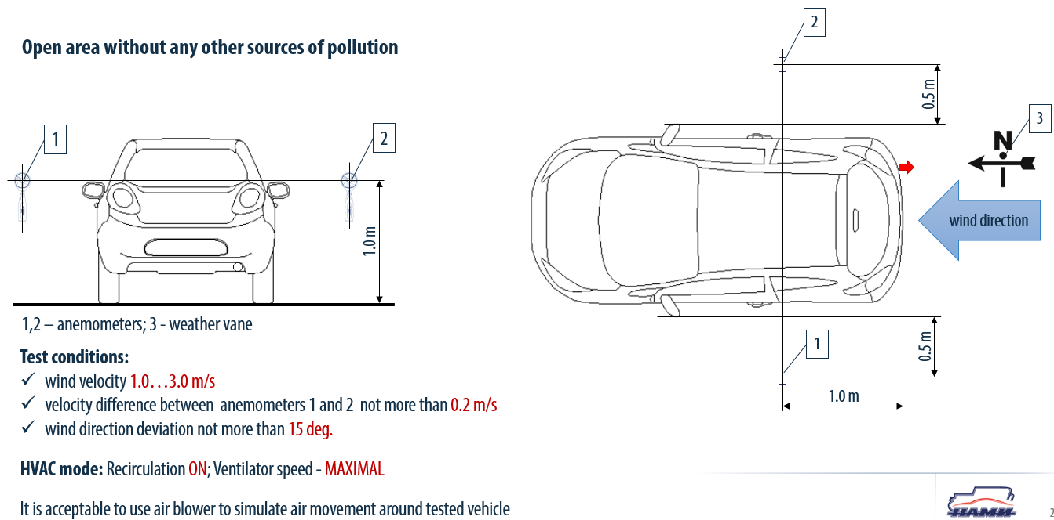
Working Items
Discussion of Idle Test Conditions and Facility (Russian Federation proposals)
Notes:
15

Slide 16
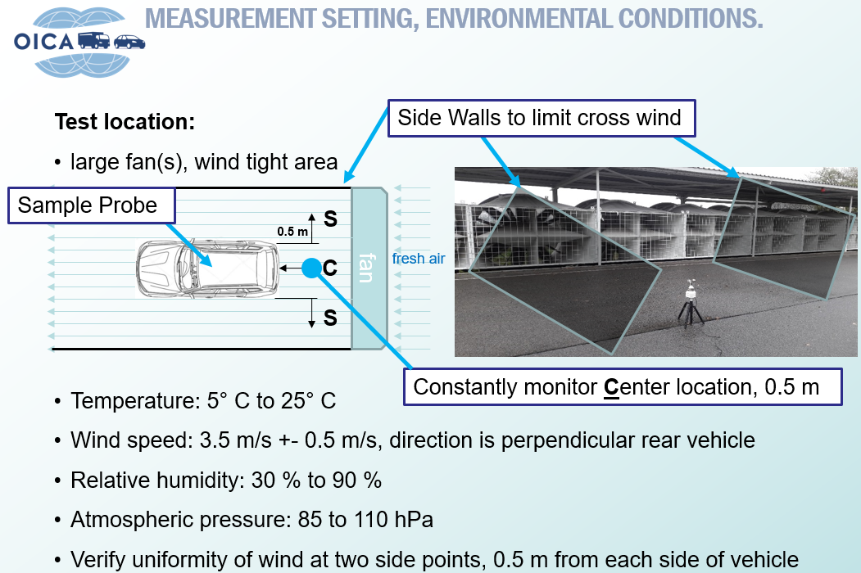
Working Items
Discussion of Idle Test Conditions and Facility (OICA proposals)
Notes:
16

Slide 17
Next VIAQ IWG Meeting
16th VIAQ IWG Meeting (TBD)
  10-12 April or 13-17 May 2019 (Paris)
  Two days
17th VIAQ IWG Meeting (TBD)
  15-25 October 2019 (Munich)
  Two days
Notes:
17

