Slide 1

UNECE IWG on EPPR for L-category vehicles
State of play
Informal document GRPE-78-26
78th GRPE, 7-11 January 2019,
Agenda item 8(b)
Adolfo Perujo
Chairman IWG EPPR (L-cat)

Slide 2
Background
Topics to be covered by EPPR
Environmental performance:
    Type I: Tailpipe emissions test after cold start (revision);
    Type II: Tailpipe emissions test at (increased) idle / free acceleration;
    Type III: Emission test of crankcase gases;
    Type IV: Evaporative emissions test;
    Type V: Durability testing of pollution control devices;
    Type VII: Measurement of CO2 emissions, fuel consumption, electric energy consumption and electric range determination;
    Type VIII: On-board diagnostics environmental verification tests.
Propulsion unit performance:
    Unified rules and test procedures to measure power and torque for propulsion technologies fitted on L-category vehicles
    unified measurement of maximum design vehicle speed and/or power for restricted L-category vehicles should be developed and agreed upon.
GTR2
GTR17
GTR18
&
OBD 2

Slide 3


GTR2 - Completed
Stay of Play
GENERAL REQUIREMENTS
TEST TYPE I, EXHAUST EMISSIONS AFTER COLD START
TEST TYPE II, TAILPIPE EMISSIONS AT (INCREASED) IDLE AND AT FREE ACCELERATION
TEST TYPE VII, ENERGY EFFICIENCY
COMMON ANNEXES
Informal document submitted to this GRPE session for information to the CP and stake holders

Slide 4
GTR2 - Outlook
Working document will be submitted for consideration to the 79th GRPE session.

Slide 5
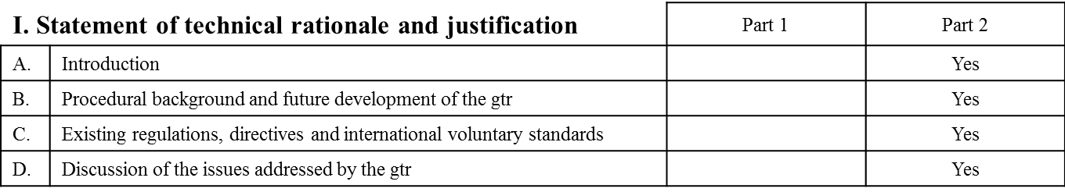
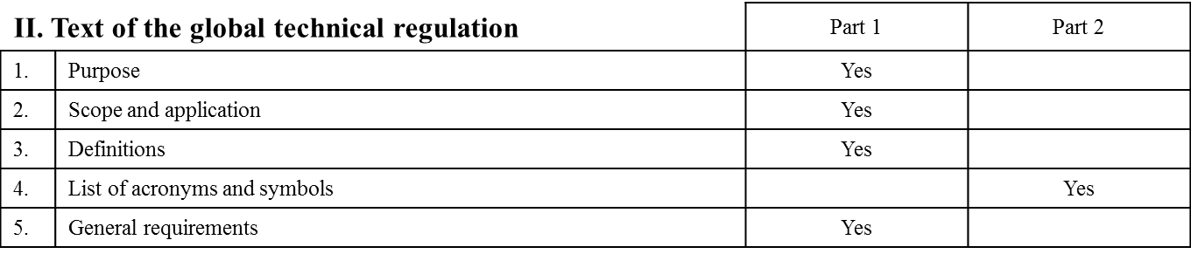
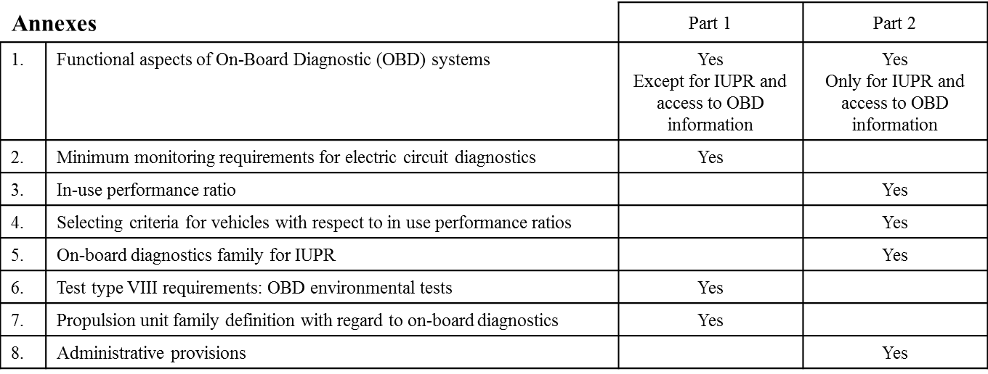
OBD 2
  The work of the OBD 2 (amendment to GTR 18) has two phases

Slide 6
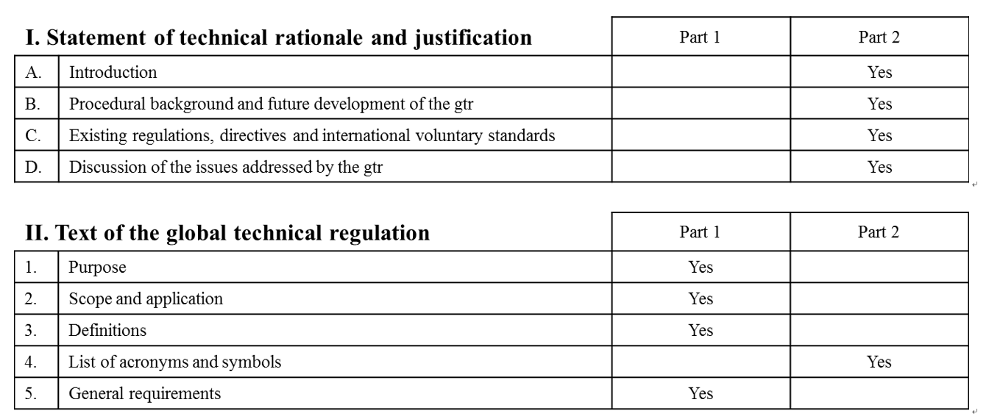
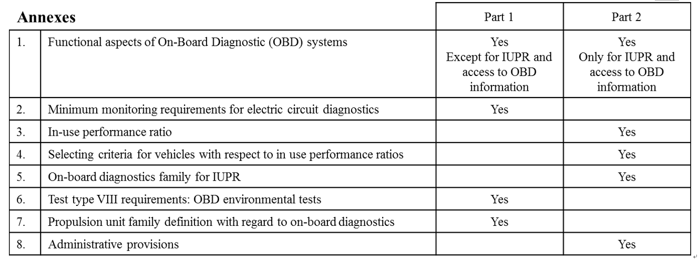
OBD 2 -Status
Phase 1
Phase 2
Progress percentage;100%
(open item;0)
Progress percentage;100%
(open item;0)
Phase 1
Phase 2
Progress percentage;90%
(open item;7)
Progress percentage;90%
(open item;7)
Phase 1
Phase 2
Progress percentage;95%
(open item;1)
Progress percentage;90%
(open item;3)
Progress percentage;95%
(open item;2)
Progress percentage;90%
(open item;1)
6

Slide 7
OBD 2 - Outlook
OBD2 GTR Phase 1 to be approved by EPPR IWG in March (2019)
OBD2 GTR Phase 1 informal document to be submitted at 79th GRPE session (May 2019)

Slide 8

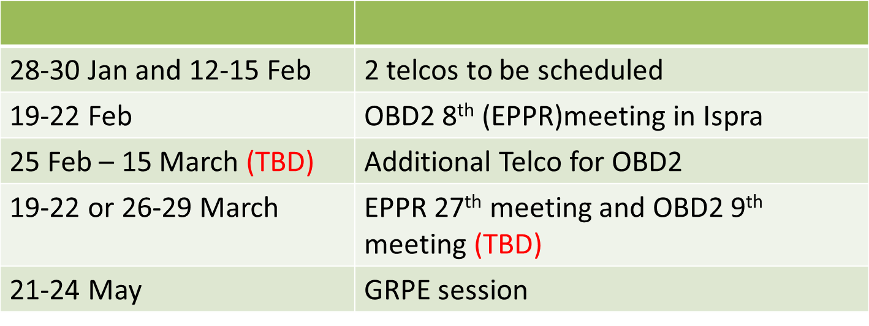
Meetings
Combination of TELCO and F2F meeting
Last f2f:
  8/01/2019 (OBD 2)
  9/01/2019 (General EPPR)

Slide 9


