Slide 1
Submitted by the expert from Republic of Korea
Informal document GRSP-65-23
(65th GRSP, 13-17 May 2019, agenda item28(a))
Korean Safety Regulations on Micro Mobility related to passive safety

Slide 2
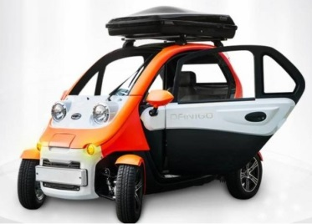
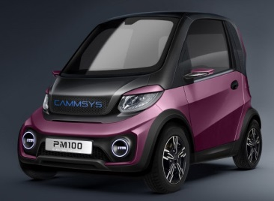
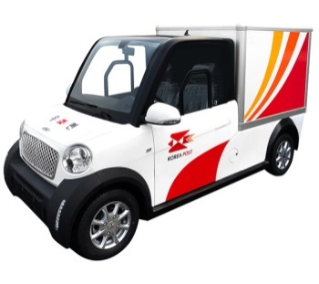
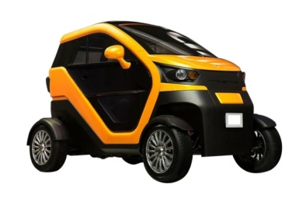
Safety Regulations on Micro Mobility
Implementation of Safety Regulations on Micro Mobility
Reference : L7 category vehicle in EU regulation 168/2013
Classification and safety regulations on Micro Mobility
* Research : Reference GRSP-61-24_Introduction plan for implementing safety requirements of micro mobility
Enforcement date: 11 July 2018
Classification of Micro Mobility
Power : Maximum continuous related power : 15kw or less
(Internal-combustion engine : 250cc or less)
Dimensions : Length : 3.6m or less, Width : 1.5m or less, Height : 2.0m or less
Vehicle Type : passenger vehicle(600kg or less), vehicle for the carriage of goods(750kg or less)
2p

Slide 3
Safety Regulations on Micro Mobility
Major requirements related to passive safety
Door latch & hinge : similar to UN R11, apply about 80% of load
Applied Load | Striker & Latch (direction) | Hinge (direction)
UN R11 | 1,130 kg (Vertical) 905 kg (Width) | 1,130 kg (Longitudinal) 905 kg (Width)
Korean Requirements | 910 kg (Vertical) 730 kg (Width) | 910 kg (Longitudinal) 905 kg (Width)
Seatbelt Anchorage
2 points-seatbelt : 1,820kg (0.2s or more)
3 points-seatbelt : 1,100kg (0.2s or more at pelvic & torso)
Applied Load | 2 points-seatbelt | 3 points-seatbelt
UN R14 (Seatbelt anchorage) | 2,270 kg (pelvic) | 1,360 kg (pelvic & torso)
Korean Requirement | 1,820 kg (pelvic) | 1,100 kg (pelvic & torso)
Seat Anchorage
Applied load : 20 times of seat weight
Electrical Safety of high voltage system
After collision test*, Check the safety insulation & prevention against electrical shock
* Frontal : 48.3km/h, Rear : 48.3km/h, Lateral : 50km/h
3p

Slide 4
Thank you for your attention
4p

