Slide 1
Submitted by the expert from Republic of Korea
Informal document GRSP-65-22
(65th GRSP, 13-17 May 2019, agenda items 28(a))
Status of Korean Safety Regulation on Sleeping Child Check System

Slide 2
Background
Background of establishing Safety Regulation
For securing the traffic safety of children, Safety Regulations on school buses have been reinforced*
* Enhance regulation on visible light transmission of window glass, install more than 2 rear safety devices to secure safety when driving in reverse, install speed limiter, assistant stairs for getting on/off, and stop sign
Despite the Road Traffic Act requires drivers to check if all children has got off school bus, accidents continued taking place
〈Number of accident and death by locked in school buses〉
Year | 2011 | 2012 | 2013 | 2014 | 2015 | 2016 | 2017 | 2018 | Sum
Accident | 1 | 0 | 0 | 0 | 0 | 3 | 3 | 2 | 9
Death | 1 | 0 | 0 | 0 | 0 | 1 | 0 | 1 | 3
As the Article 53 Paragraph 5 of the Road Traffic Act mandates operation of device in school buses that can check if all children has got off (16 Oct. 2018), Vehicle Safety Regulation was also amended
2p

Slide 3
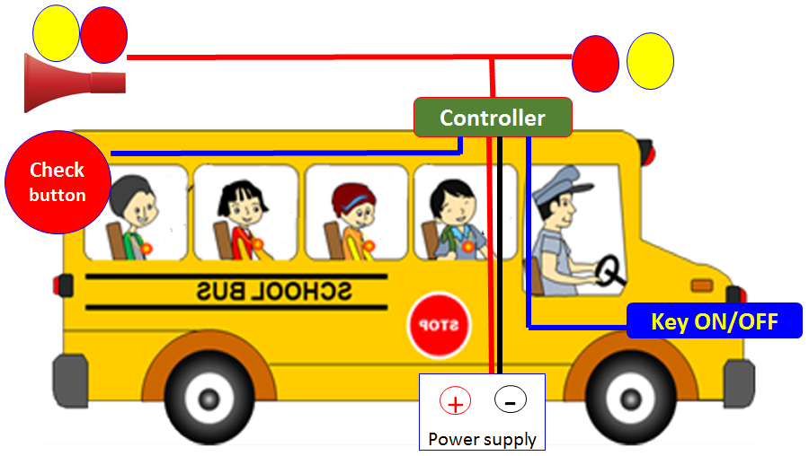
Regulation in KMVSS
Amended Vehicle Safety Regulation (KMVSS*)
* KMVSS : Korean Motor Vehicle Safety Standards
Article 53-4 (unloading child confirmation alert system)
Application: school bus
Regulation: After turning off the engine of school bus, if the device installed at the back of the bus is not pushed within 3 minutes, alarm and light will go off.
Enactment date: 21 March 2019
Enforcement date: 17 April 2019
Option
Regulation + emergency button
Regulation + motion sensor
3p

Slide 4
Thank you for your attention
4p

