Slide 1
Submitted by the experts of ETRTO
Informal document GRRF-86-04
86th GRRF, 12-16 February 2018
Agenda item 7(b)
ETRTO proposal for UN R30 & 64 amendments

Slide 2
BACKGROUND REAL WORLD vs. RUN FLAT TEST

Slide 3
UN R30 FLAT RUNNING MODE TEST DESCRIPTION
Test criteria |  | Comments
Drum diameter, d | 1,7 m or 2,0 m | —
Conditioning | 3 h at 35 ± 3 °C and 250 kPa | —
Inflation | Valve core removed | —
Speed | V = 80 km/h | to be reached in 5 min, with a speed tolerance of up to ±2 km/h
Load | 65 % load index | —
Duration | 60 min
Ambient temperature | (35 ± 3) °C
Pass/fail criteria | Decrease of no more than 20 % of the deflected section height compared to the start of test, and tread connected to the two sidewalls. | The deflected section height is defined as the difference between the deflected radius, measured from the centre of the rim to the surface of the drum, and one half of the nominal rim diameter as defined in ISO 4000‑1.

Slide 4
UN R30 FLAT RUNNING MODE TEST MEANING
When introduced, Run Flat tyres were supposed to focus mainly on tyre durability performance in flat running mode condition (i.e. zero inflation pressure) and as a consequence, the above mentioned load and speed durability test was designed with this regard.
The parameters describing the test are resembling an extreme event such as a tyre pressure loss occurring at very high ambient condition, for a fully laden vehicle where the tyre loses its valve, or the tyre has a big hole on the tread.
In fact, being the test an indoor one where the tyre is just rolling on a drum test bench, the conditions turn to be more severe than what really occurring on the road; for instance the temperature cooling effect due to the air flow is missing and for this reason the tyre heats up much more dramatically than in an outdoor test performed at the same temperature.
At the same extent it is really rare that the tyre loses completely the pressure; instead at least 0.1 bar are still observed, turning into a supporting factor for tyre structure capability.

Slide 5
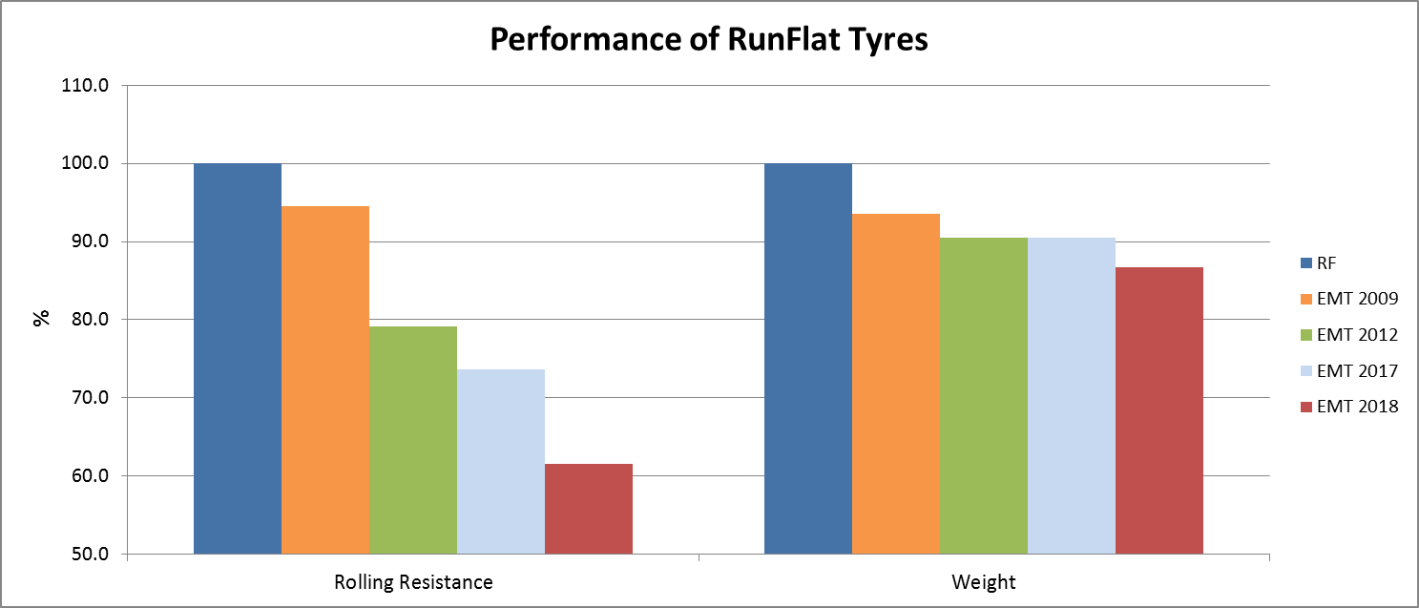
ACEA DATA ON RF vs. EMT
In addition to the performances set for conventional inflated tyres,
OEMs / Tyre Manufacturers needs
Rolling resistance improvement → Fuel consumption / CO₂ reduction.
Weight and stiffness improvement → better NVH (comfort, acoustics).
Chassis loads reduction → enabler for light-weight chassis components and consequent reduction of fuel consumption/CO₂ and safety increase due to reduced inertia.
Considerations
80 km on vehicle always kept
All the performance improvements were obtained without compromising vehicle dynamics in flat mode. Running EMT projects still show margin for improvement in weight and rolling resistance. EMT completely fulfils customer expectations as no complaint from the market was received.
-38%
-13%

Slide 6
Tyre Industry investigation & OEMs experience

Slide 7
TYRE INDUSTRY STARTING POINT
EMT performance in flat running mode condition needs to be properly described through a laboratory test on tyre, considering that:
in any case safety shall be ensured → sufficient flat running mode range, safe vehicle handling, etc.
driver satisfaction shall be guaranteed → no need for immediate action (side road accidents prevention)
POSSIBLE OPTIONS:
To amend current RUN FLAT definition → leading to market confusion
To work on a new definition for EMT → clear regulatory framework
Option 2 was chosen to prevent market confusion, while ensuring a clear regulatory framework

Slide 8
VEHICLE MANUFACTURERS ON ROAD TESTS
OEMs experience was useful for Tyre Industry better understanding
OEMs’ testing procedures rough overview:
Test performed on a defined testing track representing real driving conditions, instead of a drum test in a laboratory
Tyre valves removed (no pressure remaining)
Speed: max. 80 km/h with moderate acceleration/braking
Max Lateral acceleration range: 0.3 – 0.4 g
Pass/fail criteria: => Run flat distance to be achieved without impairment of vehicle handling in flat running mode e.g. due to strong vibrations, shaking, ...
Customers Feedback: Since 2009 more than 7 million vehicles had been sold worldwide fitting EMT, without any customer complaints on insufficient flat running mode performance.

Slide 9
ETRTO DESIGN OF EXPERIMENT – APPROACH
ETRTO did not want to reinvent the wheel, hence starting from the RF test, ETRTO was searching for
the best parameters combination capable to properly reflect these products capability to grant a minimum performance on vehicle: also known as 80 km x 80 km/h;
more reasonable testing conditions to be closer to real life applications;
improved testing quality in terms of repeatability and reproducibility

Slide 10
ETRTO DESIGN OF EXPERIMENT – TYRES SELECTION
ID | SW | AR | R | RIM CODE | LI | SS | SL/XL
1 | 225 | 45 | R | 17 | 91 | W | SL
2 | 225 | 60 | R | 17 | 99 | V | SL
3 | 255 | 40 | R | 18 | 95 | Y | SL
4 | 195 | 55 | R | 16 | 87 | V | SL
5 | 195 | 55 | RF | 16 | 87 | V | SL
6 | 225 | 50 | RF | 17 | 94 | V | SL
7 | 225 | 50 | R | 17 | 94 | W | SL
8 | 245 | 50 | R | 18 | 100 | W | SL
9 | 255 | 55 | R | 18 | 109 | V | XL
10 | 255 | 50 | R | 19 | 103 | Y | SL
11 | 315 | 35 | R | 20 | 110 | Y | XL
12 | 285 | 40 | ZR | 19 | 103 | Y | SL
ALL THESE TYRES GRANT A MINIMUM VEHICLE EXTENDED MOBILITY EQUAL TO 80 km
Different brands / sizes / vehicle applications were selected to investigate the current market performance level and the impact of different testing conditions on those products.
note:
each tyre was tested under different sets of testing conditions by 3 different labs (1 Lab tested all)
THE INVESTIGATION OUTCOME WAS THE BASIS FOR ISO 16992 REVISION

Slide 11
NEW ISO 16992 EMT TEST DESCRIPTION 1/2
3.3 new "Extended Mobility Tyres" definition
Test criteria |  | Comments
Drum diameter, d | 1,7 m or 2,0 m | —
Conditioning | 3 h at 25 ± 3 °C and 250 kPa | —
Inflation | Valve core removed | —
Rim | Rim contour with hump (round or flat) on both rim sides Measuring rim width | Rim contour according to ISO 4000‑2 Rim width according to ISO 4000‑1
Speed | V = 80 km/h if d = 2,0 m V = 75 km/h if d= 1,7 m | to be reached in 5 min, with a speed tolerance of up to ±2 km/h
Load | 60 % load index | —
Duration | 60 min | After reaching the test speed and load condition
Ambient temperature | (25 ± 3) °C | The sensor shall be at a distance not less than 0,15 m and not more than 1,00 m from the tyre sidewall
Pass/fail criteria | Decrease of no more than 20 % of the deflected section height (Z in the figure) compared to the start of test, and tread connected to the two sidewalls. | The deflected section height is defined as the difference between the deflected radius, measured from the centre of the rim to the surface of the drum, and one half of the nominal rim diameter as defined in ISO 4000‑1.
In orange main differences compared to RF test, in green new requirements implemented also for RF test

Slide 12
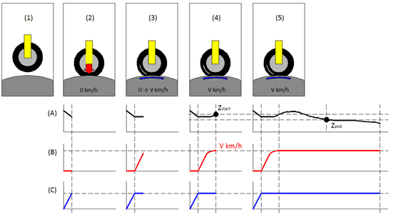
NEW ISO 16992 EMT TEST DESCRIPTION 2/2
Higher testing quality was achieved by introducing more detailed requirements and preventing interpretations.
ISO 16992 symbol for an extended mobility tyre
(1) | Attachment | (A) | Deflected section height Z graph
(2) | Apply load | (B) | Speed graph
(3) | Acceleration | (C) | Load graph
(4) | Start of the test Z_{start} triggered
(5) | Test continued until Z_{end}

Slide 13
EMT TEST PARAMETERS DESCRIPTION
Testing Load meaning:
Current RF testing Load value was obtained starting from the vehicle normal load on the road corresponding to 88% LI (max value),
It was reduced by 20% for drum curvature correction,
Further reduced by 7% to consider load transfer from a deflated tyre
So: 88% x 80% x 93% = 65%
ISO load 60% LI on the drum corresponds to 81% on the road well reflecting current applications on the market, as per exchanges with Vehicle Industry.
Inflation pressure meaning:
By keeping the zero inflation pressure condition, the test is kept more severe than what observed in real world application, where it is really rare that the tyre loses completely the pressure; instead at least 0.1 bar are still observed, turning into a supporting factor for tyre structure capability.

Slide 14
EMT TEST PARAMETERS DESCRIPTION
TEMPERATURE MEANING:
In accordance to UNECE R30 & 54, where the high speed and endurance tests are made in the range of 20-30°C, also the Extended Mobility Tyres test shall be done at this temperature range allowing a direct link with other performances like e.g. Rolling Resistance, for which the measurement is performed at 25°C.
In addition, to be noted that due to the way the indoor test is conducted, it results much more severe than the outdoor test where
there isn’t the chance to maintain an high temperature constant value;
there is a cooling effect due to the movement of the tyre and to the air that flows next to it.
As result, in the indoor test the tyre is heated up much more dramatically than in an outdoor test performed at the same temperature.
Higher testing quality was achieved, introducing more detailed requirements.

Slide 15
EMT as an emergency mobility equipment.

Slide 16
SOLUTIONS AT A GLANCE
Solution
SOLUTION
Spare Tyre
Tempa spare
Tyre repair Kit
„RF“ tyre
EMT
Search the spare tyre
Search the emergency wheel
Search the tyre repair kit
SIDE ROAD RISK
Lift the vehicle
Lift the vehicle
Connect the repair kit
Dismount the damaged tyre
Dismount the damaged tyre
Able to use the tyre repair kit???
Mount the spare tyre
Mount the emergency wheel
Remove the tyre repair kit
Put the damaged tyre back in the car
Put the damaged tyre back in the car
Put the tyre repair kit back in the car
DOES IT WORK?
restart driving
If spare not underinflated
restart driving @ limited speed
If not underinflated
Restart driving with limited speed if able to use the kit
Keep driving with limited speed for at least 80 km
Keep driving with limited speed for at least 80 km
NEED TO REPAIR
CHECK
Go to the garage to repair or substitute the damaged tyre
Go to the garage to repair or substitute the damaged tyre
Go to the garage to repair or substitute the damaged tyre
Go to the garage and check the damaged tyre
Go to the garage and check the damaged tyre

Slide 17
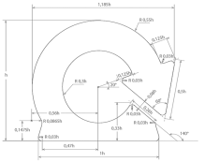
UN R.30 AMENDMENT AT A GLANCE
"Extended Mobility Tyre" describes a pneumatic radial tyre designed to operate in an inflated mode and allowing the pneumatic tyre, mounted on the appropriate wheel and in the absence of any supplementary component, to supply the vehicle with the basic tyre functions at a speed of 80 km/h (50 mph) and a distance of 80 km when operating in flat tyre running mode.
Procedure to assess the "flat tyre running mode“ of "extended mobility tyres"

Slide 18
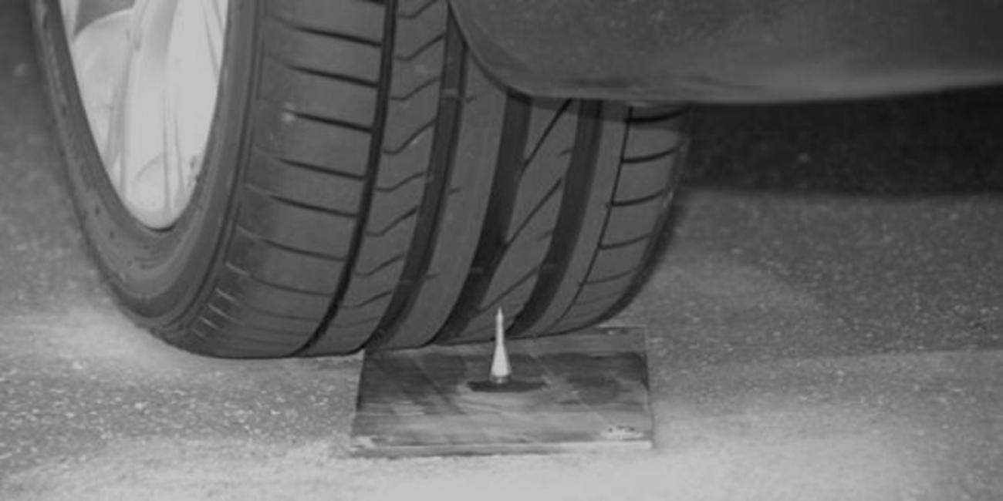
Thank you!

