Slide 1
77th UNECE GRPE session
PMP IWG Progress Report
Informal document GRPE-77-14
77th GRPE, 6–8 June 2018
Agenda item 7
Geneva, 7th -8th June 2018
UNITED NATIONS

Slide 2
PMP meetings in 2018
2018-01-09: PMP 46th (GRPE Geneva summary)
2018-05-16/17: PMP 47th
NEXT F-2-F MEETING: 13th/14th (tbc) November 2018 (Location: tbc)

Slide 3
EXHAUST PARTICLE EMISSIONS

Slide 4
Main open points
Round Robin Sub-23nm
Raw exhaust sampling
Calibration - Round Robin PNC (Particle Number Counter)
Horizon 2020 projects

Slide 5
Sub23 nm particles
Development of a sub23nm (cut-off size:∼ 10 nm) particle number measurement procedure based on the existing PMP methodology conveniently adapted.
Main purpose: Monitoring particle emissions of new engine/after-treatment technologies.
Assessment of the repeatability/reproducibility of the proposed particle counting methodology by means of a “round robin”.

Slide 6
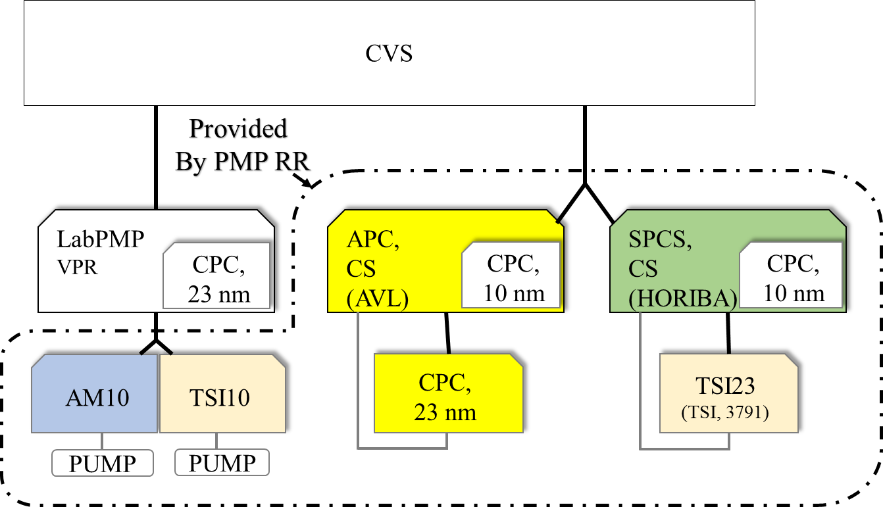
About the exercise
Measurement of a LD GDI vehicle in 8 laboratories
3 cold WLTC, 5 hot WLTC, 1 steady speed test
Objectives of the exercise is to
  uncertainties PMP-23nm and PMP-10nm, the need of a catalytic stripper (CS) and data for sub23nm
Two systems with CS and 10nm CPC to circulate
APC | 10 and , 23 nm cut-off, CS
SPCS | 10 nm cut-off, CS
AM10 | 10 nm cut-off LabPMP
TSI23 | 23 nm cut-off, SPCS
TSI10 | 10 nm cut-off LabPMP

Slide 7
About the exercise
Measurements so far conducted in 6 different laboratories
Switzerland and Japan to be done
Some problems with instruments and transportation (always solved but caused some delay)
PN10 and PN23 Data with Heated Evaporation Tube and Catalytic Stripper (CS) from all of the laboratories (CS1 or CS2 )
Until now only results from PMP vehicle (gasoline DI without GPF)
The data shown is about variability between the laboratories

Slide 8
Summary
The measurement data shows acceptable variability between the laboratories
  CO2 emission variability below 1 % between the laboratories (only one laboratory deviates from average)
  The PN23 (particle diameter>23nm) data shows that the variability of current PMP-method (VPR) is at the same level as that of Catalytic Stripper-method
  Similarly PN10 measurement variabilities are at the same level for both CS and for VPR
  Next Steps - robustness : longer term durability of CS / efficiency checks and challenging the method also on HD engines Q4 2018

Slide 9
Summary
PN measurement variability between labs
Speed/ gear | PN23, VPR | PN23, CS | PN10, VPR | PN10, CS
100/4 | 11% | 13% | 27% | 14%
120/5 | 6% | 10% | 27% | 8%
100/3 | 4% | 6% | 19% | 5%
50/2 | 5% | 8% | 22% | 7%
Measurement variability between laboratories over WLTC-cycle. The variablity between PN-emissions
 | CO2 | PN23, VPR | PN23, CS | PN10, VPR | PN10,CS
HOT | 2% | 19% | 16% | 19% | 18%
COLD | 1% | 12% | 12% | 16% | 8%

Slide 10
Average CO2 emission in (WLTP)
Things to do: recheck labs
normalization temperature
To be solved
Random order
CO2 variability, normalized to mean (100)
 | STD | Lab1 | Lab2 | Lab3 | Lab4 | Lab5 | Lab6
HOT | 2% | 100 | 99 | 98 | 99 | 100 | 104
COLD | 1% | 100 | 100 | 98 | 101 | 99 | 102
Emissions normalized to mean
  Reddish color |deviation| > std

Slide 11
PN Counting from Raw Exhaust via Fixed Dilution
Interest in this approach confirmed by some engine manufacturers and some instrument manufacturers
01 Series of amendments to Reg. 132 already includes such possibility but the procedure is not defined
Preliminary results generated by the JRC show 20% differences - Data presented by the industry during the 43rd meeting confirms good correlation
ACEA and JRC have discussed and agreed to carry out a joint experimental programme to investigate all the open issues – Indicative timing: 4th quarter 2018

Slide 12
PNC Calibration Round Robin
Draft final report finished – Uploaded on the PMP website for comments
  Main message: soot can work well as material for calibration. Generation of soot particles critical
Open issues:
  Emery oil or soot? “Academic calibration exercise” vs real world?
  Emery oil not suitable for the calibration of the whole system (RDE)
  Differences up to ±15% in the field among CPC calibrated according to the procedure (need to tighten tolerances?)

Slide 13
PNC Calibration
Options:
  Continue working for the improvement of the current calibration procedure to reduce the differences between PMP systems (up to ± 20% in the field)
    However impact on the existing systems and on limits should be considered
  Focusing the attention on the calibration procedure for systems able to measure below 23 nm
The PMP group will prepare a roadmap in the November meeting for one or both options to be presented in the next GRPE plenary session

Slide 14
HORIZON 2020 projects
The group is monitoring the progress of the three projects funded by EU under the H2020 scheme
  DownToTen
  PEMS4nano
  SUREAL-23
These projects have the objective of investigating (nature, composition,…) sub23 nm emissions and to develop new test procedures to measure these particles
Representative of the consortia provide regular updates to PMP group – Presentations available on the PMP website

Slide 15
Gas engine testing
Further investigations on light duty and heavy duty will be carried out during 2018
Gas engine tested in the joint project ACEA/JRC?

Slide 16
Additional topics to be addressed?
In the informal meeting during the GRPE of January 2018 a few additional points were raised:
Impact of fuel quality on PN emissions
Effect of biofuels of different nature blended with conventional fuels on PN emissions
These topics are not included in the current mandate of PMP.

Slide 17
Additional topics to be addressed?
The PMP IWG has discussed in the last meeting the issue and has proposed the following approach
First step: Literature survey and knowledge gap analysis
Further steps to be decided on the basis of the result of the survey
Scope of the literature survey to be defined (guidance from GRPE)
  Engine out, tailpipe emissions or both?
  Only light duty? (i.e. exclude motorcycles and HD ?)
  PI, Diesel or both?
Guidance from GRPE is welcome

Slide 18
NON-EXHAUST PARTICLE EMISSIONS

Slide 19
NON-EXHAUST PARTICLE EMISSIONS
Development of a NEW REAL-WORLD BRAKING CYCLE FOR STUDYING BRAKE PARTICLE EMISSIONS
WLTP Database Analysis (Concluded)
Comparison of WLTP data with Existing Industrial Cycles (Concluded)
Development of a first version of the new (WLTP based) and backup (LACT based) braking schedule (Concluded)
Validation of the cycles - Round robin (reproducibility assessment on different dynos) (Deadline: March – April 2018) (Deadline: December 2018)

Slide 20

NON-EXHAUST PARTICLE EMISSIONS
Development of a NEW REAL-WORLD BRAKING CYCLE FOR STUDYING BRAKE PARTICLE EMISSIONS
FORD has concluded the development of the schedule in collaboration with Heinz Steven
Technical details regarding the cycle have been presented in EuroBrake 2018
The cycle will become available to the public after its acceptance to the WEAR Journal (June 2018)

Slide 21
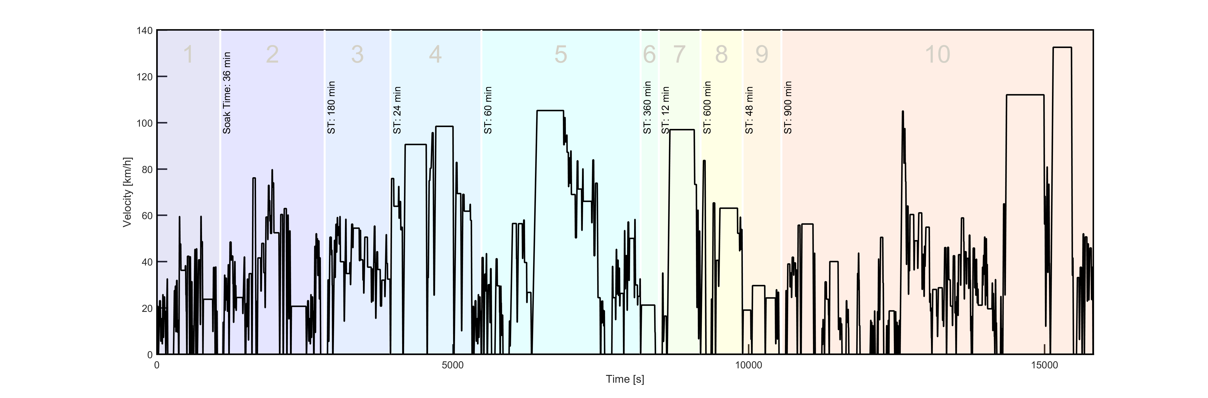
Development of a NEW REAL-WORLD BRAKING CYCLE FOR STUDYING BRAKE PARTICLE EMISSIONS
NOVEL CYCLE
303 stops at a distance of 192 km
4h 24min duration
Average speed of 44 km/h and maximum speed of 133 km/h
Deceleration 0.49 – 2.18 m/s² (mean of 0.97 m/s²)

Slide 22
BRAKING TEST CYCLE – OPEN ISSUES
Low flow dynamometer testing will lead to higher maximum temperatures than observed in the field. How can we reproduce correct temperature levels?
Which temperature will be achieved for other vehicles (vehicle classes)
How to adapt cycle to other vehicle classes?
Influence of breaks between the trips
Temperature level and cooling influence on other test setups for emission testing

Slide 23
BRAKING TEST CYCLE – NEXT STEP
A round robin has been scheduled for the next months with the purpose of validating both braking schedules in terms of temperature. All labs participating in TF1 will take part and the round robin is expected to be completed by the end of 2018
A paper with the title “A novel real-world braking cycle for studying brake wear particle emissions” has been submitted to WEAR and is expected to be published soon

Slide 24
BRAKE DUST SAMPLING AND MEASUREMENT
MAIN TASKS
Selection of the testing methodology (Concluded)
Comparison of existing systems/test rig configurations (Deadline: January 2018 – Concluded on-time)
Selection/definition of testing parameters (Deadline: March 2018 – Still on-going)
Validation of the selected configuration(s) & measurement methodologies (Deadline: To be defined depending on the progress)
Data processing method (Deadline: To be defined depending on the progress)

Slide 25
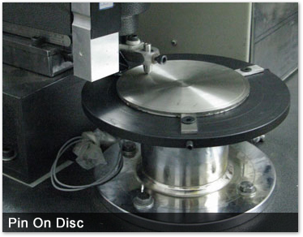
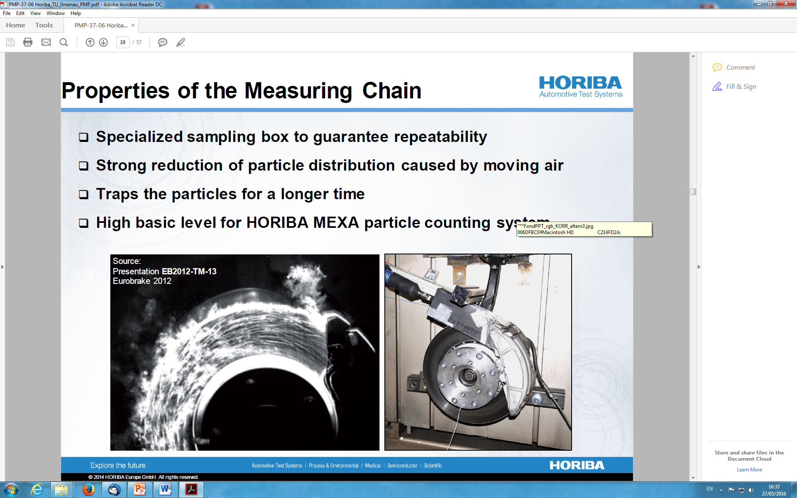
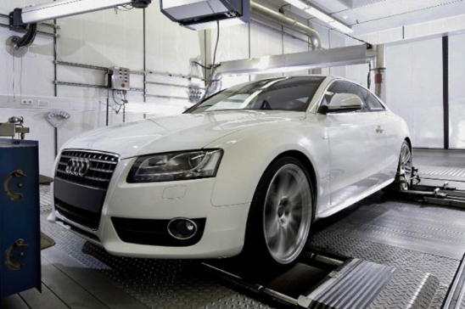
BRAKE DUST SAMPLING AND MEASUREMENT
SELECTION OF THE TESTING METHODOLOGY
Pin-on-disc
Brake dyno
Chassis dyno
Also, different on-road approaches have been employed by several researchers

Slide 26
BRAKE DUST SAMPLING AND MEASUREMENT
COMPARISON OF EXISTING TEST RIG CONFIGURATIONS
Technical Specifications | JARI | TU Ilmenau | Ford | Horiba – Audi | Brembo | LINK | TU Ostrava | GM
Inlet air flowrate (Min – Max – Optimal) | Adjustable 30 – 300 m³/h. Optimal 60 m³/h | PM_{2.5}-setup: 850 m³/h (Min: 100 m³/h – Max: 1000m³/h) | Optimal air flowrate value set at 250 m³/h | Adjustable 430 – 3300 m³/h Optimal value set at 3300 m³/h | Adjustable 500 – 2500 m³/h Optimal value set at 1175 m³/h | Adjustable 250 – 2500 m³/h | Max. 2500 m³/h | Adjustable 630 to 4900 m³/h. Not optimized for PM sampling
Duct diameter and geometry | Straight line. D = 84.9 mm (or 100 mm) | Horizontal π shaped duct. D = 160 mm | Vertical reverse U shaped duct . D =150 mm | 90° bend CVS tunnel . D = 300 mm | Vertical reverse U shaped duct. D = 56 mm | Vertical reverse π shaped duct. D adjustable 100 – 250 mm | “C”-shaped duct. D =300 mm | Square. D =356mm

Slide 27
BRAKE DUST SAMPLING AND MEASUREMENT
SELECTION/DEFINITION OF TESTING PARAMETERS
MAIN STEPS
Define the scope based on the mandate and what is feasible to achieve with the current state of experience in the TF2 (Concluded)
Structure the work in different thematic topics (Concluded)
Define individual groups within the TF2 to deal with each thematic topic (On-going – to be concluded in June)
Start collecting experimental data within the TF2 (June and onwards)

Slide 28
BRAKE DUST SAMPLING AND MEASUREMENT
SELECTION/DEFINITION OF TESTING PARAMETERS
Work structured in different thematic topics (Concluded)
Define individual groups within the TF2 to deal with each thematic topic (On-going – to be concluded in June)
vi. What is the current status regarding these items?
The work has been structured in 9 Chapters (document will be presented separately) based on the needs identified at the discussion for the definition of the scope
Smaller groups have been nominated as “responsible” for drafting individual chapters (see document). Feedback from all TF2 partners will be added after the first draft of the chapters

Slide 29
BRAKE DUST SAMPLING AND MEASUREMENT
SELECTION/DEFINITION OF TESTING PARAMETERS
Start collecting experimental data within the TF2 (June and onwards)
Data already exist from previous projects (already presented in 37th – 45th PMP Meetings)
TF2 members are involved in many on-going projects and more data will come from there in the near future
Based on this data the TF2 will define all necessary testing parameters and will come up with a minimum set of requirements for the sampling set-up and the necessary instrumentation

Slide 30
SAMPLING AND MEASUREMENT – Challenges
There is a common understanding that both PM₁₀ and PM_{2.5} as well as PN emissions should be investigated
Challenge: Optimal layout and sampling conditions might be different for mass and PN measurement!
A compromise could be needed

Slide 31
How to take into consideration other technologies capable of reducing brake wear emissions?
The test rig approach clearly focuses only on the brake system
Other technologies (e.g. regenerative braking, v-2-v communication,…) may have the potential to reduce brake wear PN emissions
How to assess these technologies?
  The topic has been discussed in the last PMP meeting – Presentation from VDA
  Different options have been identified (modified cycle, modified brake dynos, eco-innovation like approach, modelling…)
  Further analysis will follow once the common methodology development is concluded

Slide 32
Particles from tyre and road wear
In the 47th PMP meeting a session was dedicated to this subject
No major developments in the field.
JRC presented the results of a small study investigating the influence of the treadwear rating on PM/PN emissions
The development of a standardized methodology to measure the abrasion rate is currently an option under discussion

Slide 33
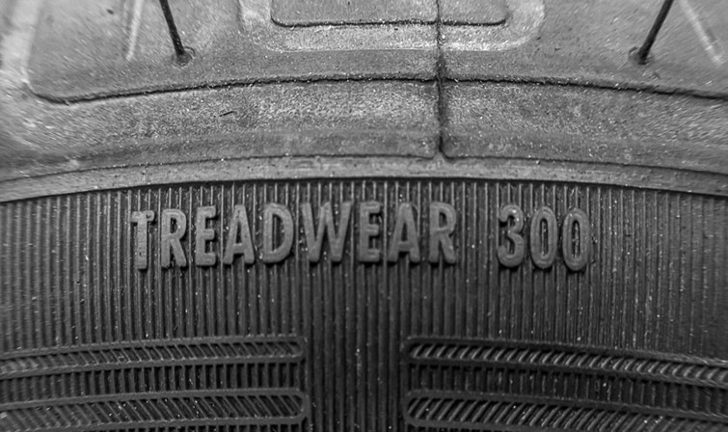
SCOPE OF THE EXERCISE
The aim is to explore the relevance of expected tyre durability expressed as the Treadwear Rating (TWR) for total tyre wear as well as for PM and PN emissions from the interaction between the tyre and the road surface.
iii. What is the Treadwear Rating (TWR)?
The Treadwear Rating (TWR) provided by tyre manufacturers on the sidewall of summer tyres is a marking intended to inform the customer about the expected durability of the tyre (USA – “49 CFR 575.104 - Uniform tyre quality grading standards”)
TWR uses numbers from 100 to about 700. The higher the number, the higher the mileage that the customer can expect to drive before reaching the minimum allowed tread depth

Slide 34
WRAP-UP
There is no general relation between TWR and measured tread mass loss or PM₁₀, PM_{2.5} or PN concentration
Tyres of different brands and same TWR display different wear as well as PM₁₀ and PM_{2.5} concentrations, thus not allowing a categorization based on the TWR
Within the subset of two B tyres the one with lower TWR has higher tread mass loss and PM₁₀ emissions. Further research with more tyres of same brand and different TWR is required to confirm the feasibility of categorization within the same brand

Slide 35
WRAP-UP
Approximately 50% (by mass) of emitted PM₁₀ fall within the size range of fine particles
Particle mass size distribution is bimodal with one peak falling to the coarse size range and another to the fine size range
Particle number size distribution is unimodal and is dominated by ultrafine particles most often peaking at 20–30 nm
The total tread mass loss was found to be 3-11 g/tyre resulting in a calculated wear rate of mass loss between 55–212 mg/km per vehicle*
*This does not refer to PM emissions factors BUT total mass loss of the 4 tyres

Slide 36
Information Request on Tyre Activities in Contracting Parties:
EU 3rd Mobility Package
New Proposal from EC for a REGULATION on the labelling of tyres with respect to fuel efficiency and other essential parameters
The mileage of tyres is related to their durability and life expectancy. Tyre abrasion is a major source of microplastics released into the environment.
It is therefore proposed to consider using delegated powers to include these parameters in the future, once an appropriate test standard is finalised.
Due to the lack of a reliable and reproducible testing method, this measure is not technically feasible at this stage. To facilitate this process, the Commission could give a mandate to CEN/CENELEC to develop such a methodology.
Any similar activity in other contracting parties?

Slide 37
Any questions?
You can find us at
giorgio.martini@ec.europa.eu - Chairman of UNECE PMP IWG
chosier@ford.com - Technical Secretary of UNECE PMP IWG

