Slide 1
Resolution on Road surface labelling Draft proposal: ECE/TRANS/WP.29/GRB/2018/8 and 9
Informal document GRB-68-29
(68th GRB, 12-14 September 2018,
agenda item 11)
Transmitted by the expert from the Netherlands
Dr.ir. Arian de Bondt and dr.ir. Frank Bijleveld - Ooms Civiel / Strukton Civiel
Jan Spoelstra - Province of Gelderland
Michiel van Koeverden and Kees van Oostenrijk - RecyBEM
Prof. dr. Dik Schipper and dr.ir. Henny ter Huerne - University of Twente
Presented by: Johan Sliggers - Ministry Infrastructure and Environment, The Netherlands
UNECE Working Party on Noise and Tyres (GRBP)
September 2018, Geneva

Slide 2
Road surface label has 4 indicators
Noise reduction
Wet skid resistance
Rolling resistance
Lifespan

Slide 3
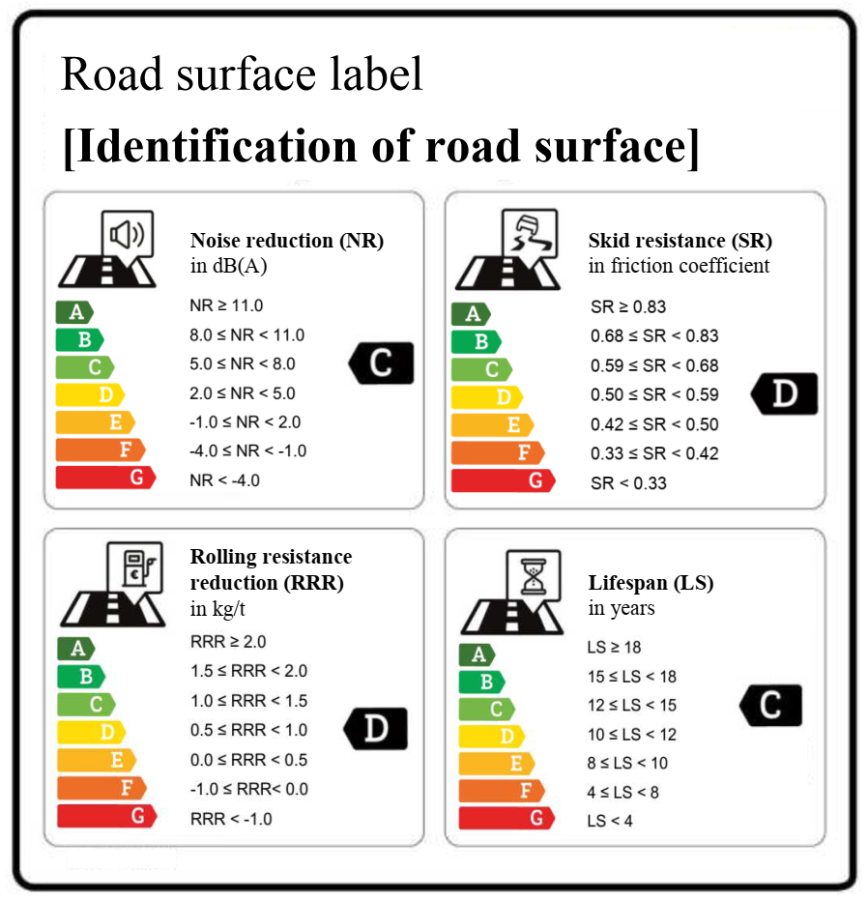

Slide 4
Video news broadcast
First road surface with a quality label
Advantages label
Transparant
Innovation
Acknowledges that a road surface is a product that can be developed, designed, built, maintained and removed
Facilitates the collaboration between tyre manufacturers and road builders and other relevant industrial partners (e.g. Automotive)
Facilitates and makes the optimisation of tyre-road interaction possible
Recognition for society and politicians
Facilitates the interaction and communication with road users and residents

Slide 5
Tender province Gelderland
Judgement of tender prices determined by the quality of the label
40% base and 60% label
Label | Minimum | 1 sublabel higher | 2 sublabels higher | 3 sublabels higher
Noise reduction | D | C:20% | C:20% | C:20%
Wet skid resistance | E | D:10% | C:15% | C:15%
Rolling resistance | E | D:10% | C:15% | B:20%
Lifespan | E | D:20% | C:35% | B:40%
Max total |  | 60% | 85% | 95%

Slide 6
Criterion | Province Gelderland | Contractor #1: 10 M euro | Quality discount | Contractor#2: 6 M euro | Quality discount
Noise | D | C | 6M*20%=1.2 | D | -
Wet skid resistance | E | D | 6M*10%=0.6 | D | 3.6*10%=0.36
Rolling resistance | E | B | 6M*20%=1.2 | D | 3.6*10%=0.36
Lifespan | E | B | 6M*40%=2.4 | E | -
Fictional tender price |  |  | 10M-5.4= 4.6M |  | 6M-0.72= 5.28M

Slide 7
Conditions to the tender
Comparable and accepted measurement methods per indicator
Prove characteristics every 2 years
Repair and maintenance allowed
Fine for not meeting the offered sublabel (twice the given fictional discount)

Slide 8
Resolution on Road surface labelling
GRB67 asked for a Working document, that may become a resolution
Two documents:
Proposal for a draft Resolution
Background information
Resolution is a Guideline and is thus a non-mandatory instrument
Instructions/manual how to use this road surface label

Slide 9
Structure Resolution (I)
Preamble
WP.29 on this Resolution on road surface labelling:
Harmonisation of technical requirements ensuring high quality
Facilitation of assessment of road pavement surface performance
Complements the existing tyre label
Does not prescribe minimum requirements
No regulatory status
Recommends the use establishing a road surface label

Slide 10
Structure Resolution (II)
Introduction
Resolution establishes a framework
Aim is to increase safety and environmental and economic efficiency of road transport
Scope
Definitions
Label, 4 indicators, classes
Requirements
Annex I gives the classes for the 4 indicators
Annex II-V give the determination/measurement methods for the 4 indicators
Annex VI gives the format of the label

Slide 11
Background information for the draft Resolution on road surface labelling: ECE/TRANS/WP.29/GRB/2018/8 and 9
Provides extra information
Benefits
Scope
Expands on the labelling concept and gives examples
Some references

Slide 12
Annex III of the draft resolution
Replacement current Annex III
Annex III in ECE/TRANS/WP.29/GRB/2018/8 is a reference to an article in German language
Annex III should be self-explaining and in English/French/Russian
Measurement methodology Annex III
Now ‘Braking friction coefficient’ instead of ‘Side ways friction coefficient’
Replacement of Annex III consequently leads to adjustments to both the draft Resolution on Road surface labelling and its Background information
Informal document GRB-68-08 gives the amendmends and adjustments to both Working Documents

Slide 13
Technical/detailed questions?
If we cannot answer them at this GRBP: fbijleveld@ooms.nl
When can the draft Resolution go the WP.29 for adoption?
Thank you for your attention!

