Slide 1
Intermodality: what UNECE Transport Statistics can tell us
Alex Blackburn
Secretary, Working Party on Transport Statistics (WP.6)
Presentation to Working Party on Intermodal Transport, 62nd Session
Geneva, 19-21 November 2018

Slide 2
Overview
WP.6 Introduction
Glossary for Transport Statistics
Eurostat Intermodal statistics
E-Rail and E-Road Censuses and potential for modal shifting
Data for SDG Monitoring

Slide 3
Transport Statistics at UNECE
WP.6 is a forum for inland transport statistics, covering:
Rail, road, inland waterways, pipeline
Infrastructure, vehicle fleet, traffic, transport measurement, safety
UNECE data come through a common questionnaire with ITF and Eurostat, minimizing the reporting burden and improving international comparability

Slide 4
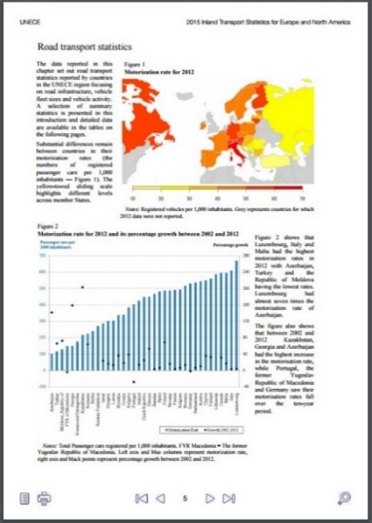
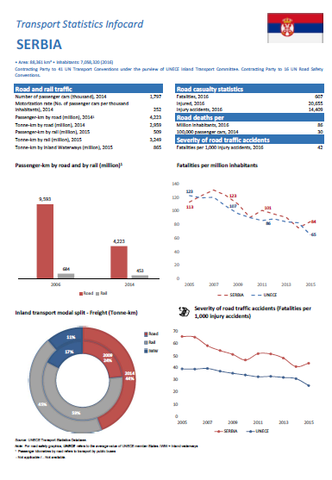
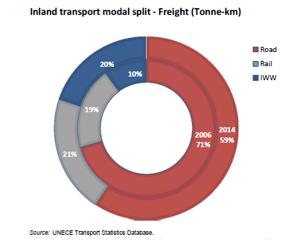
Inland Transport Statistics: to be published end-2018
Road Accident Statistics: Published November 2017
Infocards: produced annually for the ITC (February)
All available from unece.org/trans/resources/publications/transport-statistics.html

Slide 5
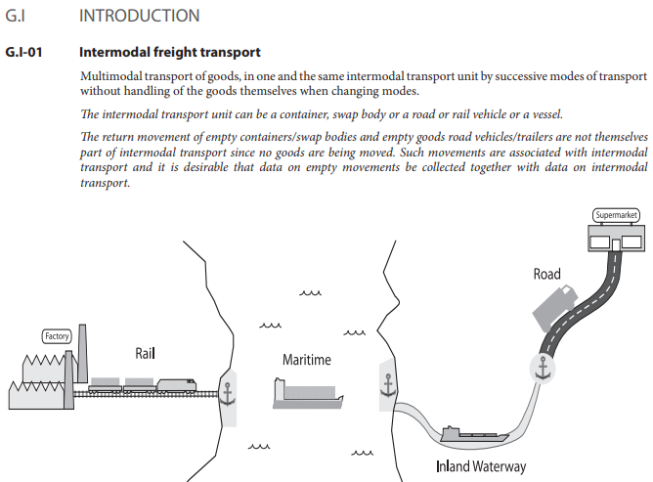
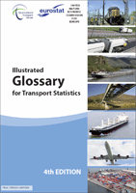
Transport Statistics Glossary
Existed as a joint UNECE/ITF/Eurostat publication since the early 1990s
Covers ALL transport modes. Infrastructure, vehicles, traffic, transport measurement, safety, energy use.
Allows transport statistics to be produced consistently across countries and modes
Fifth edition currently being finalized.
Notes:
5

Slide 6
Glossary: Main Changes to Intermodal Definitions
All intermodal terminology taken from the modal chapters and collated in the Intermodal chapter.
This has improved harmonization — container type definitionss now the same regardless of the mode reporting.
Some clarifications added to improve understanding of terms in North America.
Energy consumption terminology now in dedicated chapter.
Added chapters on passenger mobility and environmental impact of transport.
Notes:
6

Slide 7
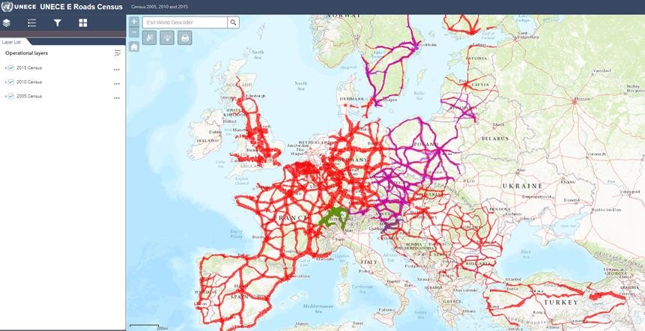
E-Rail Census
E-Road and E-Rail censuses ask for infrastructure information and traffic volumes on the AGR and AGC networks every 5 years
Since 2017 the E-Road census interactive map has been available; Rail map now in development.

Slide 8
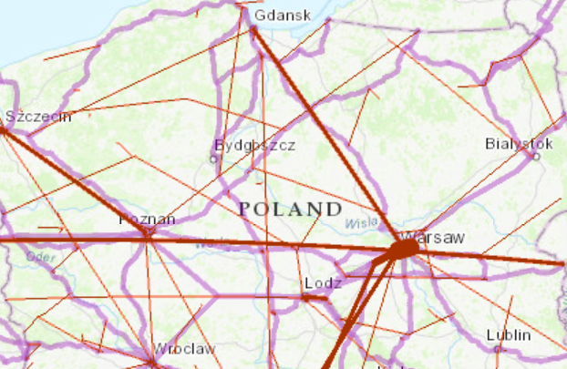
E-Rail Census: limitations
Only point-to-point, so doesn’t follow rail lines’ true path (not v. important for the main corridors)
More lines included than TEN-T (and the TEN-T network is bigger than the AGC
Data quality: some lines start/end in the sea
TEN-T network
E-Rail census data

Slide 9
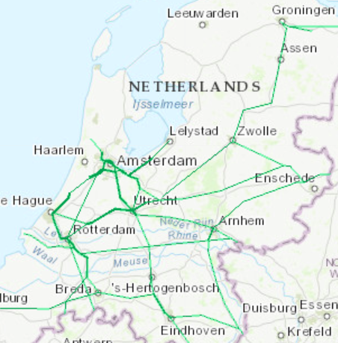
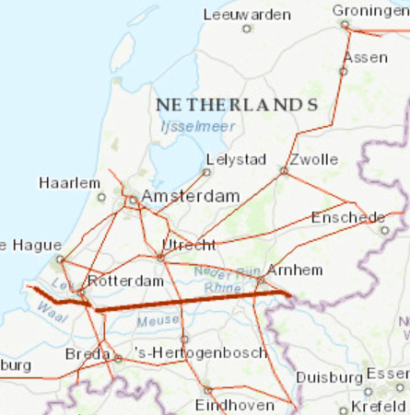
E-Rail Census
E-Road data give some insights into goods traffic, but E-Rail’s split between passenger and freight trains makes this distinction much clearer.
Rail passengers
Rail freight

Slide 10
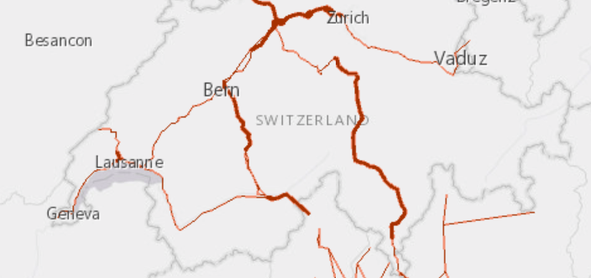
Census added value: putting a value on international rail crossings
22786 trains through Simplon tunnel, 30391 trains through Gotthard line (the year before the Gotthard base tunnel opened). Italy imported 159 million euros of goods from CH, and exported 467 million EUR by rail (Eurostat).
Thus Simplon tunnel worth approximately 268 million EUR in trade in 2015, and Gotthard 358 million.

Slide 11
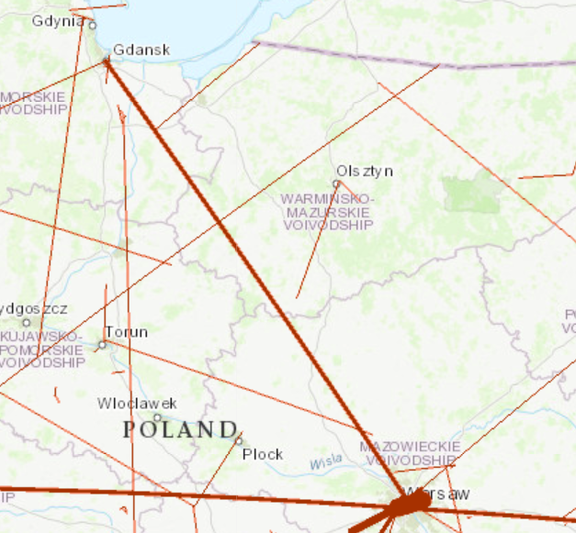
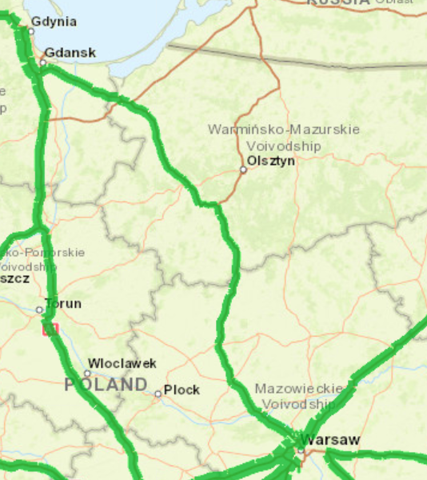
Combining freight data (with a few assumptions)
Rail
Road
27491 trains a year in total, ~75 trains a day
11939 AADT, of which 2781 heavy vehicles.
Two extra 60-container trains on the route each day both ways would reduce HGV traffic by ≈8%.
Notes:
11

Slide 12
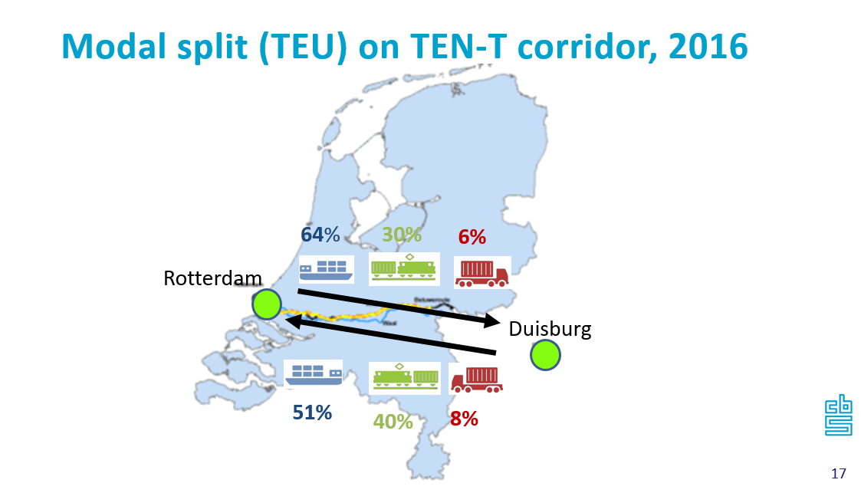
Combining the Censuses: regional modal split analysis
From Statistics Netherlands
Number of trains does not give us numbers of TEU or tonnage moved.
Intermodal transport terminal information would give infrastructure capacity (Formal document 3, Agenda item 11).
Notes:
12

Slide 13
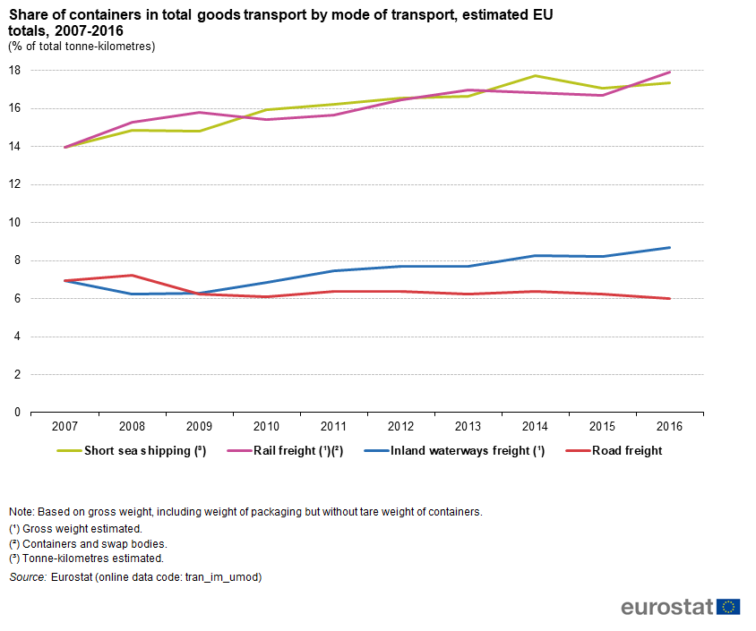
Eurostat work on Tracking Containerisation
Containerization rates for different modes, EU average (based on “German approach” to data collection)
Notes:
13

Slide 14
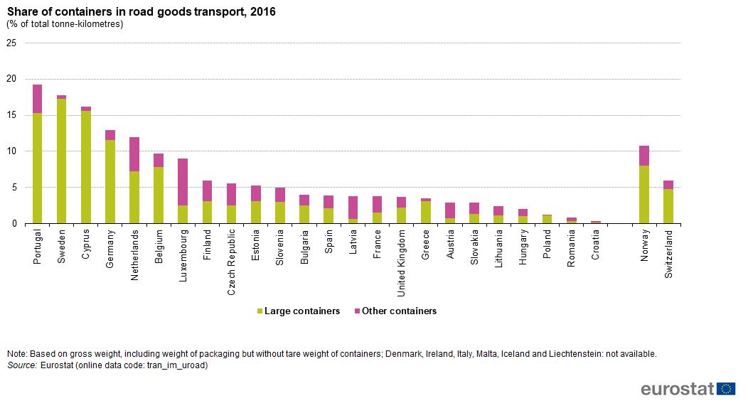
Eurostat work on Tracking Containerisation
Notes:
14

Slide 15
Transport-related SDGs
3.6: Halving the number of road accident fatalities by 2020. TIER 1
9.1.2: Passenger and freight volumes (passenger-km and tonne-km) by mode. TIER I
11.2.1: Proportion of urban population with convenient access to public transport. TIER II
Current indicator: proportion of population within 500m of a transport stop.

Slide 16
Improving measurement of 9.1.2
See currently reported data at https://unstats.un.org/sdgs/indicators/database/.
Custodian agencies: ICAO and ITF-OECD, with UNECE as a partner agency. Ongoing discussions.
Implementation and refinement of the indicator
Currently does not use available official statistics.
Reported data exclude inland water transport (significant for many European countries).
Indicator doesn’t try to measure anything. Could be improved as tracking share of non-road freight tkm and share of public transport pkm (see Eurostat’s SDG report for an example of this).

Slide 17
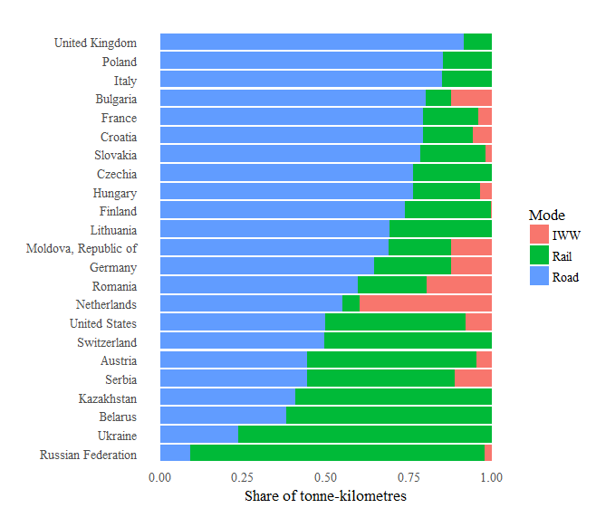
SDG Papers: Freight modal split
Read our transport data SDG papers at https://www.unece.org/trans/main/wp6/sdg_papers.html

Slide 18
Summary
All UNECE transport statistics are free to download and use w3.unece.org/PXWeb/en.
Next meeting June 2019 (details of last meeting at unece.org/index.php?id=46888.) More cooperation on rail statistics is welcome.
E-Rail census visualizes traffic volumes and could have uses in modal shifting. Better data would help.
Rail p-km and t-km data directly monitor SDG 9. Reporting for this indicator can be improved.
Thanks! Questions? BlackburnA@un.org

Slide 19
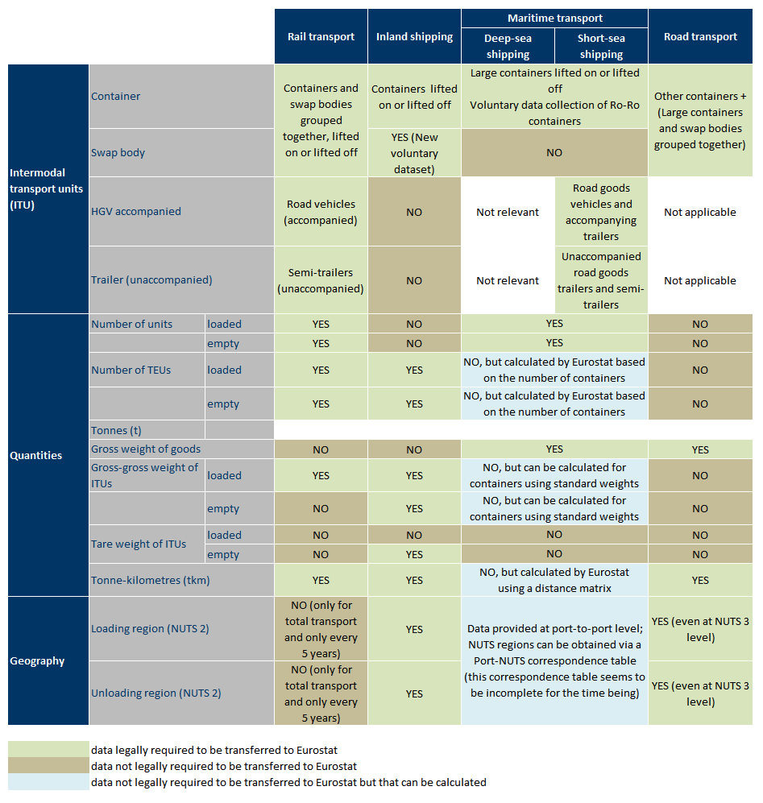
Annex
Description of existing European data collection on containers

