Slide 1
Secure and Facilitate Global Trade for international railway transport
Change the Color
of any of these layouts to fit your company or personal preference. Go to the Design tab up top and choose COLORS under the tab on the upper right or you may have to open or click on a drop down in the Design tab to the far right, it may be labeled Varients, that will bring up the “COLORS” tab. You can customize the COLORS as well to get the exact color scheme you want.
Some Layouts have both Animated & Static.
Delete pages you don’t need and keep others. Click on items to and move them around if you want. Pretty much everything is customizable.
Rail Security Workshop
ITF Annual Summit 2018, Liepzig, Germany
23 May 2018
Copyright © 2018 World Customs Organization.
All rights reserved.
1
Notes:
f

Slide 2
World Customs Organization (WCO)
Established in 1952 as the Customs Co-operation Council
Independent intergovernmental organization exclusively focused on Customs matters
Currently 182 Members from all geographic regions and at different stages of development, responsible for managing > 98% of world trade
Members are grouped in 6 regions supported by regional structures
Copyright © 2018 World Customs Organization.
All rights reserved.
2

Slide 3
Customs – Railways Cooperation
WCO signed MoUs with OTIF (July 2017) and OSJD (March 2018)
WCO Permanent Technical Committee discusses Customs - Railways Cooperation (October 2017 and April 2018)
Areas to be addressed:
Customs transit declaration ---possible standardization of data elements
Pre arrival advance electronic information (AEI)
Passenger control
Customs control in railway transportations--- merit/ demerit of electronic seals and other technologies (X ray)
Customs transit procedures in respect of postal items
Copyright © 2018 World Customs Organization.
All rights reserved.
3

Slide 4
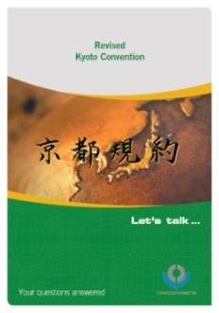
WCO instrument and tools -The Revised Kyoto Convention
The WCO Council adopted the Revised Kyoto Convention in June 1999 as the blueprint for modern and efficient Customs procedures in the 21st century
Was the basis for the TFA negotiations
Currently 113 Contracting Parties
Copyright © 2018 World Customs Organization.
All rights reserved.
4

Slide 5
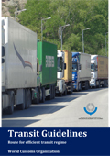
WCO instrument and tools
-Transit Guidelines
Launched at the Global Transit Conference, 10-11 July 2017, WCO Headquarters in Brussels
Conference attended by over 200 delegates from more than 80 countries
Supplement the Transit Handbook released by the WCO in 2014
The Transit Guidelines contain 150 guiding principles
Available in four languages - English, French, Spanish and Russian at http://www.wcoomd.org/en/topics/facilitation/instrument-and-tools/tools/transit-guidelines.aspx
Copyright © 2018 World Customs Organization.
All rights reserved.
5

Slide 6
Rising Roles of Customs in Security -SAFE Framework of Standards to Secure and Facilitate Global Trade
Adopted by the WCO Council in 2005
169 Members expressed intent to implement the SAFE FoS
Unique instrument comprised of standards aimed at securing the supply chain without impeding international trade, especially through:
Risk management
Advance Electronic Information(AEI)
Outbound inspection (using non-intrusive inspection methods)
Business partnerships (Authorized Economic Operator (AEO) ),
Cooperation with other government agencies, etc.
Copyright © 2018 World Customs Organization.
All rights reserved.
6
Notes:
As the government organization that controls and administers the international movement of goods, Customs have faced increased demands to take on more and greater responsibilities, not only in the accurate collection of revenue but also in areas such as security, to prevent the illegal movement of goods, for instance, arms and weapons, improvised explosive device (IED), and to prevent illicit financing.
Following the terrorist attacks of 11th September 2001, the WCO, the international body that represents Customs administrations’ interests, began to focus more on supply chain security. This transition culminated in 2005 with the adoption of the WCO SAFE Framework of Standards to Secure and Facilitate Global Trade (SAFE Framework).
The SAFE Framework is a unique instrument comprised of standards aimed at securing the supply chain without impeding international trade, especially through
risk management and the Authorized Economic Operator (AEO) programme, and the need to work with other government agencies especially at the border concept.
The SAFE Framework is a living instrument as it is subject to a 3-yearly review cycle to ensure it stay most relevant and up-to-date. Council in June is expected to endorse the SAFE 2018.
Punta Cana resolution was Adopted at Policy Commission in Punta Cana, Dominican Republic in December 2015
Recalled three key Recommendations issued by the WCO;
Recommendation Concerning the Use of Advance Passenger Information (API) and Passenger Name Record (PNR) for Efficient and Effective Customs Control (June 2015)
Recommendation Concerning the Protocol Against the Illicit Manufacturing of and Trafficking in Firearms, their Parts and Components and Ammunition (2002)
Recommendation on the need to Develop and Strengthen the Role of Customs Administrations in Tackling Money Laundering and in Recovering the Proceeds of Crime (2005)
Emphasized the key role that Customs Administrations have to play - and the critical space they occupy at the border - in the prevention of future terrorist attacks.

Slide 7
Areas to be addressed -Customs Transit declaration
RKC, Chapter 1 of Specific Annex E
Standard 6
Any commercial or transport document setting out clearly the necessary particulars shall be accepted as the descriptive part of the Goods declaration for Customs transit and this acceptance shall be noted on the document.
Recommended Practice 7
The Customs should accept as the Goods declaration for Customs transit any commercial or transport document for the consignment concerned which meets all the Customs requirements. This acceptance should be noted on the document.
Copyright © 2018 World Customs Organization.
All rights reserved.
7
Notes:
One example of commercial/transport documents is a international consignment note, such as CIM/SMGS consignment note.

Slide 8
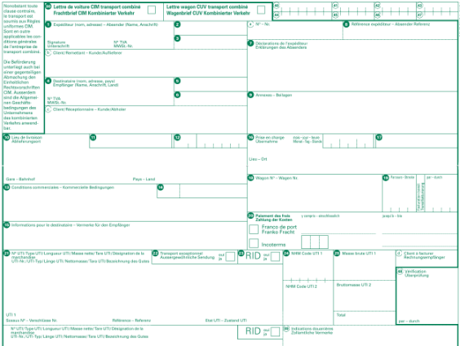
Possible Harmonization of Data Elements
What Customs need for transit procedure → What private sector can provide for Customs
Customs transit declaration
Copyright © 2018 World Customs Organization.
All rights reserved.
8

Slide 9
Areas to be addressed -Advance Electronic Information (AEI)
Advance Electronic Information (AEI)
Customs export declaration at the country of origin
Customs transit declaration in each transit country
Customs import declaration in each transit country
→ Need seamless flow of data through the entre rail transit/transportation process, in future?
Copyright © 2018 World Customs Organization.
All rights reserved.
9

Slide 10
Areas to be addressed - AEI for Customs Passenger control
Advance Passenger Information (API)
Elements of API can be obtained from the machine-readable area of a passport, as passengers check in.
API includes the name, date of birth, gender, citizenship, and travel document data (e.g. passport number).
Passenger Name Record (PNR)
PNR data is generated during the booking or buying of an air ticket in the operator’s reservation system.
It includes: in addition to API data, type of ticket, date of travel, travel itinerary, etc.
----> Effective use of passenger related data provided in advance can contribute for
Preventing the illegal cross border movement of goods
Performing effective risk analysis on passengers and their luggage
Copyright © 2018 World Customs Organization.
All rights reserved.
10

Slide 11
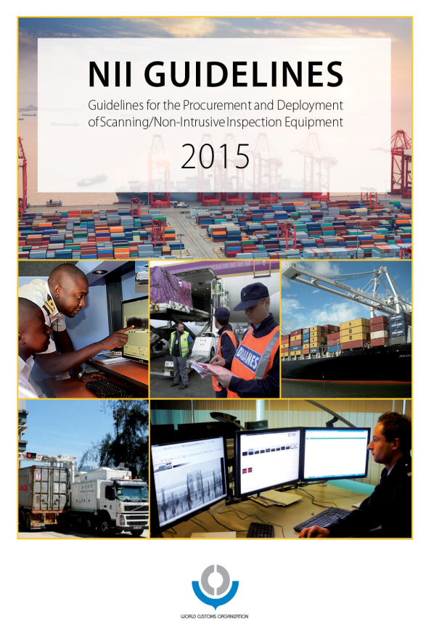
Areas to be addressed - Use of NII (Non-Intrusive Inspection) equipment-
SAFE FoS, Pillar 1, Standard 3 – Modern Technology in Inspection Equipment
Non-intrusive inspection equipment and radiation detection equipment should be available and used for conducting inspections, where available and in accordance with risk assessment.
This equipment is necessary to inspect high-risk cargo and/or transport conveyances quickly, without disrupting the flow of legitimate trade.
Copyright © 2018 World Customs Organization.
All rights reserved.
11

Slide 12
Areas to be addressed - Use of Customs Seals
RKC, Chapter 1 of Specific Annex E
Standard 8
The Customs at the office of departure shall take all necessary action to enable the office of destination to identify the consignment and to detect any unauthorized interference.
----> This necessity might be high especially in railway transportation, due to number of countries involve in the transit process.
----> Customs seal is one of effective means to ensure the integrity of the consignment.
- Electronic Customs Seals
----> Electronic Customs seals, based on radio frequency identification (RFID) or global positioning system (GPS) technology etc. may contribute to improve security against theft and diversion of cargo and illegal goods such as narcotics and weapons.
---> Cost of e-Customs seals and a need for standardization should be considered.
Copyright © 2018 World Customs Organization.
All rights reserved.
12
Notes:
Other merit would be
●exchange of data, Scanning Images/Customs Control results
●Tracking the trains (depend on technologies)
Weakness
But concern of ● No advance exchange of data

Slide 13
Satoko KAGAWA(Ms.)
Technical Officer
Procedures and Facilitation Sub-Directorate
World Customs Organization
satoko.kagawa@wcoomd.org
website: www.wcoomd.org
Copyright © 2018 World Customs Organization.
All rights reserved.

