Slide 1
Study on options for the security of European high-speed and international rail services
Summary of Final Report to the European Commission, published in December 2016
ITF/UIC/UNECE Rail Security Workshop
Leipzig, 23 May 2018

Slide 2
Study background
Following Thalys incident in August 2015, the European Commission was tasked with examining the impacts of initiatives for improving rail transport security in the EU
Steer Davies Gleave undertook a study to assess options for policy intervention at the EU level to improve security of (definitions from Regulation 2015/1100):
  International passenger service: where the train crosses at least one border of a Member State and where the service carries passengers between stations located in different states
  High-speed services: provided by high-speed rolling stock, including tilting trains, that travel at at least 200 km/h for at least part of the service; the use of high-speed infrastructure is not always necessary
The European Commission has published our Final Report

Slide 3
Study activities
We investigated security measures and arrangements currently in place across the EU, drawing on:
  stakeholder consultation (68 stakeholders consulted)
  review of previous academic work
  sector information sources
We developed options for intervention at European level
We assessed options in accordance with the Better Regulation Guidelines and Better Regulation Toolbox
We made recommendations for further consideration, based upon the resulting ranking of options

Slide 4
International and high-speed services are not segregated
Security:
  Security includes not only terrorism, but all crime (as defined locally)
Services can be interpreted as “train numbers”, but:
  Not all early joining passengers will cross a border or travel at high speed
  No late joining passengers will cross a border or travel at high speed
Subdividing a train’s activity into “services” is partly arbitrary:
  Trains can be renumbered or reclassified as they move around
  Services could be redesigned to avoid any classification rule
Rail infrastructure:
  Infrastructure, stations and platforms are shared with other services
Stations:
  Many stations link imperceptibly into other open public space

Slide 5
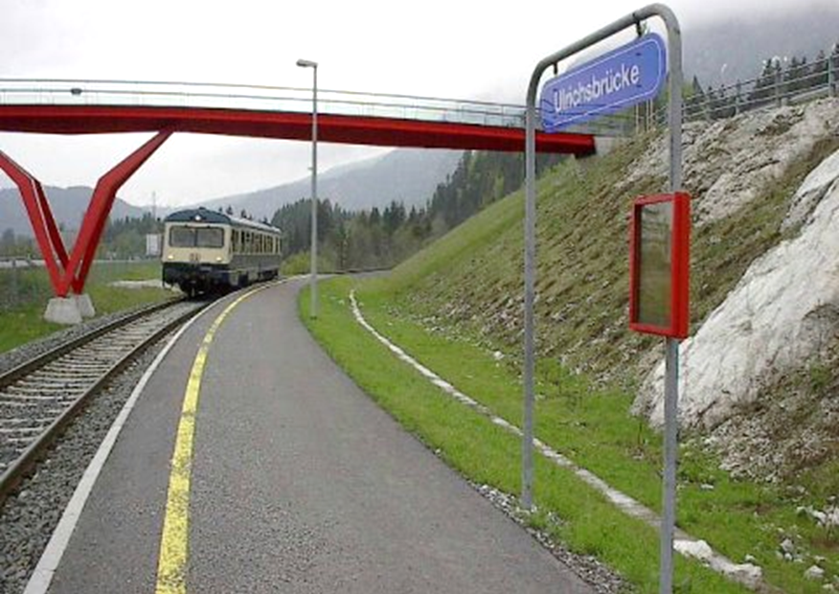
Background: international trains (Ulrichsbrücke/Füssen, AT)

Slide 6
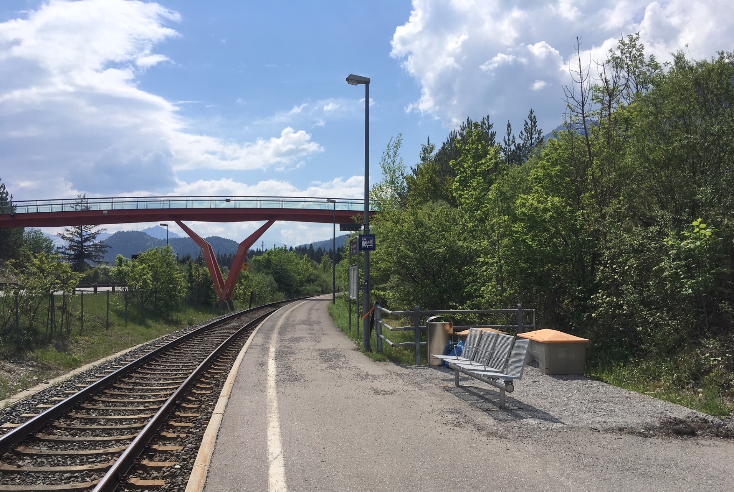
Background: international trains (Ulrichsbrücke/Füssen, AT)

Slide 7
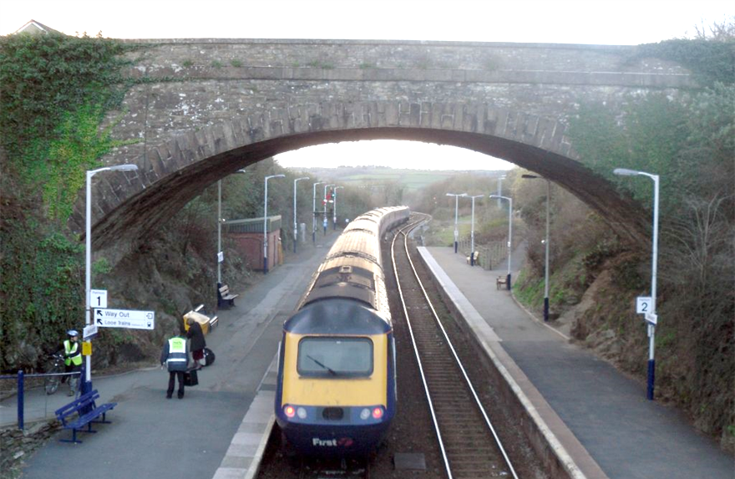
Background: high speed trains (Liskeard, UK)

Slide 8
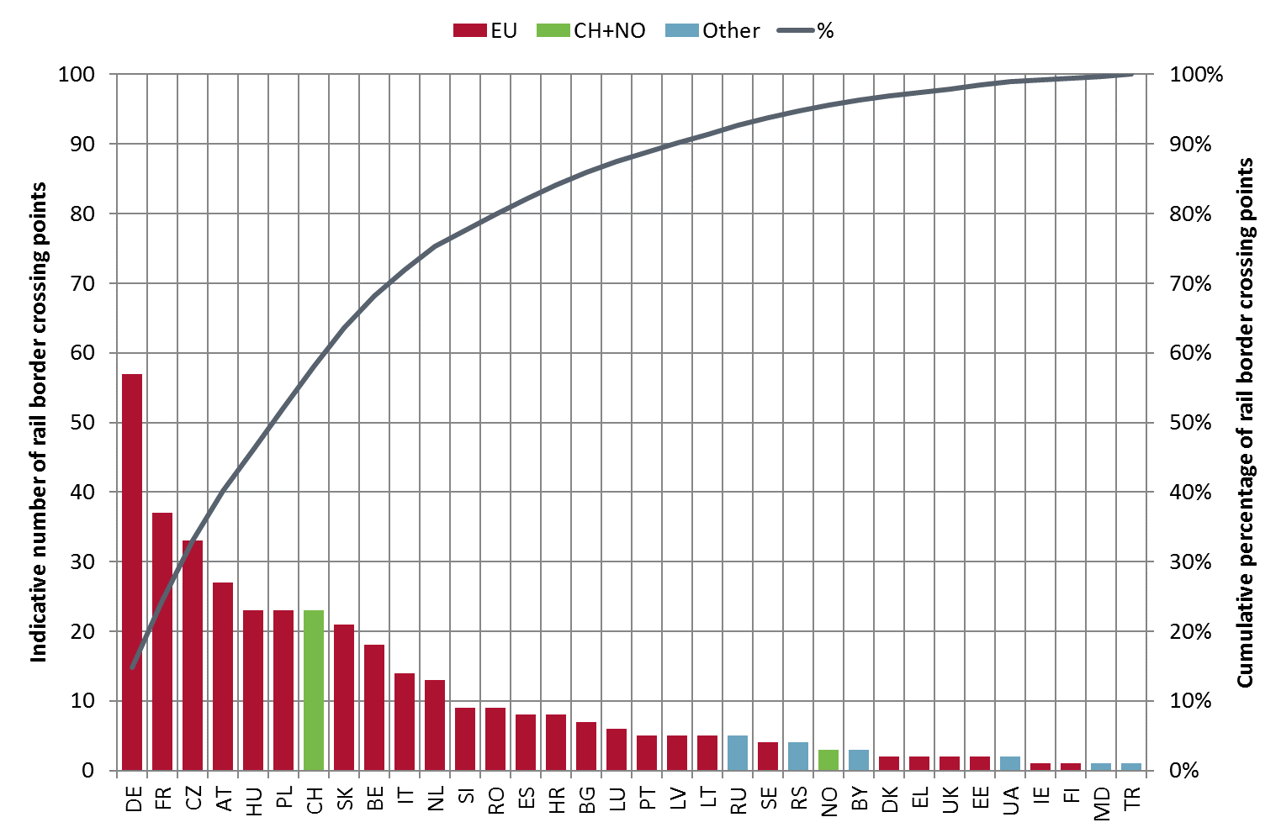
Background: rail border crossing points by State
Each crossing point is in scope, but many carry few trains

Slide 9
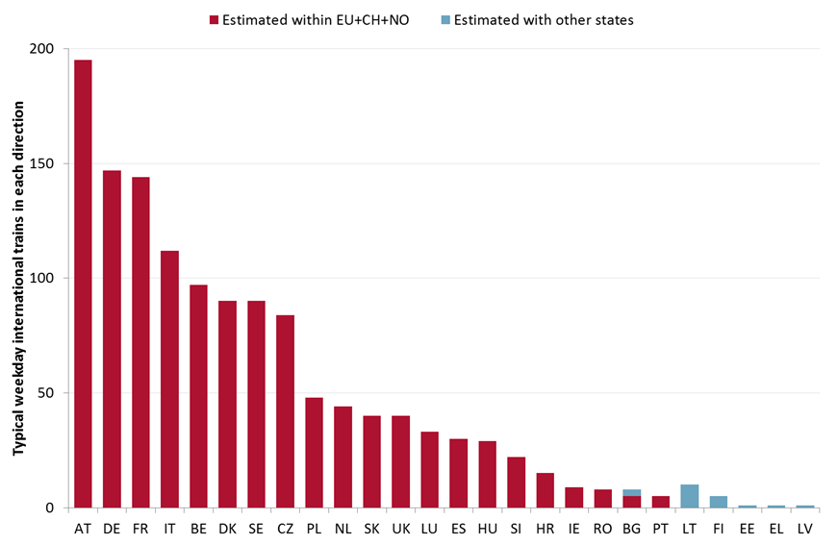
Background: services per day into and out of each State
Each international service is in scope, but many carry few passengers

Slide 10
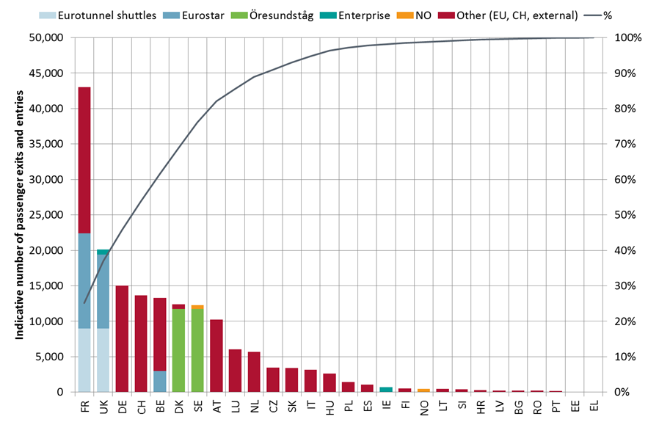
Background: passengers per day into and out of each State
Channel Tunnel
Eurotunnel vehicle shuttles
Eurostar high speed trains
Subject to special security
Öresund
Predominantly regional/suburban
Has had additional identity checks

Slide 11
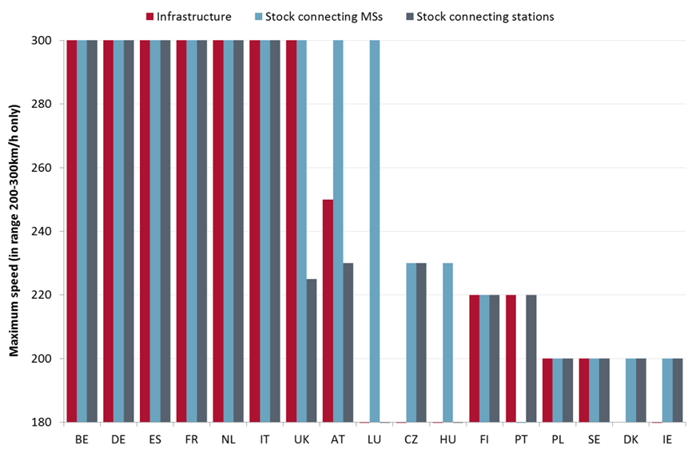
Background: high-speed activity in each State
Only six Member States have domestic connections by stock operating at 300 km/h
300 km/h stock also operates into Austria and Luxembourg

Slide 12
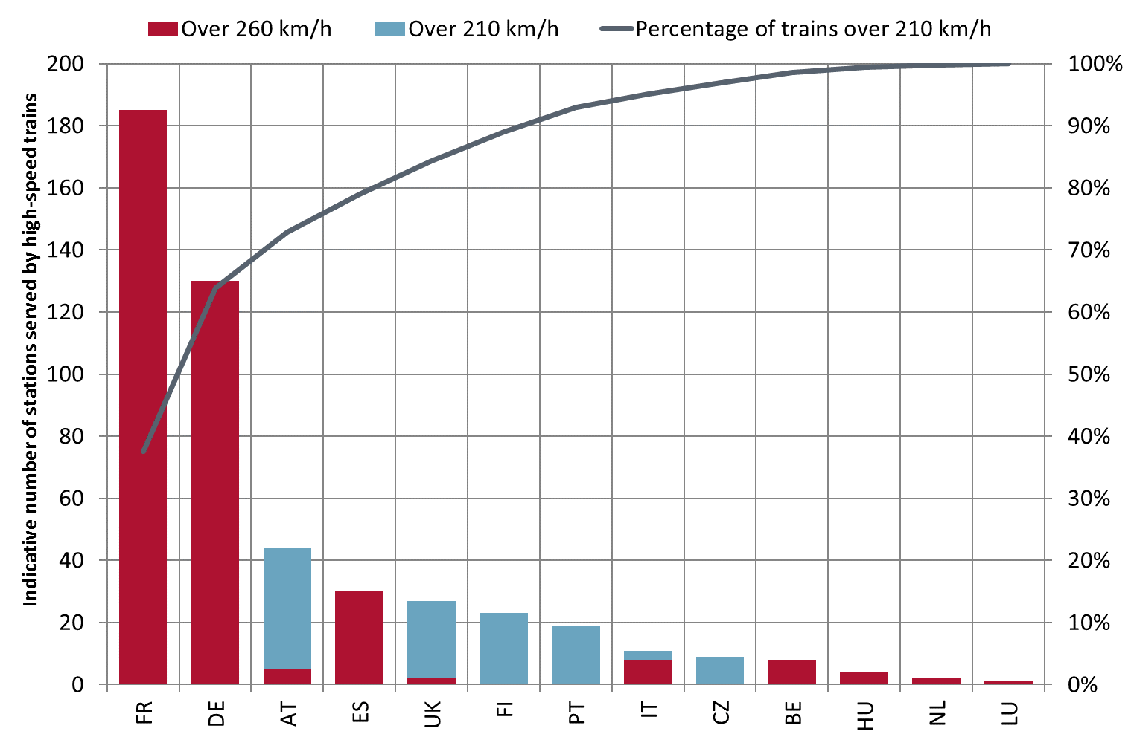
Background: stations served by high-speed trains
Two-thirds of stations served by trains capable of over 210 km/h are in France or Germany

Slide 13
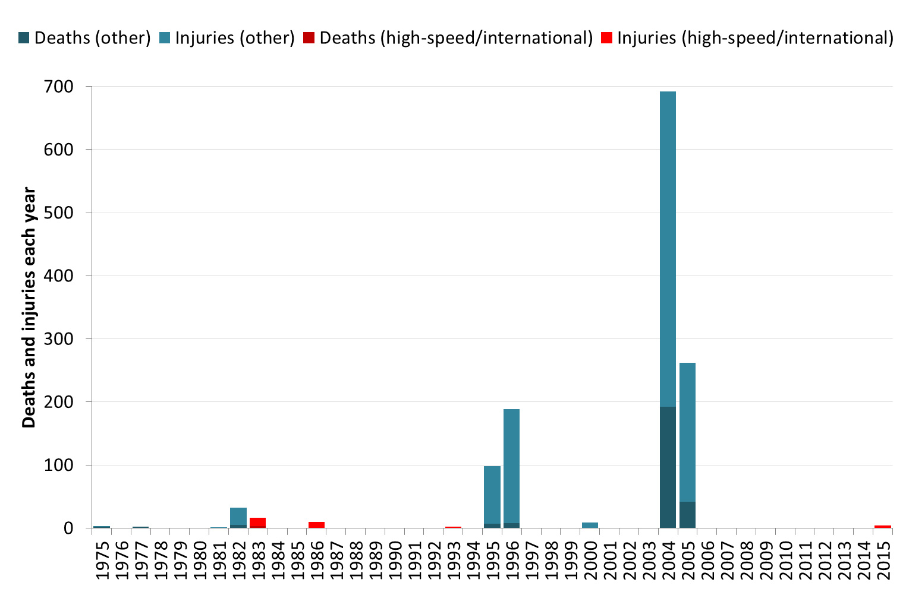
Terrorism is rare: and focused on metros and suburban lines
(RAND Database of Worldwide Terrorism Incidents)
2004
Madrid Suburban
2005
London
Metro
1995
Paris
Suburban
1995
Paris
Suburban

Slide 14
Findings: the estimated annual scale of the problem
Security failure | Average cost, all rail services | Average cost, high speed and international | Potential scale of a single incident
Vandalism and graffiti | €280 million | €30 million
Metal and cable theft | €70 million | €7 million
Terrorism | €20 million | €0.2 million | Up to €500 million
Other violent crime | No estimates found, but may be very large
Other non-violent crime | No estimates found, but may be very large
Total identified | €370 million | €37.2 million
Annual passenger numbers | 9,200 million | 300 million
Identified cost per passenger | 4.0¢ | 12.4¢
Terrorism cost per passenger | 0.2¢ | 0.7¢

Slide 15
Findings: regulation, responsibility, research, coordination
Regulation:
  Very varied structural and regulatory frameworks for security
  Approaches to defining security requirements range from prescriptive to output-based
  Some security policies had been developed specifically by rail sector actors
Responsibility:
  Most Member States have systems (external to rail) to categorise level of threat
  Often hard to identify a party with primary responsibility for security in rail
Research: little awareness of research specific to, or for, the railway sector
Coordination: International cooperation in different ways:
  A Railway Undertaking operating international services coordinates with two or more Infrastructure Managers, who may also cooperate with each other to support it
  Multilateral or European fora such as CER, COLPOFER, CORPORAL FARE, EIM, LANDSEC, RAILPOL, UIC and UNECE

Slide 16
Formal problem definition
High-speed and international rail services across the EU are subject to an unacceptable threat of attack and the associated railway infrastructure and rolling stock assets are subject to an unacceptably high risk of loss or damage
This has a number of adverse consequences, including risk to the security of passengers leading to the potential for diversion to other modes and a reduction in cross-border travel
This is linked to:
  Insufficient understanding of the security threat
  Inadequate response to the threat to the EU rail network as a whole and weak incentives to address ill-defined and poorly understood threats
  Different approaches to the mitigation of risks in different Member States due to inconsistent methodologies for assessing risks and due to cultural differences
  Fragmentation/gaps in arrangements/responsibilities at national/EU level

Slide 17
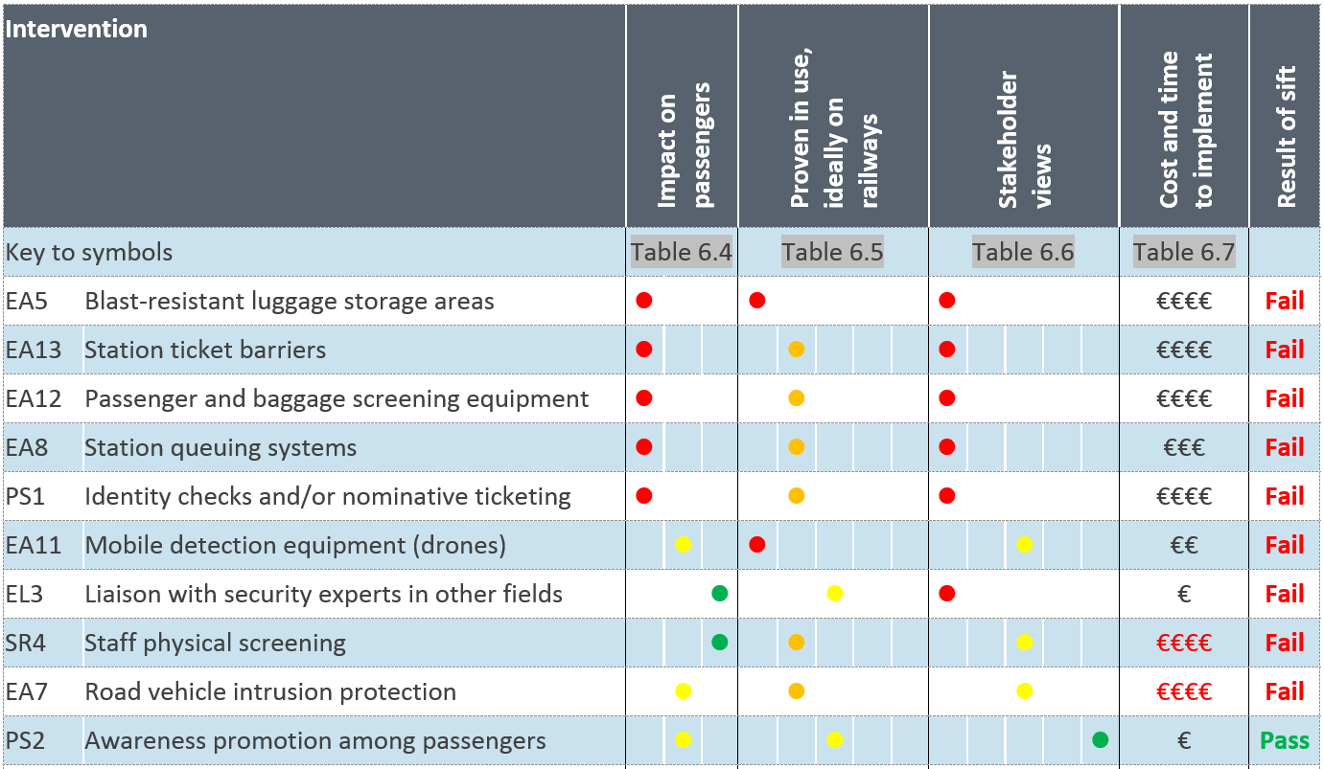
Policy measures sift: nine measures rejected on the basis of impact on passengers, lack of proven use, stakeholder concerns or indicative costs …

Slide 18
Rejected measure: station ticket barriers are inconvenient to passengers, would be expensive, and can create artificial crowds

Slide 19
Retained measures
Threat level protocols | Training in incident response | Recording of vulnerabilities in asset register
Contingency plans | Vetting of staff | Static detection equipment
Drills and exercises | Staff deployment | Resistant radio systems
Post-incident recovery | Resistance to blast | Contingency IT/communications systems
Partnerships with third parties | Minimisation of unseen areas | Awareness promotion among passengers
Partnerships with emergency services | Facilitated emergency egress | Targeted storage of contingency resources
Training in risk and behaviour monitoring | Duplicated access routes and walkways | Inspection regimes

Slide 20
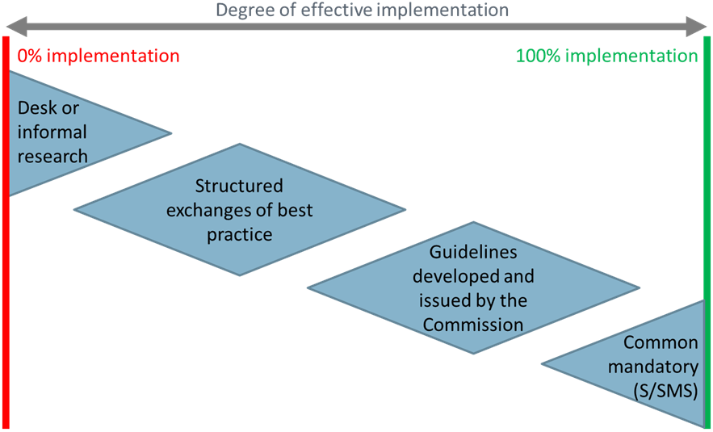
Approaches to implementation

Slide 21
Policy options developed to meet objectives: 1 “Minimal”
 | Mandatory/Guidelines
Reporting and monitoring national security data | M
CCTV on stations, with recording and facial recognition
CCTV on trains, with recording and facial recognition
S/SMS threat level protocols | G
Emergency egress and access to stations

Slide 22
Policy options developed to meet objectives: 2 “Intermediate”
Based on 1 “Minimal” but also add … | Mandatory/Guidelines
S/SMS ensure exchange of information by relevant parties | M
S/SMS contingency planning and incident recovery
S/SMS liaison, incident response, drills and exercises | G
Deploying staff where they can observe
Staff vetting and access controls

Slide 23
Policy options developed to meet objectives: 3 “Comprehensive”
Based on 2 “Intermediate” but also add … | Mandatory/Guidelines
S/SMS recording of vulnerabilities and inspection regimes | M
Researching and disseminating worldwide security data | G
S/SMS contingency IT, communications and spares
Blast-resistant features on stations
Blast-resistant features on trains
Training station/train staff in risk and behaviour monitoring
Awareness promotion among passengers

Slide 24
December 2016 recommendations (text has been abbreviated)
Reporting and monitoring | The Commission establishes a Union-wide framework for reporting and monitoring data on the security of high speed and international services.
Design of trains and stations for added security | The Commission, international and national bodies, prepare guidance on: design of station access and egress, to improve security at stations used by high speed and international services; and standards for blast-resistance on trains and at stations.
Risk assessment and contingency planning | Member States be required to ensure that bodies involved in the operation of high speed and international rail services introduce SMSs including: protocols for the exchange of information between relevant agencies responsible for the security of such services; the recording of vulnerabilities on trains, at stations and elsewhere on railway networks; and documented contingency planning and incident recovery processes.
Monitoring and awareness of security risks | The Commission, in collaboration with relevant bodies, prepares common mandatory standards for CCTV on trains and stations: as a minimum, covering requirements for recording capability; and optionally, for facial recognition and real time monitoring. Member States should be required to identify responsibilities for undertaking CCTV monitoring activity.

Slide 25
Questions
Dick.Dunmore@sdgworld.net

