Slide 1
Transmitted by the Secretary of TF-CS/OTA
Status report on the activities of TF-CS/OTA
UNECE - Joint meeting of WP.1 and WP.29/GRRF 20 September 2017,UN Palais des Nations, Geneva

Slide 2
Status report on the activities of TF-CS/OTA
Overview on Task Force – Cyber Security and Software updates (incl. over-the-air issues)
Start of activity: 21 December 2016 Co-Chair: Mr. Darren Handley (UK/DfT)
Mr. Tetsuya Niikuni (Japan/NTSEL)
Secretary: Mr. Jens Schenkenberger(OICA/Hyundai)
Participants: Contracting Parties (AU, BE, CN, EC, EG*, FR, DE, JP, KR, NL, NO, RU*, ES, SE, CH, UK, US), NGO (ITU, FIA, CITA, IRU, ISO, SAE, OICA, CLEPA)
Participation: Type approval and cyber security experts approx. 30 people per meeting
Mandate: until Dec. 2017
^{* No active participation yet}

Slide 3
Status report on the activities of TF-CS/OTA
Scope of TF-CS/OTA
Data protection
Cyber Security
Software updates
Legal aspects
Security aspects
Security aspects
Type approval aspects
Safety aspects
pre- registration
post- registration
out of scope
Threat analysis
Table of threats
Develop flow diagram
Develop
recommendation for safe execution
Define mitigation principles
Define approval method
Develop guidance/recommendation for ITS/AD

Slide 4
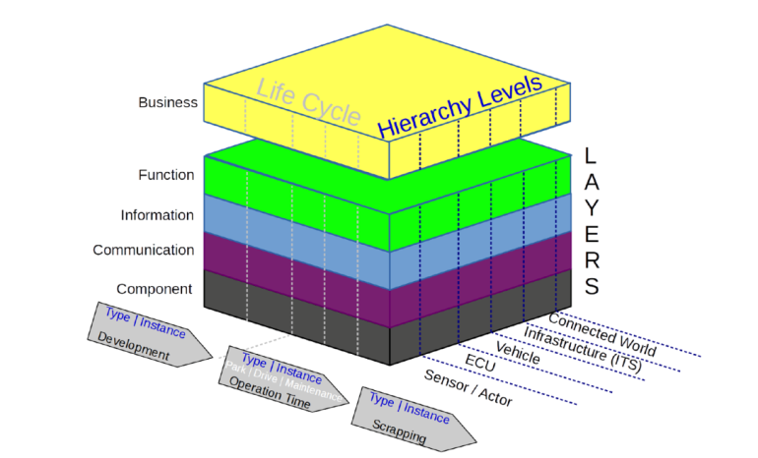
Status report on the activities of TF-CS/OTA
Cyber security:
The reference model shall be:
- the vehicle including:
its hardware
its software
data held on the vehicle
its internal communications
its interfaces with external communication systems/ functions (e.g. V2X and emergency comms) and devices (e.g. USB, CD etc)
vehicle functions/systems that use wireless communications (e.g. TPMS, keyless entry)
- support servers which directly communicate with the vehicle - diagnostic / maintenance systems Furthermore, it shall incorporate the information flow and the vehicle lifecycle.
German “Reference Architecture Model Automotive”

Slide 5
Status report on the activities of TF-CS/OTA
Cyber security (continued):
The group has identified key risks and threats, resulting in a table of threats. It includes threats associated with cyber security, data protection and software updates (incl. over-the-air issues)
The group agreed to consider “pre attack” (prevention), “during attack” (detection) and “post attack” (response)
Reference documents identified for mitigations are :
ENISA report „Cyber Security and Resilience of Smart Cars” TFCS-03-09
UK DfT Cyber Security principles TFCS-03-07
NHTSA Cyber Security Guideline TFCS-03-08
IPA “Approaches for Vehicle Information Security” (Japan) TFCS-04-05
UNECE Cyber security guideline (ITS/AD) WP.29/2017/46
SAE J 3061
ISO 19790
ISO 26262
US Auto ISAC (report by Booz Allen Hamilton) https://www.automotiveisac.com/best-practices

Slide 6
Status report on the activities of TF-CS/OTA
Cyber security (continued):
Mitigations for the threats identified had been developed, based on an extended CIA approach (CIA = Confidentiality, Integrity, Availability) leading to 18 mitigations
During the development of the mitigations the references, especially the ITS/AD cyber security guideline principles, the UK DfT principles for cyber security had been considered
The detailed outcome of the threat analysis, including the identified mitigations and correlating principles are comprised in a spread sheet (see document TFCS-08-03) Note: This document will be finally confirmed by the group at the 8th session of TF-CS/OTA
The Consolidated Resolution (R.E. 3), already incorporating the ITS/AD guideline on Cyber Security for Connected and Automated , was identified by the group as a suitable document to incorporate the outcome on cyber security. Recommendations will be given accordingly.

Slide 7
Status report on the activities of TF-CS/OTA
Software updates:
The group agreed that systems with „deep learning/self learning“ is currently out of scope
The group is considering both pre- and post-registration updates, as well as safety aspects of software updates
It was acknowledged by the group that post-registration updates are dealt with nationally. Therefore any output relating to this issue will be as guidance to support national processes.

Slide 8
Status report on the activities of TF-CS/OTA
Software updates (continued):
- The group defined a matrix for necessary actions depending on the timing of a software update and its impact on an approval
moment of update | no impact | limited impact | severe impact
Initial type approval (TA) | not applicable | not applicable | not applicable
Existing TA, before Certificate of Conformity (CoC) | no action | extension TA | new TA
Existing TA, after CoC, before registration | no action | extension TA and new CoC | new TA and new CoC
Existing TA, after registration, by OEM | no action | extension TA or individual approval or approval with limited scope. Registration according to national rules | new TA or individual approval or approval with limited scope. Registration according to national rules
Existing TA, after registration, not by OEM | (multi stage) new National approval. Registration according to national rules | (multi stage) new National approval. Registration according to national rules | (multi stage) new National approval. Registration according to national rules

Slide 9
Status report on the activities of TF-CS/OTA
Software updates (continued):
The introduction of a Regulation-linked Software Identification Number (=> RxSWIN) was agreed by the group.
Currently different views on introducing the number: in each relevant Regulation vs. introducing a standalone “Software Regulation”
The SWIN concept should support following use cases: Type approval, Periodical Technical Inspection (PTI), Roadside inspection, Market surveillance and Accident investigation
Principle: Cover the type approval relevant software versions of all impacted ECUs by one Type Approval Number for each system type approval.

Slide 10
Status report on the activities of TF-CS/OTA
Timeline: TF-CS/OTA is well „on track“ to deliver guidance papers/ recommendations on the cyber security and software updates as planned for IWG ITS/AD in March 2018. However, the group may whish to extend the mandate by six month in order to finalize its work in January 2018 an to be in existance when presenting the outcome to WP.29 IWG ITS/AD.
End of original mandate
End of potentially extended mandate
Ad hoc „SWU2“
TFCS-08 Tokyo
TFCS-09 Paris
ITS/ADGeneva
Ad hoc „Recom“
TFCS-10 UK or D
ITS/ADGeneva
27 Sep. 2017
11-12 Oct. 2017
09-10 Nov. 2017
Nov
2017
Dec. 2017
16-17 Jan. 2018
March 2018
Dec. 2017
Jun. 2018
Commonize position on S/W Updates
Adopt CS/M table; Agree format for recommendations
Agree status report for ITS/AD
Status report
Finalize and adopt recommendation papers
Presentation of recommendation papers

