Slide 1
Informal document GRB-66-22
(66th GRB, 4-6 September 2017,
agenda item 6)
Transmitted by the expert from OICA
P R E S E N T A T I O N O F
INTERNATIONAL ORGANIZATION OF MOTOR VEHICLE MANUFACTURERS
Tyre Sound Limits
Trade Off
GRB 66
September 2017 Geneva

Slide 2
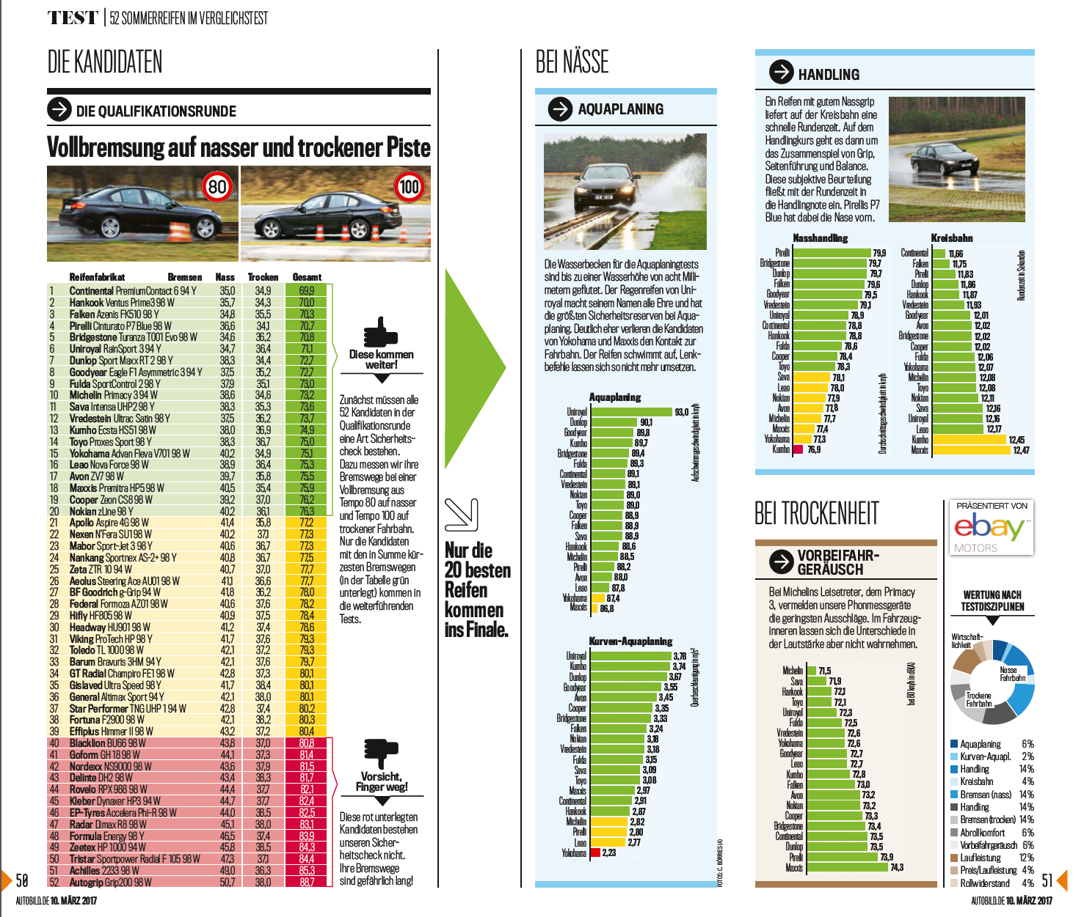
Autobild
Study on Summertyres
Size 225/50 – R17
Qualification on
52 different tyres of which 20 have been selected for a detailed analysis

Slide 3
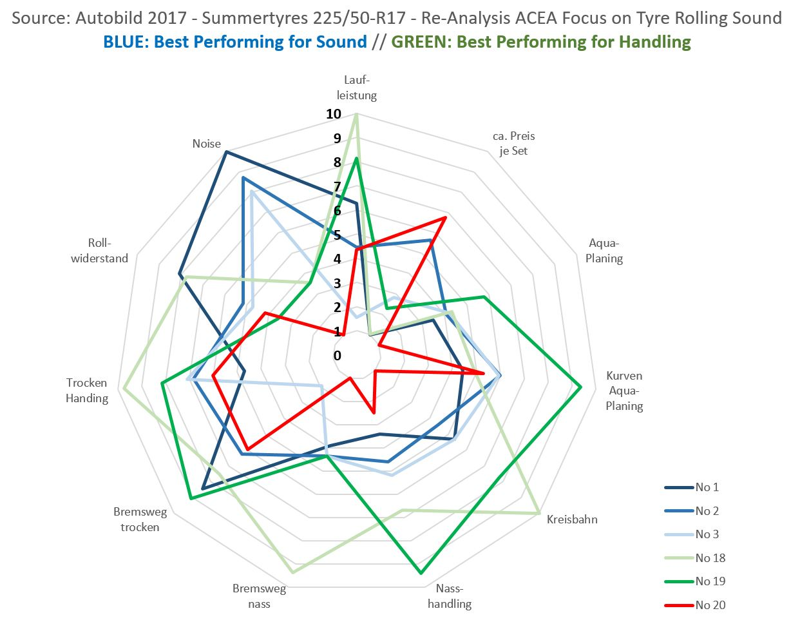
Among 20 Tyres Sets that have been measured, there was no tyre, that was performing equally good in Rolling Sound AND Handling

Slide 4
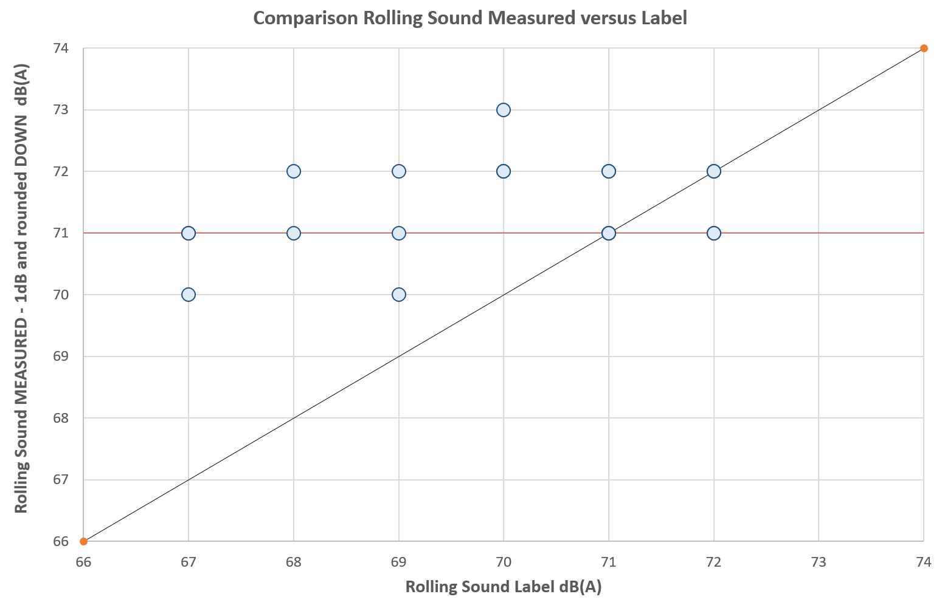
The label includes the uncertainty of the test track variation.
Source: Autobild 2017

