Slide 1


Informal document GRSP59-21
(59th GRSP May 9-13, 2016,
Agenda item 22(a))
Submitted by the expert from Japan
Pedestrian Safety Research
in Japan
59th GRSP
9th-13th May 2016
MLIT / NTSEL

Slide 2

Macro Traffic Accident Study
Traffic accident fatalities by mode
Effects of the pedestrian safety standard
Accident data
Macro accident data for 2013
Fatal accidents
Accident data
Macro accident data from 2012 to 2013
Fatal pedestrian accidents
M1 category vehicles
Compliant/non-compliant with the pedestrian safety standard
Vehicle
Motorcycle
36.2%
32.4%
Small motorcycle
1,584
1,415
3.5%
Bicycle
3.0%
Fatality rate
Pedestrian
10.6%
2.5%
13.7%
6.7%
465
2.0%
Others
600
295
1.5%
(From a document published by the National Police Agency in 2013)
1.0%
4,373 persons in 2013
0.5%
0.0%
Non-compliant
Compliant
*From a document of the 3rd vehicle safety meeting for FY2014 conducted by MLIT
Pedestrians accounted for the largest proportion of traffic accident fatalities.
Pedestrian safety standard is effective in reducing the fatalities by traffic accidents .

Slide 3
Macro Traffic Accident Study
Travel speed of the vehicle
Accident data
Macro accident data for 2008-2012
Pedestrian fatal accidents
Passenger cars (mini vehicles, sedans, mini vans) compliant with the pedestrian safety standard
Most injured
body region
42% of pedestrian fatal accidents occurred at 40 km/h or below.
Of the fatal accidents that occurred at under 40km/h , 51% accounted for the cases that the head/face were the most injured body regions.
In 55% of the above said fatal accidents, the head/face were hit by vehicle externals.
What struck head/face
There is a potential to reduce pedestrian fatalities by further improving vehicles’ pedestrian safety.

Slide 4
Micro Traffic Accident Study
Outside of the test area in R127
Accident data
Micro accident data from 1993 to 2012
Pedestrian accidents with AIS2+ head injury
Passenger cars and trucks with bonnet
Accidents excluding children aged 10 or younger /below 140 cm in height
Adult headform test area in R127
Child headform test area in R127
Striking area | No. of cases | Proportion
Hood | 15 | 21 %
A-pillar periphery | 23 | 32 %
Lower wind shield glass frame periphery | 24 | 34 %
Upper wind shield glass frame periphery | 2 | 6 %
Wind shield glass | 6 | 9 %
Fender | 1 | 1 %
Total | 71 | 100 %
O：Striking area of the vehicle in accidents with AIS2+ head injury in the micro accident survey
*From a report on results of detailed traffic accident research and analysis through medicine-engineering collaboration for vehicle safety in 2013 conducted by MLIT
Lower wind shield glass frame and A-pillar peripheries are the major areas that struck head in pedestrian accidents with AIS 2+ head injury.
-> Many were outside of the test areas in pedestrian safety standard.

Slide 5
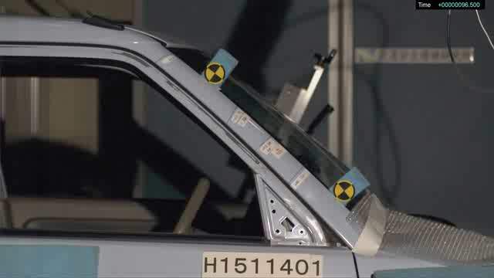
Pedestrian Head Protection Tests
We conducted the pedestrian head protection tests in which the impactor was hit at the center of the A-pillar (worst-case condition).
We conducted the tests according to the R127 specifications except for the test area.
The tested vehicle was compliant with the pedestrian safety standard.
Several tests were conducted with the same vehicle (results from the second , third, and all subsequent trials might have been affected by the preceding tests).

Slide 6
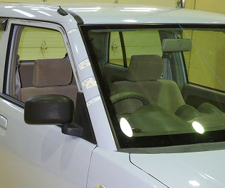
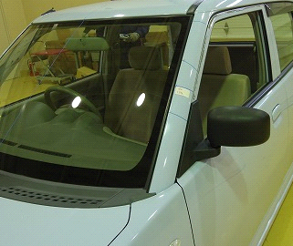
Test Results
HIC
9000
8000
A-pillar upper
7000
6000
A-pillar center
5000
4000
3000
A-pillar lower
2000
1000
0
Center right
Upper right
Lower right
Center left
Upper left
Lower left
9000
8000
7000
6000
5000
4000
3000
2000
1000
0
Test
1
Test
2
Test
3
Test
4
Test
5
Test
6
Test
7
Test
8
HIC was above the threshold in all A-pillar tests
In J-NCAP test result of the same vehicle, HIC was below the threshold in all test areas.

Slide 7
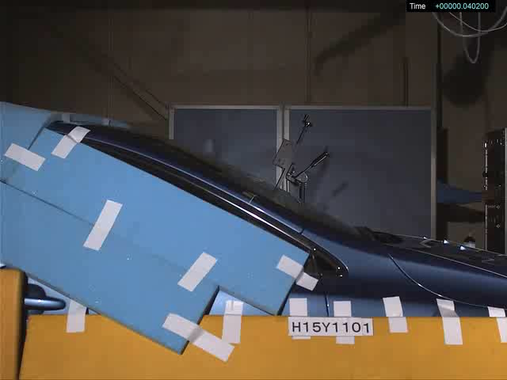
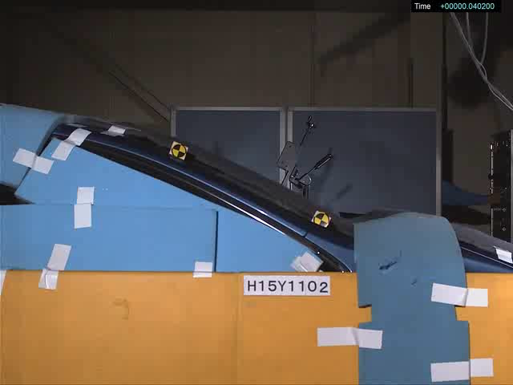
Pedestrian Head Protection Tests
We conducted the pedestrian head protection tests in which the impactor was hit at the center of the A-pillar (worst-case condition).
We conducted the tests according to the R127 specifications except for the test area.
The vehicle was equipped with a pedestrian airbag.
Tests were conducted with/without the airbag.
The pedestrian airbag was forcibly deployed at the timing when its performance was sufficient.

Slide 8
Effects of Pedestrian Airbag
With pedestrian airbag
Without pedestrian airbag
HIC 15
9000
8000
7000
Pedestrian protection standard threshold
6000
5000
4000
3000
2000
1000
0
With airbag
Without airbag
With the pedestrian airbag, HIC was far below the threshold.
Without the airbag, HIC was far above the threshold.
->The pedestrian airbag is effective in protecting the pedestrian’s head in a collision, potentially reducing the number of fatal pedestrian accidents.

Slide 9
Summary
In recent fatal traffic accidents in Japan, pedestrians account for the largest proportion.
According to the macro accident study from 2012 to 2013 in Japan, fatality rate of pedestrian accidents with vehicles compliant with the pedestrian safety standard was lower than that with non-compliant vehicles.
According to the macro accident study from 2008 to 2012 in Japan , among pedestrian accidents involving passenger cars such as sedans, minivans, and mini vehicles compliant with the pedestrian safety standard, 42% of pedestrian fatal accidents occurred at 40 km/h or below. Of the fatal accidents that occurred at under 40km/h , 51% accounted for the cases that the head/face were the most injured body regions. In 55% of the above said fatal accidents, the head/face were hit by vehicle externals.

Slide 10
Summary
According to the micro accident study from 1993 to 2012 in Japan, in the traffic accidents between an adult pedestrian and a vehicle with bonnet resulting in AIS2+ head injury, 66% were cases in which the pedestrian’s head was impacted by the A-pillar or the lower front wind shield glass frame peripheries, which were both outside of the test area in R127.
In the pedestrian head impact test cases using the one vehicle model compliant with the pedestrian safety standard, HIC of the tests impacted at the A-pillar was higher than those at the test area in R127.
In the pedestrian head impact test case using the one vehicle model equipped with a pedestrian airbag, the pedestrian airbag was effective in reducing the head injury when the head was impacted with the A-pillar.

