Slide 1
Informal document GRSG-110-19
(110th GRSG session, 26 – 29 April 2016 Agenda item 22.)
Submitted by the expert from Israel
The Issue

Slide 2
Transport for London Video
Why?
Truck/Bus blind spots are bigger than you think!

Slide 3
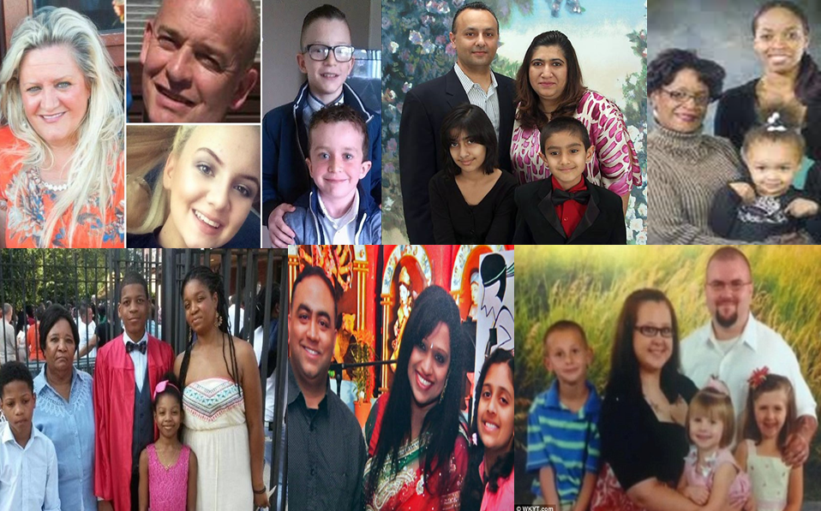
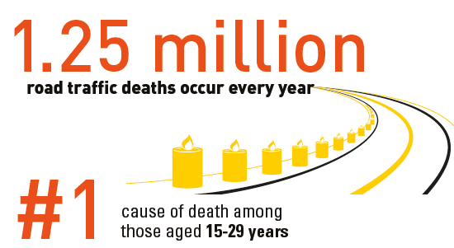
Fatalities

Slide 4
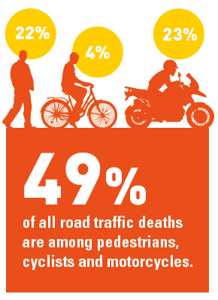
Vulnerable Road Users

Slide 5
Injuries
50 Million people incur nonfatal injuries each year from road traffic crashes.
92+ countries report policies to increase walking and cycling.
More attention must be given to VRUs.

Slide 6
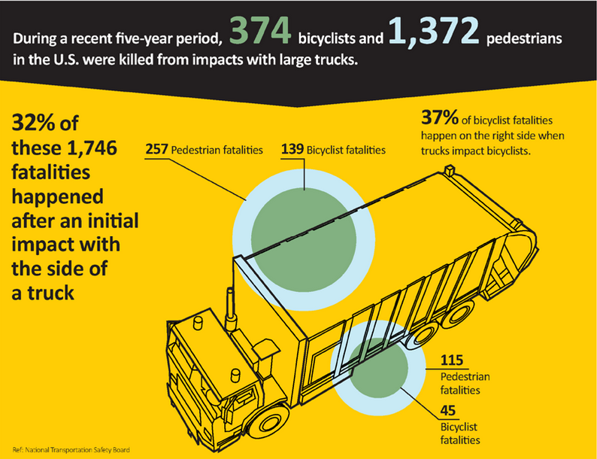
Blind Spots
Nearly 840,000 blind spot accidents occur each year in the United States resulting in 300 fatalities.

Slide 7
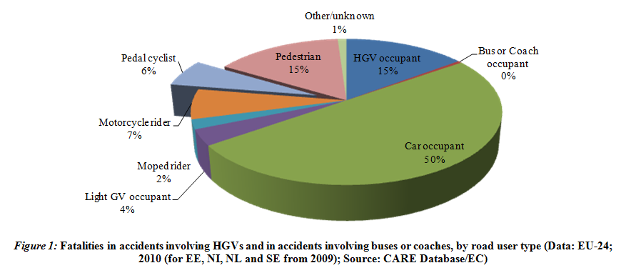
Blind Spots
- GRSG-109-19
30% of fatal accidents are between HGVs and VRUs which can be prevented by utilizing existing smart blind spot detection and advanced warning!

Slide 8
Market Conditions

Slide 9
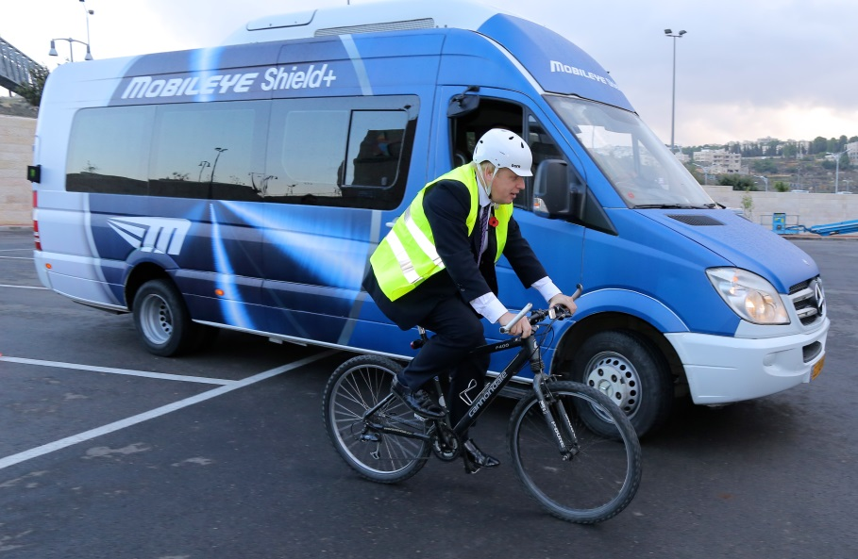
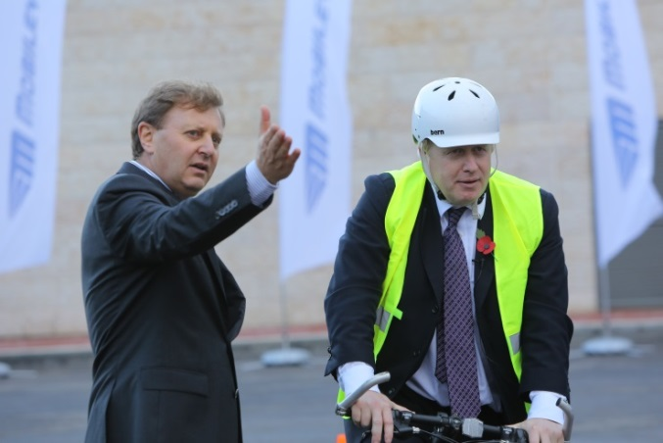
London: Safer Lorry Scheme
“HGVs are substantially overrepresented in cyclist and pedestrian accidents. Between 2008 and 2012, 53% of cyclist fatalities in London involved lorries, though they make up only around 4% of the traffic.”
-Andrew Gilligan,
London Cycling Commissioner
As of September 1st, 2015, all commercial vehicles over 3.5 tones must be fitted with minimum safety requirements

Slide 10
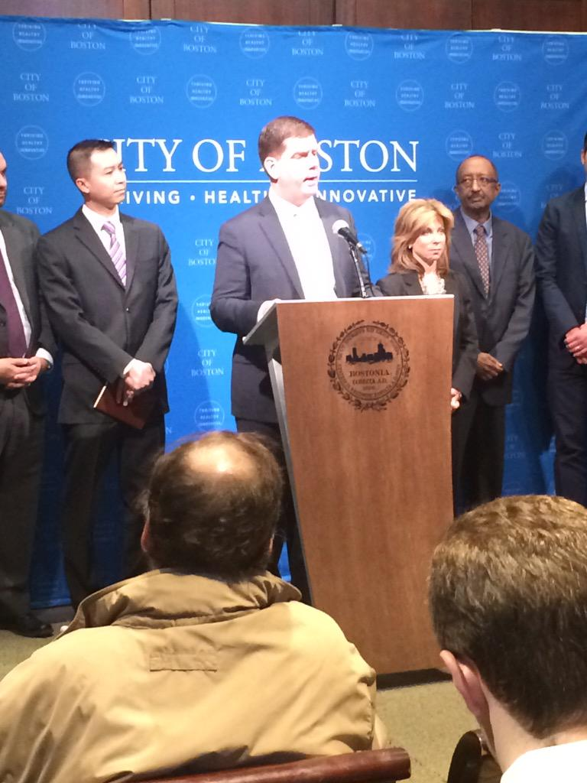
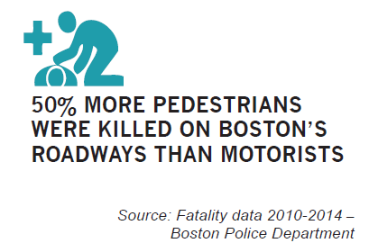
Boston
Understanding the danger of LGVs, Mayor Walsh signed ordinance requiring City agencies to contract only with vendors that meet minimum safety requirements.
- Boston Mayor Walsh Speaking at Vision Zero Event

Slide 11
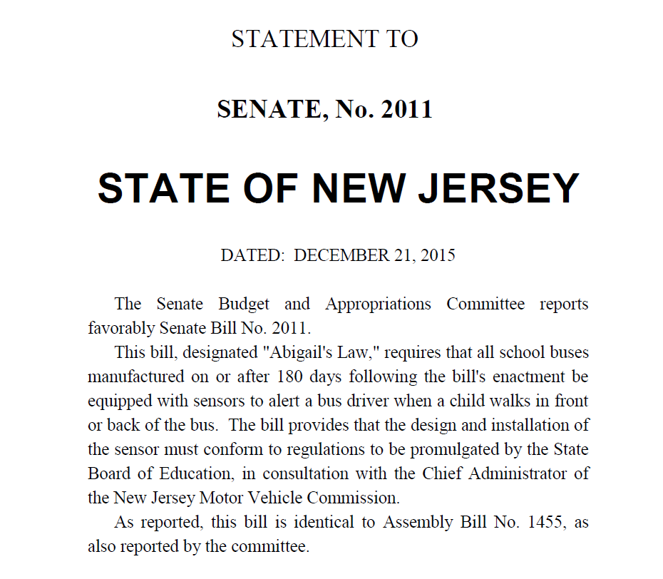
New Jersey: Abigail’s Law
Following the tragic death of 18 month-old Abigail Kuberiet, NJ requires safety sensors for school buses.

Slide 12
Mobileye Shield+
Notes:
This should be a better picture and say Shield+

Slide 13
Delivery of Warnings
Custom independent alert display for each side camera
Notes:
Discuss smart alerts with yellow-red, sound, vibration

Slide 14
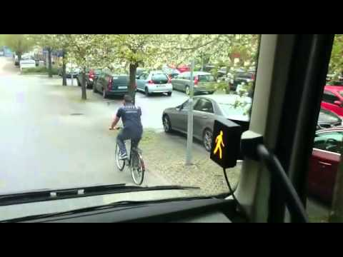
WSTIP
This proactive approach to retrofitting current bus fleets will allow transit agencies to improve safety and reduce losses in the near term, rather than waiting for collision avoidance equipment to become standard on new buses which could take 12 - 18 years based on the minimum expected life of a transit bus.
—Brian Viscusi, Senior Vice President, Alternative Markets, Munich Reinsurance America
The purpose of this safety pilot is to utilize innovative technology to prevent these collisions from occurring in the first place, thereby avoiding the devastating consequences these incidents can have on the injured parties and on the drivers.
—Jerry Spears, WSTIP

Slide 15
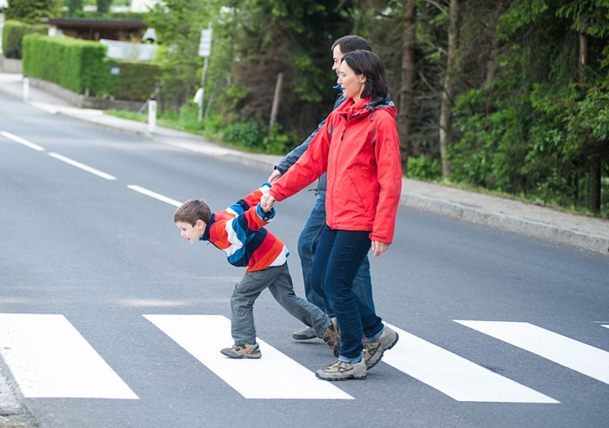
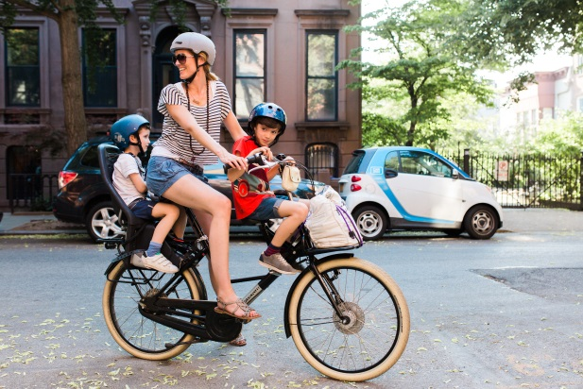
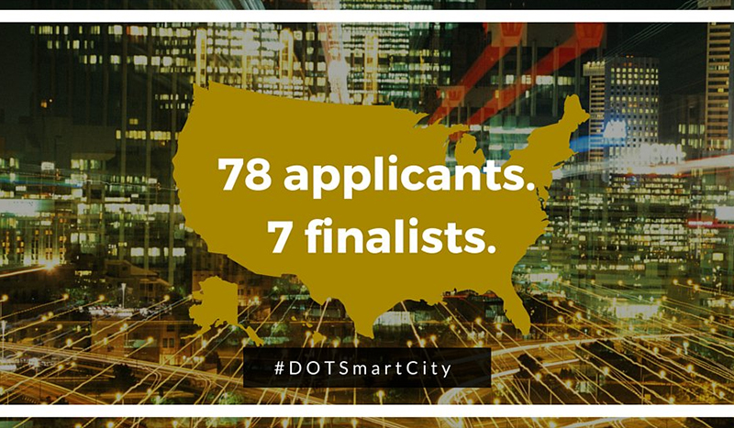
US DOT: Smart City Challenge
A Smart City is a Safe City for ALL road users
Large vehicles pose the largest threat to Vulnerable Road Users. A Smart City needs the best blind spot detection technology to prevent such crashes.

Slide 16
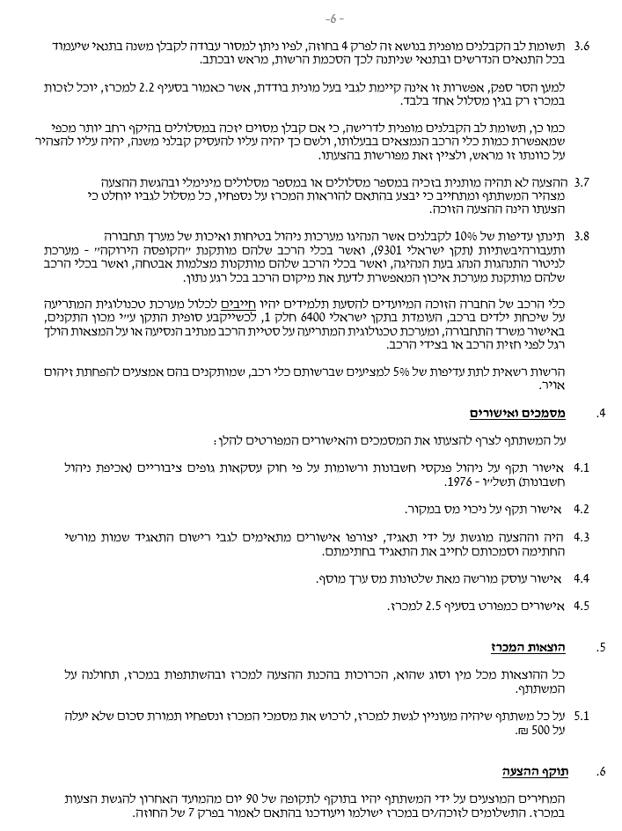
Israeli Education Ministry: School Bus Tender
-6-
3.8
10% priority will be given to contractors who have run land transport and traffic safety management and quality systems (SI 9301), and to those whose cars have installed a “green box” -
A system for monitoring the driver’s behavior when driving, and in whose vehicles are installed safety cameras, and in whose vehicles are installed positioning systems that enable outsider’s to track the vehicle’s location at any given minute.
The winning company’s vehicles intended to transport students must include a technological system that sounds an alert if children are left behind in the vehicle, which meets SI 6400 part 1, when a final device is determined by the SII with the approval of the Ministry of Transport. It must also include a technological system that sounds an alert on the deviation of a vehicle from the predetermined route, or when there is a pedestrian situated in front of, or alongside, the vehicle.
The Authority may give 5% priority to bidders who possess vehicles that have installed means of reducing pollution.
- CERTIFIED COPY -
- ORIGINAL COPY -

Slide 17
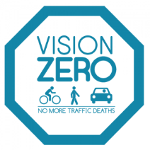
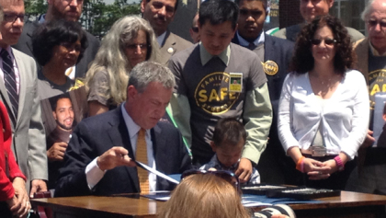
New York City
Both MTA and NYC owned HGVs are utilizing smart VRU blind spot detection and warning to reach their Vision Zero goals.
- NYC Mayor De Blasio Signs 11 ‘Vision Zero’ Bills Into Law

Slide 18
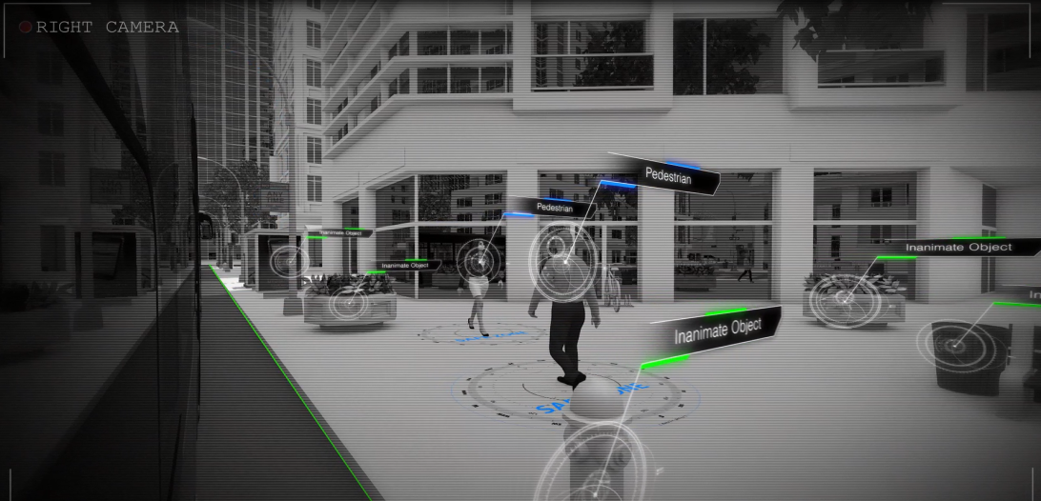
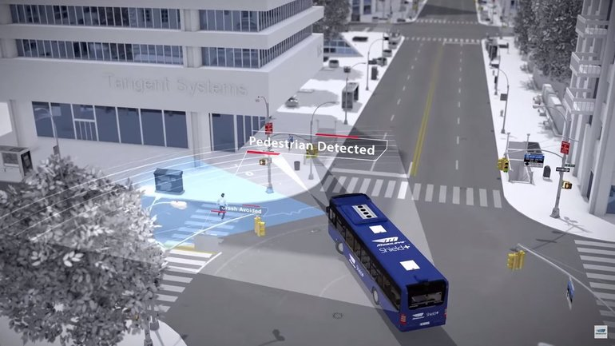
Blind Spot Detection and Warning
Artificial vision is the only technology which can identify ALL vulnerable road users (VRUs), and ignore inanimate objects and VRUs in safe zones. Providing a solution not only for the 6% of pedal cyclists fatalities involving HGVs, but the full 30% of VRU fatalities (6% pedal cyclists, 15% pedestrians, 7% motorcycle rider and 2% moped riders)

Slide 19
Proposed Legislation

Slide 20
Proposed Legislation
Vehicles over 3.5 tons should require a minimum of:
Collision avoidance technology on the front and sides of the vehicle.
VRU blind spot detection that can filter out inanimate objects
Directional warnings delivered to operator
Appropriate levels of warnings to the operator in a clear and intuitive manner
Increased intensity of warning as potential collision increases

