Slide 1
Strengthening Tyre Limits Informal doc GRB 62-11-Rev.1
Transmitted by the expert from the Netherlands
Informal document GRB-62-11-Rev.1/Add.1
(64th GRB, 5-7 September 2016,
agenda item 7)
Johan Sliggers
Ministry of Infrastructure and the Environment
The Netherlands
GRB 64, 5-7 September 2016

Slide 2
Statistics of tyre label values in relation to the limit values in EC/661/2009
Prepared for:
132nd Motor Vehicles Working Group meeting
agenda item 5, Brussels, 5 July 2016
Transmitted by the expert from the Netherlands
‒‒
Erik de Graaff
Client: Netherlands Ministry of Infrastructure and Environment

Slide 3
Question of the ministry
What is the actual tyre performance relative to:
the EC/661/2009 limits and
the EC/1222/2009 tyre label classes

Slide 4
Workplan
Collect statistical analysis of tyre label data
Data source: VACO database (Netherlands tyre branch organisation)
C1, C2 and C3 tyres; summer, winter and special
subset of top 7 brands and top 7 sizes
Pro:
Representing 90% of the tyres sold in the Netherlands
Good correlation with performance in the street
Good correlation with OEM tyres and premium tyre brands
Stable data set for multi year evaluation
Con:
B and C brands are not very well represented
This was thought acceptable as the current tyre limits apply earlier for “OEM” tyres compared to “all” tyres

Slide 5
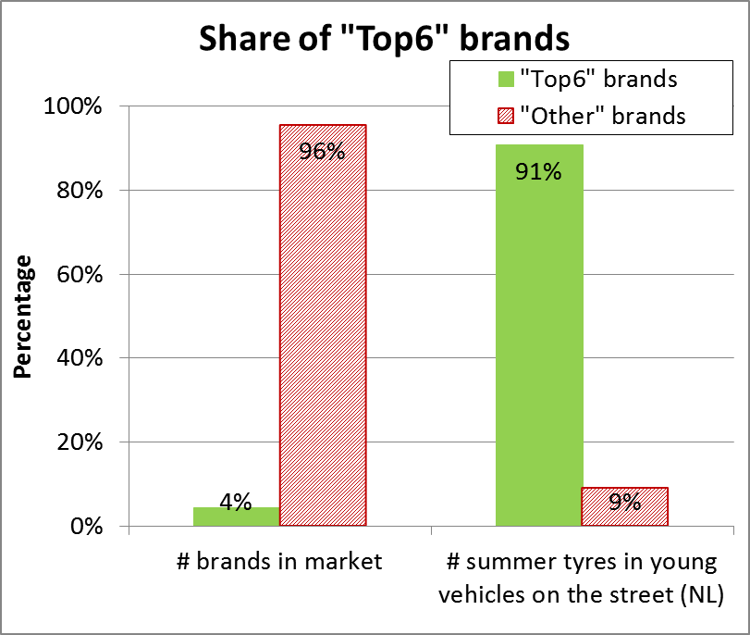
Note: Representativity of a top 6

Slide 6
Results
Trends
2007-2013 (Noise only)
2013-2016 (RR, WG and Noise)
Statistics 2016

Slide 7
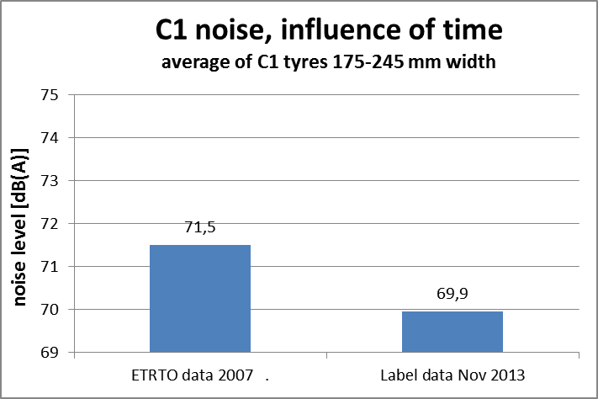
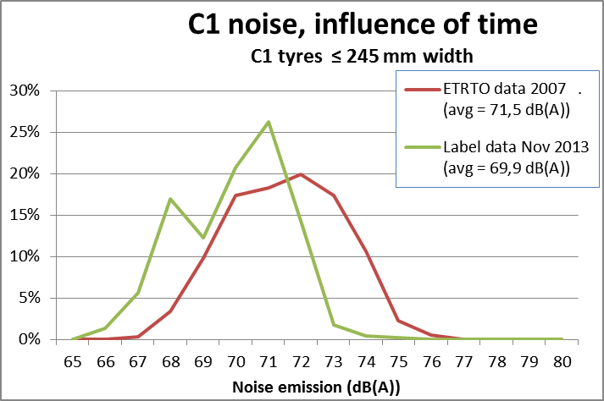
Noise of C1 tyres: 2007 vs. 2013

Slide 8
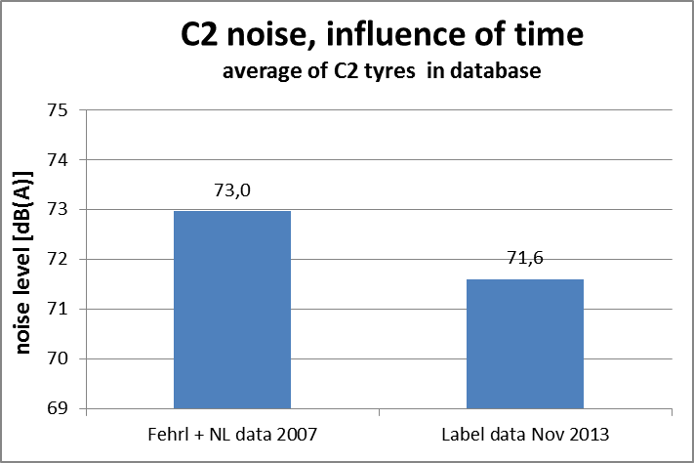
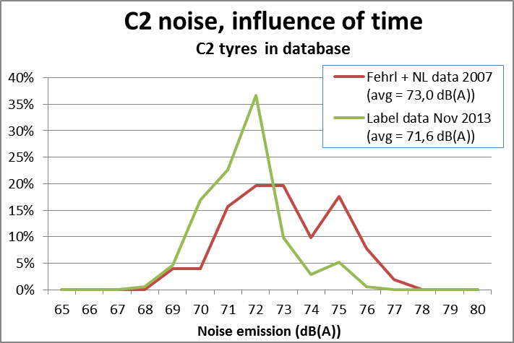
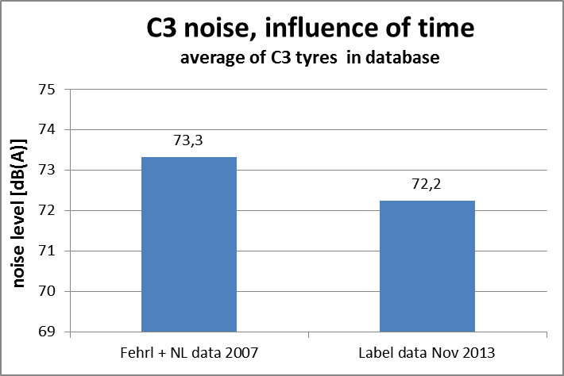
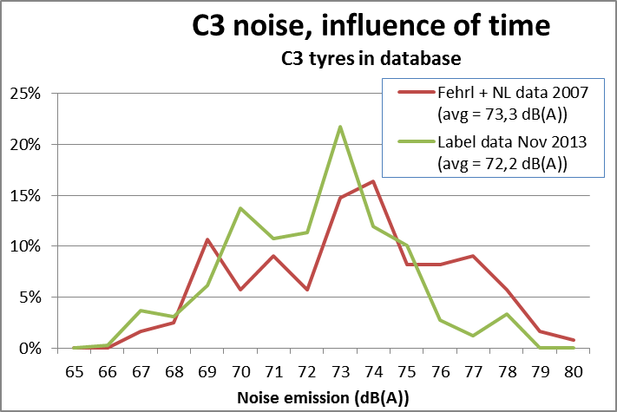
Noise of C2 and C3 tyres: 2007 vs. 2013

Slide 9
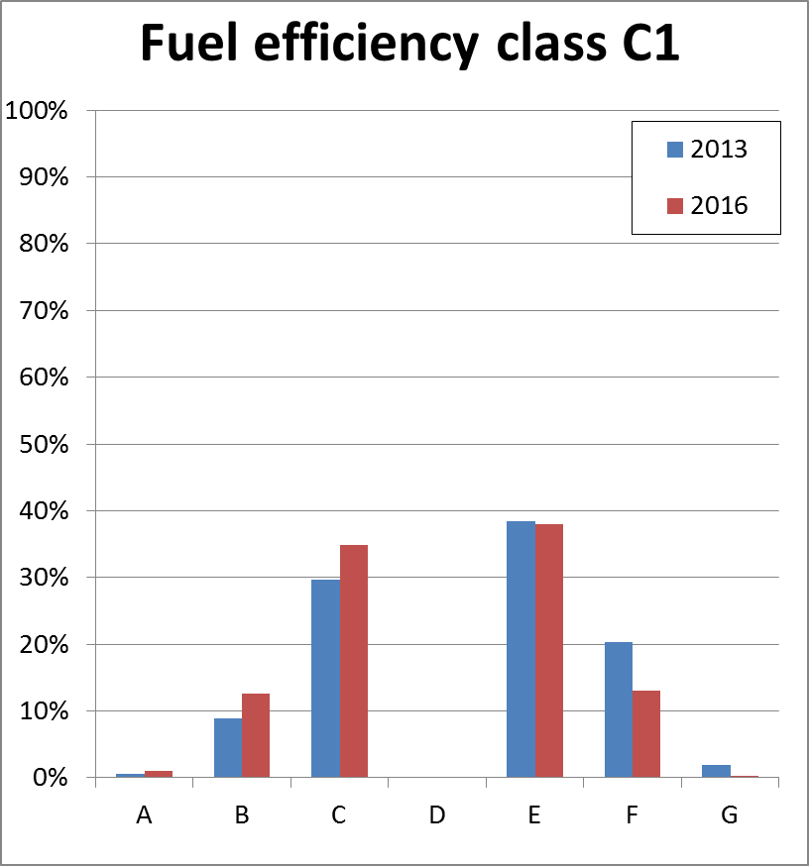
Trends 2013-2016
Shift towards better performance

Slide 10
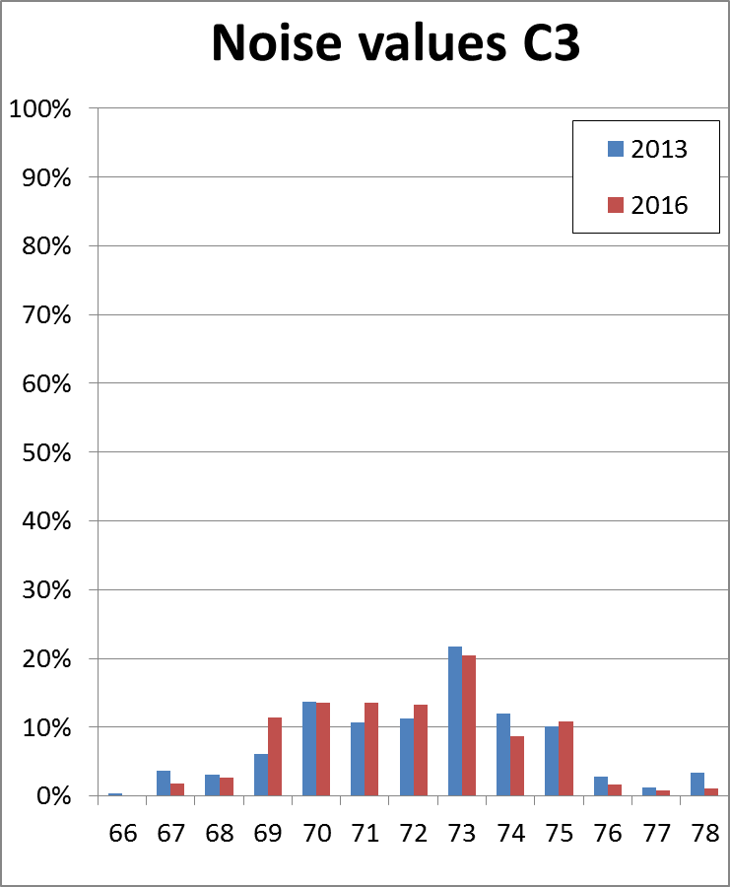
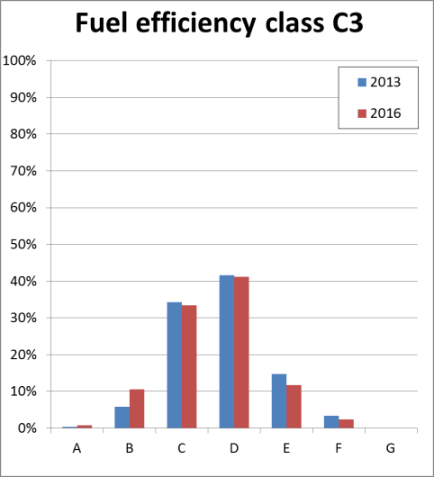
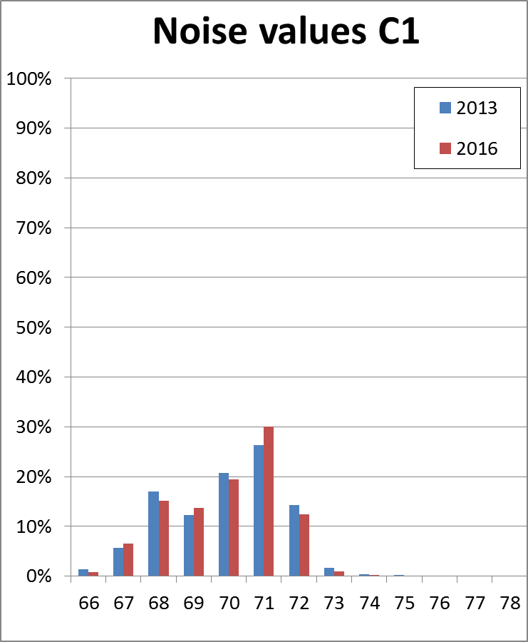
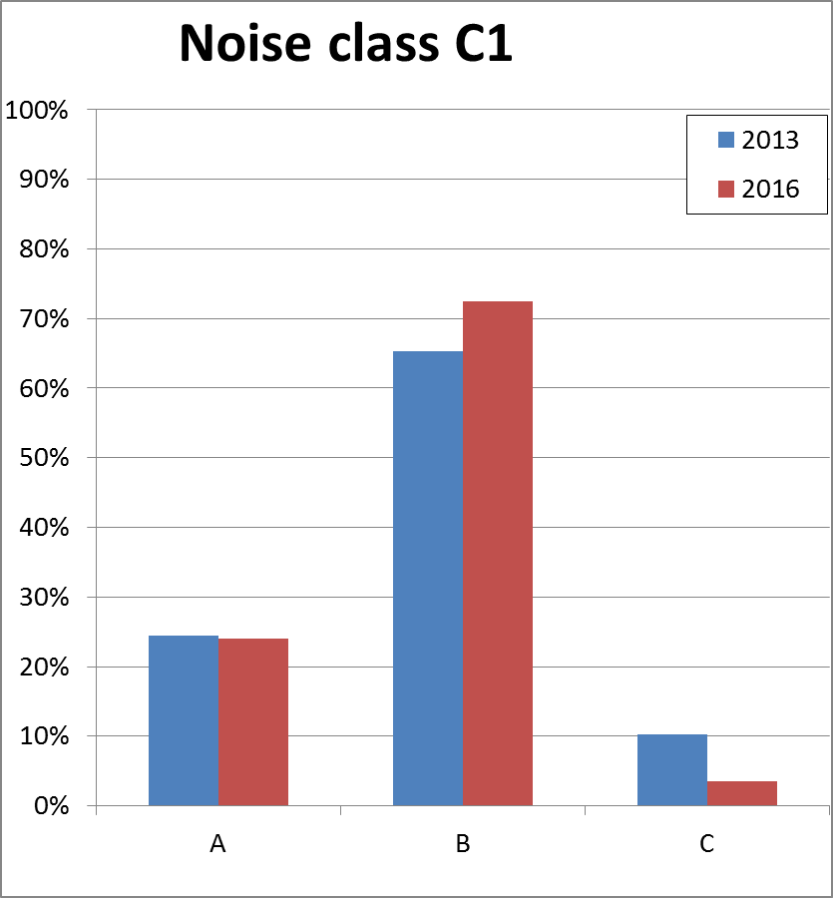
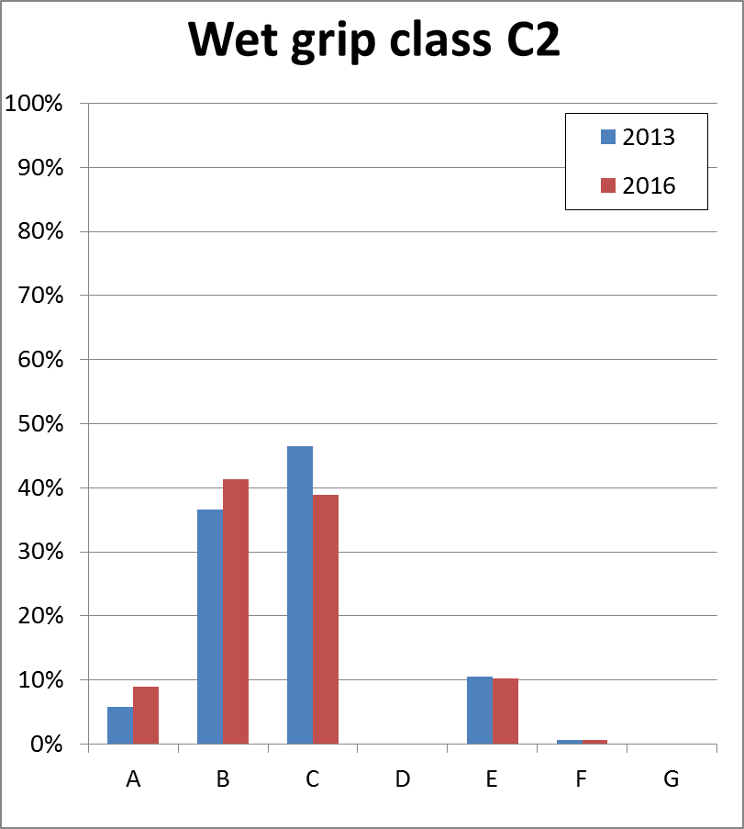
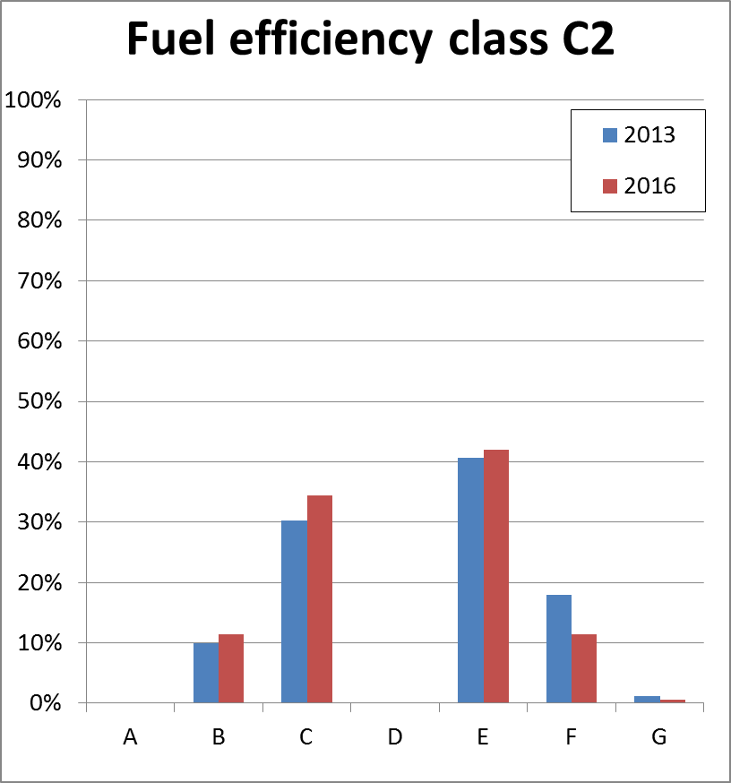
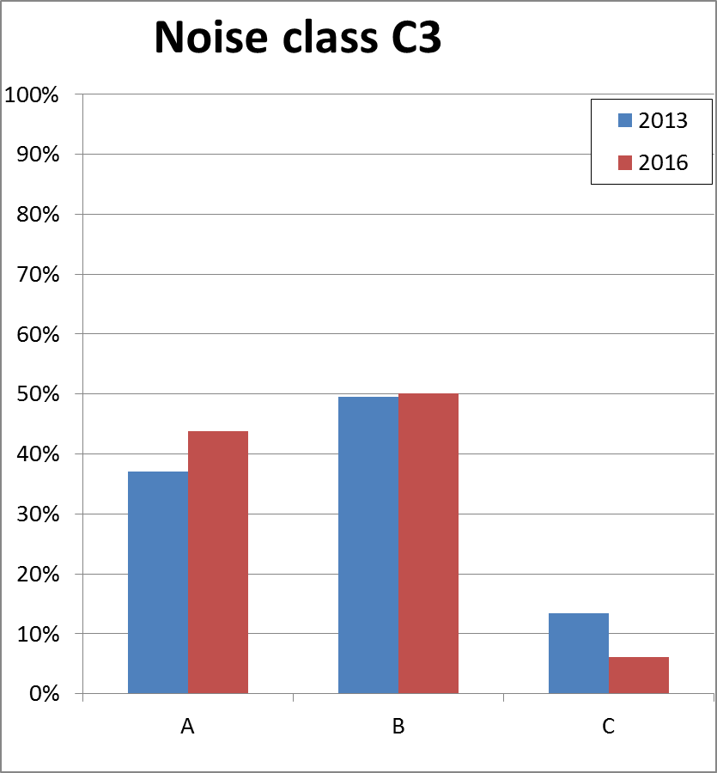
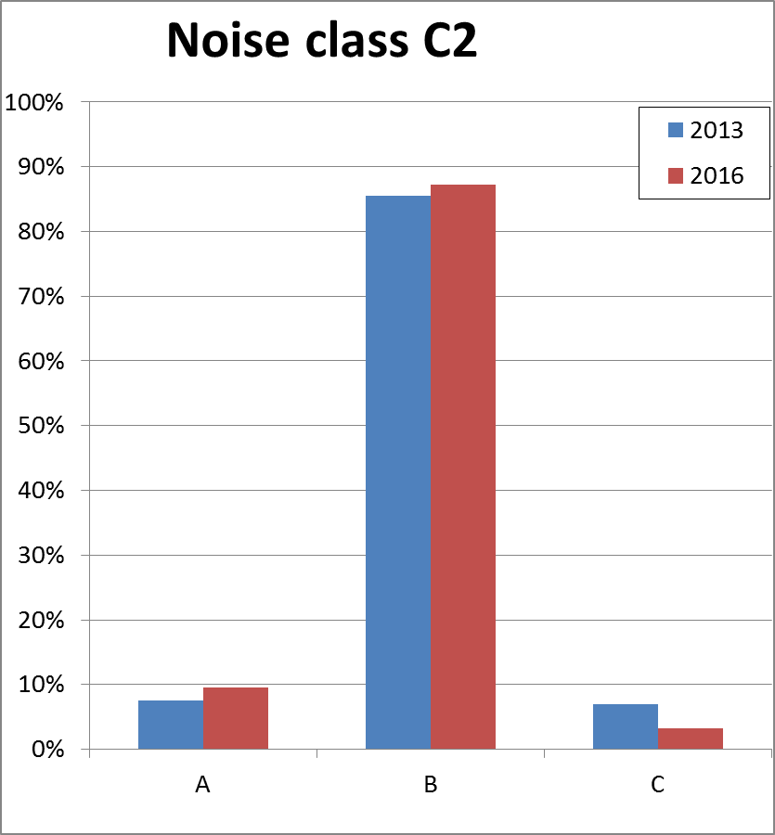
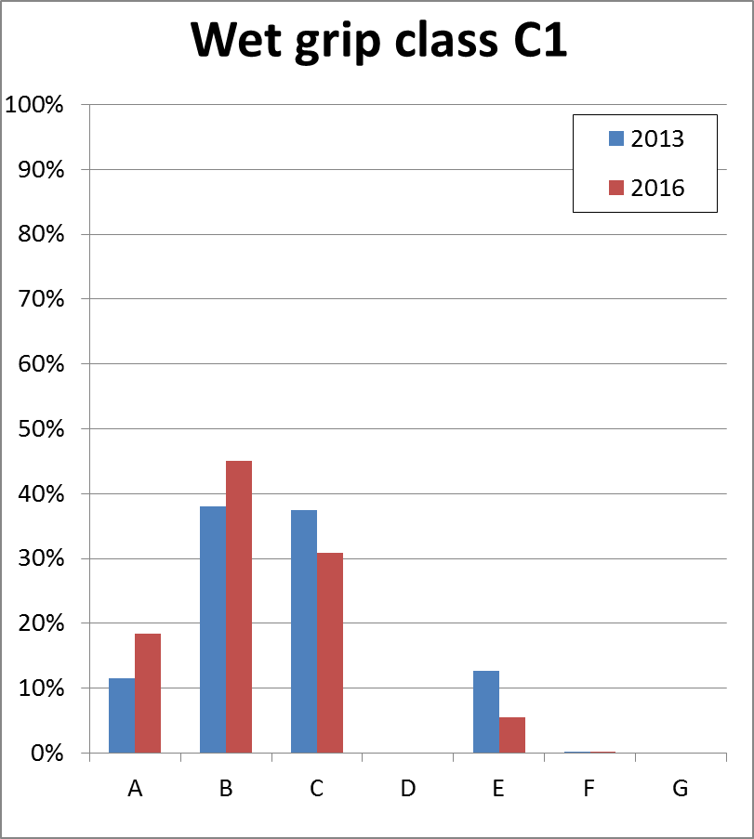
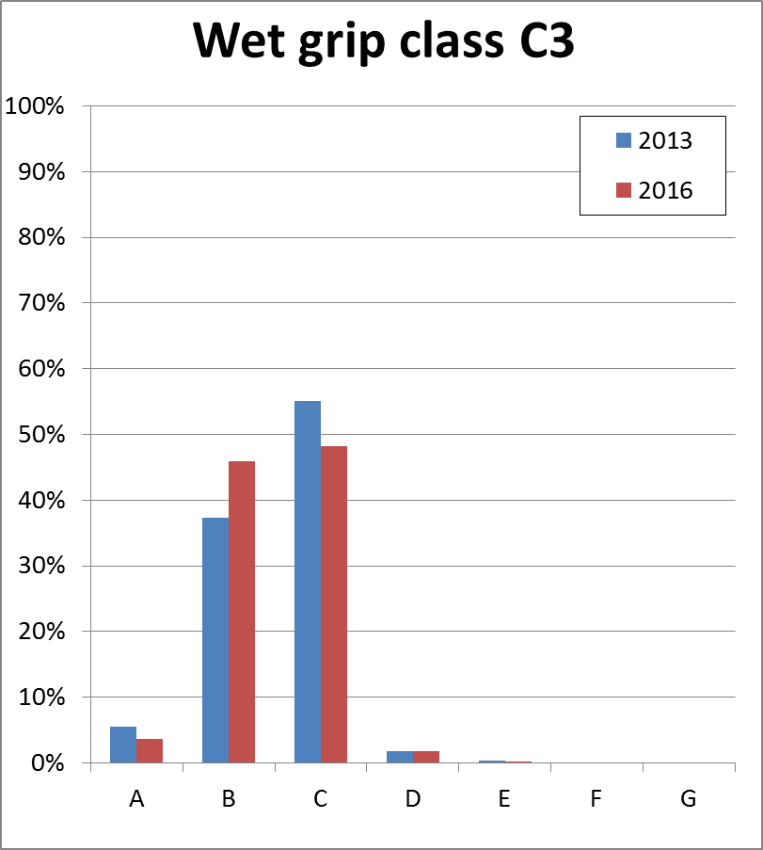
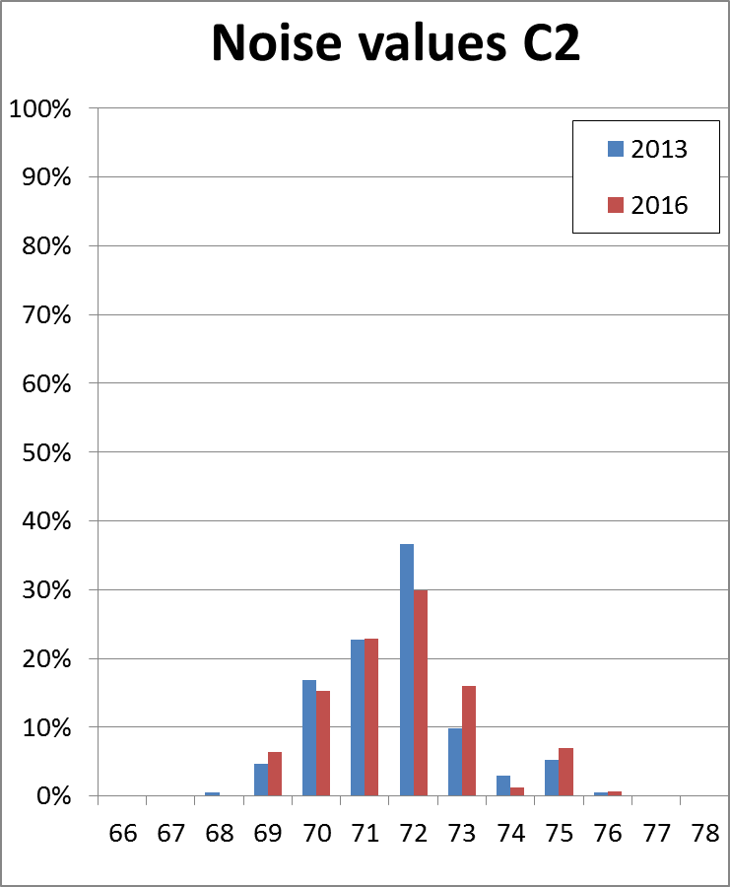
Trends 2013-2016

Slide 11
Trends 2013-2016
 |  | 2013 | 2016
 |  | avg | avg | delta
C1 | RR | 4,4 | 4,0 | 0,3
 | WG | 2,6 | 2,3 | 0,4
 | Noise | 1,9 | 1,8 | 0,1
 | dB | 69,9 | 69,7 | 0,2
C2 | RR | 4,3 | 4,1 | 0,2
 | WG | 2,7 | 2,6 | 0,1
 | Noise | 2,0 | 1,9 | 0,1
 | dB | 71,6 | 71,2 | 0,4
C3 | RR | 3,7 | 3,6 | 0,2
 | WG | 2,5 | 2,5 | 0,1
 | Noise | 1,8 | 1,6 | 0,1
 | dB | 72,2 | 71,9 | 0,3
Consistent trend for better performance in all aspects/classes

Slide 12
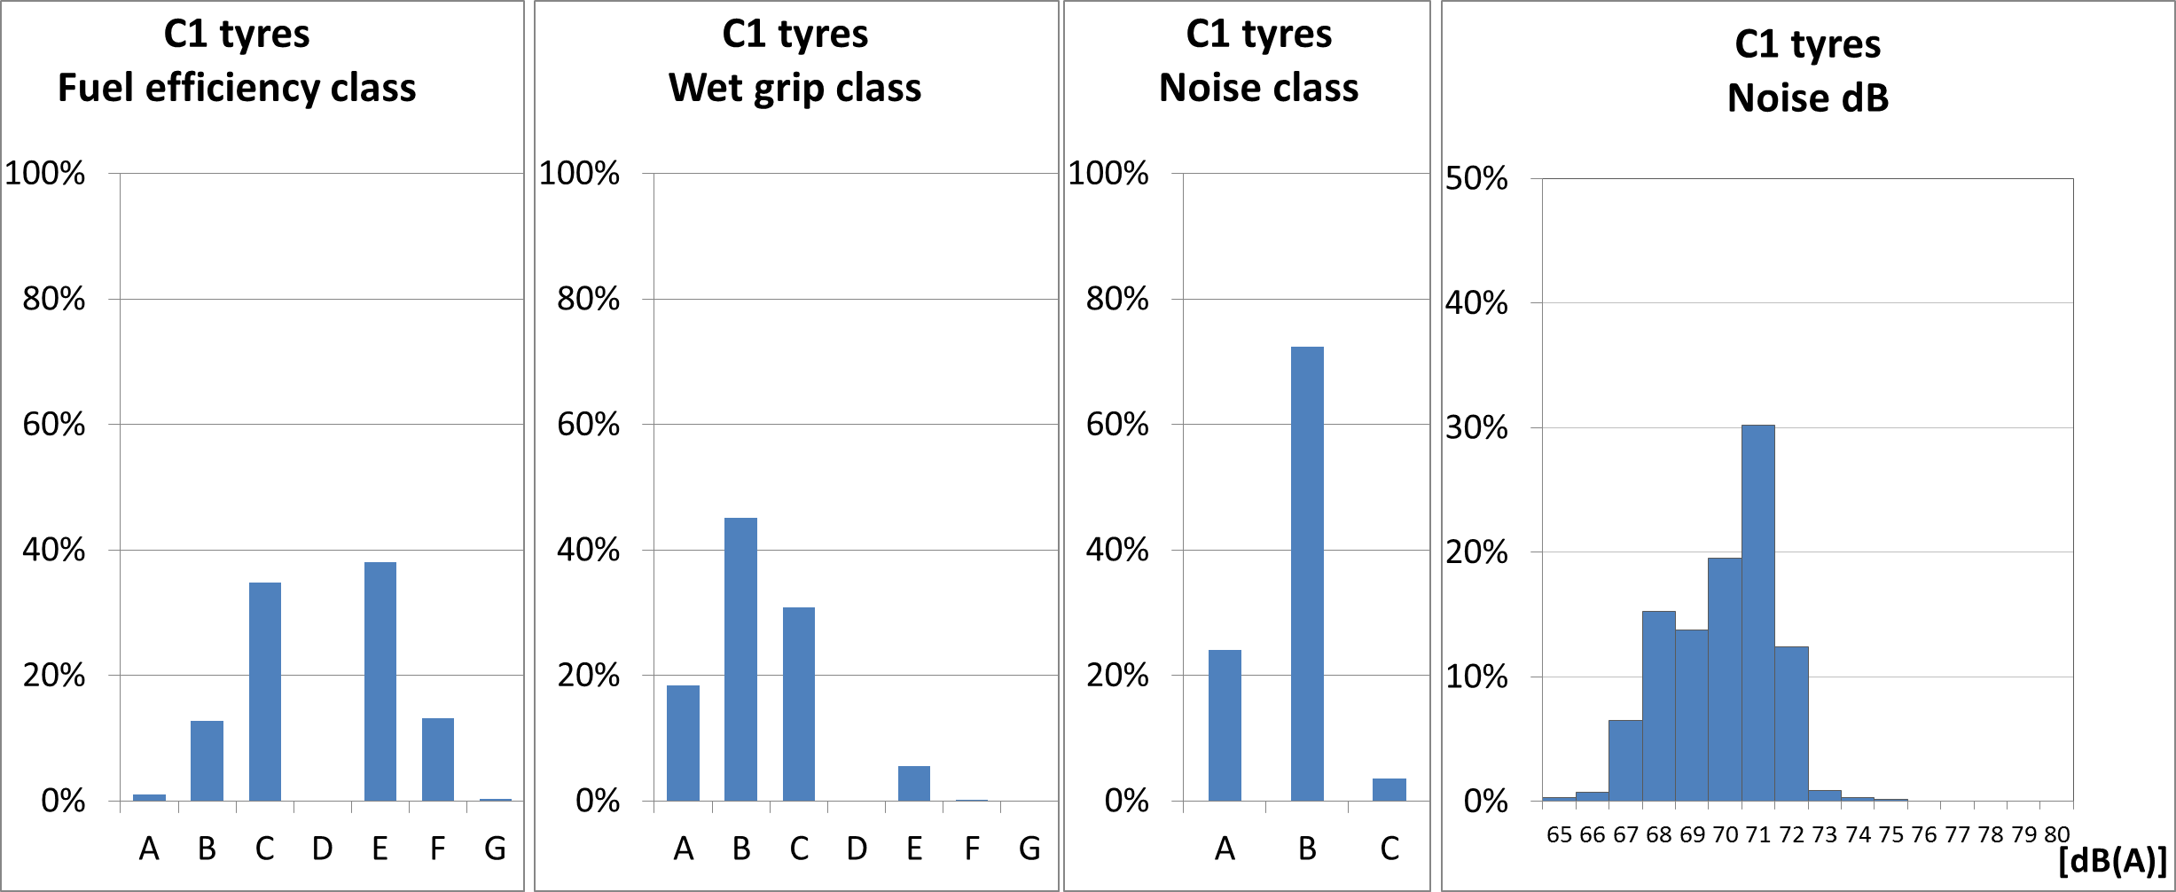
2016 Statistics C1 tyres
Blue bars: percentage per label class

Slide 13
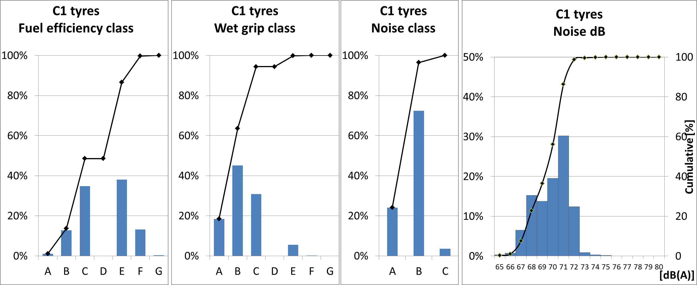
2016 Statistics C1 tyres
Blue bars: percentage per label class
Black lines: cumulative percentage

Slide 14
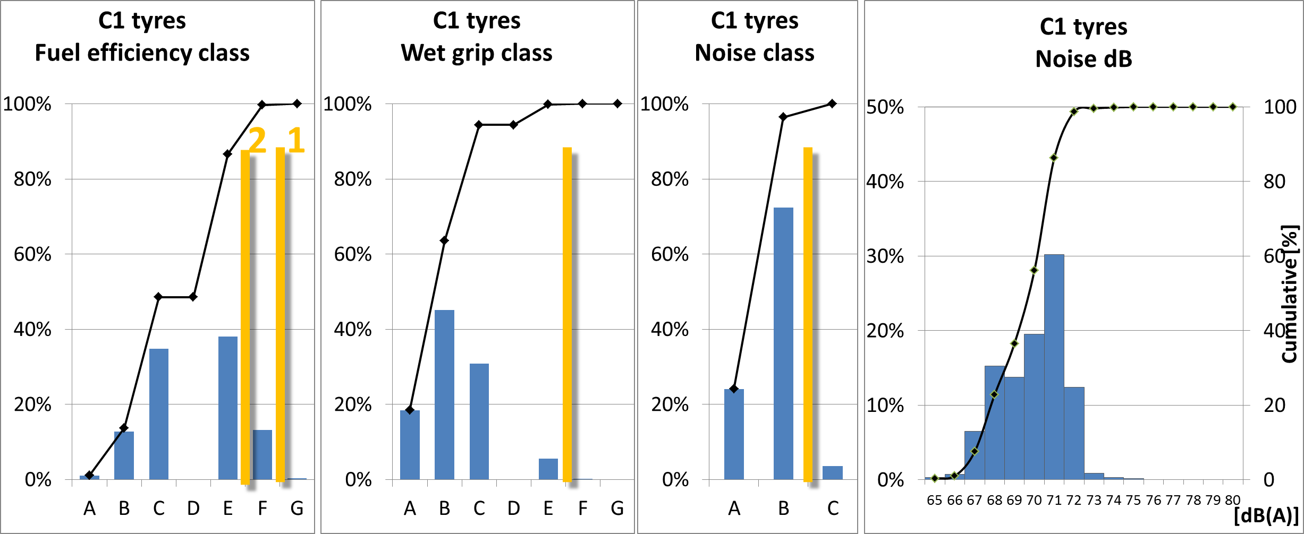
2016 Statistics C1 tyres
Blue bars: percentage per label class
Black lines: cumulative percentage
Orange lines limit value EC/661/2009 (phase 1 and 2)

Slide 15
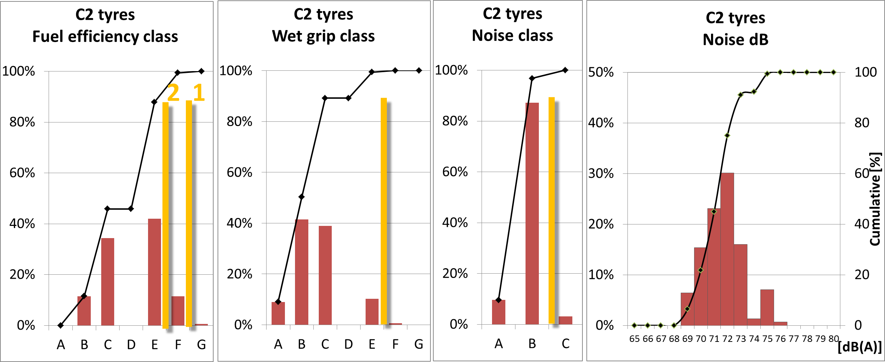
2016 Statistics C2 tyres

Slide 16
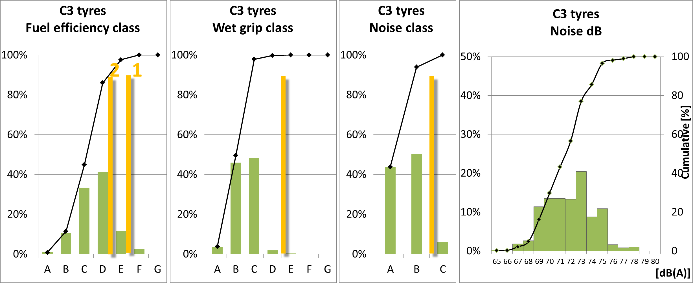
2016 Statistics C3 tyres

Slide 17
2016 Statistics C3 tyres
Significant number of tyres perform (much) better than the limits
A small percentage of tyres does not meet the 2012 limits

Slide 18
2016 Statistics C3 tyres
50%
50 percentile complies with “CBA” label

Slide 19
Summary of observations
(contistent) trend for better performance in all aspects/classes
Only a small percentage of the tyres (1-5%) does not yet meet the 2012 limits (Note: these can be legally sold for some time)
Significant number of tyres perform (much) better than the limits
The 50 percentile of these tyres complies roughly with
Label C for Rolling Resistance
Label B for Wet Grip
Label A for Noise

Slide 20
Strengthening Tyre Limits Regulation 661/2009 and 1222/2009
Johan Sliggers
Ministry of Infrastructure and the Environment
The Netherlands
132nd MVWG, July 2016

Slide 21
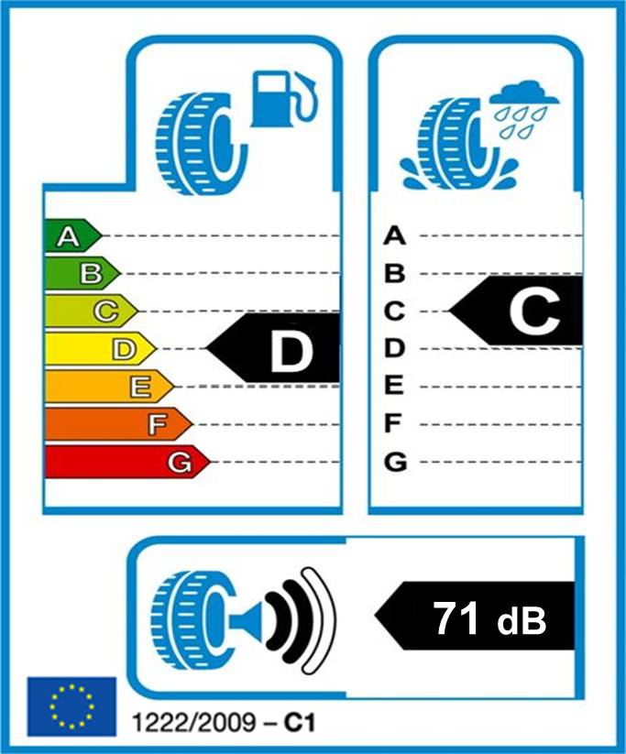
The average tyre label in the NLs

Slide 22
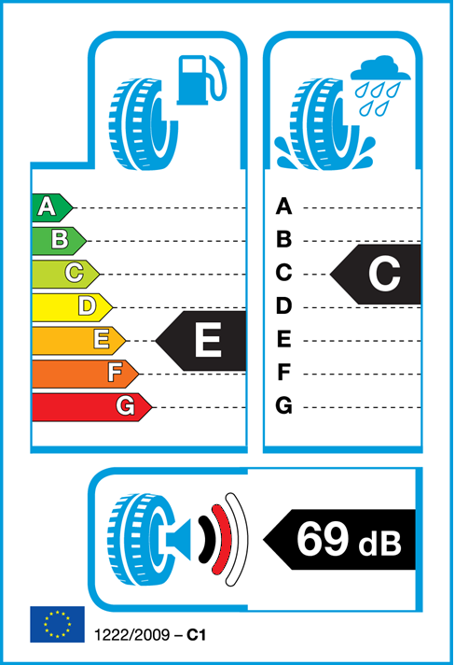
¹ Extra fuel costs per year (17000 km/yr)
² Extra braking distance wet road at 80 km/h (Braking distance A=27 m)
³ Noise*
A: 2 times as quiet
B: average
C: 2 times as loud
* Doubling noise is 3 dB
1
2
0 €
0 m
+30 €
+3 m
+90 €
+6 m
-
-
+150 €
+10 m
+220 €
+14 m
+250 €
-
3
C
A
B
+4 dB

Slide 23
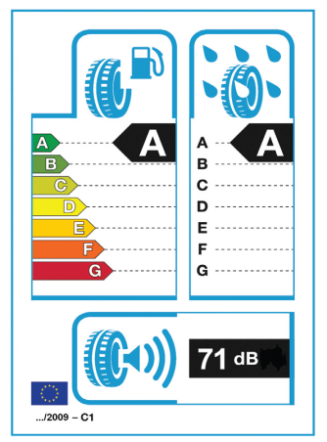
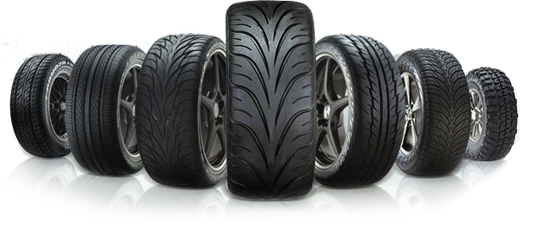
Triple-A tyres – benefits for environment, noise, safety and economy
Results of ‘Potential benefits of Triple-A tyres in the Netherlands’and the EU, a study performed by order of the Dutch Ministry of Infrastructure & Environment
66 dB
source: www.garageadrem.nl
Notes:
Goedenmiddag,
Titel project.
Mijn naam is Stephan van Zyl, consultant bij STL (TNO).

Slide 24
Potential Benefits Best Tyres in EU
Potential benefits | Energy | Safety | Noise | TOTAL
Annual fuel savings [ billion l] | 17 | - | -
Annual CO₂ reduction [ MtCO₂] | 42 | - | -
Reduced number of fatalities | - | 2567 | -
Reduced number of slight/serious injuries | - | 19631/ 12353 | -
Reduced number of annoyed people [millions] | - | - | 13
Reduced number of sleep disturbed people [ millions] | - | - | 6
Annual cost savings [ billion €] | 13 | 10 | 11 | 34

Slide 25
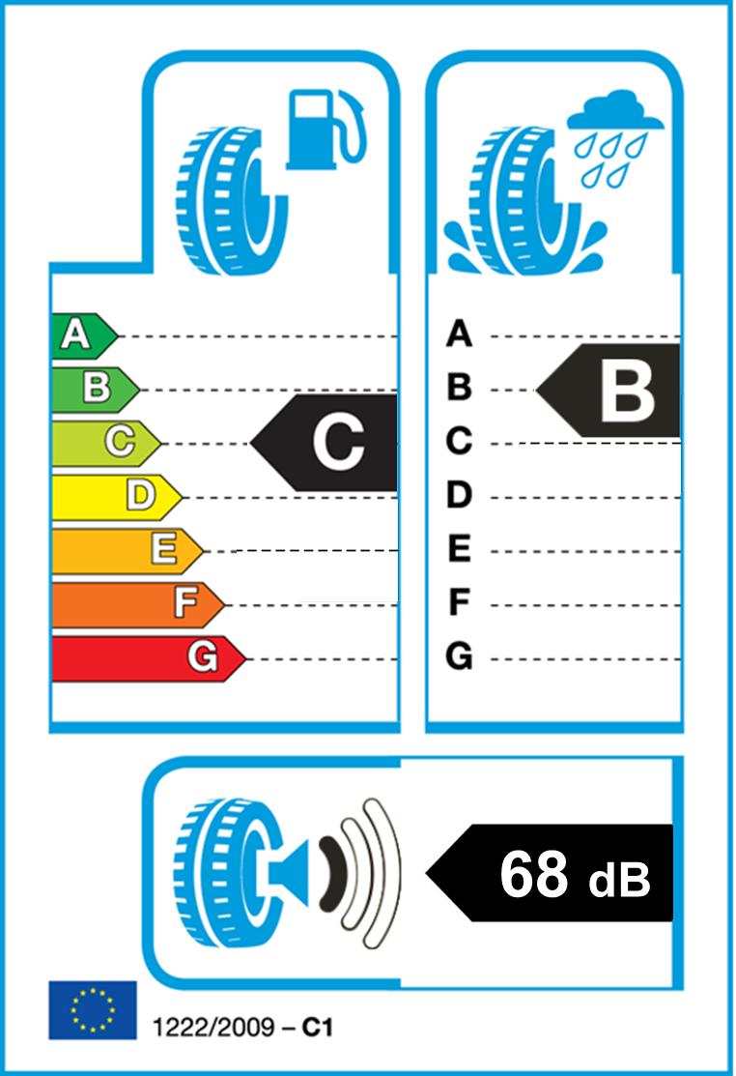
Tyre label (Reg. 1222/2009)

Slide 26
Rolling resistance (Reg. 661/2009)
Tyre type | Current value (kg/ton) | Suggestion NLs
C1 | ≤10.5 | -1.5
C2 | ≤9.0 | -1.0
C3 | ≤6.5 | -0.5

Slide 27
Wet grip indexes (Reg. 661/2009)
Tyre type | Current value (G) | Suggestion NLs
C1 | ≥1.1 (1.0; 0.9) | +0.3
C2 | ≥0.95 (0.85) | +0.3
C3 | ≥0.80 (0.65) | +0.3

Slide 28
External Noise (Reg. 661/2009)
Tyre type | Current limit value (dB(A)) | Suggestion NLs
C1A-E | 70-74 | -3dB
C2 | 72-73 | -2dB
C3 | 73-75 | -4dB

Slide 29
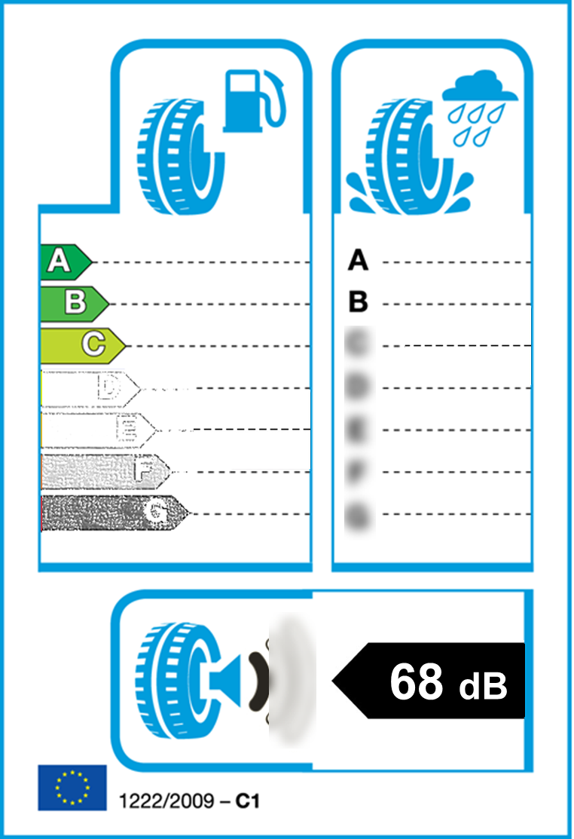
Tyre label (Reg. 1222/2009)

Slide 30
Potential Benefits EU of NLs suggestion
Potential benefits | Energy | Safety | Noise | TOTAL
Annual fuel savings [ billion l] | 13.5 | - | -
Annual CO₂ reduction [ MtCO₂] | 35 | - | -
Reduced number of fatalities | - | 2000 | -
Reduced number of slight/serious injuries | - | 15000/ 10000 | -
Reduced number of annoyed people [millions] | - | - | 13
Reduced number of sleep disturbed people [ millions] | - | - | 6
Annual cost savings [ billion €] | 10 | 8 | 11 | 29

Slide 31
Question to the European Commission
-Please start with the evaluation and subsequent strengthening of the limit values for tyres on wet grip, rolling resistance and noise (Regulation 661/2009).
-Adjust Regulation on Tyre Labelling accordingly (Regulation 1222/2009)

Slide 32
Adjustment to inf doc GRB-62-11-Rev.1
Proposal for amendments to the 02 series of amendments to Regulation 117

