Slide 1
Informal document WP.29-165-12-Rev.1 (165th WP.29, 10-13 March 2015, agenda item 6)
ASEAN Road Safety Centre Professor Dr. Wong Shaw Voon Director General Malaysian Institute Of Road Safety Research
World Forum for Harmonization of Vehicle Regulations (165th session)
Geneva, 10 - 13 March 2015

Slide 2
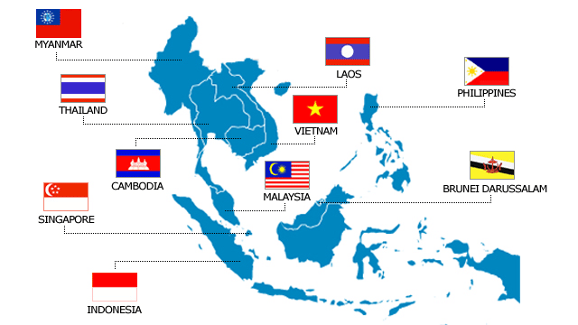
ASEAN Road Safety Centre (ARSC)

Slide 3
Background
The proposal for ASEAN Road Safety Centre (ARSC) was presented on 14 May 2013 at the 4th Meeting of ASEAN Multi-sector Road Safety Special Working Group (MRSSWG) by MIROS.
The Centre aims to provide information and knowledge, and to assist to develop know-how on RS in ASEAN Member States which include followings:
RS Data & Regulation Implementation
Engineering Challenges
RS Education and Advocate
Traffic Law and Technical Regulation Enforcement
RS Intervention Evaluation
Notes:
on the following: traffic laws and regulations, road accident data, road transport data, vehicle regulations concerning standard and inspections, driver training and driver testing, traffic police activities, road safety education in schools, road safety information / campaigns to the community.

Slide 4
Background
Subsequently the 20th ASEAN Transport Ministers Meeting (ATM) on 27 November 2014 in Mandalay, Myanmar welcomed the appointment of Malaysian Institute of Road Safety Research (MIROS) as the ASEAN Regional Road Safety Centre

Slide 5
Road Safety in the Region
Road safety situation in the region
Inconsistent approach for monitoring road safety situation between member countries: regional comparison is not realistic
Different level of economic development
Harmonization of trade requirement for member countries through harmonization of safety standard so that people in the region are equally protected.
Unsustainable road safety initiatives
Road safety require multidiscipline involvement and action by road safety lead agency alone is not enough. Lack of capacity at various level in member countries lead to unsustainable road safety initiatives. Hence, support for capacity building of various stakeholders related to road safety is a major concern
Evidence-based road safety interventions
Effective road safety initiatives should based on science as well as art to implement
Lacking of best practices / successful track record backed by sciences
Learning from member countries is the most efficient way instead of reinvent a new efforts

Slide 6
Role of ARSC
Design and implement road safety programs based on science and art for the region
Develop and Harmonize of standard, guideline and method of road safety activities for the region
Coordinate and collate the efforts of member countries for knowledge sharing
Provide technical guidance and effective leadership to member countries
Monitor implementation of the program and intervention by member countries, as well as the regional road safety performance.
Evaluate road safety performance and initiatives of member countries

Slide 7
Functions and Activities
Pillar 1
Pillar 4
Vehicle regulations concerning standard and inspections
Pillar 3
Road engineering enhancement and best practice
Pillar 2
Traffic laws and regulations
Road accident data
Road transport data
Coordinating ISO 39001
Capacity building
Road safety audit
International road assessment programme
Road safety audit certification and training
Testing facilities
Vehicle Type Approval
Coordinating and perform New Car Assessment Programme (NCAP) for the AESAN
Harmonization of Vehicle Regulations (WP29)
Driver training and testing
Traffic police activities
Road safety training in schools
Road safety information/campaigns to the community
Research and development into improving post-crash response
Pillar 5
National trauma care data system
National pre-hospital care systems
Notes:
Function of ARSI should be aligned with the Global Plan for the Decade of Action for Road Safety 2011 – 2020

Slide 8
Thank you

