Slide 1
LPG Direct Injection
Submitted by the expert from Italy Informal document GRSG-105-07
(105th GRSG, 8-11 October 2013
Agenda item 8)
R67-01 Amendment

Slide 2
Agenda
Presentation of the LPG Direct Injection technology
Why petrol in the tank is not an issue
Amendment proposal
Clarified doubts
Notes:
1. Brief presentation of the LPG Direct Injection technology: - architecture and why a return flow is needed - explication that petrol can goes to LPG tank only during the switch phase - advantages in term of emissions (we have data for that) and use of LPG vs petrol (crank in LPG) 2. Why petrol in the tank is not an issue: - pressure reduction thanks to the blend - components validated also for gasoline (if possible we would avoid, check with Salvatore if we really need to talk about this point) 3. Amendment to control the amount of petrol in LPG: - system shall avoid that petrol flow in the LPG tank overcome the 80% - system shall avoid that petrol amount overcome the 20% of the total fuel (20% is coming from amendment to R83) considering that the effort of the system maker and the end user is to maximize the use of LPG instead petrol (no reasons to burn petrol).

Slide 3
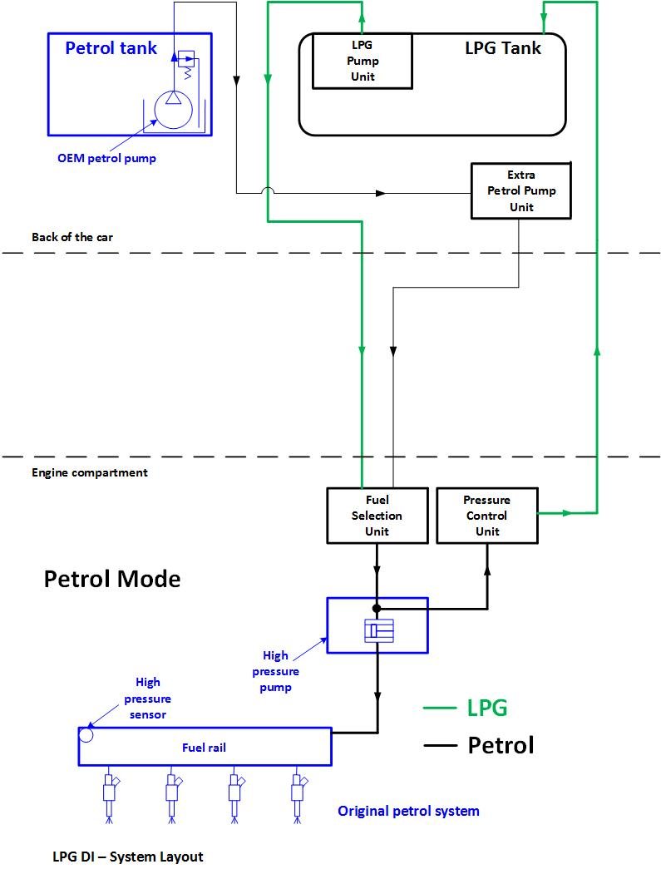
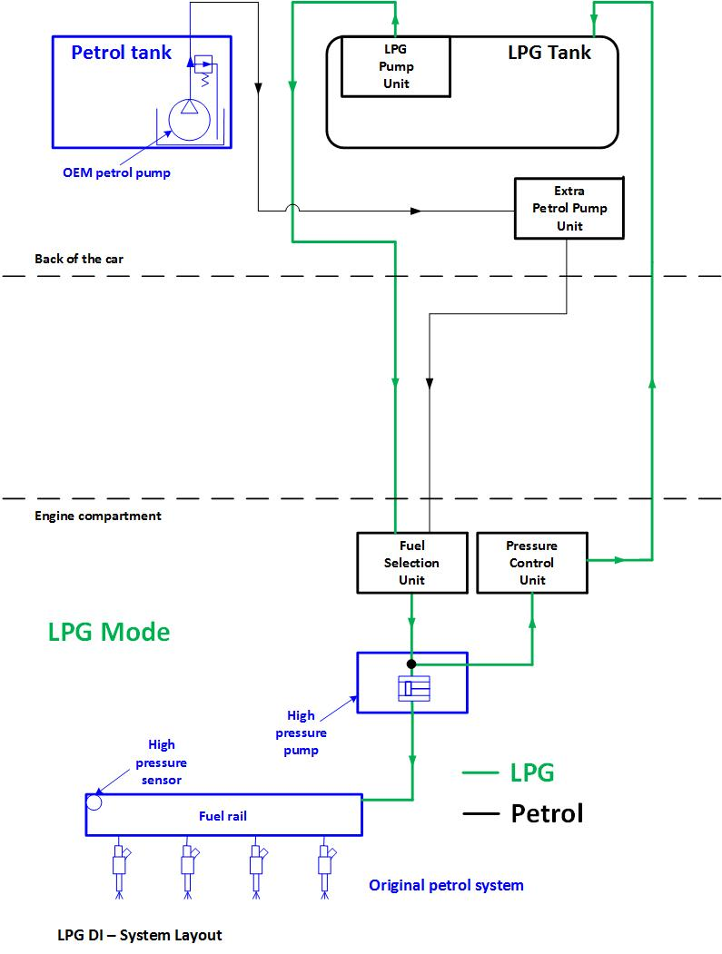
LPG DI Technology
Notes:
Here a brief introduction of the LPG Direct Injection Technology.
The system is based on the possibility to inject the LPG fuel directly in the combustion chamber, using HP pump and Injectors located in the cylinder head.
The LPG is injected in liquid phase and shall be maintained liquid from the tank to the HP pump, in order to allow the HP pump to work correctly and increase the LPG pressure in the fuel rail.
The presence of vapor phase at the inlet of the HP pump determine that the pump itself will not work correctly.
In order to keep the LPG in liquid phase, considering that the engine bay is hot, it is required to have a circulation of the LPG from the tank, to the components in the engine bay and then back to the LPG tank.
This is managed with a tank LPG pump which pumps to the front of the vehicle a flow bigger then what is required by the engine and the excess flow goes back to the tank, cooling the components and avoiding the vapor lock issues.

Slide 4
LPG DI Technology
Here a brief introduction of the LPG Direct Injection Technology.
The system is based on the possibility to inject the LPG fuel directly in the combustion chamber, using HP pump and Injectors located in the cylinder head.
The LPG is injected in liquid phase and shall be maintained liquid from the tank to the HP pump, in order to allow the HP pump to work correctly and increase the LPG pressure in the fuel rail.
The presence of vapor phase at the inlet of the HP pump would determine that the pump itself will not work correctly.
In order to keep the LPG in liquid phase, considering that the engine bay is hot, circulation of LPG from the tank to the components in the engine bay and then back to the LPG tank is necessary.
This is managed with a tank LPG pump which pumps to the front of the vehicle a flow higher than that required by the engine, and the excess flow goes back to the tank, cooling the components and avoiding the vapor lock occurrence.

Slide 5
The fuel switch
From the tank
To the tank
PCU include valves that enable the flow back to the LPG tank
Volume of petrol when the engine runs in petrol mode
Notes:
Considering that the system can be bifuel, a fuel switch from LPG to petrol and vice versa shall be managed.
In this kind of equipment the LPG system and the petrol system use the same HP pump and injectors. That means that the fuel switch shall be done trough valves which allow one fuel or another to reach the inlet of the HP pump.
During the switching phase the two fuels are blended in the volume from the Fuel Selector Unit to the Pressure Control Unit.
As already explained, the system need a cooling flow which determine that a certain quantity of petrol will flow in the LPG tank.
The flow of petrol in the LPG tank happen only during the switch phase.

Slide 6
The fuel switch
Considering that the system can be bifuel, a fuel switch from LPG to petrol and vice versa is needed.
In this kind of equipment the LPG system and the petrol one use the same HP pump and injectors. That means that the fuel switch shall be done through valves which allow one fuel or the other to reach the inlet of the HP pump.
During the switching phase the two fuels are blended in the volume contained from the Fuel Selector Unit to the Pressure Control Unit.
As already explained, the system needs a recirculation cooling flow which determines that a certain quantity of petrol will flow in the LPG tank.
The flow of petrol in the LPG tank occurs only during the switch phase.

Slide 7
LPG DI Advantages
 |  | LPG Vapor PI | LPG DI
Engine starts (201k km) | [#] | 55.500 | 55.500
Time gasoline/engine start | [s] | 60 | 0
Time gasoline | [h] | 925 | 0
The injection of the LPG in liquid phase directly in the combustion chamber give a lot of advantages both vs. standard LPG port injected system, then vs. petrol DI.
The LPG DI system starts directly with LPG fuel, also in cold conditions.
This feature generates:
An important reduction of the use of petrol if compared with a standard LPG vapor port injection system (see table)
The possibility to reduce the emissions also during the engine crank and the cold phase

Slide 8
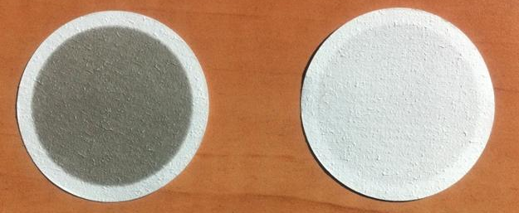
LPG DI Advantages
Test | Fuel | CO₂ | PM | PN
[-] | [-] | [g/km] | [mg/km] | [#/km]
[-] | [-] | [-] | [% limit] | [% limit]
Average Petrol (2 best tests) | Petrol | 176,4 | 0,41 | 7,88E+11
 |  | - | 8,2% | 131,3%
Average LPG (2 best tests) | LPG B85 | 157,6 | 0,11 | 1,08E+10
 |  | - | 2,1% | 1,8%
LPG vs Petrol | - | -10,7% | -74,0% | -98,6%
Thanks to the fast vaporization of the LPG, this technology solves the problem of particulate matter emission, which is a not negligible challenge for the petrol DI engines.
Petrol
LPG

Slide 9
Petrol in the LPG tank
Why Petrol in the LPG tank is not dangerous?
Since petrol blended in LPG determines a reduction of the vapor pressure, it does not affect tightness, design and burst pressure requirements and tests defined in R 67/01.
 | Petrol [%] | Propane [%] | T [K] | Vapor Pressure [MPa]
Blend A | 100 | 0 | 300 | 7,80E-03
Blend B | 0 | 100 | 300 | 0,996
Blend C | 50 | 50 | 300 | 0,478

Slide 10
R67-01 Amendment
LPG in the petrol tank has a safety impact → Redundant devices shall be introduced to prevent it
Petrol in the LPG tank can have a safety impact if the fuel level overcome the 80% → The system shall be capable to avoid that the fuel level overcomes the 80%
Petrol in the LPG tank does not have impact if the fuel level is below 80%. Nevertheless, petrol blend must be kept under the percentage permitted by emission regulations → The system shall be capable to limit the quantity of petrol blended in LPG at a maximum value of 20% in energy unit (13% in volume of tank total capacity)
Notes:
In order to take in consideration the implication of the new technology here described , the amendment we propose consider 3 situations to be managed:
LPG in the petrol tank
Already discussed to have redundant systems to avoid that LPG flows in the petrol tank.
2. Already discussed and agreed.
3. An LPG system is designed to maximize the use of LPG, in all conditions. This is also what the end customer want. The LPG DI allow to start directly in LPG, then there are no reasons for a system maker don’t avoid to minimize the petrol in the LPG tank. Anyway it is important to fix a limit that can be of 20% of gasoline on 80% of LPG, considering the same value (on energy basis) has been already discussed and agreed for R83 e R115.

Slide 11
Doubts clarification Petrol in LPG % management
RV
LPG ECU
TC = LPG tank capacity
RV = volume of LPG refuelled at each refuelling operation
VP = Volume of PETROL flows back during switch (worst case)
CV = Volume of uel consumed between switch over and/or refuelling operations
PP= Petrol percentage
VP
Is PP > 12% TC?
No actions
PP
NO
CV
PP=0
YES
Actions to prevent further petrol flows until PP>12%TC
Notes:
In order to take in consideration the implication of the new technology here described , the amendment we propose consider 3 situations to be managed:
LPG in the petrol tank
Already discussed to have redundant systems to avoid that LPG flows in the petrol tank.
2. Already discussed and agreed.
3. An LPG system is designed to maximize the use of LPG, in all conditions. This is also what the end customer want. The LPG DI allow to start directly in LPG, then there are no reasons for a system maker don’t avoid to minimize the petrol in the LPG tank. Anyway it is important to fix a limit that can be of 20% of gasoline on 80% of LPG, considering the same value (on energy basis) has been already discussed and agreed for R83 e R115.

Slide 12
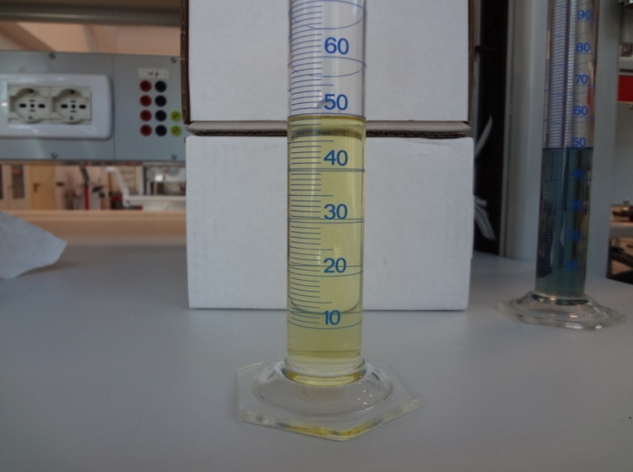
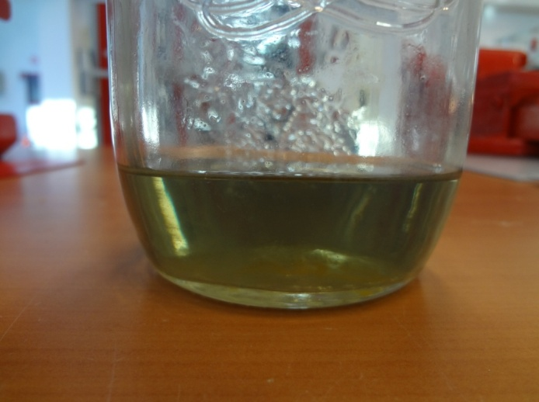
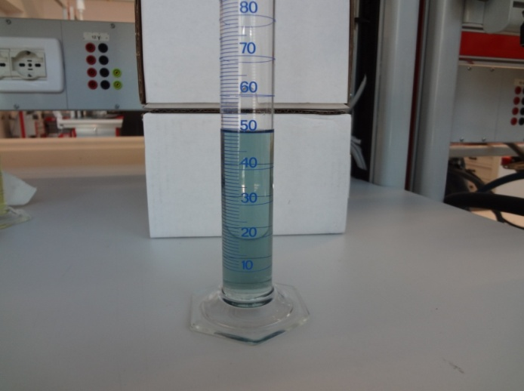
Doubts clarification Petrol in LPG Miscibility
Pentane
Blend
Theory:
Miscibility (in all proportions) and solubility of two or more chemical substances (in this case in the same liquid phase) are based on the their "chemical affinity" (intermolecular forces).
LPG and petrol HC's miscibility/solubility is proven by the fact that petrol commonly contain dissolved LPG's (butane, isobutane, ...).
Experimental test:
Pentane (close to LPG characteristics) is well miscible with Petrol.
In the Real application the continuous fuel recirculation help the mixing.
Petrol

