Slide 1
Transmitted by GFV and LNG-TF
Informal document No. GRPE-66-27
66th GRPE, 3-7 June 2013
agenda item 8
World Forum for Harmonization of Vehicle Regulations (WP.29)
Working Party on Pollution and Energy (GRPE)
66th session, 4-7 June 2013
Information about LNG Vehicles for GRPE
at the request of the GRSG
André Rijnders/Jeff Seisler
Informal GFV Group

Slide 2

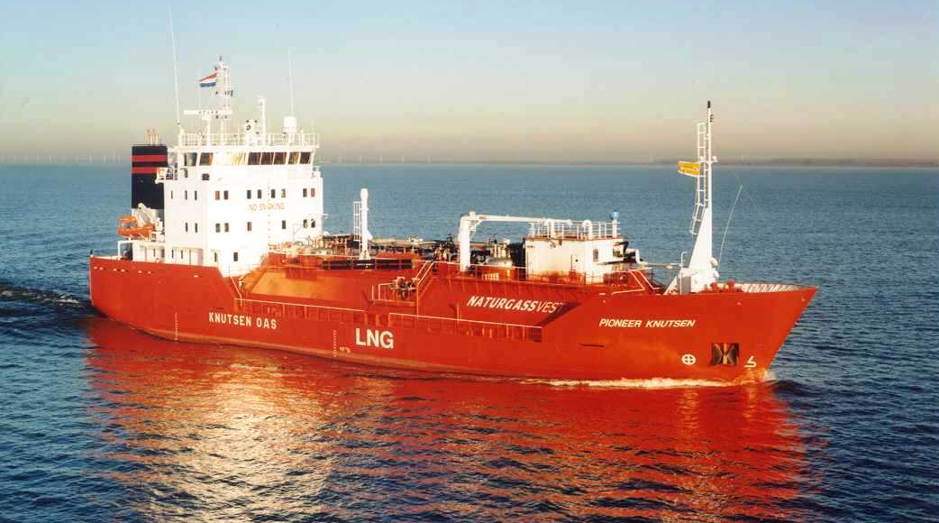
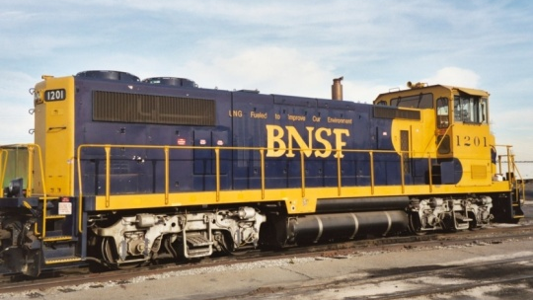

Liquefied natural gas (LNG) is becoming more popular as a fuel for heavy duty trucks and also for ships, locomotives and non-road vehicles.

Slide 3

Natural gas liquefies at -162°(C)
  LNG is stored in specially designed vacuum insulated tanks in order to keep it cold when in transit, stored at the fuelling station, or on-board the vehicle. But at each step LNG absorbs a small amount of heat, which causes the temperature and pressure to increase over time
  LNG vehicle and fuelling systems are designed to be ‘vent free’ otherwise operators ‘lose money into the atmosphere’

Slide 4
LNG now is regulated as a vehicle fuel
LNG reference fuel was part of the Heavy Duty Dual-Fuel amendments in R.49 (GRPE)
The GFV - LNG Task Force began its work in May 2011 to include LNG vehicle components and systems into Regulation110 (NGV safety/installation)
The LNG vehicle amendments to R.110 were approved by the 104th session of the Working Party on General Safety (GRSG) in April 2013 (ECE/TRANS/WP.29/GRSG/2013/7)

Slide 5
LNG ‘hold-time’ and venting (‘boil-off’) is an operational issue
  5 day minimum LNG ‘holding time’ in R.110 amendments are aligned with US regulations (SAE J 2343 and CARB)…the most severe in the industry
Recognizing that potential methane release -- venting from ‘boil off’ -- is an environmental issue (not a vehicle safety concern), the GRSG suggested that the GRPE be made aware of this

Slide 6
Though designed to be ‘vent free’ it is not possible to prevent small amounts of methane escaping to the atmosphere
Commercial trucking systems are designed to match fuel consumption with fuel storage and delivery quantities
Few commercial operators have trucks immobile for five days
Venting in enclosed spaces (i.e. workshops) is taken into account (as with CNG) to provide proper ventilation

Slide 7
LNG venting management systems and techniques are well known
Pressure regulator (‘economizer’ regulator) vents at pre-set pressure, opening for ~10-30 seconds and then closes again.
Adding LNG to the fuel tank condenses ‘warmer’ fuel
Starting the engine or driving briefly relieves pressure in the tank and prevents venting
Vapor recovery systems on the vehicle can be installed, sending ‘warm’ fuel back to fuelling station tanks

Slide 8
Transmitted by GFV and LNG-TF
Informal document No. GRPE-66-27
66th GRPE, 3-7 June 2013
agenda item 8
World Forum for Harmonization of Vehicle Regulations (WP.29)
Working Party on Pollution and Energy (GRPE)
66th session, 4-7 June 2013
Information about LNG Vehicles for GRPE
at the request of the GRSG
André Rijnders/Jeff Seisler
Informal GFV Group

