Slide 1
Status of the draft GTR
Transmitted by WLTP
Informal document No. GRPE-65-34
(65th GRPE, 15 - 18 January 2012, agenda item 3(a))
65th GRPE, 15-18 January 2013

Slide 2
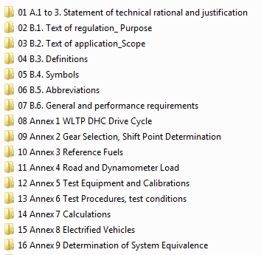
A.1 to 3: Statement of technical rational and justification
To be done by DG-ENTR

Slide 3
B.1. Text of regulation: purpose
Uploaded to CIRCABC
Open point: proposed text to be reviewed

Slide 4
B.2. Text of regulation: scope
Uploaded to CIRCABC
Open point: proposed text to be reviewed

Slide 5
B.3. Definitions
Not yet reviewed.

Slide 6
B.4. Symbols and B.5. Abbreviations
Work has started on these sections but have not been reviewed.

Slide 7
B.6. General and Performance Requirements
DC proposal uploaded to CIRCABC in January. This Section has not yet been reviewed.

Slide 8
Annex 1 WLTP DHC Drive Cycle
The Annex includes speed/time diagrams and tables for all cycles. It also includes a definition of the various vehicle classifications.
This Annex is essentially complete pending running modifications.

Slide 9
Annex 2 Gear Selection and Shift Point Determination
This Annex contains calculation methods to determine which gears are to used on the respective cycles.
Furthermore, cycle tolerances and aspects of driving such as starting, stalling, re-starting, choke operation, steady state driving, accelerating, decelerating, clutching and declutching, etc. are currently being reworked by DTP and DHC and will be moved here from Annex 6.

Slide 10
Annex 3 Reference Fuels
Input has been received from subgroup Reference Fuels.
Tables describe fuels (petrol, diesel, E85, LPG, CNG, etc.) in Europe, India, South Africa, Japan, South Korea.

Slide 11
Annex 4 Road Load Determination
Major open drafting-relevant points:
on-board anemometry (to be included or not)
methods of road load calculation
road condition (slope)
vehicle selection
options
moveable aerodynamic aids
tyre tread depth
vehicle warming up

Slide 12
Annex 5 Test equipment and Calibrations
This Annex is fairly complete.
Major open drafting-relevant points:
particle concentration factors
analysis of formaldehyde and acetaldehyde
sampling storage time for ethanol

Slide 13
Annex 6 Test Procedures, Test Conditions
Major open drafting-relevant points:
all aspects on driving (starting, stalling, re-starting, choke operation, steady state driving, accelerating, etc.) will be moved to Annex 2
test cell temperature
subgroup PM/PN currently reviewing text on PM and PN sampling, filter weighing rolling average
the entire section on regenerative systems to be reworked by PM/PN and LabProcICE

Slide 14
Annex 7 Calculations
This Annex is essentially complete.
Major open drafting-relevant points:
Calculating CO₂ emissions at different vehicle masses using a regression method.

Slide 15
Annex 8 Electrified Vehicles
Major open drafting-relevant points:
Equations to be reviewed and rewritten
Subgroup to review proposed text from DC on test procedure and conditioning of BEVs and OVC-HEVs
Determining utility factors
Many more web/telephone conferences or f2f meetings are still required

Slide 16
Annex 9 Determination of System Equivalence
There has in the past been no general agreement as to whether there should be an annex on this subject. However, at DTP #9, it was decided that there must be a way to demonstrate equivalency of systems, such as for measurement equipment/methods or coastdown methods. Hence, an Annex on equivalency should be kept.
DC will investigate how other GTRs and ECE regulations (e.g., 49) deal with equivalency.

