Slide 1
Informal document GRSP-51-38
(51st GRSP, 21 – 25 May 2012,
agenda item 20)
GRSP Inf. Group on Child Restraint Systems
CRS-31-08
April 11th , 2012
Comparison of CRS Side Impact Test Results Using by Acceleration Type Sled and Deceleration type Sled
JASIC / Japan
Notes:
I will present the “Comparison of CRS Side Impact Test Results Using by Acceleration Type Sled and Deceleration type Sled”.

Slide 2
Background & Purpose
NTSEL (type approval test department in Japan) has the acceleration type sled test system. So it is necessary to compare the CRS side impact sled test results between tested by deceleration type sled system and tested by acceleration type sled test system.
We done CRS side impact sled tests by acceleration type sled test system and confirm to compare the test severity between deceleration sled and acceleration sled.
Notes:
The back ground of this research is that the NTSEL, which is the type approval test department in Japan, has the acceleration type sled system, and does not have the deceleration type sled system.
So we need to confirm that we can do the CRS side impact sled test by acceleration type sled test system.
We done CRS side impact sled tests by acceleration type sled test system and confirm to compare the test severity between deceleration sled and acceleration sled.

Slide 3
Concept of CRS Side Impact Test Using by Acceleration Type Sled System
Notes:
Next speak to Concept of CRS Side Impact Test Using by Acceleration Type Sled System

Slide 4
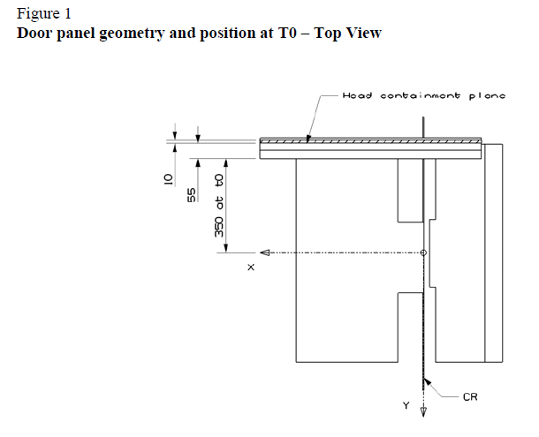
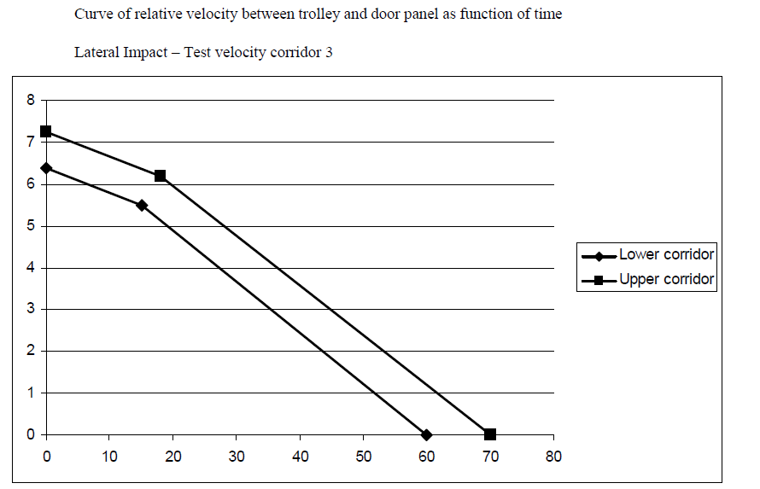
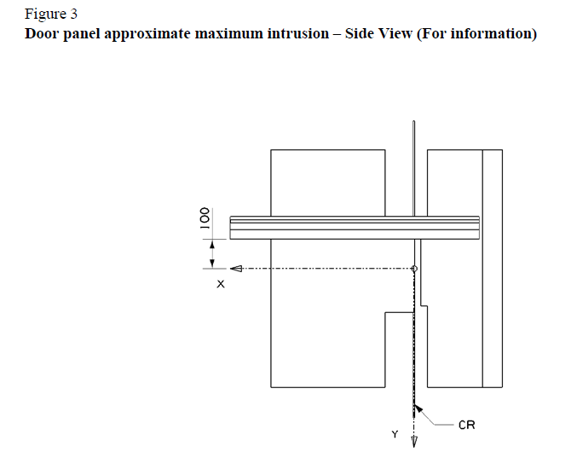
Parameters of New Side Impact Test
Relative velocity between door and sled
Door intrusion
Notes:
This shows the parameters of side impact test.
The relative velocity between sled and door, and door intrusion are the parameters.

Slide 5
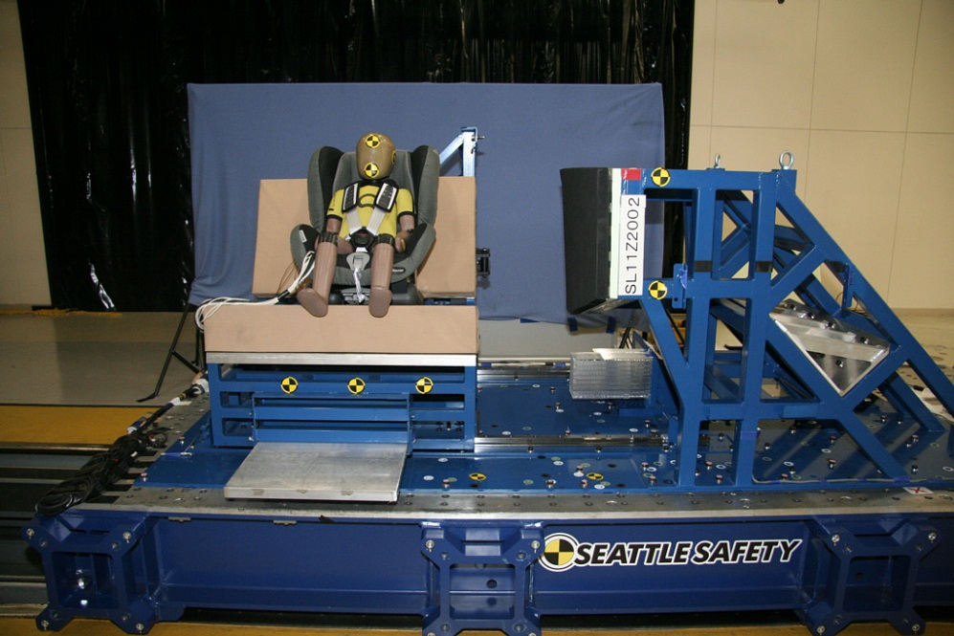
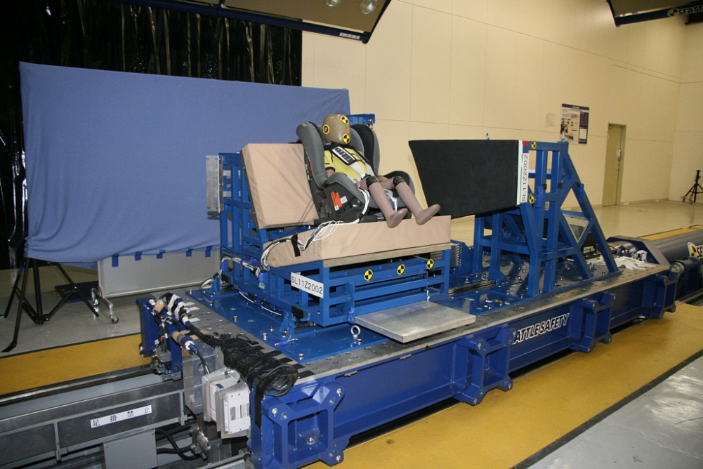
Photos before sled tests
Notes:
This shows the photos of sled test initial conditions.
Seat is set on sled on sled and therefore seat can be easily moved.

Slide 6
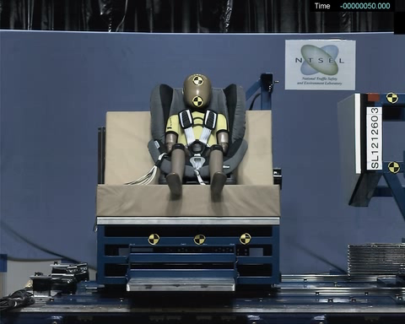
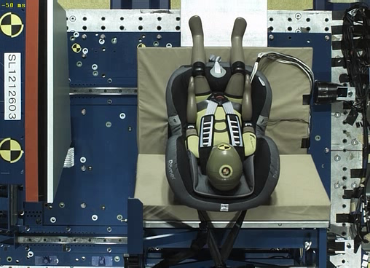
Video
Notes:
This shows the video of test.

Slide 7

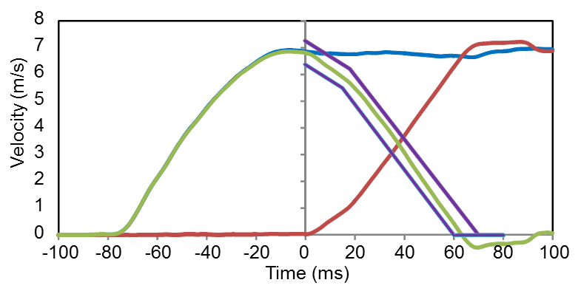
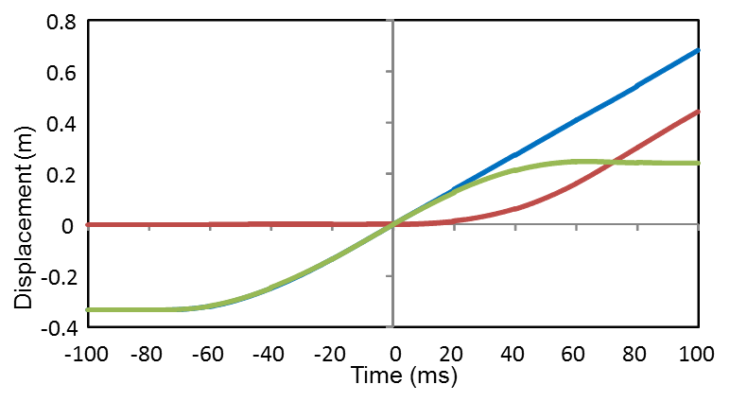
Test Concept
Relative velocity
Intrusion
In this test concept, door moved with sled and seat moved on sled on sled.
Notes:
This shows the velocity and intrusion time histories.
Time of 0ms is defined when the door is at the end of the seat, defined in regulation.
The door velocity is maximum before time is 0ms, and the door velocity keep almost constant till the seat velocity catches up with the door.
The seat velocity start increasing almost at time is 0ms.
Relative velocity between the door and seat is in corridor.
The intrusion is the same with relative displacement of door and seat.
And the intrusion is almost 250mm and satisfy the regulation.

Slide 8
Comparison of Test Results Using by Acceleration Type Sled System and Deceleration Type Sled System
Notes:
Next speak about the comparison test results.

Slide 9
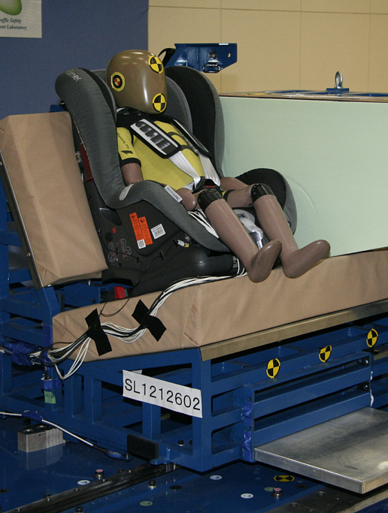
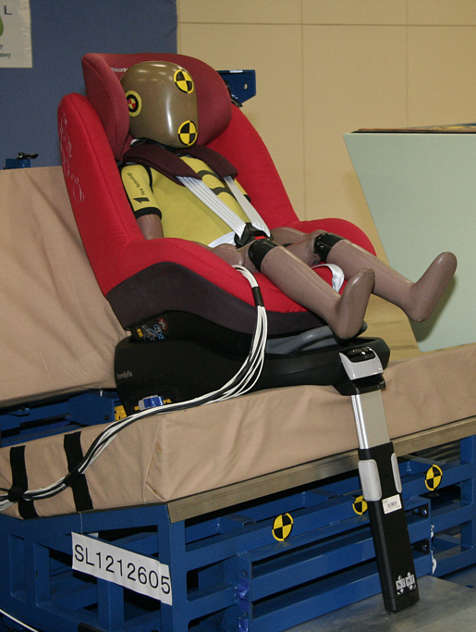
Tested CRS
CRS A
CRS B
CRS A is Group I TT CRS and CRS B is Group I SL CRS
Notes:
This shows tested CRS.
We tested 2 types of CRSs.
Both CRSs were the Group I CRS.
CRS A is TT and CRS B is SL.

Slide 10
Maximum injury Measures (CRS A)
Date from TUB and Dorel
Notes:
This is the comparison of maximum injury measures about CRS A.
As for the CRS A, we get the data from TUB and Dorel.
Test labs were 5 places, Britax, TUB, IDIADA, Dorel and NTSEL.

Slide 11
Maximum Injury Measures (CRS A)
Date from TUB and Dorel
As for the head injury measures, the test results were almost similar
Notes:
This shows the deviation to mean and coefficient of variation.
As for the head injury measures, coefficient of variation are less than 5%.
And deviation to mean are less than 10%.
So as for the maximum head injury measures, the test results were almost similar.

Slide 12
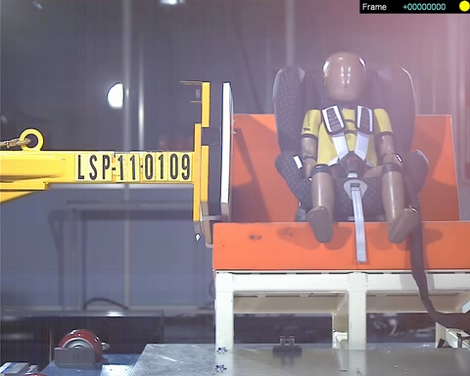
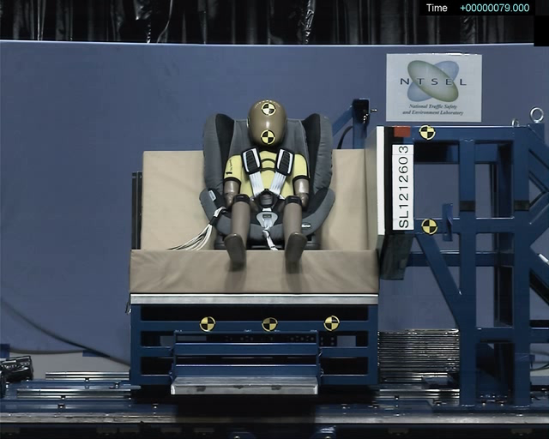
Video of Side Impact Test (CRS A)
Deceleration Sled
Acceleration Sled
Date from Dorel
Notes:
This shows the test videos of CRS A tests used by deceleration sled and acceleration sled.
Data was got from Dorel

Slide 13
Time Histories (CRS A)
Relative velocity
Date from Dorel
Notes:
This shows the relative velocity time histories.

Slide 14
Time Histories (CRS A)
Head acceleration
Date from Dorel
As for the head acceleration, time histories were almost similar
Notes:
This shows the head resultant acceleration time histories.
Though the timing of start rising of head resultant acceleration was different, the shape and maximum head resultant accelerations were similar.

Slide 15
Time Histories (CRS A)
Date from Dorel
Chest acceleration
Pelvis acceleration
Neck Upper Force
Neck Upper Moment
Notes:
This shows chest and pelvis acceleration ,neck force and neck moment.

Slide 16
Time Histories (CRS A)
Date from Dorel
Head acceleration (Dorel data moves 5ms)
As for the head acceleration, time histories were almost similar
Notes:
This shows the time history that the time changed.
The shape of chest injury measures were almost same.

Slide 17
Time Histories (CRS A)
Dorel data moves 5ms
Date from Dorel
Chest acceleration
Pelvis acceleration
Neck Upper Force
Neck Upper Moment

Slide 18
Maximum Injury Measures (CRS B)
Date from Dorel
Date from Dorel
Notes:
This is the comparison of maximum injury measures about CRS B.
As for the CRS B, we get the data from Dorel.
Test labs were 2 places,, Dorel and NTSEL.

Slide 19
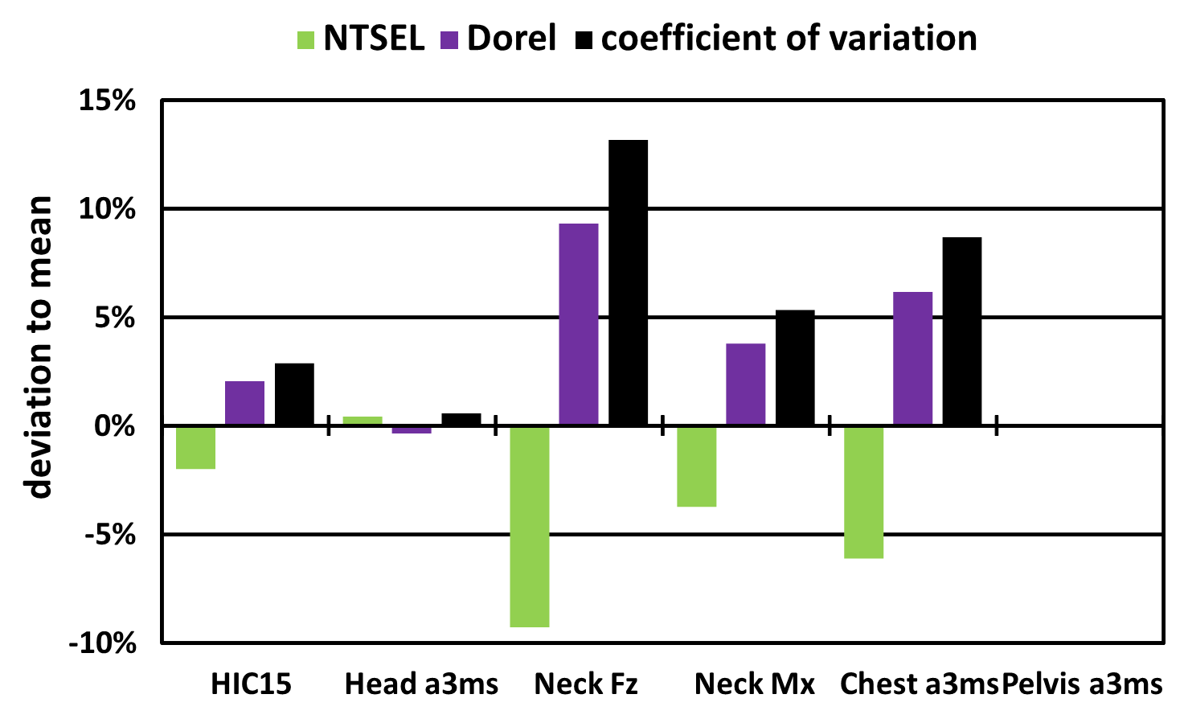
Maximum Injury Measures (CRS B)
As for the head injury measures, the test results were almost similar
Date from Dorel
Notes:
This shows the deviation to mean and coefficient of variation.
As for the head injury measures, coefficient of variation are less than 5%.
So as for the maximum head injury measures, the test results were almost similar.

Slide 20
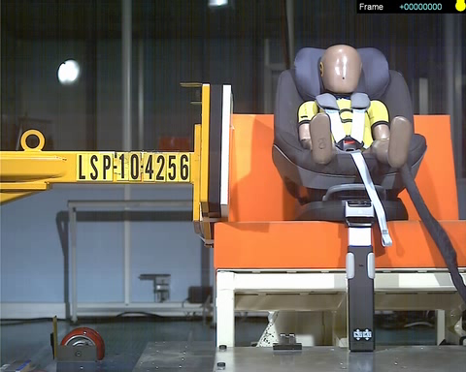
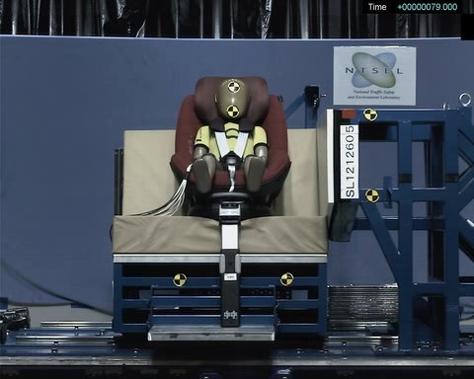
Video of Side Impact Test (CRS B)
Deceleration Sled
Acceleration Sled
Date from Dorel
Notes:
This shows the test videos of CRS B tests used by deceleration sled and acceleration sled.
Data was got from Dorel

Slide 21
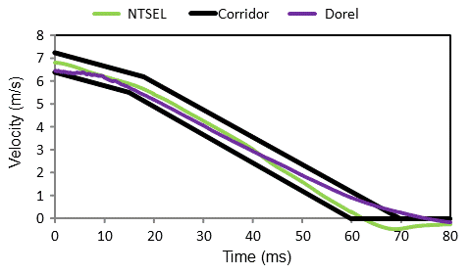
Time Histories (CRS B)
Relative velocity
Date from Dorel

Slide 22
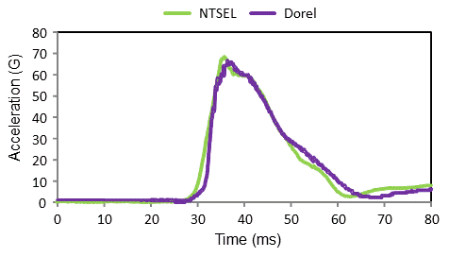
Time Histories (CRS B)
Head acceleration
Date from Dorel
As for the head acceleration, time histories were almost similar
Notes:
This shows the head resultant acceleration time histories.
The shape and maximum head resultant accelerations were similar.

Slide 23
Time Histories (CRS B)
Date from Dorel
Chest acceleration
Pelvis acceleration
NTSEL
Dorel
NTSEL
Dorel
80
110
70
100
60
90
80
70
50
Acceleration (G)
Acceleration (G)
60
40
50
30
40
20
30
10
20
10
0
0
0
10
20
30
40
50
60
70
80
0
10
20
30
40
50
60
70
80
Time (ms)
Time (ms)
Neck Upper Force
Neck Upper Moment
NTSEL
Dorel
NTSEL
Dorel
1000
14
900
12
800
10
700
8
600
6
Force (N)
500
4
400
Moment (N m)
300
2
200
0
100
-2
0
10
20
30
40
50
60
70
80
0
-4
0
10
20
30
40
50
60
70
80
-6
Time (ms)
Time (ms)
Notes:
This shows chest and pelvis acceleration ,neck force and neck moment.
The shapes were similar.

Slide 24
Conclusion
As for the head injury measures, the results used by acceleration sled and deceleration sled were almost similar.
Comparison of Dorel data and NTSEL data, time histories were almost similar.
Severity of the CRS side impact test used by deceleration sled and acceleration sled are similar.

