Slide 1
Informal Document No. GRSP-44-25
(44th session, 10-12 December 2008, agenda item 15(a))
Proposed amendments to the UNECE Regulation No. 29 on truck cab safety
OICA comments to Informal Document GRSP-44-01 (Russian Federation)
GRSP-44
December 2008

Slide 2
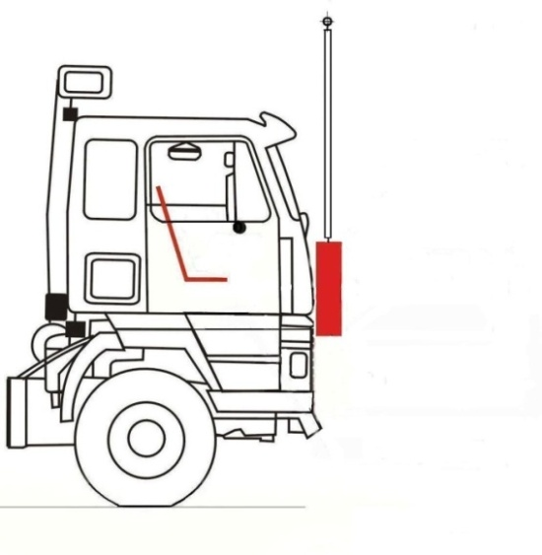
Frontal impact
N vehicles below 7.5t GVM (all N1; N2 ≤ 7.5t GVM)
GRSP-44-01 proposes to maintain the current R29.02 requirements, i.e.:
Impactor energy: 29.4 kJ
Impactor:
size: h=800 mm; l = 2500 mm
mass m = 1500 ± 250 kg
Impactor position:
с=50±5 mm below the H-point (R)‏
beam suspension of the impactor, L ≥ 3500 mm, b ≥ 800 mm
N1 vehicles meeting R94 or R33 are exempted from this impact test.
OICA agrees with this proposal

Slide 3
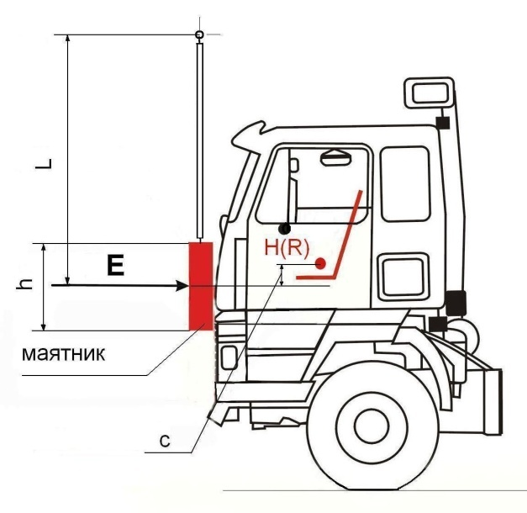
Frontal impact
N vehicles above 7.5t GVM (N2 > 7.5t GVM; all N3)
GRSP-44-01 proposes an impactor test based on current R29.02, with following characteristics:
Impactor energy: 58.8 kJ (33% increase
compared to R29.02)
Impactor:
- size: h=800 mm; l ≥ 2500 mm
(same as R29.02)
- mass m = 1500 – 2500 kg
(similar but not identical to R29.02)
Impactor position:
- с=50±5 mm (50 ±5 mm lower than point Н (R))‏ (same as R29.02)
- beam suspension of the impactor, L ≥ 3500 mm, b ≥ 800 mm (same as R29.02)
Test is only applicable to cab-over-engine and short bonnet vehicles ("75% or more of its engine length (excluding cooling systems) is located in front of the lowest rim of the wind shield. The length of the engine is limited by the clutch carter connector")
OICA agrees with this proposal, with the following comments

Slide 4
Frontal impact
N vehicles above 7.5t GVM (N2 > 7.5t GVM; all N3)
OICA POSITION
Energy level: the proposed energy level of almost 60 kJ seems excessive for several cab designs (see following slide) and OICA proposes a maximum energy level of 55 kJ (compromise between the original proposals from Russia (60kJ) and from OICA (50 kJ))
OICA fully supports the proposal that "conventional" trucks would be exempted from the impactor test (the same exemption should apply to vehicles ≤ 7.5t), but suggests the following wording:
The impactor test only applies to Cab Over Engine (COE) vehicles (also called Forward Control Vehicles in European texts)
A forward control/COE vehicle is a vehicle where more than half of the engine length is rearward of the foremost point of the windshield base and the steering wheel hub is in the forward quarter of the vehicle length (See European Directive 2007/46, Annex 1, footnote z)

Slide 5
Frontal impact
N vehicles above 7.5t GVM (N2 > 7.5t GVM; all N3)
Energy level - firewall intrusion
+ 41%
Intrusion
+ 26%
+ 11%
Energy
44 kJ
50 kJ
55 kJ
60 kJ
Recommendation

Slide 6
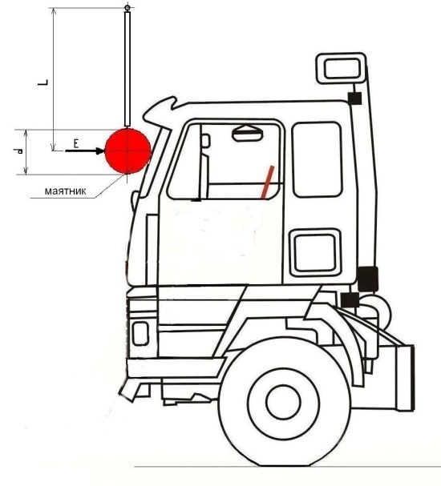
Front pillar impact
GRSP-44-01 proposes a new test, supposed to represent a 90° rollover with subsequent impact, as follows:
Applicable to N2 > 7.5t and N3 only
N1 and N2 ≤ 7.5 t: apply R29.02 (i.e. exempted)
Impactor energy: 29.4 kJ
Impactor:
- size: d=[300 - 600] mm; l ≥ 2500 mm
- mass m = 1000 – 1500 kg
- beam suspension, L ≥ 3500 mm, b ≥ 800 mm
Impact at the middle height level of the wind shield
OICA believes that the proposed A-pillar lacks does not fully represent the deformation patterns observed in available real world data
OICA however can accept the Russian proposal as a compromise, with the following comments:
Impactor diameter: 600 mm seems the most suitable
Impactor mass: the upper limit should be deleted, i.e. "mass m ≥ 1000 kg"

Slide 7
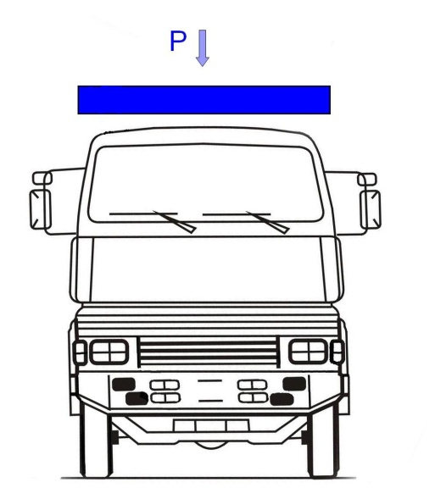
Roof Strength
N vehicles ≤ 7.5t GVM (all N1; N2 ≤ 7.5t GVM)
GRSP-44-01 proposes to maintain the current R29.02 requirements:
Static load P
Р = Рп with maximum of 98 kN Рп = part of the full weight of the vehicle borne by the front axle (axles)
OICA agrees with this proposal

Slide 8
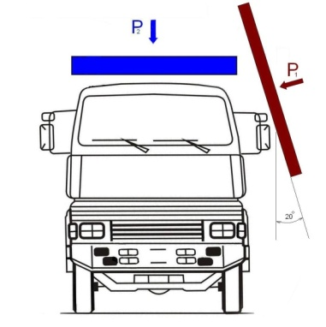
Roof Strength
N vehicles > 7.5t GVM (all N3; N2 > 7.5t GVM)
GRSP-44-01 proposes new test procedure based on SAE standard J2422 :
1st test – lateral preloading of the cab:
Impactor energy: 17.6 kJ
Impactor:
- size: h=800 mm; l = 2500 mm
- mass m = 1500 ± 250 kg
- 20 degrees relative to the vertical plane
- beam suspension of the impactor, L ≥ 3500 mm, b ≥ 800 mm
2nd test – roof strength
Static load P
Р = Рп with maximum of 98 kN Рп = part of the full weight of the vehicle borne by the front axle (axles)
OICA fully supports this proposal with following suggestions:

Slide 9
Roof Strength
N vehicles > 7.5t GVM (all N3; N2 > 7.5t GVM)
Dimension of plate: delete all dimensions and replace with the requirement that "The platen shall be sufficiently large and positioned such that the cab will contact only the interior of the platen, not the edges."
Pendulum impactor: in addition to a pendulum impactor, alternative procedures at choice of manufacturer should be allowed
Impactor mass: the mass should be minimum 1500 kg, without maximum

Slide 10
Roof Strength
N vehicles > 7.5t GVM (all N3; N2 > 7.5t GVM)
Justification of the 17.6 kJ pre-load energy
SAE J2422 Energy Calculation
17.6 kJ is minimum requirement - testing to higher energy is optional at the manufacturer's choice
Based on kinetic energy developed from vehicle static stability point to impact point during 90° roll sequence
Multiplied by 1.6 to reflect actual damage patterns
Test validations performed under SAE CRP-13
Complete analysis of development in “Heavy Truck Crashworthiness – Phase III,” SAE CRP-13

Slide 11
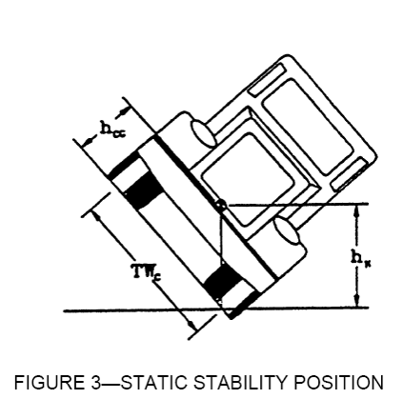
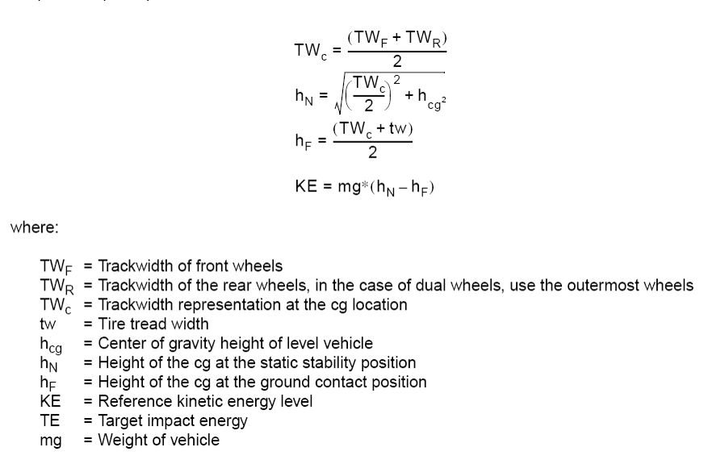
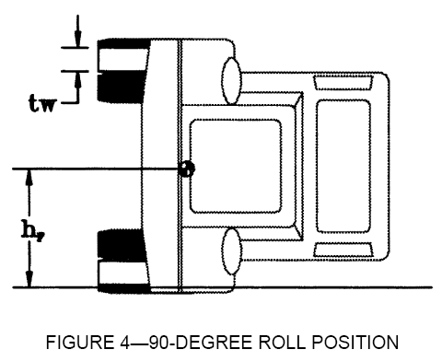
Roof Strength
N vehicles > 7.5t GVM (all N3; N2 > 7.5t GVM)

Slide 12
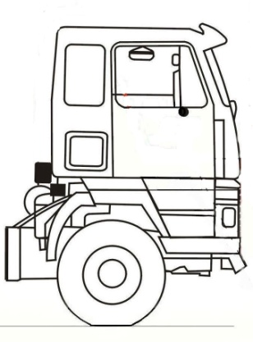
Back Wall Strength
N vehicles ≤ 7.5t GVM (all N1; N2 ≤ 7.5t GVM)
GRSP-44-01 proposes to maintain the current R29.02 requirements, i.e.:
Load:
1.96 kN per one ton of the load
Application of this test is optional at the choice of the manufacturer

Slide 13
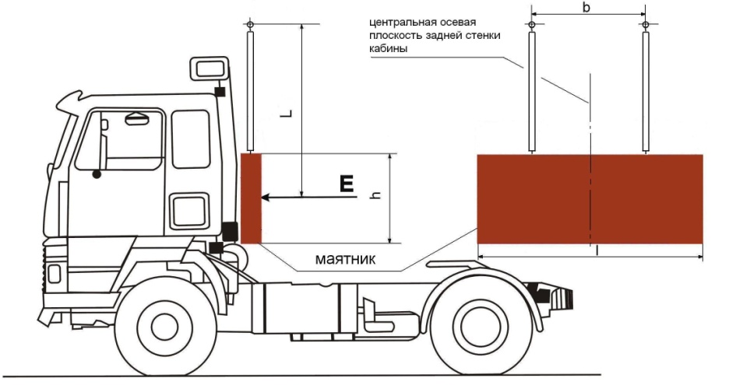
Back Wall Strength
N vehicles > 7.5t GVM (all N3; N2 > 7.5t GVM)
N2 > 7.5t and N3
Impactor energy: 29.4 kJ
Impactor:
- size: h=800 mm; l = 2500 mm
- mass m = 1500 ± 250 kg
- Impact centre:
coincide with central axial plane of the back wall
located in middle-point between cabin floor and roof
- beam suspension, L ≥ 3500 mm, b ≥ 800 mm
Application of this test is optional at the choice of the manufacturer

Slide 14
Back Wall Strength N vehicles
OICA position
OICA recognises that the back wall test is already part on UNECE R29 as an option to the manufacturer
However, no data exist to justify maintaining this test
The back wall test should therefore be deleted altogether for all N vehicles
If the back wall test is retained:
It must remain optional at the choice of manufacturer
It can only apply to vehicles with a separate cab.

Slide 15
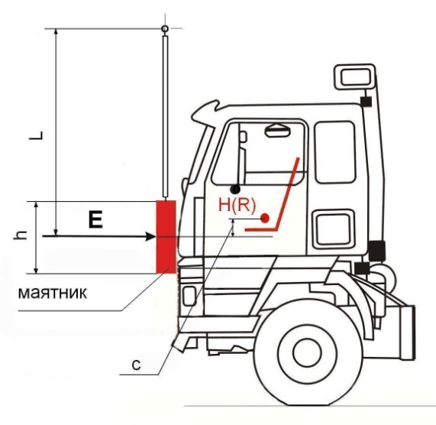
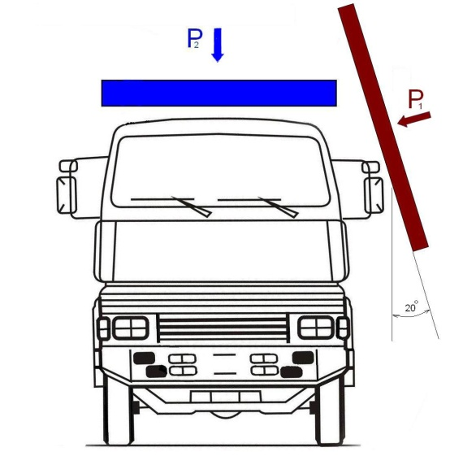
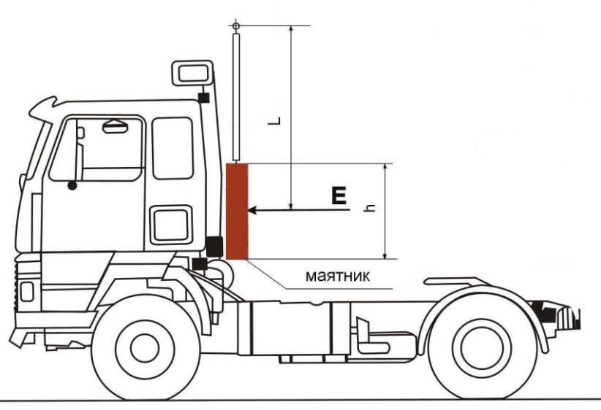
Summary of Cab Strength Tests for N > 7.5t
Test A
Test B
Test С
Test D (optional)‏

Slide 16
Final remarks
Simulations should be allowed for each of the tests
Pass fail criteria should remain based on UNECE R29 survival space, however replacing the current manikin by an un-instrumented 50th %-ile Hybrid III dummy
OICA in general supports alternatives but cannot comment the proposed criteria in GRSP/2007/14: OICA has no information on the justification of the proposal by Russia
Additional criteria of UNECE R29.02 should remain unchanged, i.e.
Cab attachments
Door opening

Slide 17
Thank you

