Slide 1
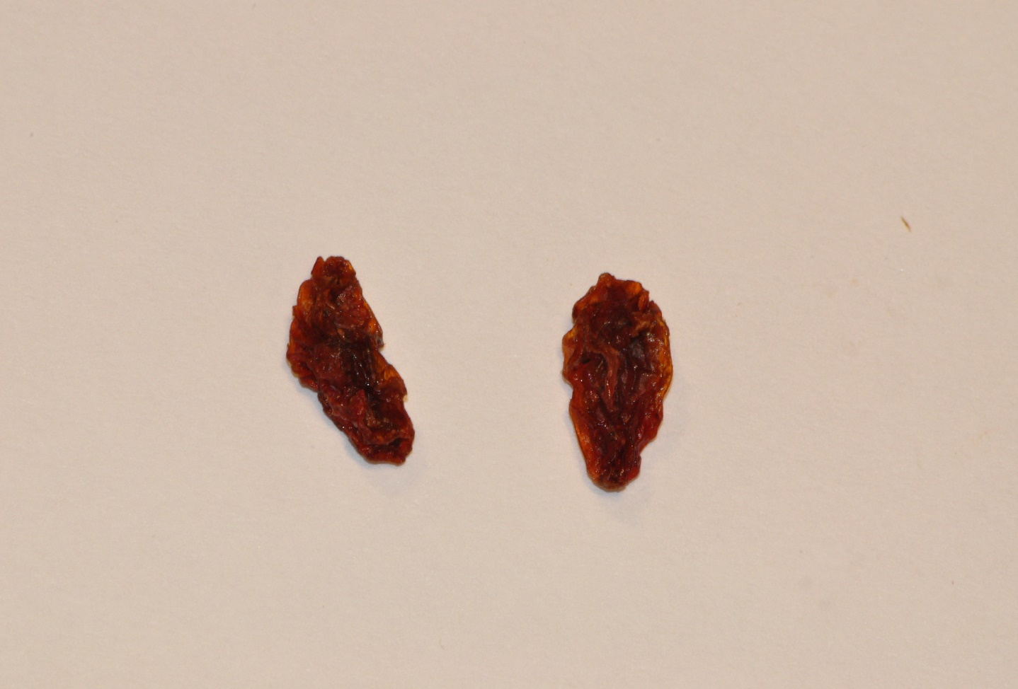
Undeveloped Berries

Slide 2
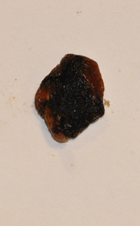
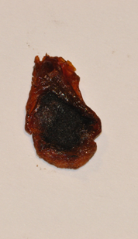
Mouldy

Slide 3
Damaged by pests

Slide 4
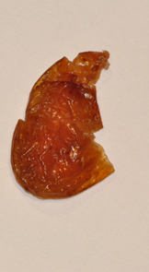
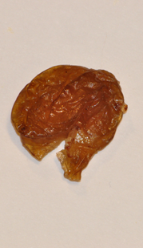
Mechanical Damage

Slide 5
Berries having seeds in seedless types

Slide 6
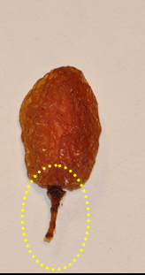
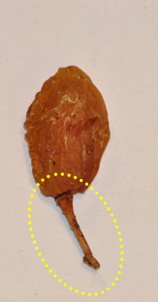
Berries with capstem attached
>3 mm

Slide 7
Extraneous vegetable material excluding pieces of stem (EİB)

Slide 8
Mineral impurities

Slide 9
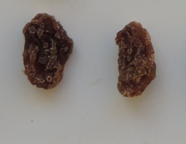
Sugared

Slide 10
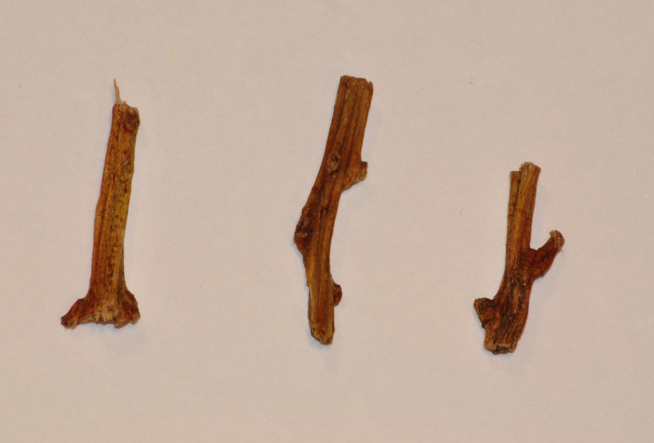
Pieces of stem

