Slide 1
Working Party on Agricultural Quality Standards Report 2016 Liliana Annovazzi-Jakab, Head, Agricultural Quality Standards Unit, UNECE Steering Committee on Trade Capacity and Standards, May 2016
Notes:
This is a sample Title Slide with Picture ideal for including a dark picture with a brief title and subtitle.

Slide 2
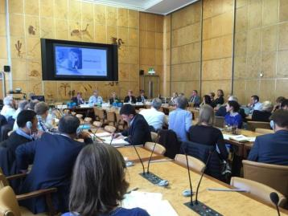
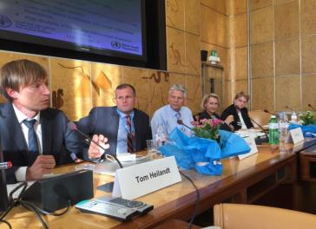
MeetingS and output WP.7 (2015)
Specialized Sections on Standardization of
Meat (September 2015 )
2nd meat symposium on quality/food safety/public/private
Total number of revised/new standards - 3
Decision to work on eating quality and include references to Codex Standards
public meets/meats private
Meat Seminar
28-09-2015

Slide 3
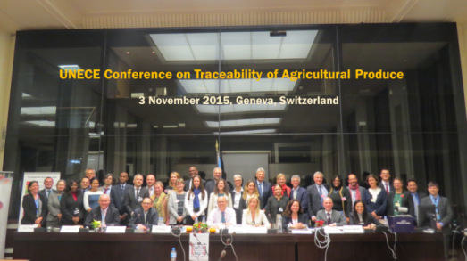
Meetings and output WP.7 (2015)
Working Party on Agricultural quality Standards
International Conference on Traceability of Agricultural Produce
Total number of revised/new standards in 2015: 13
Highly successful conference – outcome discussion group on traceability Increased attention to food waste and food loss issues

Slide 4
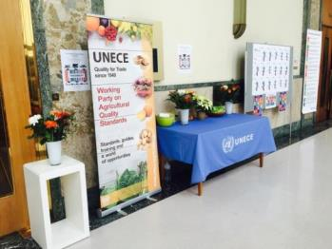
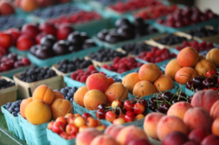
Meetings and output WP.7 (2016)
Specialized Sections on Standardization of Fresh Fruit and Vegetables (1 session)
Total number of revised/new standards in 2016: 20
Extensive discussions on food waste and traceability

Slide 5
Meetings and output WP.7
Total number of new guides: 4
Guide to Potato Diseases, Pests and Damages
Guide to Seed Potato Field Inspection
Explanatory Brochure for Inshell walnuts
Explanatory Brochure for Persimmon (kaki fruit) - forthcoming

Slide 6
Most striking increase in participation
 |  | Last session (2014 or 2015) | 2015/2016
Working Party 7 |  | 14 countries 16 delegations 23 participants | 28 countries 46 delegations 75 participants
Fresh Fruit and Vegetables |  | 17 countries 21 delegations 37 participants | 23 countries 28 delegations* 51 participants
*Many new participating countries

Slide 7
Priorities since September 2015
Working in sync with the SDGs and particularly
Goal 2. End hunger, achieve food security and improved nutrition and promote sustainable agriculture
Goal 12. Ensure sustainable consumption and production patterns
Goal 17. Strengthen the means of implementation and revitalize the global partnership for sustainable development
Cross-cutting themes including food waste and traceability

Slide 8
Sustainable agriculture
trade
Partnership with ITC
Project 1 - STANDARDS MAP
http://www.intracen.org/itc/market-info-tools/voluntary-standards/standardsmap/
Project 2 SustainabilityXchange
http://www.intracen.org/itc/market-info-tools/voluntary-standards/sustainabilityxchange/

Slide 9
Strengthened and new partnerships with Codex, OECD, EU, UNDP, ITC and donor agencies
Participation in
Donor funded project
OECD Plenary Meeting – December 2015
CCFFV meeting – October 2015
WTO Public Forum – October 2015
Geneva International Food Talks – 15 Geneva-based agencies working on food related issues

Slide 10
Sustainable agri trade
Partner UNDP and donor agencies

Slide 11
Capacity-building
UNDA project “Strengthening the capacity of transition and developing economies to participate in cross-border agricultural food supply chains” Western Balkan region, Central Asia, South Asia and South East Asia.
training on public/private meat standards (Geneva, September 2015)
case study (Business Process Analysis) on the export of dried apricots (Tajikistan) and currently on dried grapes (Uzbekistan)
Upcoming 2016 activities:
Nuts and Dried Fruit Workshop (Tashkent, Uzbekistan, July 2016)
Project coordination meeting with donor agencies (Geneva, June 2016)
Fresh Fruit Vegetables workshop for Balkan countries (October 2016)
Workshop on Agriculture Trade Facilitation (Bangkok, September 2016)
Fresh Fruit Vegetables workshop for Asia (Bangkok, November 2016)

Slide 12
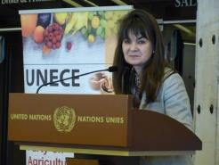
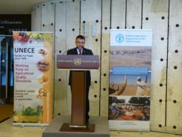
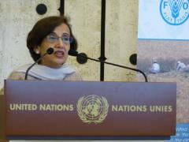
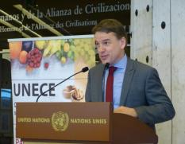
Achieve Food Security and Sustainable agriculture
in partnership with FAO and national delegations

Slide 13
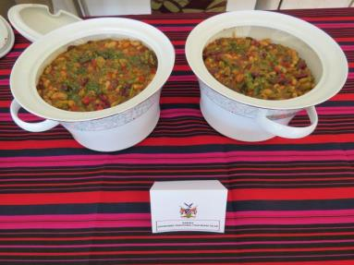
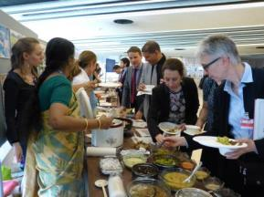
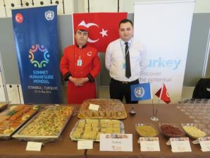
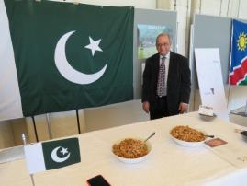

Slide 14
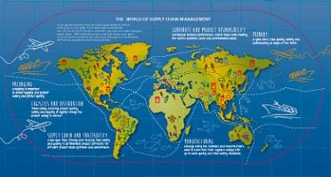
CHALLENGES
Today, the UNECE, national, regional, international regulators and the private sector have to take into account:
New import and export markets
More, and diverse players, more complex international supply chains and retailers that operate globally
Notes:
14

Slide 15
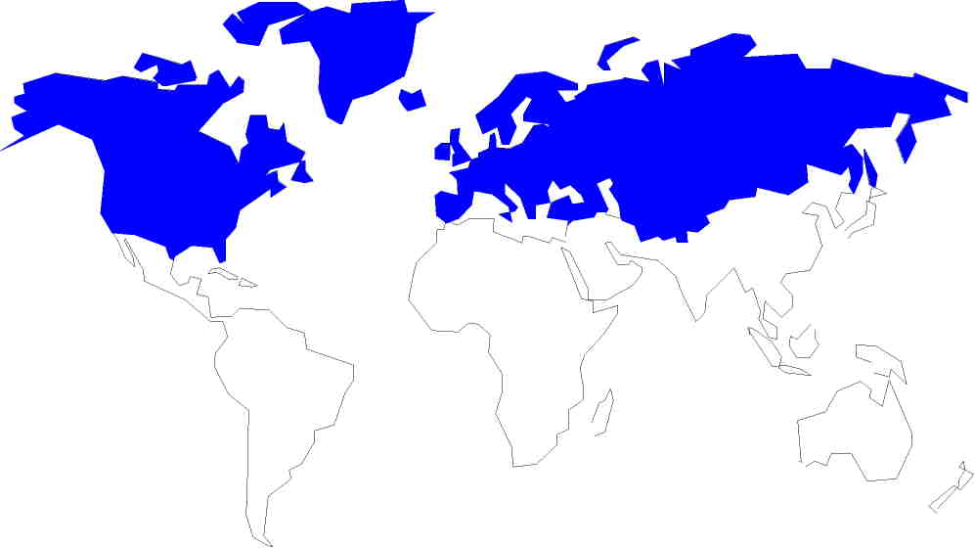
ECE
ESCWA
ESCAP
ECA
ECLAC
ECE – only regional commission working on agricultural quality and marketing standards

Slide 16
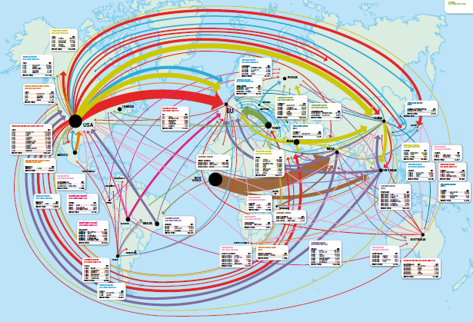
Example: Dried fruit and nut trade flows

Slide 17
Over the years UNECE has evolved into a platform
for the development of
agreed
international best practice for international and national trade in agricultural produce
Countries turn to UNECE for advice on regulating their national markets to obtain quality which improves nutrition and food security.
Food security exists when all people, at all times, have physical and economic access to sufficient, safe and nutritious food that meets their dietary needs and food preferences for an active and healthy life”. (World Food Summit, 1996)
Notes:
17

Slide 18
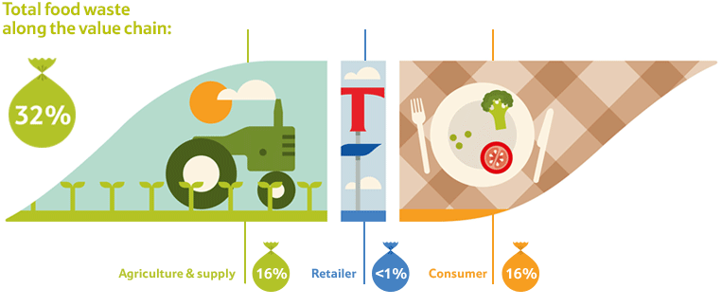
CHALLENGES
Today, the UNECE, national, regional, international regulators and the private sector have to take into account:
Concerns of consumers, producers and retailers about the origin of their food, its safety and quality and the waste resulting from standards
Notes:
18

Slide 19
MEETING DATES 2016
27 - 29 June 2016: Specialized Section on Dry and Dried Produce, Geneva, Switzerland
11 -13 July 2016: Nuts and Dried Fruit Workshop, Tashkent, Uzbekistan
29 - 31 August 2016: Specialized Section on Meat, Geneva, Switzerland
31 August - 2 September 2016: Specialized Section on Seed Potatoes, Geneva, Switzerland
October 2016: Fresh Fruit and Vegetables Workshop, Balkan countries, venue tbc
9 - 11 November 2016: Working Party on Agricultural Quality Standards, Geneva, Switzerland
10 November 2016
International Conference on Food Waste and Food Loss in Agri Trade
Notes:
There has to be a formal meeting in 2016 (we di not have one in 2015)
Mr. John Kerr will be one of the speakers at the Traceability Conference on 3 November. He will speak about the traceability of seeds.

Slide 20
Contact:
Liliana Annovazzi-Jakab
Head UNECE Agri Standards Unit
liliana.annovazzi-jakab@unece.org
agristandards@unece.org
THANK YOU

