Slide 1

UNECE - Steering Committee on Trade Capacity and Standards
Removing regulatory and procedural barriers to trade in the ECE region
Republic of Albania – Republic of Moldova
Geneva 26 May 2016
David HANLON
Conformity Assessment Board (CAB) Secretary dha@iec.ch www.iec.ch
Antoinette PITTELOUD
External Liaisons Officer api@iec.ch ww.iec.ch
Skype antoinette-iec

Slide 2
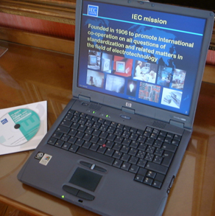
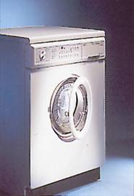
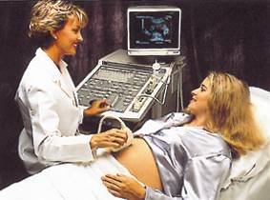
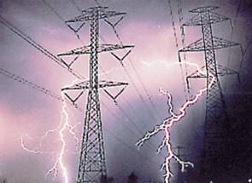
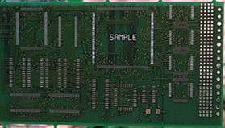
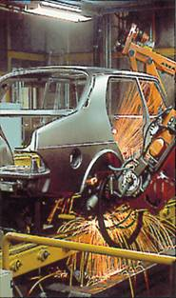
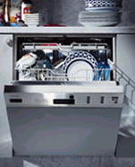

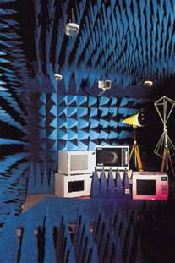


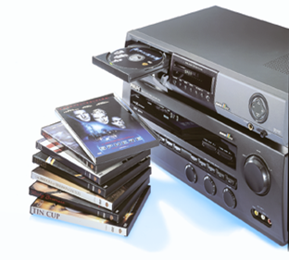
IEC – 100 years of experience
Founded in 1906
To promote international co-operation on all questions of standardization and conformity assessment
Preparation of International Standards

Slide 3


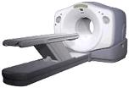
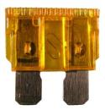
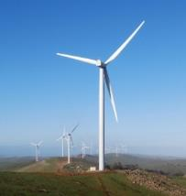

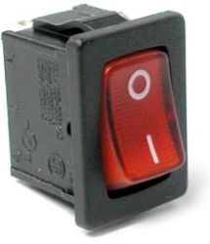
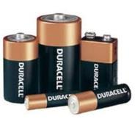
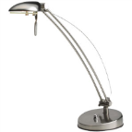
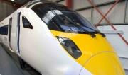


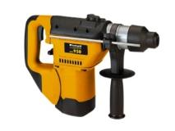
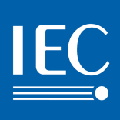
Scope of the IEC
Millions of devices and systems that use or produce electricity and contain electronics.
Interoperability, safety, performance, EMC, waste management and environment
Notes:
IEC work covers billions of electrical and electronic components, devices and systems that are used in homes, offices, health facilities and public spaces, power networks, cities, transportation, information technology, agriculture, manufacturing, and more.
The IEC always looks at interoperability, safety, electromagnetic interference, the responsible use of hazardous substances, waste management and the environment.

Slide 4
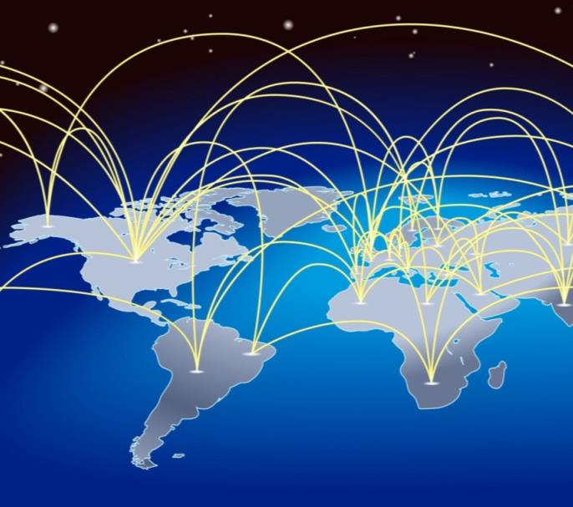
Biggest after raw energy
Raw energy: 16%
(3,209 trillion)
World trade in electronics and electrical devices: 12%
(USD *2,382 trillion)
Vehicles: 7.2%
(USD 1,390 trillion)
Fashion: 2.5%
(USD 0,473 trillion)
*not including lighting, optical electronic and photo devices, medical devices, aircraft
Notes:
Raw energy represents the biggest trade value with USD 3,052 trillion or 16% of total trade.
Next in line:
electrical and electronic goods represent 12% or USD 2,282 trillion in 2014.
Actually, this value should be even higher as the statistics don’t include lighting, optical electronic and photo devices, medical devices, aircraft and a couple of other items.
In comparison: the share of world export of motor vehicles represents only
7.2% and that of fashion is only 2.5%

Slide 5
WTO TBT Agreement context
WTO recommends
The use of relevant International Standards as a basis for their technical regulations, except
  when such International Standards would be ineffective or inappropriate, i.e. because of fundamental climatic or geographical factors or fundamental technological problems
5
Notes:
Most of the 161 WTO member states commit to using IEC International Standards as a technical basis for their laws and regulations for electrical and electronic devices and systems.

Slide 6
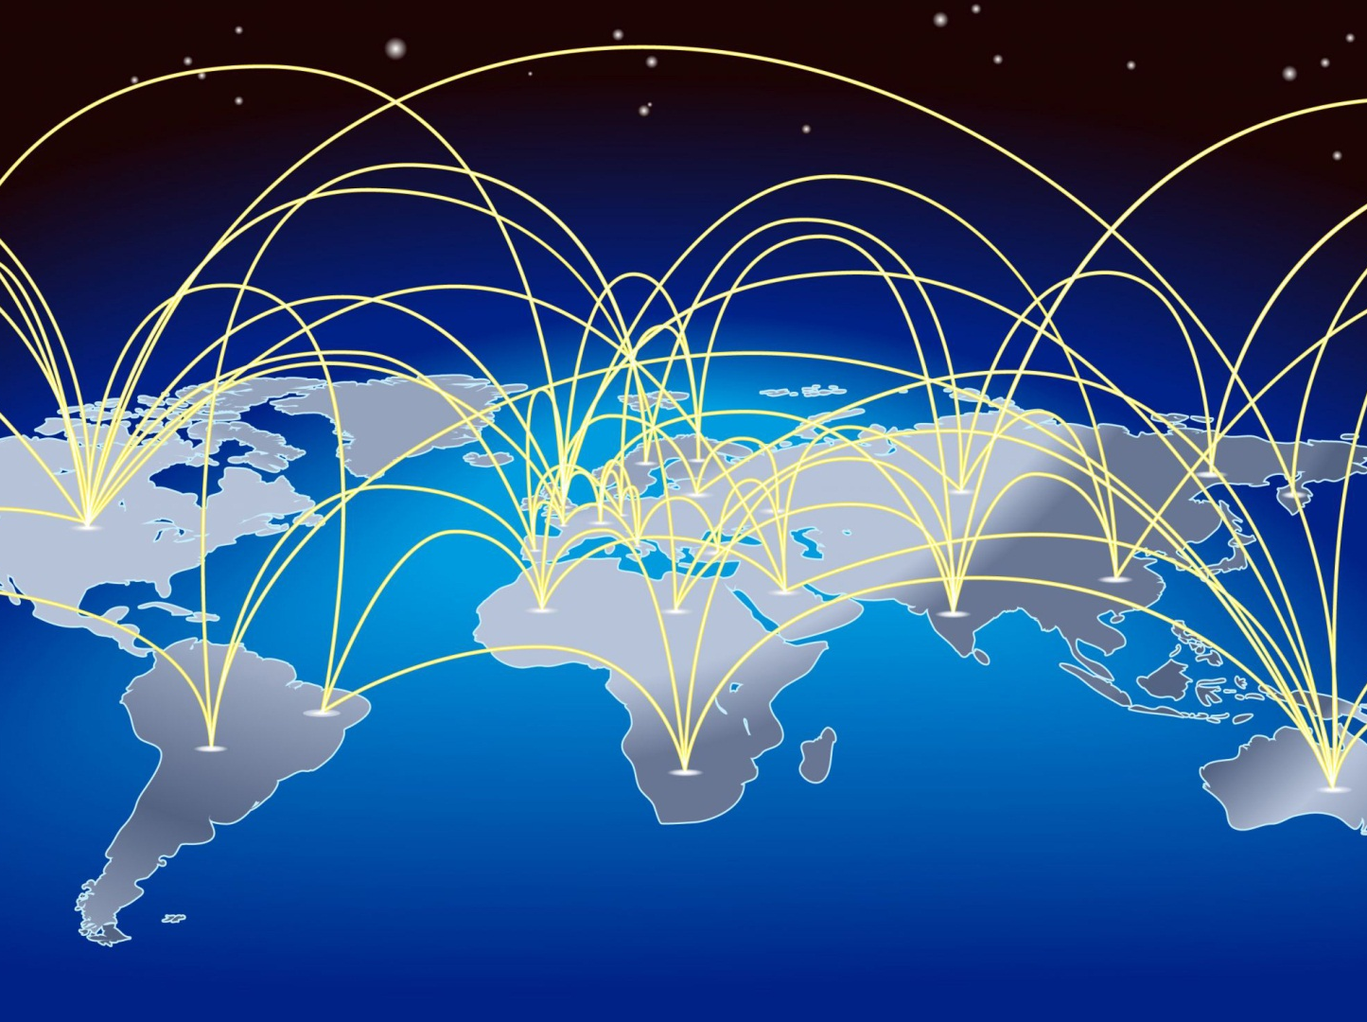
made in the world
Notes:
There are many reasons why International Standards are now growing in importance.
One of them is that economies are increasingly interdependent. Any country that wants to export must also be able to import standardized parts and components.
Today electrical and electronic goods represent the large majority of global trade after raw energy. Most of them rely on IEC International Standards.

Slide 7
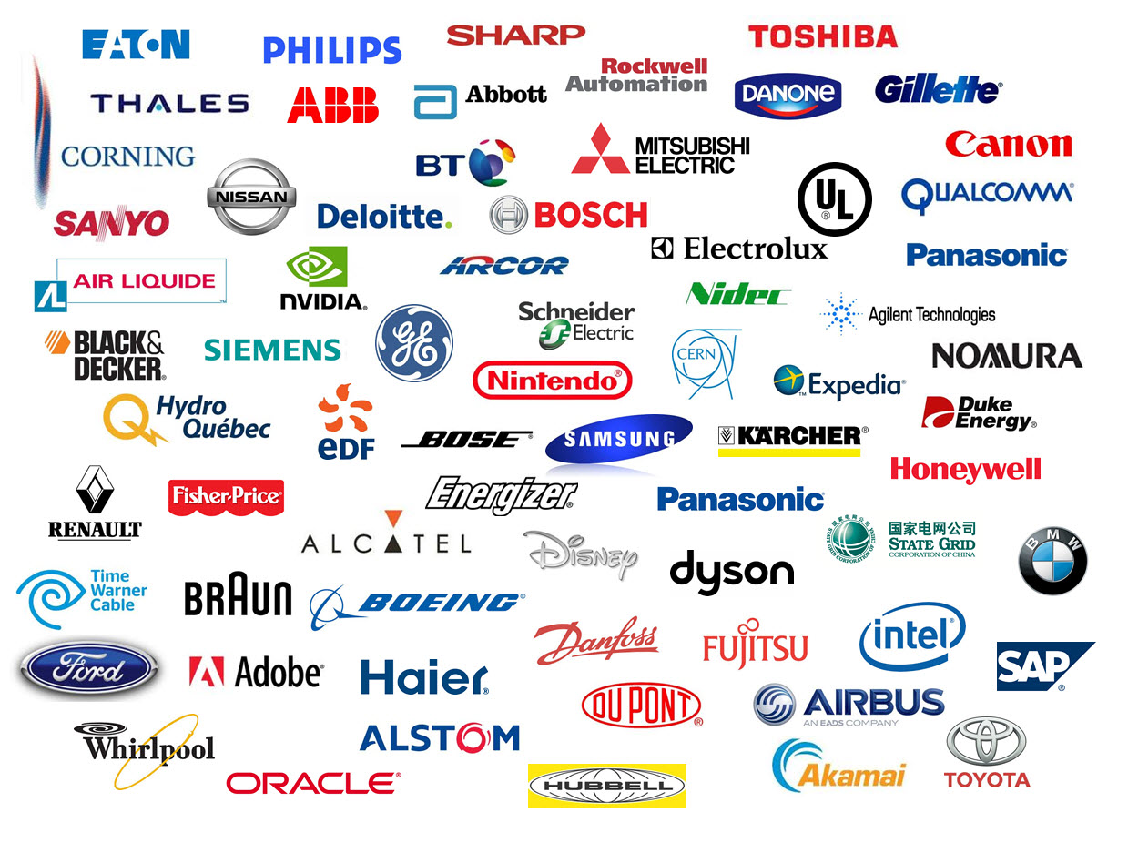
Notes:
This is just an overview of some of the companies that participate in IEC work via their National Committee.
They understand that active participation in the IEC allows them to shape the rules their industry will work with in the future.
Generally they participate in every technical area that impacts their products.
They see this as an important tool that allows them to compete globally. They also participate because they don’t want the competition to decide what rules they will have to work with in the future.

Slide 8

Global knowledge platform
20 000 experts
212 Technical Fields (SC/TC)
1 450 working groups
9 000 standards

Slide 9
IEC Family: 167 countries
83 Members 84 Affiliates
Notes:
Today, we have 84 developing countries participating in the IEC Affiliate Country Programme completely free of charge.
The objectives of the Programme are to get developing countries using IEC International Standards to reduce technical barriers to trade and for the benefit of their population’s safety. By so doing we can also improve the global reach of IEC International Standards. They are also encouraged to recognize certificates issues within the four IEC Conformity Assessment Systems

Slide 10
83 National Committees
ALBANIA (AM)
ALGERIA
ARGENTINA
AUSTRALIA
AUSTRIA
BAHRAIN (AM)
BELARUS
BELGIUM
BOSNIA-HERZEGOVINA (AM)
BRAZIL
BULGARÌA
CANADA
CHILE
CHINA
COLOMBIA
CROATIA
CUBA (AM)
CYPRUS (AM)
CZECH REP.
DENMARK
DPR OF KOREA (AM)
EGYPT
ESTONIA (AM)
FINLAND
FRANCE
GEORGIA (AM)
GERMANY
GREECE
HUNGARY
ICELAND (AM)
INDIA
INDONESIA
IRAN
IRAQ
IRELAND
ISRAEL
ITALY
JAPAN
JORDAN (AM)
KAZAKHSTAN (AM)
KENYA (AM)
KOREA, REP. OF
LATVIA (AM)
LIBYA
LITHUANIA (AM)
LUXEMBOURG
MALAYSIA
MALTA (AM)
MEXICO
MOLDOVA (AM)
MONTENEGRO (AM)
MOROCCO (AM)
NETHERLANDS
NEW ZEALAND
NIGERIA (AM)
NORWAY
OMAN
PAKISTAN
PHILIPPINES
POLAND
PORTUGAL
QATAR
ROMANIA
RUSSIAN FEDERATION
SAUDI ARABIA
SERBIA
SINGAPORE
SLOVAKIA
SLOVENIA
SOUTH AFRICA
SPAIN
SRI LANKA (AM)
SWEDEN
SWITZERLAND
THAILAND
THE FYR OF MACEDONIA (AM)
TUNISIA (AM)
TURKEY
UKRAINE
UAE
UK
USA
VIETNAM (AM)

Slide 11
IEC – close to its family members
IEC CO
Geneva
ReCNA
Boston
AFRC
Nairobi
APRC
Singapore
LARC
São Paulo
IECEx/IECQ
Sydney
Notes:
The Headquarters of the IEC is in Geneva with approximately 100 employees.
APRC in Singapore for Pakistan and Malaysia
IEC has five regional representations in the world and a sixth one which was inaugurated in Nairobi, Kenya, 2nd November : IEC Africa Regional Centre (AFRC)-
It is intended in the next future to open an office for the Russian speaking countries.

Slide 12
The world of standards
International:
IEC, ISO, ITU
Regional: Africa (ex. AFSEC)
Americas (ex. COPANT, CANENA, MERCOSUR)
Asia-Pacific (ex. ASEAN, PASC)
Europe (ex. CENELEC, ETSI, EASC)
Gulf countries: GSO, Islamic countries: SMIIC
National Committees
(ex. Albania, Moldova…)

Slide 13

partnering with others:
25 Agreements and MoU
Liaisons with 156 organizations http://www.iec.ch/dyn/www/f?p=103:218:0
Notes:
25 co-operation agreements/MoU/collaboration pledge are available on the IEC website at http://www.iec.ch/dyn/www/f?p=103:218:0
In preparation GSO, SARSO
In the future with SMIIC
The IEC has liaisons with 156 organizations at the global and regional level.
The IEC cooperates with several international and regional bodies with the aim of encouraging implementation of its international standards and to reduce work overlaps.
By partnering and cooperating with international bodies, industrial organizations, fora, consortia and other standards developing bodies, we aim to take on board all relevant expertise and work to reduce duplication and waste.
With its broad industry representation the IEC is uniquely positioned to bridge the gap between private players and public interest groups.

Slide 14

CENELEC Dresden agreement:
~ 80+% aligned standards
Notes:
20’000 international experts
10’000 European experts
Parallel work for CDV and FDIS
In the European Union, the IEC has a special agreement with CENELEC, the so-called Dresden agreement. The aim is to expedite the publication and common adoption of International Standards to make rational use of available resources. CENELEC has put in place mirror committees to those in the IEC. Relevant Committee Drafts for Voting and FDIS are automatically circulated for voting within CENELEC.
This agreement allows the European IEC Members to be directly involved in the planning of new IEC work, avoid duplication and make best use of expert’s time. Today around 80% of European electrotechnology standards are identical or based on IEC International Standards.

Slide 15

IEC value creation
Using standards = CA
Standards and CA
are like two sides of a coin…
…neither side has value
without the other
Standards + CA = Value
Notes:
The IEC is supported on two main pillars.
The first pillar is the standards development activities.
The second vital pillar is the conformity assessment activities.
Whether it’s a manufacturer or an end user or an independent 3rd party,
when they use a standard to check a product, they are all doing conformity assessment.
In this way, standards and conformity assessment are like two sides of a coin…
neither side has value without the other.
Only together do standards and conformity assessment create value.

Slide 16

One test…one certification… many countries
IEC CA Systems
Only international standardized form of certification
Biggest working multilateral recognition agreement
Good way to reduce technical barriers to trade*
*Ch Johnson, Technical Barriers to Trade: Reducing the Impact of Conformity Assessment Measures,
U.S. International Trade Commission, September 2008
Notes:
The IEC is the only organization in the world that provides an international standardized form of testing, verification and certification.
The IEC Conformity Assessment Systems are the largest and most successful multilateral recognition agreement.
Certificates of the IEC Conformity Assessment Systems are widely accepted, well beyond member countries.
Thousands of testing labs participate in the IEC CA Systems.
Each of them accepts the certificates and conformity assessment reports of the other Members of a System.
A study by the U.S. International Trade Commission confirms that mutual recognition agreements are a good way to reduce technical barriers to trade, particularly in the area of conformity assessment measures and standards.

Slide 17

IEC CA Systems
Global conformity assessment Systems
IECEE
IECEx
IECQ
IECRE
Notes:
The IEC has four global conformity assessment systems.
IECEE – for home, office, medical, manufacturing, public spaces, Smart Grid, Evs and so on.
IECEx – for all verification needs of the Ex industry, or, explosive atmospheres sector
IECQ – for electronic components and supplier quality management
and
IECRE – for renewable energy in the wind energy, marine energy and PV solar energy sectors.

Slide 18
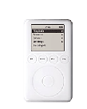
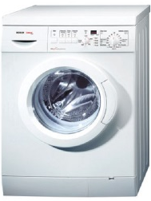


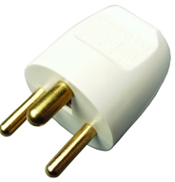
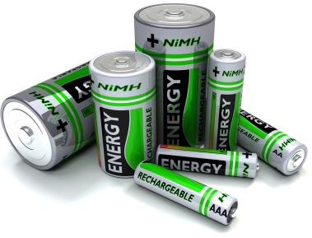

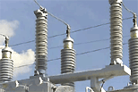


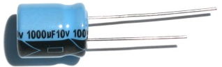
IECEE CA Schemes
CB-Scheme
CB-FCS
Notes:
IECEE stands for
the IEC System of Conformity Assessment Schemes for Electrotechnical Equipment and Components
IECEE continues to be the flagship for the verification and certification of the safety, quality, efficiency and overall performance of a wide range of goods that are used in the home, office, medical environments, public spaces or manufacturing.
The IECEE operates two conformity assessment schemes,
the long running and very successful CB-scheme, and
the more recent CB-Full Certificate Scheme or CB-FCS.
54 countries are members of the IECEE and use the CB-Test reports as a basis for certification and validation for access to their national market.

Slide 19
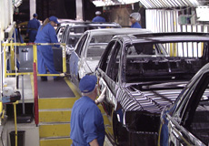
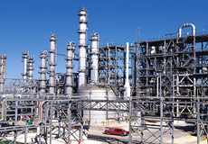
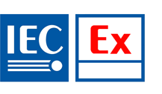
IECEx – explosive atmospheres
Equipment Scheme ← unit certification
Service Scheme ← process certification
Certified Persons Scheme ← people certification
Mark Licensing Scheme ← licencing
Notes:
IECEx stands for
the IEC System for Certification to Standards Relating to Equipment for Use in Explosive Atmospheres
IECEx is the International Standards-based way of doing Ex certification.
IECEx is a “conformity assessment tool” providing confidence that products, services and personnel covered by an IECEx certificate meet specified requirements.
It runs these four scheme.
IECEx addresses all verification needs of the Explosive atmosphere industry.
It covers design, planning, installation, inspection, maintenance and repair and the assessment of the competence of personnel working in this highly specialized area.

Slide 20
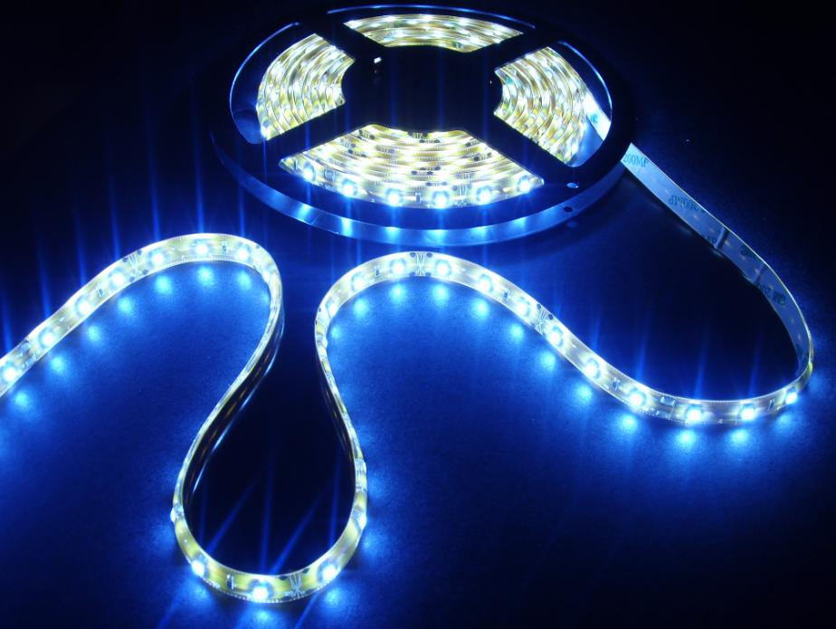

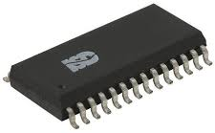
IECQ – Quality
HSPM – Hazardous Substances ← process
ECMP for avionics ← supply chain
Counterfeit Avoidance Process Scheme
LED lighting Scheme
Notes:
IECQ stands for
the IEC Quality Assessment System for Electronic Components
IECQ helps industry, including for example automotive and avionics, to efficiently manage electronic components and suppliers.
Most recently IECQ has added the LED lighting scheme that facilitates the mass production of quality LED components and assemblies.
The System is an important tool against counterfeit electronic components.

Slide 21

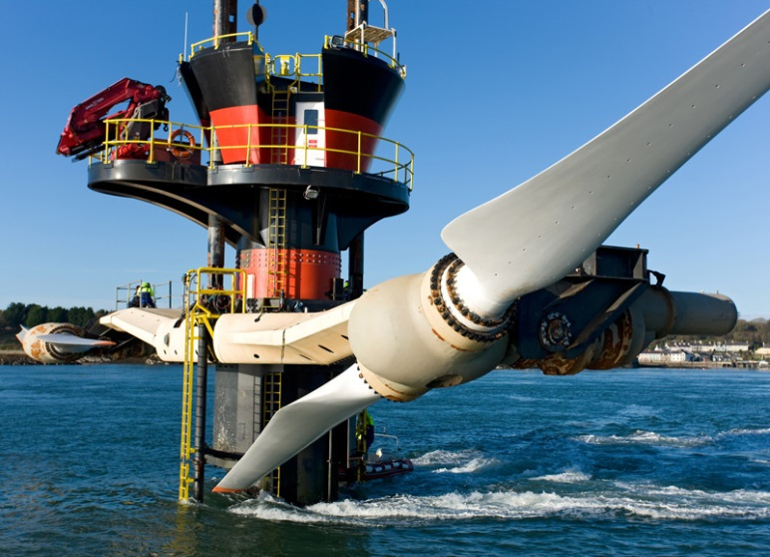

IECRE – Renewable Energy
Wind Energy
Marine Energy
Solar PV Energy
Notes:
IECRE stands for
the IEC System for Certification to Standards Relating to Equipment for Use in Renewable Energy Applications.
The IECRE is the most recent IEC global CA System and was launched in September 2014.
To date, 18 countries are involved.
IECRE currently provides services for three renewable energy sectors.
Wind energy
Marine energy
And solar PV energy

Slide 22
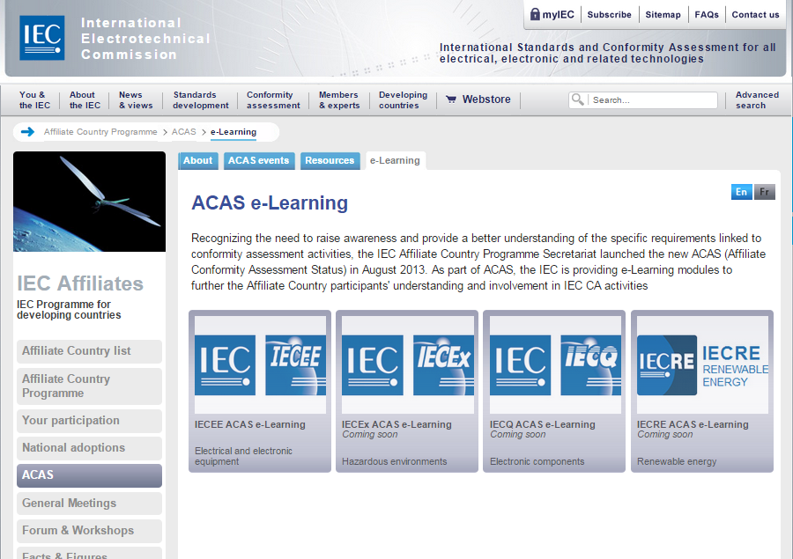
IEC e-learning modules
http://www.iec.ch/affiliates/acas/e-learning/
Notes:
If you wish to learn more about the IEC global conformity assessment services, we invite you to take a look at the new IEC CA e-learning modules on the IEC website, at this URL.
www.iec.ch/affiliates/acas/e-learning/

Slide 23
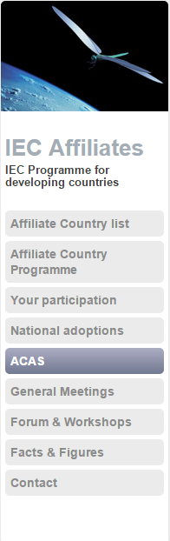
e-Learning modules
Level 0
  Introductory e-Learning modules
  Available for all Affiliate participants with IEC login
Level 1
  Intermediate e-Learning modules
  Available only for Affiliate participants nominated through the ACAS Pledge signed by their country
  Short test at end of Level 1 for access to Level 2
Level 2
  Advanced e-Learning modules
  Available for Affiliate participants who have passed the test for the previous levels, and whose country has signed the ACAS Declaration
  At the end, participants will receive a "Recognition of Achievement" attesting that they have successfully completed an ACAS e-Learning course
Notes:
Valid for members and affiliaites
level 0 accessible to everyone
Level 1 pledge
Level 2 declaration
ACAS e-Learning
The ACAS e-Learning modules are intended to provide a better understanding of the functioning of the systems as well as their conformity assessment activities. The knowledge has been split into 3 levels: Introductory, Intermediate and Advanced.

Slide 24
IEC value creation
Standards = Quality
Conformity Proven
Assessment Quality
=
Notes:
Once again,
to create value,
standards and conformity assessment must work together.

Slide 25

IEC National Committee of Albania – IEC member since 2009 http://www.iec.ch/dyn/www/f?p=103:16:10846585156611
 | IEC National Committee of Albania Albanian General Directorate of Standardization (DPS) Rr: 'Mine Peza', Nr 143/3 P.O. Box/ Kutia Postare 98 AL-1014 TIRANA Albania
President | Mr Riza Hasanaj
Secretary | Mrs Anita Reçi

Slide 26
Ways forward for Albania
1. Use International Standards
  Already exists
  Will be updated automatically
  Reflects state of the art, international consensus
  Cheap, quick, easy to use
  Avoids lengthy process of drafting a new standard that is unrecognized and could just be “reinventing the wheel”
  Is transparent
  Allows capacity building by sharing experience with other countries
  85% of the IEC IS are adopted as European standards

Slide 27
Ways forward for Albania
2. Adopt more IEC International Standards
  Licence agreement to use IEC Publications in electronic format with electronic watermark for internal use only by the National Committee was signed in 2010 by Albania
  Albania has adopted 396 IEC International Standards
  Articles 15-17 of the Albanian law on standardization provides guidance for the adoption of international standards

Slide 28
Ways forward for Albania
3. Participate in the standardization process
Nominate more experts in IEC/TC 13 Electrical energy measurement where Albania is IEC P-member (participating member)

Slide 29
Ways forward for Albania
4. Participate in the standardization process
by becoming P-member in international TCs
in the electrotechnical field
DPS/KT 3 – Electrical and electronic material (IEC TC 32 – Fuses)
DPS/KT 4 – Electrical and electronic devices (IEC TC 96 - Transformers, reactors, power supply units and similar products for low voltage up to 1100 V)
DPS/KT 6 – Technical safety and environment (IEC TC 44 - Safety of machinery – Electrotechnical aspects; IEC TC 59 - Performance of household and similar electrical appliances; IEC TC 61 - Safety of household and similar electrical appliances; IEC TC 31 - Equipment for explosive atmospheres; IEC TC 111 – Environmental standardization for electrical and electronic products and systems)
DPS/KT 7 – Semiconductor materials and devices. Electromechanical components and
mechanical structures for electronic equipment (IEC TC 39 - Electronic tubes; IEC TC 40 - Capacitors and resistors for electronic equipment; IEC TC 47 – Semiconductor devices; IEC TC 48 –Electromechanical components and mechanical structures for electronic equipment; IEC TC 49 - Piezoelectric and dielectric devices for frequency, control and selection)
DPS/KT 8 – Measuring equipment. Testing techniques. (IEC TC 13 - Electrical energy
measurement, tariff and load control; IEC TC 85 – Measuring equipment for electrical and electromagnetic quantities)

Slide 30
Ways forward for Albania
5. Training courses – workshops
Free of charge
Either in Geneva or in Albania

Slide 31
Ways forward for Albania
6. Recognize CB certificates (free of charge)
CB certificate is proof of conformity to standard
Recognizing the certificate costs nothing
Build QI according to national priorities
Save resources → use existing QI
IEC CA Systems are existing QI (free of charge)

Slide 32
Ways forward for Albania
7. ACAS e-learning
Learn about IEC CA Systems
IEC CA Systems can be used as free QI
Ensure safety and quality of imported goods

Slide 33

IEC National Committee of Moldova – IEC member since 2012 http://www.iec.ch/dyn/www/f?p=103:16:0::::FSP_ORG_ID:1093
 | IEC National Committee of Moldova Moldovan Electrotechnical Committee Secretariat held at the National Standardization Institute (INS) Str. Coca 28 MD-2064 CHISINAU Moldova, Republic ofo
President | Mr Iurii Socol
Secretary | Ms Lucia Mursa

Slide 34
Ways forward for Moldova
1. Use International Standards
  Already exists
  Will be updated automatically
  Reflects state of the art, international consensus
  Cheap, quick, easy to use
  Avoids lengthy process of drafting a new standard that is unrecognized and could just be “reinventing the wheel”
  Is transparent
  Allows capacity building by sharing experience with other countries
  85% of the IEC IS are adopted as European standards

Slide 35
Ways forward for Moldova
2. Adopt more IEC International Standards
  Licence agreement to use IEC Publications in electronic format with electronic watermark for internal use only by the National Committee was signed in 2012 by Albania
  Moldova has adopted 369 IEC IS so far

Slide 36
Ways forward for Moldova
  3. Participate in the standardization process by becoming P- member in international TCs in the electrotechnical field
  Moldova as IEC Associate Member can choose to participate in 4 Technical Committee and Sub-Committees

Slide 37
Ways forward for Moldova
4. Training courses – workshops
Free of charge
Either in Geneva or in Albania

Slide 38
Ways forward for Moldova
5. Recognize CB certificates (free of charge)
CB certificate is proof of conformity to standard
Recognizing the certificate costs nothing
Build QI according to national priorities
Save resources → use existing QI
IEC CA Systems are existing QI (free of charge)

Slide 39
Ways forward for Moldova
6. ACAS e-learning
Learn about IEC CA Systems
IEC CA Systems can be used as free QI
Ensure safety and quality of imported goods

Slide 40


Slide 41

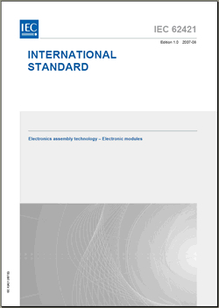
What is an IEC International Standard?
technical guidelines or characteristics developed
by experts representing
all stakeholders
based on international
consensus
always voluntary
Notes:
So what is an IEC International Standard?
It consists of guidelines or characteristics that are developed by experts who represent as broadly as possible different interested parties. These experts cooperate on the IEC global platform to come up with solutions to common problems their industry faces. They develop a consensus agreement on what the norm should be in terms of things such as measurements, ratings, vocabulary, performance, safety, reliability and so on; whatever is relevant to a given topic.
These so-called voluntary consensus-based International Standards are available for anybody to use and follow. Consensus-based means that a majority agreement by all interested parties has been achieved and sustained opposition on substantial issues has been overcome.
Such Standards should not to be confused with regulations, which are always obligatory and generally issued by a national or regional governmental body.

Slide 42
Advantages of using an IS
Already exists
Will be updated automatically
Reflects state of the art, international consensus
Cheap, quick, easy to use
Avoids lengthy process of drafting a new standard that is unrecognized and could just be “reinventing the wheel”
42

Slide 43
Adopting and referencing International Standards
IS can be adopted
  By companies, consortia …
  Nationally
  Regionally
IS can be referred to
  In company procedures, marketing literature …
  In other standards (national, regional, international)
  In technical regulations
In some countries IS can be used directly
In others, they may not be used unless first adopted as national standards
43
Notes:
Adoption or reference – which is better ?
If the whole contents of an IS are needed, adoption is the most suitable choice – but in some cases it is just a specific provision or requirement of an IS that is needed. Then, a reference to that provision can be suitable … but beware ! What happens if that provision changes ?

Slide 44
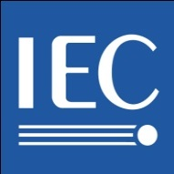

How to adopt
ISO/IEC Guide 21:2005
Regional or national adoption of International Standards
Part 1: Adoption of International Standards
Part 2: Adoption of International Deliverables other than International Standards
44

Slide 45
What is an adoption?
The publication of a regional or national normative document
Based on an International Standard
Has the same status as a national standard or other normative document
Can have deviations
45

Slide 46
Declaration to be made on adoption
In IEC, there is a database of adopted IEC International Standards
Members have to feed in their adoption data directly
46
Notes:
Contact persons at IEC CO for reporting on adoptions:
From IEC National Committees: Guilaine Fournet / Head of Sales and Business Development (gnf@iec.ch)
From IEC Affiliates: Françoise Rauser / Affiliate Country Programme Executive Secretary (fra@iec.ch)

Slide 47
How to source documents for adoption
For IEC National Committees: IEC Publications in MS Word format for national adoption
  Visit IEC website: http://std.iec.ch/iec-lib/revisablefile.nsf/
  welcome?readform
  Licence agreement to use IEC Publications in electronic format with electronic watermark for internal use only by the National Committee
  Signed in 2010 by Albania – who has adopted 396 IEC IS
  Signed in 2012 by Moldova – who has adopted 369 IEC IS
47

Slide 48
My National Committee
http://www.iec.ch/nc_area/mync/
The IEC members are its National Committees. There can only be one NC per country and it has a number of rights and obligations under the IEC Statutes and Rules of Procedure, including the commitment to allow and encourage all interests within its country to be involved in its activities.
As an NC, you represent your nation's electrotechnical interests in the IEC's management, standardization and Conformity Assessment work. Your NC is therefore the focal point for developing a consensus position for your country.
My NC's commitments
As a Member of the IEC, your NC represents all of your country's stakeholders in its interactions with the IEC. Your NC is the point of contact for your country and it is therefore responsible for coordinating the national opinion on IEC issues.
As a Member of the IEC, your NC has committed to:
abide by the IEC Statutes and Rules of Procedure.
promote the objectives of the IEC.
support the IEC's work.
implement the IEC's International Standards as national or regional standards.
open access to and have balanced representation from all private and public electrotechnical interests in their country.
prevent unauthorized reproduction or distribution of IEC International Standards or publications in their country.

Slide 49
Who should an NC represent?
Since there is only ONE National Committee in your country, you must encourage representation of all interests in your country in the field of electrotechnical standardization, including conformity assessment. Being fully representative allows you to be sure that all national aspects have been taken into account when you, as the NC for your country, participate in the IEC's work.
Wherever possible and appropriate, your National Committee should include representatives of:
power generation and distribution authorities;
manufacturers;
research and development establishments;
testing laboratories;
relevant professional and teaching institutions;
consumers;
the national standards body; and
government departments concerned with electrical and electronics applications.
These representatives, as members of your committee, should be involved in the decisions taken at both technical and management levels, allowing all stakeholders to have a real influence on your NC's activities.

Slide 50
NC President's role in the IEC
key position as one of the official contact points for the National Committee.
responsible for ensuring that your National Committee abides by the IEC Statutes and Rules of Procedure, particularly in terms of representation. In this regard, you and the NC Secretary are responsible for identifying and addressing any gaps in the representation of all national interests in your National Committee.
Attendance at meetings
Council
Full Member National Committee (NC) Presidents are members of Council and vote at the meetings on behalf of their NC. NC Presidents of Associate Members are not members of Council but they are encouraged to attend the meeting as observers. Each year NC Presidents should register to attend the Council meeting. If an NC President is unable to attend the Council meeting in a given year he may nominate a Head of Delegation in his place.
NC Presidents' Forum
Each year the General Secretary invites all NC Presidents to attend the NC Presidents' forum (or workshop) which is held at the IEC General Meeting.

Slide 51
NC Secretary's role in the IEC
Coordination of national position
In accordance with the Statutes (Art.4) a NC shall be fully representative of national interests in the fields of activity of the Commission. The NC Secretary, is responsible for ensuring the coordination of the national interests to determine the national position and communicating the position to the IEC.
Publications management
You are responsible for maintaining your NC's collection of IEC publications for the purpose of national adoptions, sales and for distribution to experts who were involved in their elaboration. You are also responsible for ensuring that national adoptions are reported to the IEC via the National Adoptions database.
Contact with the IEC
As an Officer of your National Committee, you are an official contact for the IEC Central Office and for other IEC Members. You are also responsible for officially notifying the General Secretary's Office if there are any changes to the NC structure, contact information and/or membership.
National administrator
As an NC Secretary, you are also automatically assigned with the role of NC administrator. You should therefore also see the section on the role of NC administrators for details of the activities undertaken in this role. You are also able to assign the role of NC administrator to other people in your NC.
Attendance at meetings
Each year at the IEC General Meeting, NC Secretaries are invited to participate in the NC Secretaries forum

Slide 52
NC Administrator's role in IEC
Appointment
The Secretary of the NC is responsible for appointing their NC administrators and can do this by contacting TISS. Several NC administrators may be appointed and the NC Secretary is also automatically given the NC administrator role.
Managing your NC's experts or users
As the NC administrator you are responsible for adding NC staff and experts from your country to EMS (Expert Management System), which is the application used to manage all your NC's experts and users. When you add a new person, EMS will automatically send them their personal username and password which they will use when accessing IEC tools and applications.
Through this application you should also manage the permissions for your NC experts/users, giving them rights to access restricted documents as well as rights to comment and vote on them, as appropriate. In EMS you can also administer roles as decided by your NC, by assigning experts to working groups, project teams or maintenance teams. Once an expert has been assigned a role they will have automatic access to the CTS (Collaboration Tools Suite) area of the relevant group.
In summary, you are responsible for the overall management of your NC's experts/users in EMS, including checking their contact details are up-to-date, deleting them when they leave the NC and adding new experts/users. Visit the Tools & Services section for more information about how to manage your NC experts/users in EMS.
Meeting registrations
For all IEC meetings a person from the National Committee should also be assigned with the role of NC accreditor. The NC accreditor is responsible for accrediting the attendance at meeting for people from your NC.

Slide 53
True NEC
(National Electrotechnical Committee)
Article 4 of the IEC Statutes states: "Any country desiring to participate in the work of the Commission shall form an Electrotechnical Committee for its own country; upon admission this Committee is called the National Committee
Information needed:
organization chart of the National Committee with a clarification of which specific group or committee within TSE represents the IEC (decision making process should be independent)
Terms of reference (scope and limitations of activity)
List of members of the National Committee
Decision making: do they include private sector, electrical utilities, Academia?
Standards making process (does the money come from the sales, from the private sector?)
Balance representation (public and private sector) if possible

Slide 54
Membership and Affiliation
60 Full Members | 23 Associate Members | 84 Affiliates
May submit votes on all TC/SC and Council documents via electronic voting system | May submit votes/ comments on documents of 4 selected TC/SCs via electronic voting system | May not vote No membership
May submit comments on all TC/SC and Council documents | May submit comments only on TC/SC documents but not on Council documents | May submit comments on the documents of 10 selected TC/SCs by e-mail
Fully participate in international standardization activities | Limited participation of countries with limited resources | A type of participation, but not membership
Full access to IS for adoption and for commercial exploitation | Full access to IS for adoption and for commercial exploitation | Selection of 200 IS to start basic electronic library. Facilitated adoption procedure

Slide 55

IEC YP Programme
Objective: encourage professionals at the start of their career to participate in IEC work
Who: Young managers, engineers, technicians aged from early 20s to mid-30s
  What: YPs learn about the IEC, observe meetings, network with IEC officials and experts, work together on projects, get their voice heard
How: yearly workshop during the IEC GM
  Frankfurt, 10 – 12 October 2016
  www.iec.ch/youngprofessionals

Slide 56
See you at the next
IEC General Meeting
  Frankfurt, Germany 10-14 October 2016
  Vladivostok, Russia 9-13 October 2017
  Busan, Korea, October 2018
  China, October 2019
  Sweden, October 2020
  UAE, October 2021
  USA, October 2022
  Egypt, October 2023
56

Slide 57
Thank you!
David HANLON
Conformity Assessment Board (CAB) Secretary dha@iec.ch www.iec.ch
Antoinette PITTELOUD
External Liaisons Officer api@iec.ch ww.iec.ch
Skype antoinette-iec

