Slide 1

Fresh fruit and vegetable exports from Greece: solutions
International good practice

Slide 2
Programme of the day
Time | Subject
09:00-09:15 | Welcome - Representative UN ECE Presentation of participants
09:15-09:30 | Purpose and scope of the meeting Dr Heiner Lehr
09:30-10:00 | Summary of initial workshop and identified challenges Dr Heiner Lehr
10:00-11:00 | International good practice as benchmarks for Greece Part I EXPORT PROMOTION BOARDS COOPERATIVES as models to get economies of scale Dr Heiner Lehr
11:00-11:30 | Coffee break
11:30-13:00 | International good practice as benchmarks for Greece Part II EXTENSION SERVICES ELECTRONIC SUPPY CHAIN TRANSPORT AUTOMATION AND SCHEDULING OF INSPECTIONS Dr Heiner Lehr
14:00-14:30 | Light Lunch
14:30-16:00 | Discussion of solutions Dr Heiner Lehr
16:00-16:20 | The smarter food vision Dr Heiner Lehr
16:20 | Closure Representative UN ECE

Slide 3
Export promotion

Slide 4

The Norwegian Seafood Council
Creating a Unique Brand For Norwegian Seafood
Notes:
The Norwegian Seafood Council is a export promotion board owned by Norwegian authorities with the aim to promote fish caught or farmed by Norwegian companies. It is financed by membership fees consisting of a fixed sum per annum (15000 NK, about 1850€) as well as general export fees based on the export volume and exported species/product of the company. While companies can decide whether to join the NSC or not, the export levies apply to all exports of seafood from Norway.

Slide 5
Norwegian Seafood Council: Areas of Work
Market Intelligence
Statistics and Trade Information
Joint Marketing
Uniform Branding for Seafood from Norway
Communication
PR activities increasing general knowledge about NSC and its Brand Principles
Ensures high reputation of NSC
Reputation Management
Monitors Trends and Developments
Information on Regulatory Changes in Export Markets
Supports Sales Efforts of Members
Marketing Projects to Increase Demand for Norwegian Seafood
Enforcement of NSC principles
Notes:
The NSC’s four major fields of work are market intelligence, marketing, communication and reputational risk management. The Market Intelligence department is mainly concerned with gathering statistics and trade information for the members. Additionally it provides updates on recent trends and developments in the seafood market along with information on regulatory changes in the export markets. The marketing department of the NSC provides the members with an uniform branding scheme including logos, designs and homepages for consumers in the target market. Another import part of the NSC is its reputation management. All members have to comply to NSC standards of production to be able to use the NSC branding. By that the NSC attempts to ensure high quality products with a high market value that increase the consumers brand awareness. To enforce these standards the NSC uses third-party inspection.

Slide 6
The Norwegian Seafood Council: The Marketing Strategy
Origin branding
Graphic profile and brand identity
Branding for specific products
Consumer websites
Notes:
The NSC’s marketing strategy is to create a uniform branding for all Seafood from Norwegian companies. To achieve this they provide a logo, a graphic profile and several sub-brands for specific products. Additionally they maintain consumer websites for 16 target market in the respective domestic language (including USA, Italy, Brazil, Germany and China). The consumer websites provide information about fishery in Norway as well as recipes and information on the healthiness of fish from Norway. All members of the NSC may use the brand logo’s on their packages as long as they comply to the production rules defined by the NSC, which aim to ensure a high level of quality. Specific brands are in place for: SKREI (Spawning cod), Norwegian White Halibut, Norwegian Fresh Cod, Norwegian frozen, cooked and peeled prawns, Norwegian Arctic Char; Norwegian Fjord Trout and Norwegian Wetsalted Cod.

Slide 7
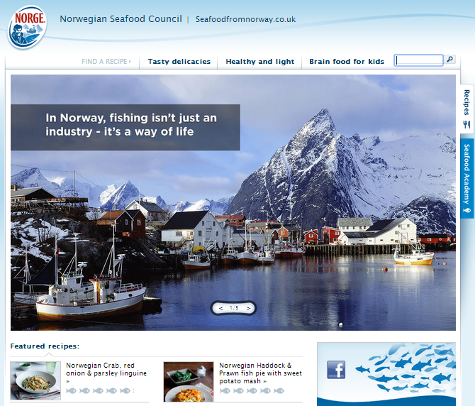
For the UK consumers
seafoodfromnorway.co.uk

Slide 8
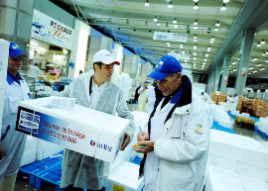

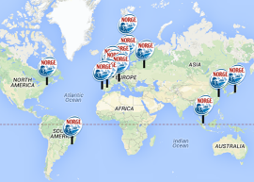
The Norwegian Seafood Council: Organizational Structure
Management Board Of Directors
Marketing
Fish Specific Marketing Advisory Groups
Environmental Documentation
Market Intelligence
Managerial Layer
Functional Layer
Subunits
Communi-cation and Reputation
Domestic Market
Country Offices
Reputation Management
Communication
Country Offices
Notes:
The organizational structure of the NSC is relatively basic. The Board of Directors is appointed directly by the Minister of Fisheries and for two years. The board does not include governmental officials, but people with private background in the seafood industry. The same applies for the management of the NSC. While the Board of Directors act as a representation for NSC towards the industry and other third parties, the management is only concerned with the operative business of the NSC. The other departments of the NSC are provided by employees (in total 77) and industry representatives in advisory groups (the NSC implements about 500 marketing projects in 25 different countries per annum according to their website). Thus, even though the NSC is partly funded by the government, its employees and representatives have private sector background and therefore a good understanding of the seafood industry. Furthermore the partial financing through export fees might reduce “free-riding”, since general export fees might be much larger for exporting companies than the registration fee. The sub-departments of the marketing are all advisory groups consisting of industry representatives. Their main aim is to support Norwegian companies in their marketing efforts. The Country Offices that are placed in thirteen different countries including Norway support the Norwegian companies in their export effort to the specific countries or regions

Slide 9
The Norwegian Seafood Council: Export Statistics of Norway
Source: OECD
Notes:
Since basically the whole Norwegian seafood industry is part of the NSC, the general seafood exports of Norway may give an accurate picture of the development. While growth has been strong in the early 2000s, the growth rate has declined since 2008 resulting from weak demand in Europe due to the crisis. Nonetheless growth has been positive even though Europe is the main market for seafood from Norway. There is no direct way to measure the impact of the NSC, but it is very likely that it has help to increase and sustain growth of Norwegian seafood exports.
Data Source: http://www.oecd-ilibrary.org/agriculture-and-food/oecd-review-of-fisheries-country-statistics-2012/imports-and-exports-of-fish_9789264189287-table8-en

Slide 10
Funding NSC
The Norwegian Seafood Council is a export promotion board owned by Norwegian authorities with the aim to promote fish caught or farmed by Norwegian companies.
It is financed by membership fees consisting of a fixed sum per annum (15000 NK, about 1850€) as well as general export fees based on the export volume and exported species/product of the company.
While companies can decide whether to join the NSC or not, the export levies apply to all exports of seafood from Norway.

Slide 11

New Zealand Trade and Enterprise
Notes:
The NZTE is the main EPA of New Zealand and was formed in 2003. It consults about 2000 companies, focusing on a group of 500 of them. The NZTE is a government agency subordinated to the Ministries of Trade and Economic development and thus funded publicly. Nonetheless most of their board members as well as employees have business background.
Source: https://www.nzte.govt.nz/en/

Slide 12
Areas of activity
The NZTE supports companies exporting from New Zealand through 3 main channels:
  non-financial support
  market intelligence
  funding
Non-financial support:
  NZTE provides a How-to-export guide as well as individualized recommendations based on an interactive questionnaire.
    This enables exporters to assess which steps have to be taken next and in how far the NZTE can/will help them with these steps.
  NZTE helps companies to built capacities in the areas strategy, leadership, research and development, operations, marketing, capital and international markets by e.g. connecting participants to a network of private advisors called “Beachheads” who then act as mentors and “provide insights into the realities of growing internationally successful businesses”
  Other supporting sub organizations include the kea, an organization for expats, “Better by Design”, a organization that helps businesses use design to become more innovative, efficient and internationally competitive, and the New Zealand International Business Awards.
  Other capacity building services are carried out by related organizations as well, such as their Regional Business Partners.

Slide 13
Areas of activity
Market intelligence:
  NZTE maintains detailed market reports for 30 different countries and 11 industries. The country reports give an general introduction to the country as well as an analysis of its up- and downside. The industry reports are focused on export and marketing strategies and try to lend exports a hand in designing their export strategy.
Funding:
  The NZTE offers funding for a limited range of companies, classified as “fast-growth export businesses, and sectors and regions that present the greatest opportunities for international success”. Furthermore applicants have to at least the invest the same amount on their own in the business.
  For the other cases, the NZECO offers products that “help exporters manage risk and capitalize on trade opportunities around the globe”, such as securities and loans. The NZECO is a department of the ministries of treasury and its obligations to third parties are guaranteed by the New Zealand government.

Slide 14

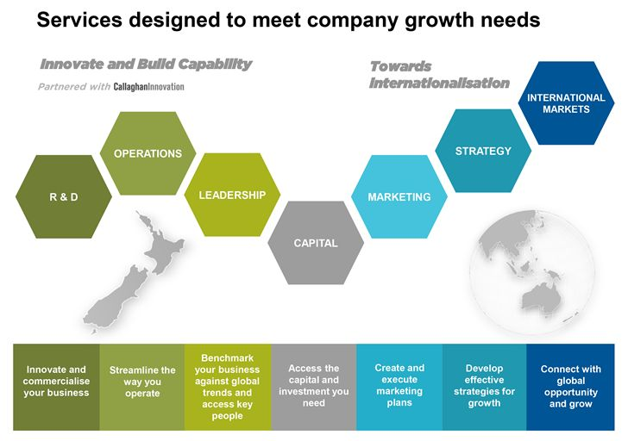



NZTE: Fields of Work
Market Intelligence
Non-Financial Support
Funding
Market research for 30 countries
Capacity building
Strategy recommendations for 11 industries
“How to export” Guide
New Zealand Export Credit Office
Direct Funding
Notes:
The NZTE supports companies exporting from New Zealand through 3 main channels: market intelligence, non-financial support and funding.
To provide exporters with sufficient information on target markets, the NZTE maintains detailed market reports for 30 different countries and 11 industries. The country reports give an general introduction to the country as well as an analysis of its up- and downside. The industry reports are focused on export and marketing strategies and try to lend exports a hand in designing their export strategy.
As part of the non-financial support, the NZTE website provide an How-to-export guide as well as individualized recommendations based on an interactive questionnaire. This shall enable exports to assess which steps have to be taken next and in how far the NZTE can/will help them with these steps. Additionally, the NZTE helps companies to built capacities in the areas strategy, leadership, research and development, operations, marketing, capital and international markets by e.g. connecting participants to a network of private advisors called “Beachheads” who then act as mentors and “provide insights into the realities of growing internationally successful businesses”(Other supporting sub organizations include the kea, an organization for expats, “Better by Design”, a organization that helps businesses use design to become more innovative, efficient and internationally competitive, and the New Zealand International Business Awards). Other capacity building services are carried out by related organizations as well, such as their Regional Business Partners.
The NZTE offers for a limited range of companies that they classify as “fast-growth export businesses, and sectors and regions that present the greatest opportunities for international success”. Furthermore applicants have to at least the invest the same amount on their own in the business.
For the other cases, the NZECO offers products that “help exporters manage risk and capitalize on trade opportunities around the globe”, such as securities and loans. The NZECO is a department of the ministries of treasury and its obligations to third parties are guaranteed by the New Zealand government.

Slide 15

Intrasectorial extension
In some countries, marketing assistance is provided by common sectorial forums
In South Africa, Citrus information is supplied to the industry in terms of an agreement with Perishable Products Export Control Board (PPECB) and is funded by Citrus Growers’ Association (CGA) and the Fresh Produce Exporters Forum (FPEF).
This information is supplied on a regular basis during the export season to all members of the Citrus Marketing Forum (CMF) and published on the password-protected page of the CGA web site.
  Weekly newsletter
  Tree Census
  Citrus Statistics Booklet
  Variety Focus Groups
  Packed and Shipped Volumes on a weekly basis
  Citrus Marketing Forum (CMF)
  Member of regional organisations (Mediterrean, Southern Hemisphere)
Establishment of Agrihub, an information hub which relies on the cooperation of exporters, cold stores, terminals and the like to provide electronic data flows into a central repository from which reports can be drawn on a weekly basis

Slide 16

Export Promotion Agencies
On the efficiency of export promotion agencies:
A world bank study

Slide 17
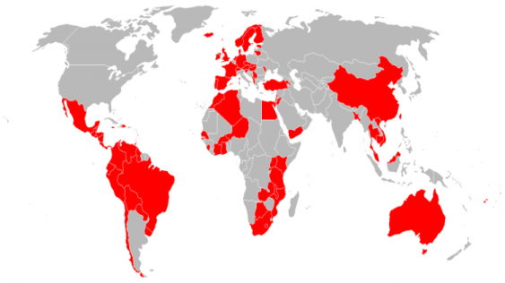
Export Promotion Agencies
The Study
Survey of 88 EPAs and Trade data
Econometric analysis
Export Promotion Agencies : What Works And What Doesn't
Authors/Editors: Daniel Lederman, Marcelo Olarreaga and Lucy Payton
Published: October 2006 Pages: 48
Complete Book PDF (451 KB)
Notes:
The paper “Export Promotion Agencies Revisited” published in 2009 as a working paper of the World Bank examines the effect of export promotion agencies on exports. The paper uses trade data and responses of EPAs to a survey conducted for this paper as a basis. The main scientific tool used by the authors is econometric regression, i.e. advanced statistical methods. The survey was answered by 88 different EPAs based in developing as well as developed countries(For map see next slide). The authors are two economists and a consultant of the BCG. The first picture shows a world map with the participating countries in red.
The paper finds that EPAs increase export significantly by an estimated range of 6 to 10%. Furthermore they find that EPA budget has a significant effect on this increase of exports, but the evidence points to decreasing marginal returns to scale. I.e. a doubling in budget does not double the effect of the EPA. This can be seen in the second picture, which is taken from the paper. The lowess smoother (locally weighted scatterplot smoothing) is a regression model that attempts to fit a non-linear model to the data and gives out the result as a line (blue line in this case). Since the slope of the curve is less than 1 (compare with red line) and the line rather concave, decreasing marginal returns to scale can be identified. This leads the authors to the conclusion that “small is beautiful” since the increase in exports per euro of funding is highest for small EPAs (mathematically).
As it turns out, EPAs were most effective when most needed, i.e. in the case of high barriers to trade and trade in heterogeneous good. Thus it seems as their main channels of influence are trade facilitation and market intelligence. Trade facilitation in the sense of overcoming trade barriers and market intelligence in the sense of analyzing consumer preferences and forwarding the results to exporting companies, which are then enabled to create differentiation value.
Key factors of success from an agency design point of view have been private party representation and public funding. Private party representation especially in the board increased the gains in export due to the EPA significantly, most likely because private parties might have a better sense for what is important to business. Public funding was in so far important as EPAs that are not publicly funded always have “free-rider” issues and as a result experience less support from the industry. The authors argue that in the case of private financing, private parties would have an incentive to opt out while profiting indirectly from the marketing of related products in the foreign market. E.g. an Italian wine producer profits from consumer knowledge about the quality of Italian wine in e.g. the USA. If that information is provided by an EPA, the consumer will be able to access the general information on Italian wine regardless of whether the producer participates in the funding of the EPA or not as long as the information is still provided without his participation. Thus not all producer will participate, which lowers the efficiency and effectiveness of a EPA through the knowledge and the finance channel. Public funded EPAs circumvent this problem by separating funding decisions from operative/ membership decisions.
Additionally it turned out that a centralized EPA tended to be more effective, mainly because of synergy effects and increased industry awareness.

Slide 18
Export Promotion Agencies
General Outcomes
Key Factors of Success
EPAs increase exports by 6 to 10% (on average)
Small is beautiful
Most effective for
markets with high trade barriers
differentiated goods
Single agency rather than multiple agencies
Large share of private parties/representatives in the board
Public funding
Notes:
The paper “Export Promotion Agencies Revisited” published in 2009 as a working paper of the World Bank examines the effect of export promotion agencies on exports. The paper uses trade data and responses of EPAs to a survey conducted for this paper as a basis. The main scientific tool used by the authors is econometric regression, i.e. advanced statistical methods. The survey was answered by 88 different EPAs based in developing as well as developed countries(For map see next slide). The authors are two economists and a consultant of the BCG. The first picture shows a world map with the participating countries in red.
The paper finds that EPAs increase export significantly by an estimated range of 6 to 10%. Furthermore they find that EPA budget has a significant effect on this increase of exports, but the evidence points to decreasing marginal returns to scale. I.e. a doubling in budget does not double the effect of the EPA. This can be seen in the second picture, which is taken from the paper. The lowess smoother (locally weighted scatterplot smoothing) is a regression model that attempts to fit a non-linear model to the data and gives out the result as a line (blue line in this case). Since the slope of the curve is less than 1 (compare with red line) and the line rather concave, decreasing marginal returns to scale can be identified. This leads the authors to the conclusion that “small is beautiful” since the increase in exports per euro of funding is highest for small EPAs (mathematically).
As it turns out, EPAs were most effective when most needed, i.e. in the case of high barriers to trade and trade in heterogeneous good. Thus it seems as their main channels of influence are trade facilitation and market intelligence. Trade facilitation in the sense of overcoming trade barriers and market intelligence in the sense of analyzing consumer preferences and forwarding the results to exporting companies, which are then enabled to create differentiation value.
Key factors of success from an agency design point of view have been private party representation and public funding. Private party representation especially in the board increased the gains in export due to the EPA significantly, most likely because private parties might have a better sense for what is important to business. Public funding was in so far important as EPAs that are not publicly funded always have “free-rider” issues and as a result experience less support from the industry. The authors argue that in the case of private financing, private parties would have an incentive to opt out while profiting indirectly from the marketing of related products in the foreign market. E.g. an Italian wine producer profits from consumer knowledge about the quality of Italian wine in e.g. the USA. If that information is provided by an EPA, the consumer will be able to access the general information on Italian wine regardless of whether the producer participates in the funding of the EPA or not as long as the information is still provided without his participation. Thus not all producer will participate, which lowers the efficiency and effectiveness of a EPA through the knowledge and the finance channel. Public funded EPAs circumvent this problem by separating funding decisions from operative/ membership decisions.
Additionally it turned out that a centralized EPA tended to be more effective, mainly because of synergy effects and increased industry awareness.

Slide 19
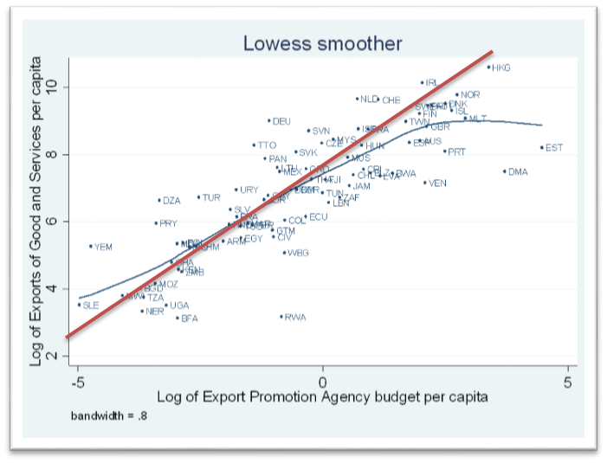
Export gains per EPA budget

Slide 20
Public vs private funding
Key factors of success are private party representation and public funding
Private party representation – especially in the board – increased the gains in export due to the EPA significantly
Public funding is considered important to avoid “free-riders”
  In the case of private financing, private parties would have an incentive to opt out while profiting indirectly from the marketing of related products in the foreign market.
  Thus not all producers will participate, which lowers the efficiency and effectiveness of a EPA through the knowledge and the finance channel.
  Public funded EPAs circumvent this problem by separating funding decisions from operative/ membership decisions.
Centralized EPAs tended to be more effective, mainly because of synergy effects and increased industry awareness.

Slide 21
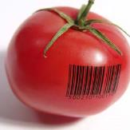
Funding
Food safety
  More trust
  Avoidance of animal diseases
Improved market access
  Access to high-value markets
  Differentiation in the marketplace
Taxes
PUBLIC PRIVATE PARTNERSHIPS
Increased supply chain efficiency
  Better sourcing
Levies
Better marketability
  Consumer interaction
  Direct marketing
Fraud avoidance
  Greater total market

Slide 22
COOPERATIVES

Slide 23

Producer Organizations in the Vegetable and Fruit Industry
Belgium: REO Veiling

Slide 24
Role of fruit and vegetable cooperatives in Belgium
In Belgium, fruit and vegetable cooperatives have been important since the early 20th century
Cooperatives were established to centralize fruit and vegetable auctioning.
  Original aim: centralization reduction in cost of selling as well as better access to markets due to the greater volume of auctions.
  Now also: increased bargaining power towards big clients.
There are still 16 producer cooperatives left
  Largest: turnover of 234 million euro per annum.
All cooperatives still use the auctioning clock as a pricing mechanism to guaranty price transparency. Almost 85% of all fresh fruit and vegetables produced in Belgium are sold through cooperatives.
Source: Support for Farmers' Cooperatives, Case Study Report ,Fruit and Vegetable cooperatives in The Netherlands and Belgium
Jos Bijman,Caroline Gijselinckx

Slide 25
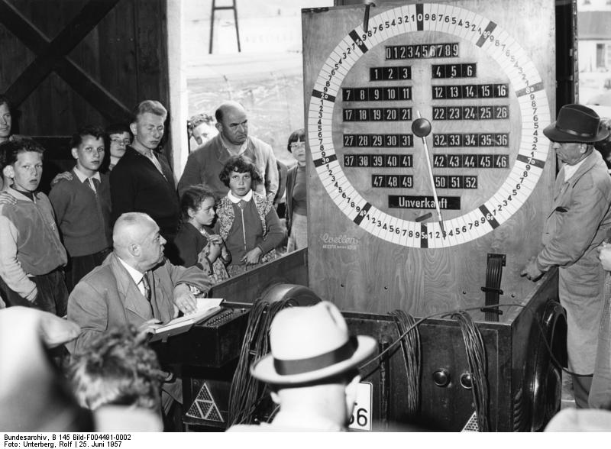
Dutch auction

Slide 26
Dutch clock auction
The classic Dutch clock auction works with a steadily declining price (fixed to a clock) and the first comes first served principle.
This is one of the most profitable auction schemes for the supplier.
Block sales mean that the produce of the same type (e.g. strawberries) of many members is put together as a bigger quantity and then sold at once.
This serves especially big buyers that save mainly time due to the facilitated process (they have to bid in less auctions compared to selling the produce member by member).
The quality of the block is assessed in advance by a third party inspector and the information made public to all bidders in advance.
Additionally the auction system allows for a home buying system, where the bidders can take part in the auction from their home office. This facilitates the procedure for bidders even more.

Slide 27
How it works
REO Veiling was established in 1942 and has become the second biggest producer cooperative in Belgium with turnover 179m€ (2010), which is a 34% increase since 2005.
Member numbers are relatively stable at 2,900 farmers
REO Veiling operates a regional Agricultural Auction Market
REO Veiling is part of LAVA, an umbrella organisation to promote co-operation among the 5 most important fruit and vegetable auctions in Belgium
  Flandria label: promoting products from Belgium,
  Responsibly fresh label: sustainable products
  Both labels create brand value as well as value to consumers
Sources:
  http://www.reo.be/eng/index.asp
  http://www.lava.be/documents/flandria/flandria-algemeen.xml?lang=en
  http://www.responsibly-fresh.com/documents/home/wat-is-het.xml?lang=de

Slide 28



Producer Organizations in the Vegetable and Fruit Industry: REO Veiling
Basic Information
Pricing
The Flandria Label and the Responsibly Fresh
Second biggest cooperative in Belgium
Turnover in 2010: 179 million €
2900 members
Established 1942
Clock auction
Block sales with quality control in advance
Home buying system
Quality/sustainability label
Provided by LAVA

Slide 29
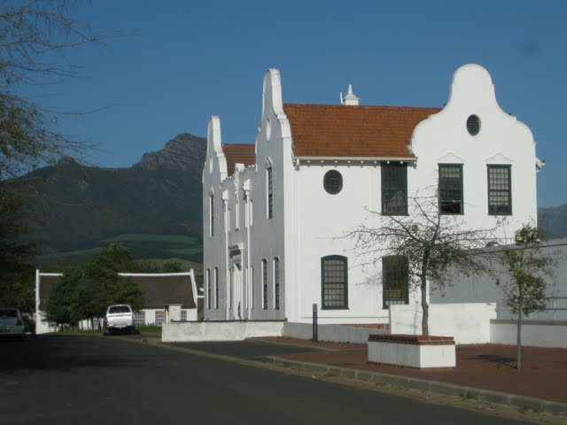
Cooperative development in South Africa
Primary cooperatives
  Farmers cooperatives, mainly for technical assistance
Secondary cooperatives
  Facing the market for common purchasing and marketing activities

Slide 30
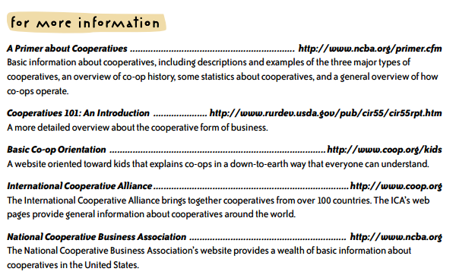

Interested?
www.cooperativegrocer.coop/files/manual.pdf

Slide 31
EXTENSION SERVICES
Case study

Slide 32
Extension services
The link between researchers (sources of new information and knowledge) and farmers (end users).
A service or system that - through education and communication - assists people to improve their farming methods and increase production efficiency and income as well standard of living.
"Extension is all the different activities that provide the information and advisory services that are needed and demanded by the farmers and other actors in the agrifood system and rural development. This includes technical knowledge, facilitation, brokering and coaching of different actors to improve market access, dealing with changing patterns of risk and protecting the environment. Extension incorporates elements of information and advice."
Source: Christoplos, Ian, Chipeta, Sanne and Peta Sandison, 2011, Extension Evaluation Guide, Global Forum for Rural Advisory Services

Slide 33
Context
The extension framework includes farmers, agricultural production, and social and economic factors.
Extension must therefore be flexible, agile and resourceful in its efforts to engage a wide range of farmers in conversation about matters related to their farms and their future vision for them.
And extension must be structured so that it is in a position to respond at ground/farmer-level as well as contribute to national strategic goals for the sector.
To be effective, there must be clear links between extension policy, implementation planning and resource allocation, coupled with adequate management capacity to give effect to the plans.

Slide 34
Key trends in international extension
The changing role of the State
Extension started out primarily as a service provided by the State.
Many governments now refocus extension services.
Localisation and customisation
There is a growing recognition that “one size fits all” standardised approaches are inappropriate, and that extension should be tailored to the location and the specific circumstances of the user.
More pluralist extension
Globally the private sector plays an increasingly important part in extension service delivery to established commercial producers.
In many countries non-governmental organisations (NGOs) partner with government to deliver extension services which target smallholder producers and the rural and urban poor.
Producers also play an important role in extension which they provide through their own associations, co-ops or commodity organisations and sometimes informally as they advise and learn from each other.

Slide 35
Key trends in international extension
Valuing local knowledge and building organisation
Experiential learning, farmer to farmer extension, farmer field schools and participatory research extension processes have become common approaches to promote enhanced production and conservation methods.
This has been linked to attempts to make extension and research more demand driven where local producers and the organisations which represent them increasingly set the extension and research agenda.
However, these new extension approaches are often reliant on donor support programmes
  Often succeed within time and area-bound projects
  Frequently fail once these projects have ended, when state extension services are forced to fall back on the lower levels of resourcing and management

Slide 36
Key trends in international extension
Defragmented pro-poor extension and rural development
Sectorial extension for farm, fish and forest producers is increasingly absorbed into integrated rural development extension efforts, which are in turn strongly linked to the themes of environmental sustainability and the concept of sustainable livelihoods.
Many governments have adopted a more pro-poor extension approach in order to reach smaller-scale, lower income producers and encouraging extension service provision to more prosperous producers by the private sector.
The digital dividend
An important trend reflects the accelerating transformation of information and communication technologies (ICTs) which offer more and more ways in which information, advice and ideas can be transmitted, at greater and greater speeds and at a fraction of the cost of face to face methods.

Slide 37
Public extension services in South Africa
Extension operations are a provincial competency.
  While the National Department of Agriculture sets policy and determines funding, the individual provinces have wide latitude in determining operational strategies and allocating resources.
The status quo
Extension must operate in highly varied contexts with inequitable access to agricultural markets and other economic infrastructure.
Extension services in South Africa are struggling, despite government (national and provincial) efforts to reverse the state of affairs.
The way forward at national level
The strategic plan of the Department of Agriculture, Forestry and Fisheries (DAFF) commits the Chief Directorate of National Extension Support (CD:NESS) to develop a National Extension Policy.
The policy development and implementation process:
  Develop a national extension policy (2012/13).
  Coordinate the approval and implementation of national extension policy (2013/14).
  Draft a National Extension Bill (2014/15).
  Facilitate the legislative process (2015/16).
  Establish a National Council for Extension (2016/17).

Slide 38
Public extension services in South Africa
The way forward at provincial level
The Extension Recovery Plan (ERP) is targeted at improving the capacity for extension in the provinces.
The ERP has five pillars:
  Ensuring visibility and accountability
  Improving the image and professionalism
  Recruitment
  Training
  Provision of ICT equipment.
The gap
The gap in present policy and plans in South Africa relates to providing information services for the farmers and farming communities, to enable them to meet the record keeping requirements of laws and trade standards. This can be described as "information extension". In essence, there is a new services industry that could be developed in rural areas.

Slide 39
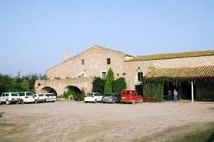

Extension services in Catalonia

Slide 40
IRTA’s mission
IRTA is a research institute owned by the Government of Catalonia adhered to the Department of Agriculture.
Mission:
  to contribute to modernising, improving, boosting competitiveness, and fostering sustainable development in the sectors of agriculture, food, agroforestry, aquaculture, and fishing, as well as in all areas of activity directly or indirectly related to the supply of healthy, high-quality foodstuffs to end consumers, while also contributing to food safety and safe processing of foodstuffs and in general enhancing the health and well-being of the population.
Objectives:
  Its general objectives are to promote research and technological development in the area of agri-food, to facilitate the transfer of scientific advances and to evaluate its own technological advances whilst seeking the utmost coordination and collaboration between the public and private sectors
IRTA partners with other public bodies leading to a consortium network of centres in technological research and development

Slide 41
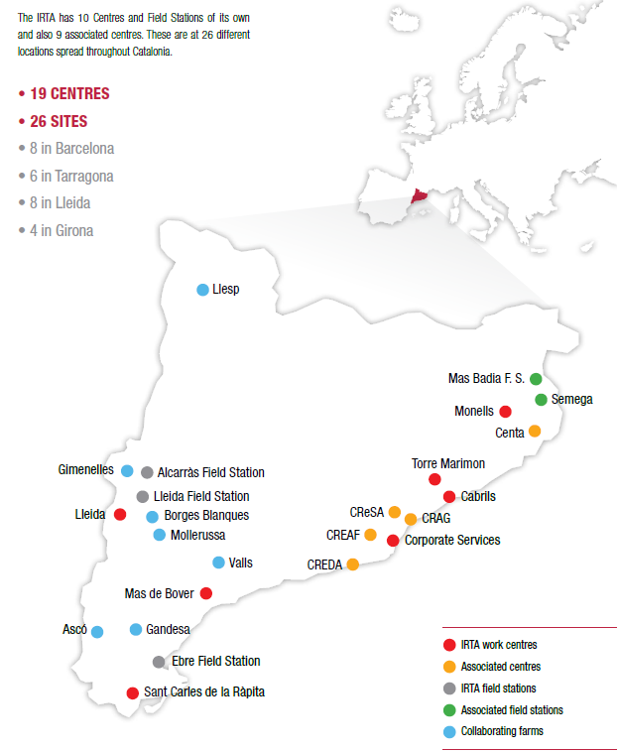
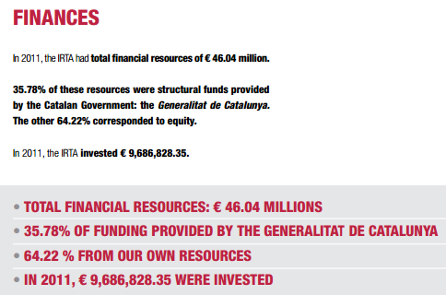
Centres and field stations

Slide 42
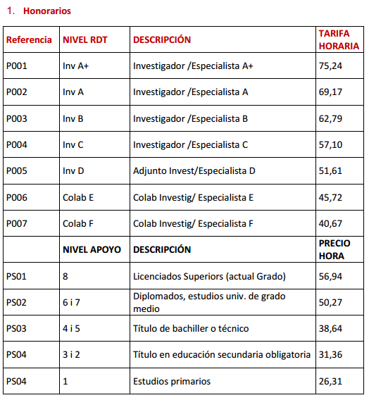
Professional rates

Slide 43
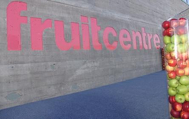
fruitcenter
El Fruitcentre is the new IRTA’s infrastructure, located in the Food Science and Technology Park of Lleida.
It was built with an investment of 14 million euros, financed by FEDER funds from the European Union, the Ministry of Economy and Competitiveness and IRTA.
The Fruitcentre is a new opportunity for Research and Development in the field of fruit and vegetables, through the application of scientific and technical knowledge in the production of fruit, from cultivation to the consumer, in order to provide health and satisfaction to the consumers of these kind of products.

Slide 44

Coniglio – a brand from South Africa

Slide 45
South Africa – post-Apartheid
Black Economic Empowerment (BEE) is a programme launched by the South African government to redress the inequalities of Apartheid by reversing it and by giving certain previously disadvantaged groups (Blacks, Coloureds, Indians, and Chinese who arrived before 1994) of South African citizens economic privileges previously not available to them.
  It includes measures such as Employment Preference, skills development, ownership, management, socioeconomic development, and preferential procurement.
Community development is one of the tools of BEE
This is similar to smallholder development programmes in other countries

Slide 46
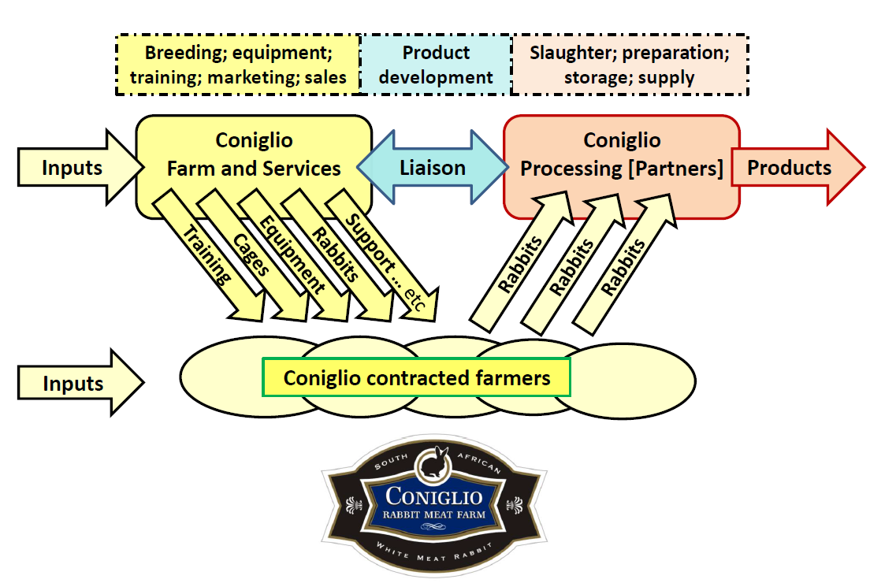
How Coniglio works

Slide 47
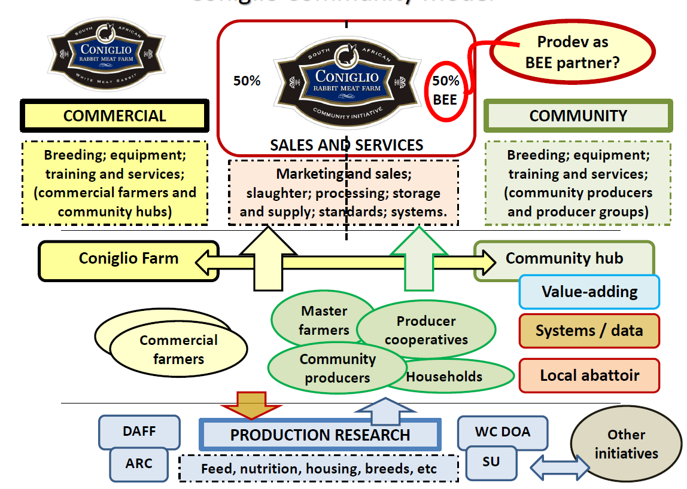
Outsourced community development
Prodev

Slide 48
Coniglio and Prodev: a private extension service
Prodev is a private joint-venture partner responsible for
  Community development from subsistence to fully commercial
  Gatekeeper between those producing on level of marketing standards and those not
  Technical assistance
  Promoting “master farmers”, as role models for the community
  Record keeping
  System development and deployment
The South African government plans to provide some match funding for Prodev’s activities
In this particular endeavour, Prodev is a joint venture partner
  Could also be a service company
  See again the smarter food vision funding model

Slide 49
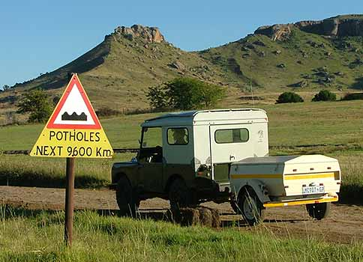
South Africa: Quality Management Systems

Slide 50
Profile of commercial farms in South Africa
Mainstream
Gaining recognition
Niche or struggling
Report for AgriSETA by Vink and van Rooyen; 2009

Slide 51
Profile of all farms in South Africa
Under the radar, insecure and frustrated
Report for AgriSETA by Vink and van Rooyen; 2009

Slide 52
Different objectives
Produce good products by applying good practices
Make more money more quickly
Comply with legal requirements
Satisfy food safety standards
Satisfy customer requirements
Ensure that products are traceable
Keep vital records
Provide relevant information when needed
Farmer’s focus
X
X
QMS focus

Slide 53

Example: South Africa QMS extension service as a project
PPECB proposes to run a 3-year Quality Management and Compliance Monitoring programme for smallholder farmers and farmer groups that grow grains and oilseeds for food, feed and biomass.
The programme aims to develop local trainers, monitors and mentors in the pilot communities, to enable smallholder farming communities to be self-sufficient with regard to complying with requirements of regulations and standards.
Participant management groups and farmers will be certified during the programme, thereby strengthening their ability to access markets.
The overall objective of the programme is to develop Quality Management and Compliance Monitoring skills and capacity in selected communities in the grains and oilseeds sector in order to enable smallholder farmers and organised farmer groups to meet the requirements of food safety laws and standards within three years.

Slide 54
12 step programme
Ref | Objective | Outcome / deliverable (3 years)
1 | Initiate and implement a three-year programme to develop local Quality Management and Compliance Monitoring skills and capacity in the grains and oilseeds industry. The programme should enable smallholder producers and managed producer groups to meet requirements of food safety laws and standards. | Competent local producers, producer groups & management teams. Evidence of development and competence.
2 | Focus on sweet sorghum during 2014, which is the preferred feedstock for a biofuels micro-processor that will be tested in selected communities in Eastern Cape and KwaZulu-Natal. | Farmers that provide feedstock for the micro-processor also provide safe food to the market.
3 | Establish and enable a multi-disciplinary advisory group in the Western Cape. | Functional and effective advisory group.
4 | Implement the programme in time for the 2014-2015 season. | The PPECB programme requires prior production training and activities.
5 | Establish and enable multi-disciplinary stakeholder groups in the pilot communities. Enable the groups, to understand the requirements, disciplines and operational practices related to Quality Management and Compliance Monitoring. Train-trainers, monitor-monitors and mentor-mentors to ensure that the groups are able to implement and manage the standards. | Effective and cohesive stakeholder groups. Competent local trainers, monitors and mentors.
6 | Implement pilot programmes in two academic institutions, namely Fort Cox in Eastern Cape Province and Empangeni Agricultural College in KwaZulu-Natal (KZN) Province. | Successful negotiations. Effective training given. Updated curricula. Effective trainers developed.
7 | Pilot the programmes in Dannhauser in KZN, and Engcobo, Burnshill and Qolora in Eastern Cape. | Successful programmes; certified groups and farmers.
8 | Ensure that the pilot communities are self-sustaining by the end of the programme. | Self-sustaining communities, who are guides and mentors to others.
9 | Enable producer groups in the pilot communities to be certified against food safety and RSB standards. | Certified farmer groups.
10 | Establish meaningful measures and monitor the progress and impact of the programme. | Critical; ongoing. A measure of achievement and changes needed.
11 | Manage the project professionally, against recognised project norms. Includes stakeholder and review meetings. | The project achieves its aims on time and within budget. (With revisions.)
12 | Align the training and materials with requirements of the Quality Council for Trades and Occupations (QCTO). | Professional training materials that support national rollout.

Slide 55
Participants
Programme management
Programme advisory group
Stakeholder representatives
Stakeholder advisory groups
Technical advisors and monitors

Slide 56

Funding
AgriSETA, the Agricultural Sector Education Training Authority
Mission: to create and promote opportunities for social, economic and employment growth for agri enterprises, in conjunction with other stakeholders in agriculture, through relevant, quality and accessible education, training and development in both primary and secondary agriculture.
Acts as inter-alia agency for training
Companies can submit a Workplace Skills Plan
  1% of payroll of larger companies goes to National Skills Fund and others
  50% of that comes back to the companies to fund Workplace Skill Plans

Slide 57
Electronic supply chain
How to improve the marketability

Slide 58
Case study: eCert
New Zealand Food Safety Authority
Material kindly provided by:
Drasko Pavlovic
Senior Programme Manager (E-cert), NZFSA

Slide 59
eCert in practice - NZFSA E-cert
When the product is ready for export, an export certificate is created in E-cert and approved by NZFSA
An approved certificate is available online to importing country officials
An automated, secure, certificate data exchange method is also available to importing country officials
If required, an approved certificate may be printed and signed by NZFSA certifying officer.

Slide 60

NZFSA E-cert Business Model
CERTIFICATION
Farm/
Vessel
Processing Plant/Store
Overseas Authorities
TRANSPORT
Exporter
Customer
ü
J
3
4
5
View and decide certificate on
E-cert web site (or data transfer)
Government Agency
Approval
1
2
2
1
Company
Product information
E-cert
Notes:
This may be difficult to read, but shows the farm to plate flow and where E-cert fits.
Animals are sent to slaughter with an animal status declaration which is a declaration by the farmer about the identity and health status of the animals
In 1, For meat and meat products, the processing plant raises an internal E-certificate for product produced which we call an Eligibility document (or ED). All required information is entered by the processor and the certificate goes into the E-cert system
No 2, Government (NZFSA) views the certificate, checks it, an approves it. It then goes back into the E-cert system
No 3, For all products the Exporter raises the export certificate in the correct template for the destination country, and populates the certificate with the data required . If product has not gone directly from the initial processing plant to export, and passes through other processing plants, or cold storage facilities, the data related to that product automatically transfers to the next certificate raised, whether it be an ED for internal movements, or an export certificate. During internal product movements, there can be product from hundreds of EDs transferring onto one export certificate. The E-cert system handles this easily with rapid and accurate data transfer.
If an exporter sends a small number of certificates in a day, they can raise them individually. If an exporter raises hundreds in a day, they can do this in a batch file. E-cert then transforms them into individual certificates.
No 4, the NZFSA official certifier then approves the certificate for export.
No 5 The Importing country competent authority can view the export certificate online. These can be accepted, rejected, or a replacement can be requested. This information is immediately available to NZFSA through the E-cert system.
No 6 Importers in future may be able to view export certificates online. At present, exporters can send E-cert data to importers, banks etc in a XML format.
Product that is destined for the New Zealand domestic market only, does not require certification. Any product that leaves a plant without certification cannot re-enter the export product chain because it has lost the link to the E-cert system.
The system is very user-friendly. Even our most non-electronic people can use the system effectively.

Slide 61


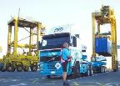
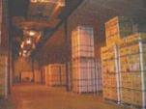
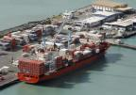

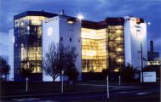







_{Product Tracing in E-Cert}
Source
Source
EDec or ED Document A1
EDec or ED Document B1
Export Certificate C1
AA
AA
Transfer
Transfer
Store
Seaport
Factory
Shipment
Processing Packing
Storage
Transfer
Transfer
Store
Airport
Source
EDec or ED Document B2
Export Certificate C2
EDec or ED Document A2
Source
AA
AA
Notes:
An Overview of E-cert
February 2008
Page 61
This slide shows a typical product movement scenario:
A number of different product is made at one establishment
The product is transported ( two separate transports)
The store(s) receive the product accompanied with internal transfer document (ED document A1 and A2)
The product is loaded for export by the store and transported to a port or airport
A required internal documents (ED document B1 and B2) accompany the consignment
Exporter has access to ED (B1 and B2) which supports submission of an export certificate (C1 and C2)
During the course of product storage it is also possible to move the product ( or some part of it) between the stores

Slide 62
Import Clearance – Life Cycle
Replaced
(NZ)
Approved
(NZ)
Revoked
(NZ)
Approved
Replacement
Acknowledged
Request Replacement
Detained
Accepted
Rejected

Slide 63
Secure Govt-Govt Data Exchange using SOAP
Border agency requests latest export certificates
Border agency updates its database as required
Border agency submits acknowledgement file
Notes:
Automatic Data Exchange
The Automatic Data Exchange is done in 3 simple steps:
Upon approval, revocation, or replacement of an Export Certificate E-cert generates an XML file to the data standard. It identifies all border control authorities that have access permissions to this certificate and deposits a copy of the XML file in their respective personal SFTP directories in the Demilitarized Zone (DMZ) on the E-cert server.
Each border control authority logs into the E-cert Demilitarized Zone (DMZ) at regular intervals using a pre-defined authorised SFTP account, and transfers the data over the Internet onto its own network server using SFTP. Upon successful transfer the authority may then remove the file from its directory using SFTP.
This step should be automated. It may be performed as frequently as required by an authority.
The border control authority compiles an acknowledgment message in the form of an XML file and transfers this back into its SFTP directory in the DMZ on the E-cert server. E-cert will pick up acknowledgment files multiple times an hour and update the certificate status accordingly.
E-cert will ignore the acknowledgement should it refer to a previous rather than the current certificate version.

Slide 64
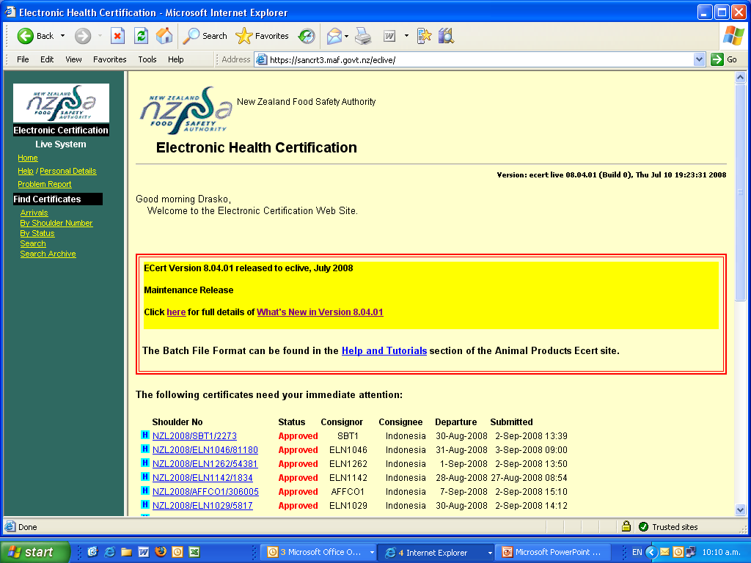
Online - Welcome Screen

Slide 65
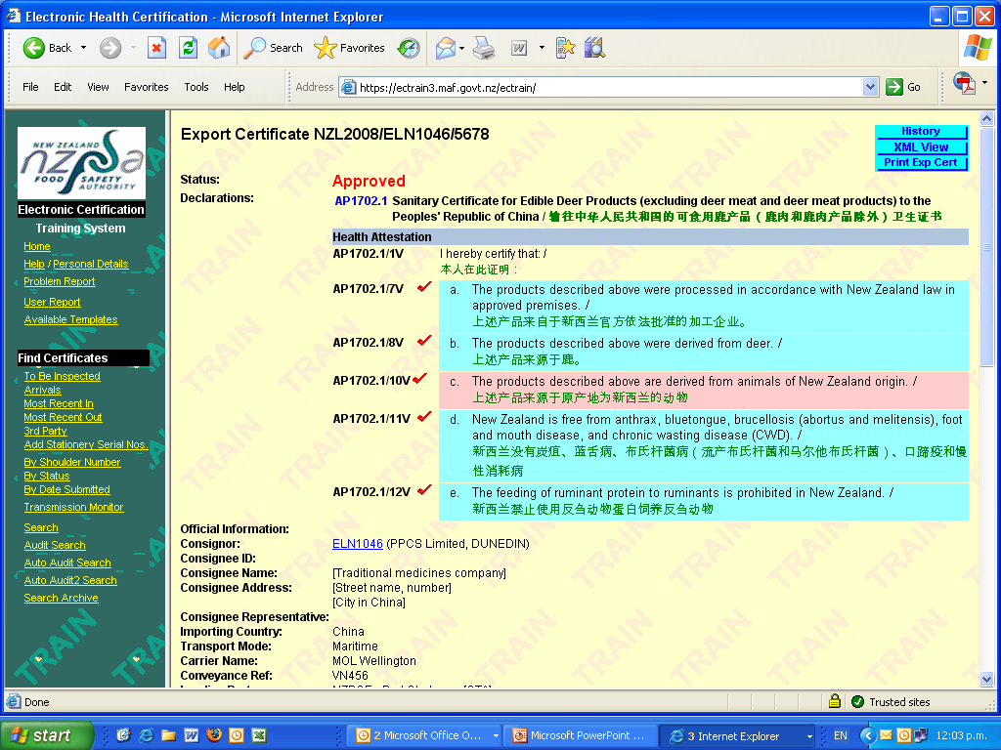
Online – viewing the certificate

Slide 66
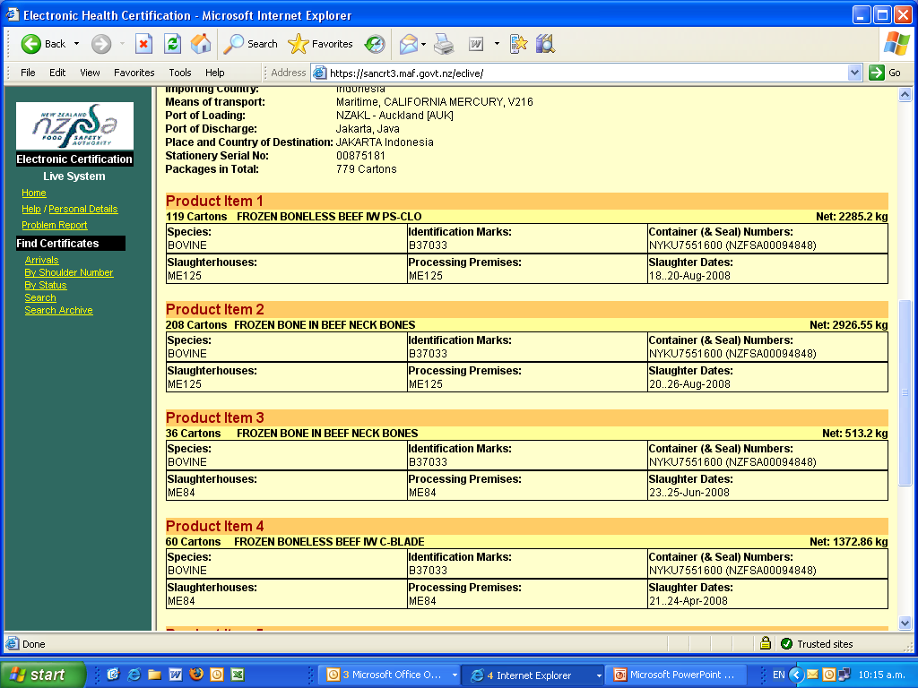
Online – viewing the certificate

Slide 67
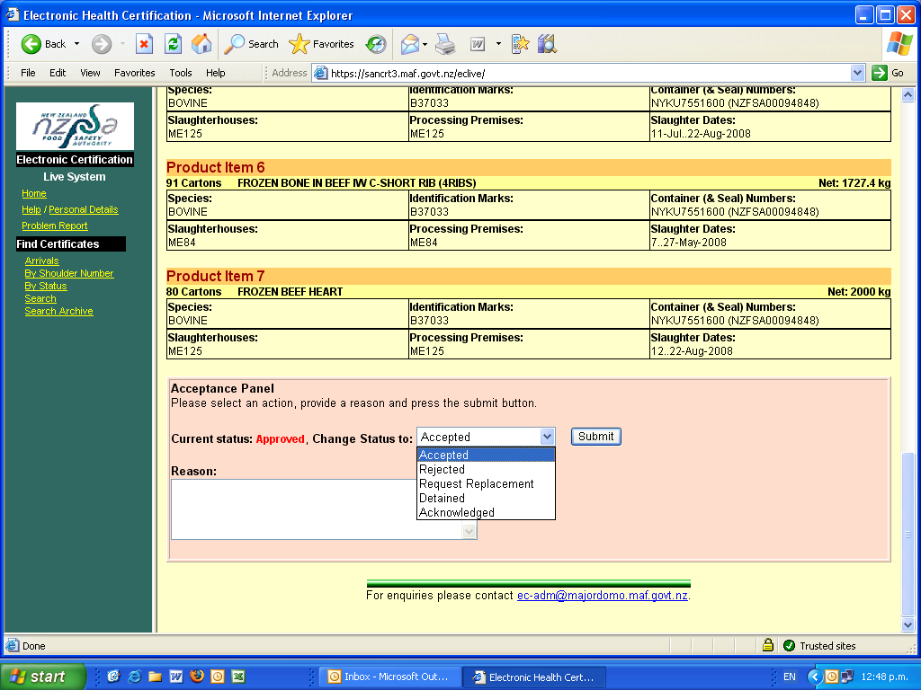
Online – decision making

Slide 68
GrapeNet
Arpeda

Slide 69

Introduction
GrapeNet is an internet based electronic service offered by APEDA to the stakeholders for facilitating testing and certification of Grapes for export from India to the European Union in compliance with the standards identified by NRC Pune, on the basis of consultation with the exporters.
GrapeNet collects, stores and reports – forward and backward traces and quality assurance data entered by the stakeholders, ie., exporters, laboratories and PSC authorities within the Grapes supply chain in India.
www.apeda.gov.in/apedawebsite/Grapenet/GrapeNet_new.htm

Slide 70
GrapeNet presentation
See also www.youtube.com/watch?v=Wp1O1otpf8s

Slide 71


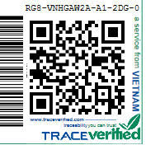
TraceVerified

Slide 72
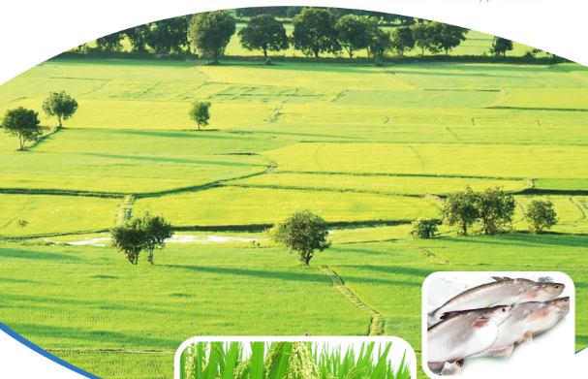
TraceVerified – the concept
To offer the full advantages of electronic trace-ability to Vietnamese pangasius producers
To provide importers with hard facts about the fish they buy – anytime, anywhere
To provide a service from Vietnam that importers in high value markets can trust
Traceability you can trust.

Slide 73
Differentiation
Traceability data is checked to ensure compliance with the principles of the system
Control of information as it flows through the supply chain
Regular and surprise visits and a fully equipped testing laboratory to ensure the quality of the data
www.TraceVerified.com
Notes:
TraceVerified is a system to meet the global traceability requirements.
However TraceVerified is fundamentally different from its competitors, because the information contained in the system is verified to ensure compliance with rules and regulations.
The tests can extend to laboratory analysis to ensure the veracity of the information.
In setting up the system, we ensure that the information transported is verifiable, we monitor the information as it flows through our databases and we perform surprise visits to match claims against reality

Slide 74
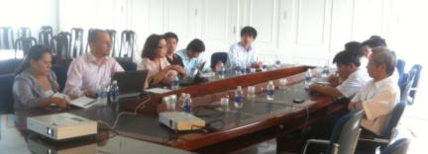
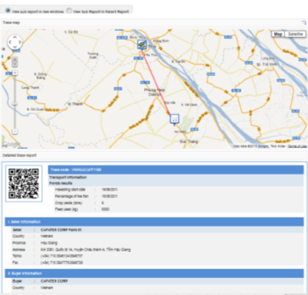


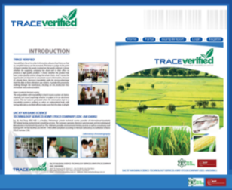
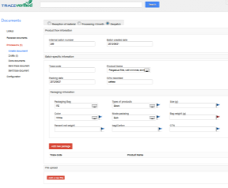
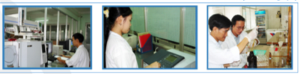
TraceVerified – the components
1) Implementation advice
and training
2) TraceLabel
5) TraceReport for importers
3) TraceVerified information system
4) Data verification

Slide 75
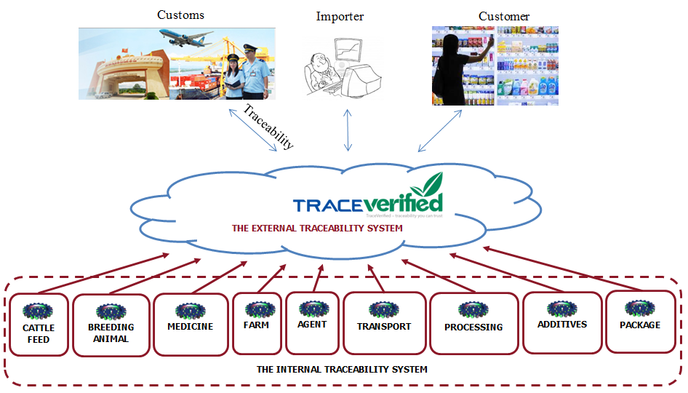
How does TraceVerified work?
www.TraceVerified.com
Notes:
TraceVerified provides what is known as “external” traceability by linking enterprises together. “Internal” traceability within the enterprise can be integrated easily with TraceVerified.
The external traceability run by us allows exporters and consumers to access the information flow connected to orders, deliveries and goods. Depending on the nature of the enterprise, additional information can be provided.
Traceability can be defined as a flow of information on the supply chain relating inputs to outputs. A traceability system transport information such as date of production, place of production, quantity/volume, procedure/mode of batch, management system in production, hygiene and safety during production, third-party certification.
Companies that do not yet have an internal traceability system can use TraceVerified thanks to the adherence to international good traceability practices and standards.
All information generated by the traceability system will be collected in a central database accessible by users with correct credentials. This centralized system generates the TraceReport, which can be customized for clients and their markets.
Companies will have to provide a minimum of information for each critical traceability control point.
All products will be labeled with the TraceVerified label.

Slide 76
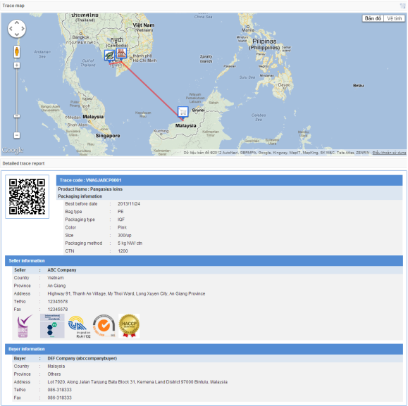
Reporting
  Traceability Report
www.TraceVerified.com

Slide 77
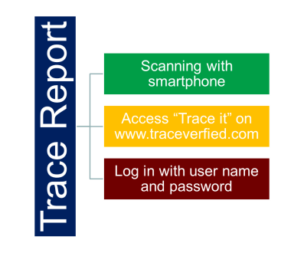
Reports
There are two types of report
General Report:
  Basic information about the product and its supply chain
  Publicly accessible
Detailed Report:
  Full information of the product and its supply chain
  Authorised access only

Slide 78

TraceVerified – adoption
TraceVerified attempts to make important development steps together with pilot users and buyers
However, motivation is mixed
  Fear of extra cost
  Lack of understanding of the advantages of information delivery
  Sector under pressure
TraceVerified has identified diversification as a main strategy to drive adoption
  Extension to shrimp, vegetables, honey and other product
Slow in adoption
  Needs to become de-facto standard
  Needs market pull in addition to technology push

Slide 79

TRANSPORT

Slide 80
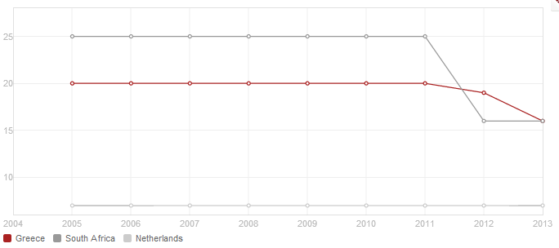
Time to export
© 2014 The World Bank Group, All Rights Reserved.

Slide 81
Cost of Logistics: Comparison
Logistic costs as % of GDP
Statistics Based
Logistics cost as % of GDP
Survey-based
Data Source: Measurement of National-Level Logistics Costs and Performance (OECD working paper),

Slide 82
Cost of Logistics: Comparison
Notes:
The results of these studies are very volatile. While the results of the GMA (a food industry group from the US) survey point to logistic costs of below 7%, other estimates from France or Finland point to logistic costs almost twice as high. Average logistic cost are likely to be within the range of presented percentages.
The Grocery Manufacturing Organization is based in the USA and includes most big food producers of the US such as Kellogg. http://en.wikipedia.org/wiki/Grocery_Manufacturers_Association#Members
Most of these surveys are conducted by logistics associations.

Slide 83

VTL: A Logistics Cooperative
Large Logistics Network through SME cooperation
Notes:
VTL is a German based logistics cooperative that serves its clients through a network of small and medium size logistic enterprises. The network consists of more than 120 SMEs with an average of about 3000 daily shipments. VTL itself has about 50 administrative employees and had a turnover of 39 million euro in 2009.

Slide 84
VTL
VTL is a German based logistics cooperative that serves its about 4000 clients through a network of small and medium size logistic enterprises.
The network consists of more than 120 SMEs with an average of about 3000 daily shipments.
VTL itself has about 50 administrative employees and had a turnover of 39 million euro in 2009.
The main advantages of VTL are its joint hubs, the joint sales department and the international cooperation.
  4 hubs in Germany and Austria with a joint storage area of 114.000 square meters and 188 gates for trucks. These hubs may be used by all VTL members.
  Joint sales unit sells logistic solution and distribute the contract duties to the member(s) best suited for the specific contract.
  Members are assigned to a contract based on their capabilities and regional presence.
VTL’s European network allows it to serve clients that are interested in shipments across borders.

Slide 85
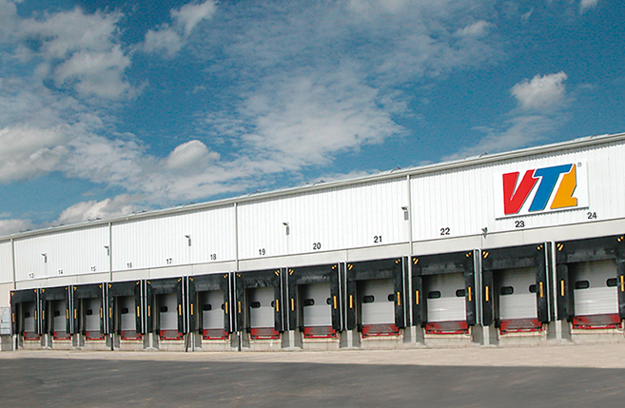
VTL: Advantages
Joint hubs
Joint Sales
International Cooperation
One main hub in Germany
VTL brokers for its members
Partnerships with SMEs in 27 continental European countries
Three regional hubs in Germany and Austria
Members are tied to specific regions/ cargo types

Slide 86
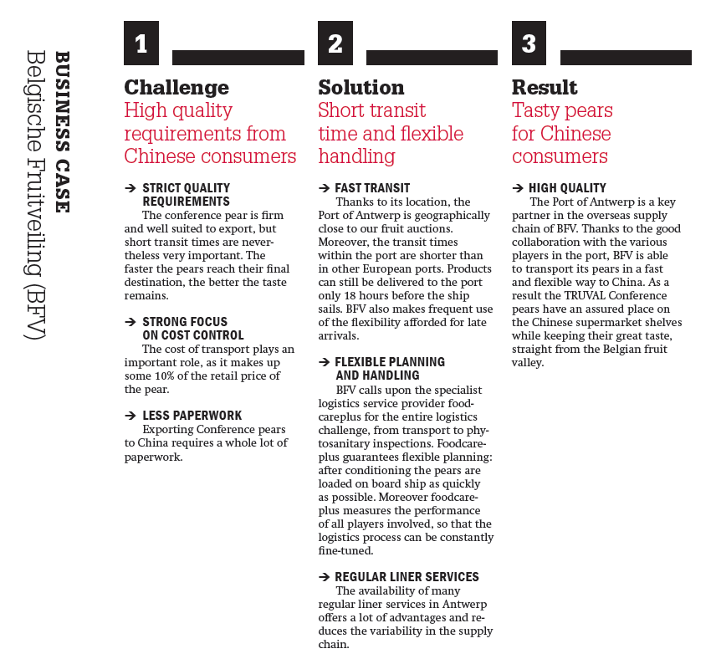
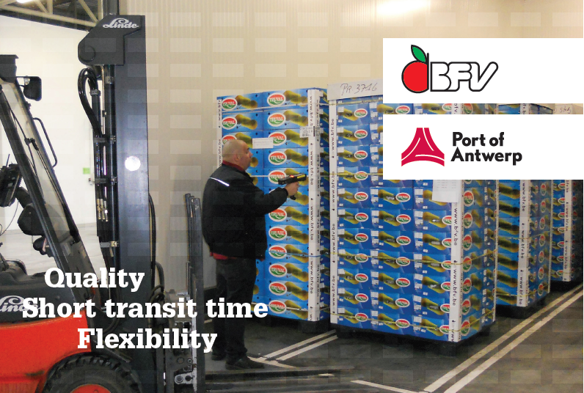
Case study: BLV
www.portofantwerp.com/sites/portofantwerp/files/BFV_EN.pdf

Slide 87



Logistics and logistics platforms
More reading:
  http://www.eib.europa.eu/attachments/country/logismed_en.pdf
  http://www.euromedtransport.eu/Fr/image.php?id=630 (summary of above)
  http://www.poms.org/conferences/poms2007/cdprogram/topics/full_length_papers_files/007-0185.pdf
coollogisticsresources.com/global
www.fruitlogistica.de
www.agrifoodlogistics.eu

Slide 88
Automation of inspections

Slide 89
Phytosanitary certificates
South Africa

Slide 90
Phytosanitary Certificates
Sanitary (human and animal health) and phytosanitary (plant health) measures (called Sanitary and Phytosanitary measures or SPS measures) typically apply to trade in, or movement of, animal-based and plant-based products within or between countries.
The regulatory framework that governs international trade comes under the umbrella of the World Trade Organization (WTO).
Through agreements, WTO members operate a non-discriminatory trading system that spells out their rights and obligations. Each country receives guarantees that its exports will be treated fairly and consistently in other countries’ markets. Each WTO member promises to do the same for imports into its own market. The system gives developing countries some flexibility in implementing their commitments.

Slide 91
SPS
The WTO “SPS Agreement” requires that governments apply food safety, animal health and plant health measures without unnecessary obstacles to trade.
The SPS Agreement allows countries to set their own measures to protect their economy or environment from damage caused by the entry, establishment or spread of pests.
Governments are encouraged to use international standards, guidelines and recommendations when developing SPS measures. The SPS Agreement states that measures should be science-based and not used for trade protection.
It requires that phytosanitary measures be based on an assessment of the risk to plant health, taking into account risk assessment techniques developed by the relevant international standard setting body, and that the measures be technically justified.

Slide 92
South Africa
South Africa is a member of the WTO and a signatory to the SPS Agreement.
South Africa has issued a Draft Plant Health (Phytosanitary) Bill, 2013 for international comment.
The purpose of the proposed regulation is to “provide for phytosanitary measures to prevent the introduction, establishment and spread of regulated pests in the Republic; for the control of regulated pests; for regulation of the movement of plants, plant products and other regulated articles into, within and out of the Republic; as well as to provide for matters connected therewith”.

Slide 93
Responsibilities in food control
Responsibility for the South African food control system is shared between the Department of Agriculture, Forestry and Fisheries (DAFF), the Department of Health (DOH) and the Department of Trade and Industry (dti).
Responsibility for official control functions is divided between national, provincial and local sphere of government as well as the assignees of government. At local level, the monitoring and enforcement of food law is carried out by the municipalities and government’s assignees, one of which is the Perishable Products Export Control Board (PPECB).
The “National Plant Protection Organisation of South Africa” (NPPOZA) is responsible for the functions relating to phytosanitary control. NPPOZA’s responsibilities include:
  inspecting consignments of plants, plant products and other regulated articles
  issuing phytosanitary certificates for exports and re-exports
  Other phyto-sanitary services

Slide 94
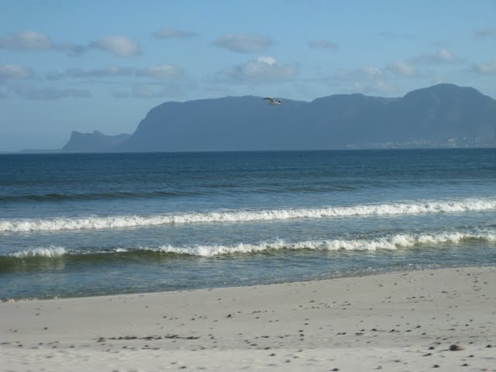
Cold treatment
Within South Africa, the Perishable Products Export Control Board (PPECB) is responsible for cold chain management i.e. ensuring that products destined for export are handled, stored and transported at specific temperatures and optimum conditions, as well as export inspections and issuing export certificates.
PPECB is authorized to apply cold treatment procedures relating to phytosanitary measures, which responsibilities extend to international destinations.

Slide 96
Export process

Slide 97
Specific procedures
Quality inspection, auditing and certification: Before export and phytosanitary certificates are issued, physical inspections are carried out to ensure compliance to regulations:
Product compliance (quality specification, phytosanitary and traceability requirements).
Equipment compliance (suitability to protect the cargo and operate within certain parameters).
Systems compliance (protection of the cargo against unfavourable conditions such as temperature and elements, and food safety requirements such as pollution and contamination).
Cold store and storage requirements address cold store registration; cold store construction and insulation requirements, refrigeration capacity, temperature instrumentation; relative humidity, pallet handling equipment, pre-cooling and storage protocols, temperature and relative humidity records, and cold store and storage management.

Slide 98
Phytosanitary measures
Movement controls within South Africa:
South Africa takes measures to prevent and combat the spreading of diseases within the country, e.g. the Agricultural Pests Act, 1983 (Act No.36 of 1983) prohibits movement of citrus propagation material and other citrus related material from one area to another, unless the movement is authorised by means of permit, or the material is certified.
Regulation of exports and re-exports:
Plants, plant products or other regulated articles exported from South Africa must comply with the phytosanitary import requirements of the importing country.
An exporter applies to the executive officer for the prescribed phytosanitary certificate, in the prescribed manner, and pays the prescribed fees. The point of exit must be identified or might be prescribed by the export phytosanitary protocol. The consignment must comply with the prescribed protocols and related requirements, and be made available for inspection where applicable.

Slide 99
Phytosanitary certificates
On receiving an application by an exporter, the executive officer inspects the consignment and, where the consignment meets the importing country's phytosanitary measures, issues a phytosanitary certificate and any other required declaration.
Certification is denied where requirements have not been met. A consignment that is rejected for an actionable pest may not be repacked and presented for re-inspection for that market or for any other market that lists the same actionable pest for which the consignment was rejected.
The exporter must maintain the integrity and phytosanitary security of a consignment after certification, in compliance with relevant conditions of the NPPOZA.
When a consignment is imported into South Africa for export to another country, the exporter applies to the executive officer for a prescribed phytosanitary certificate for re-export and provides all associated documentation. As with exports, the executive officer confirms that the consignment and documents presented meet the requirements of the importing country. The country of origin of the consignment must be specified on the phytosanitary certificate.
A record of violations lists the country, intercepted organism, plant species, commodity and date.

Slide 100
Phytosanitary certificates
A phytosanitary certificate indicates that a consignment of plants, plant products or/and other regulated articles complies with specified phytosanitary import requirements of the NPPO of the importing country and conforms to the certifying statement on the phytosanitary certificate. Phytosanitary certificates may also be issued to support re-export certification to other countries.
A phytosanitary certificate may not be pre- or post-dated, or issued after a consignment is despatched. The export consignment must leave South Africa within 14 days after certification.
The original phytosanitary certificate, or a certified true copy issued by the NPPO, must accompany the consignment that is presented to the relevant officials upon arrival in the importing country.

Slide 101
Special trade agreements
China PPECB Doc No: HP34C 08/05/07 | This procedure refers to the cold treatment of quarantine organisms (Ceratitis capitata, Mediterranean fruit fly and Ceratitis rosa, Natal fruit fly) in citrus, as prescribed by the General Administration of Quality Supervision, Inspection and Quarantine of the Peoples’ Republic of China (AQSIQ). This procedure will be applied by the PPECB as authorized by the South African Department of Agriculture (DOA). Also refer to PPECB ISO 9001-2000 Work Instructions AWI03 (Break Bulk) and AWI04 (Container) for loading procedures.
China PPECB Doc No: HP34G 08/05/07 | This procedure refers to the cold treatment of quarantine organisms (Ceratitis capitata, Mediterranean fruit fly and Ceratitis rosa, Natal fruit fly) in grapes, as prescribed by the General Administration of Quality Supervision, Inspection and Quarantine of the Peoples’ Republic of China (AQSIQ). This procedure will be applied by the PPECB as authorized by the South African Department of Agriculture (DAFF). Also refer to PPECB ISO 9001-2000 Work Instructions AWI03 (Break Bulk) and AWI04 (Container) for loading procedures.

Slide 102
Exporting fruit from South Africa: Activities
Producer
Packhouse / cold store
Sea/airport
Vessel
Arrival
Transport
Transport
Transport
Register farm (as export FBO / for markets)
Orchard checks
(pre-season)
Certifications
(minimum
SA-GAP)
Product inspections
(if needed)
Register facilities for export /markets
Facility checks and certifications
Product inspections (quality; residues;
phyto compliance)
Temperatures
(cooling; start cold chain management)
Monitor loading
Export inspections and approval
(if containerised inland)
Register facilities for export markets
Facility checks and certifications
Vessel checks
Product inspections (if required)
Temperatures
Monitor loading
Issue export certificate with addendum
Issue phytosanitary certificate
Vessel checks
Temperatures
Cold sterilisation (if needed)
Vessel checks
Temperature logs
Product checks
Acceptance
(if required by protocol agreement)
(Road and rail might be used
to regional destinations)

Slide 103
Exporting fruit from South Africa: Documentation
Producer
Packhouse / cold store
Sea/airport
Vessel
Arrival
Transport
Transport
Transport
Field inspection report
Spray records
GAP certificate
PPECB Service request
Supplier FBO list / Sample results
Compliance certificates
Market registrations
Temp certificates
PPECB Service request
Supplier FBO list
Compliance certificates
Market registrations
Temp certificates
Registrations
Clearance certificate
Consignment release
(if no additional requirements; e.g. in EU and regional markets)
Exporter / Export agent / Shipping agent Authority Authority
Import permits
Planned exports (for shipping): products, volumes, times, transport modes, final destinations
Certificates
Temperature logs
Consignment Release
(If required by
protocol agreement)
Export certificate
Export certificate addendum
Phytosanitary certificate

Slide 104
Exporting fruit from South Africa: Timing
Producer
Packhouse / cold store
Sea/airport
Vessel
Arrival
Transport
Transport
Transport
Register with DAFF for export markets before the season starts
(to allow for orchard/facility inspections; sometimes by receiving country)
Shipping lines need notice of cargo at least 3 weeks before sailing
Start documentation process 3-4 weeks before planned shipment
(to allow for product inspections and logistics arrangements)
Meet
Pre-harvest conditions
Harvest fruit
Deliver to packhouse or cold store
(might be on-farm or off-farm)
Maintain temperature/quality protocols
Cold sterilisation
(may start on land if allowed by protocol agreement)
Inspections/
Release of consignment
Check residues Allow 4 days for sample results
PPECB needs 3 days’ notice for export inspection
(inspections might be inland for containers or at port)
Pack and ship within same week as harvest
(some commodities e.g. apples might be
held in long-term cold storage)
Issue export /phytosanitary certificates
before the vessel sails

Slide 105
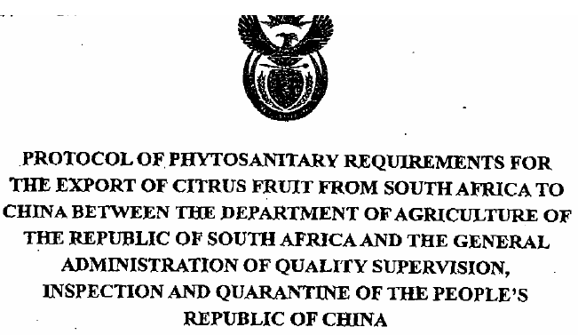
Exporting fruit from South Africa: China citrus protocol
Orchards, packing houses, storage and cold treatment facilities must be registered with DAFF and approved by the Chinese inspection authority AQSIQ and DAFF
DAFF must carry out routine inspections; ASQIQ can request information from DAFF, which must be provided
Citrus fruit destined for China to be kept apart from other fruit during storage and packing
Each package of fruit to display the following:
  in Chinese: “For the People’s Republic of China”
  in English: Place of production; name or registration number of orchard, packing house and storage facility
… periodic inspections by AQSIS at South Africa’s expense

Slide 106
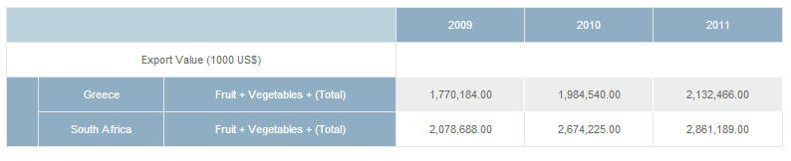
Inspection officers
South Africa operates this system with about 300 inspectors throughout the whole country
Src: FAOSTAT
 | 1990 | 2000
Agricultural land (sq. km) in Greece | 92,220 | 85,290
Agricultural land (sq. km) in South Africa | 968,000 | 996,400
Src: www.tradingeconomics.com

Slide 107
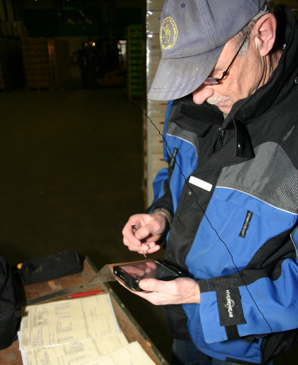
OVERVIEW ICT KCB.
Martin Waasdorp
2014.

Slide 108
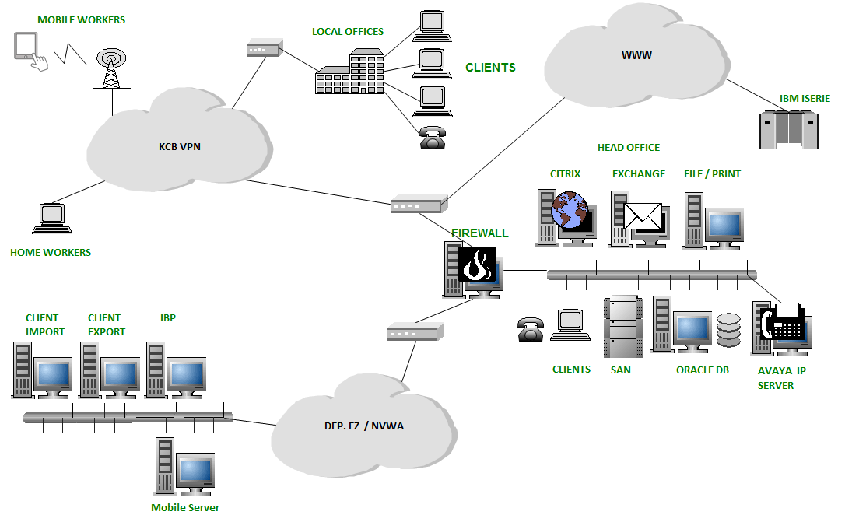
ICT LANDSCAPE KCB : INFASTRUCTURE

Slide 109
ICT LANDSCAPE KCB : INFORMATIONSYSTEMS
TASK
IMPORT | INTERNAL MARKET | EXPORT | QUALITY MANAGEMENT SYSTEM
CLIENT IMPORT CLI | DATABASE TRADERS AND GROWERS DMD | CLIENT EXPORT CLE
INSPECTION MANAGEMENT SYSTEM IBP
MOBILE INSPECTION REPORT MIR
TIME REGISTRATION SYSTEM PTS
BILLING SYSTEM FAC
FINANCIAL SYSTEM FMS
SUPPORTING
SYSTEMS

Slide 111
CLIENT IMPORT 1
Phytosanitary and quality inspections prior to customs procedures
Risk Analysis (product/country of origin)
Selection of the goods to be inspected
Analysis and selection based on data from the declaration of the goods
Selection of goods - which is based on profiles – is fully automated

Slide 112
CLIENT IMPORT 2
Inspection request sent to Inspection Management System
Non selected shipments will be administrative checked for proper documents and registration in CLIENT import

Slide 113
CLIENT EXPORT
Phytosanitary inspection based on third country demands.
Quality inspections based on EU regulations (EU 543-2011). Analysis and selection on basis of data from the declaration of the shipments (manual)
Electronic handling (partial) of certifcate of conformity (agreement with Dutch Customs).
Uniform edited documents

Slide 114
INSPECTION MANAGEMENT SYSTEM (IBP)
Registration of all inspection requests
Planning of inspection requests
Registration of inspection results
Electronic feedback send to CLIENT-systems
Email feedback to import- en exportcompany

Slide 115
INVOICE SYSTEM FAC
Produces all invoices for KCB .
1250 different customers
20.000 invoices per Year (estimate 2014)
Uploading all data to the Financial system

Slide 116
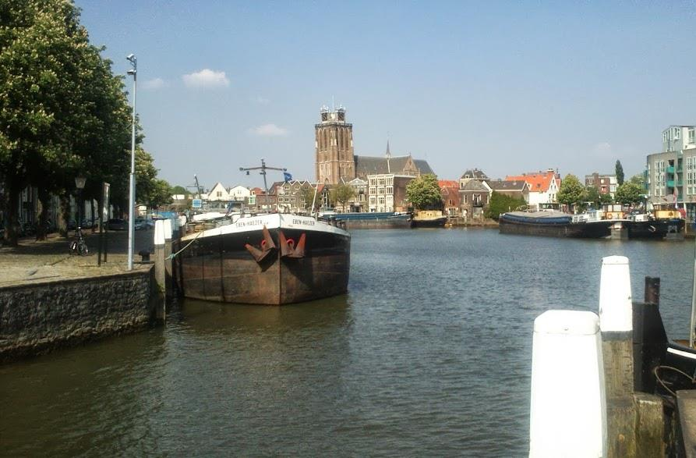
Peer review 2011
The Netherlands is one of the largest exporters and importers of fruit and vegetables products in the world. The inspection system has to be well organised in order to manage the large volume and diverse fruit and vegetable consignments.
KCB also covers phytosanitary inspection of many products
This system is fully digitalised from the request for inspection to the issuance of certificates.
The system is run by the Ministry for Economic Affairs, Agriculture and Innovation but the daily operation is the responsibility of KCB.
Most traders have a user interface for the IT system Client Import (alternative: fax)
For exports a risk assessment based inspection system is in the introduction phase

Slide 117
Peer review 2011
The consignments which are subject to inspection come into an electronic system where they are associated with inspectors. This planning is done by experienced experts, who take into account the place of inspection, the required type(s) of inspection, the qualification of the inspector and the capacity of the inspectors in charge of the given day.
The electronic system is usually running smoothly. However, during the visit, the central server collapsed and all the system was shut down. In this case, the coordination of inspection has to be done manually, using the traditional method of paper notifications, phone calls, faxes and paper based documentation.
The inspectors automatically receive their daily inspection plan on their PDA. They have to implement the phytosanitary and/or quality inspection of the consignment and fill in the online forms. As a result of a positive inspection, a code is sent to traders via the system. With this code, custom clearance can be done by the trader.
If the result is negative, the inspector puts the consignment on hold. The custom authorities are also informed of this decision.

Slide 118
Quality Control Board
The KCB, the Quality Control Bureau was established in 1924 by Dutch growers and traders.
  The Bureau was established with the primarily task of quality inspection of Dutch fruit and vegetables exports to Western European markets.
As of today, the KCB is still a fully independent body.

Slide 119
Efficiency of inspection
The KCB employs 78 inspectors (June 2011) responsible for quality control of fruit and vegetables before the retail phase. They belong to the Field Service within the organisational structure of the body.
  Fruit and vegetables sector produced EUR 2.6 billion in 2010.
  The sector plays a prominent role in international trade with an export value of EUR 9.3 billion, including re-exports, and an import value of EUR 7.1 billion in 2010.
  In total 15,810 lots were inspected for export in 2010. This corresponds to 2 204 000 tons, of which 1 389 000 tonnes was SMS produce.
  In comparison: Greek exports of fruits and vegetables amounted to 535.5 m€ in 2012
The 87 fruit and vegetable products which are subject to import inspection are also subject to export inspection.
As regards the inspection frequency, consignments with only SMS products or a mix of SMS and GMS products are inspected in 100 percent.
The consignments which contain only GMS products are randomly checked in a 10 percent frequency. However, the risk analysis system can further adjust the inspection frequency; e.g. for approved traders, only five percent of the shipments is subject to inspection.

Slide 120

Inspections
When a consignment is located in a warehouse, the sample boxes are picked randomly from the total number of boxes. If an import consignment is in a transport vehicle, the sample boxes are taken from the first six pallets in the container. All the boxes in the sample are emptied for inspection.
In case of an export inspection, the total consignment must be ready for inspection. If part of the consignment is already in the transport vehicle, the vehicle has to be unloaded again.

Slide 121
Approved traders
The companies must meet the following criteria, in order to participate in the RIK (Reglement Interne Kwaliteitscontrole, Regulation on Internal Quality control) system and become an approved trader:
  To have good inspection results over a period of six consecutive months; this means less than 10% non conformities over this period; and,
  To have an operating quality control system for fruit and vegetables in place that meets the criteria that are laid down in the KCB Quality Code
The quality control system is audited, before a trader gets the RIK approval. During the audit, the KCB examines the design and implementation of the quality control system, the qualifications of the quality inspectors and the maintenance of the system.
In the first year, the company is audited two times, and in the following period only once per year. Any deviation recognised during an audit can eventually lead to the exclusion of companies from the RIK system.
Moreover, in case of severe problems, like manipulation of country of origin, transportation of produce that is in non conformity or repetitive offenses, companies can be excluded.

Slide 122
Quality control of inspections and inspectors
The KCB has an internal auditing system, in order to harmonize inspections between individual staff. The inspectors are audited yearly on each qualification which they hold. The audits are done by the Assistant Specialist of the District Office, who is nominated by the Management. The Assistant Specialists, on their turn, are audited by the Specialists of KKB Department.
Moreover, the KKB Department is analyzing the database with inspection results (IBP) on a monthly basis, in order to check if all inspections are executed by qualified inspectors, and to see the number of non conformities per inspector. Notable cases are discussed with the district manager and the Assistant Specialist in the area.
In case of large errors, an inspector may lose a qualification. This can be regained after sufficient training, followed by examination by the Specialist of the KKB Department.

Slide 123
Costs
The costs of the inspections are invoiced to the market actors.
For imports and exports, KCB applies a standard fee per inspection (for covering administrative and travelling costs), plus a fee per minute for the duration of the inspection (for covering inspection costs).
For Structural Supervision a standard price per year applies per risk category, and the inspector takes a standard time for the duration of the visit depending the type and size of the company.
The standard time varies between 1⅛ and ½ hour: 1⅛ hour in case of a (big) trader or packing house and ½ hour in case of a primary production company.
In case of necessity, the duration of the visit can be extended.

Slide 124
Thank you for your attention!
Dr Heiner Lehr
Syntesa Partners & Associates
heiner@syntesa.eu

