Slide 1
Comparison of IRENA/IEA and JWEE/FAOSTAT wood energy data Adrian Whiteman, IRENA, Abu Dhabi
Bioenergy from the Forest Sector, 6-8 December 2016, Budapest, Hungary

Slide 2
Outline
Sources
Comparison tables
Main differences
Summary

Slide 3
Sources

Slide 4
Energy tables: IEA

Slide 5
Forestry tables: FAOSTAT

Slide 6
Comparison: IEA-FAOSTAT

Slide 7
Energy tables: IRENA

Slide 8
Forestry tables: JWEE
Main activity producers
Industry + autoproducers

Slide 9
Comparison: IEA-FAOSTAT

Slide 10
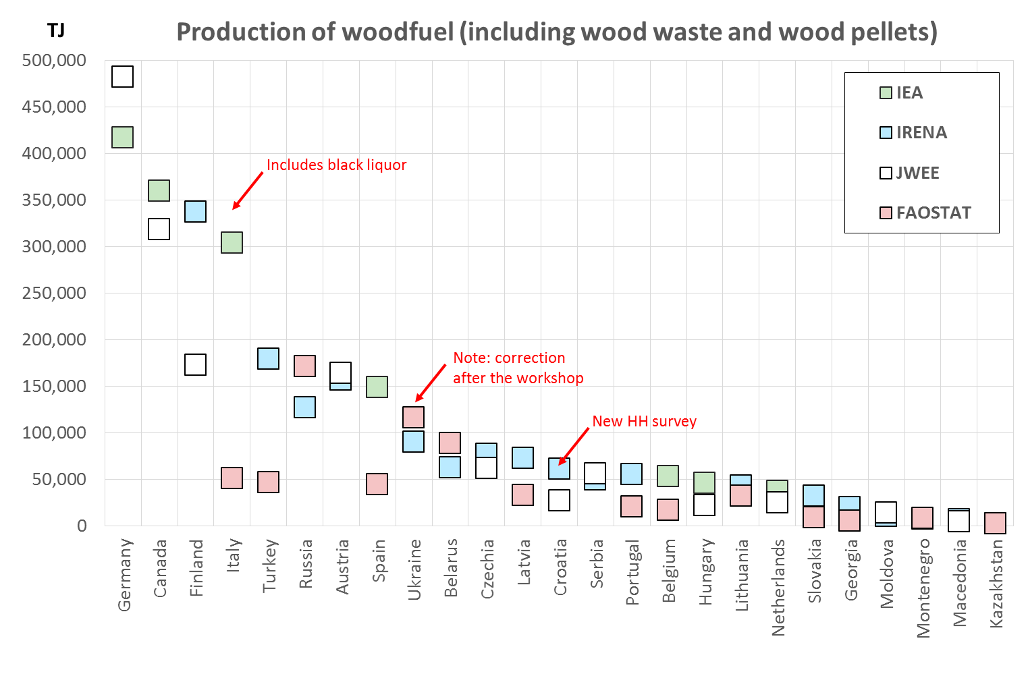
Differences: Production

Slide 11
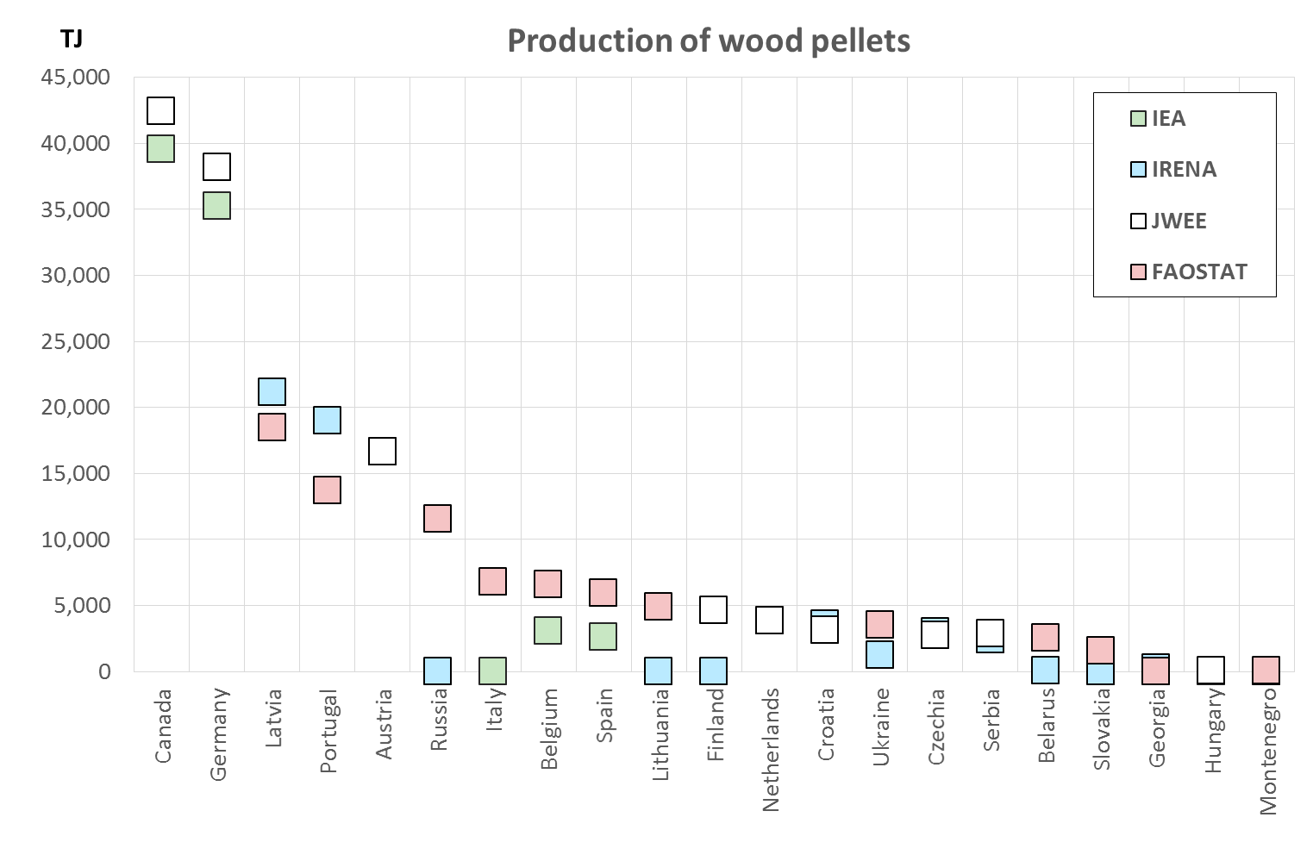
Differences: Production

Slide 12
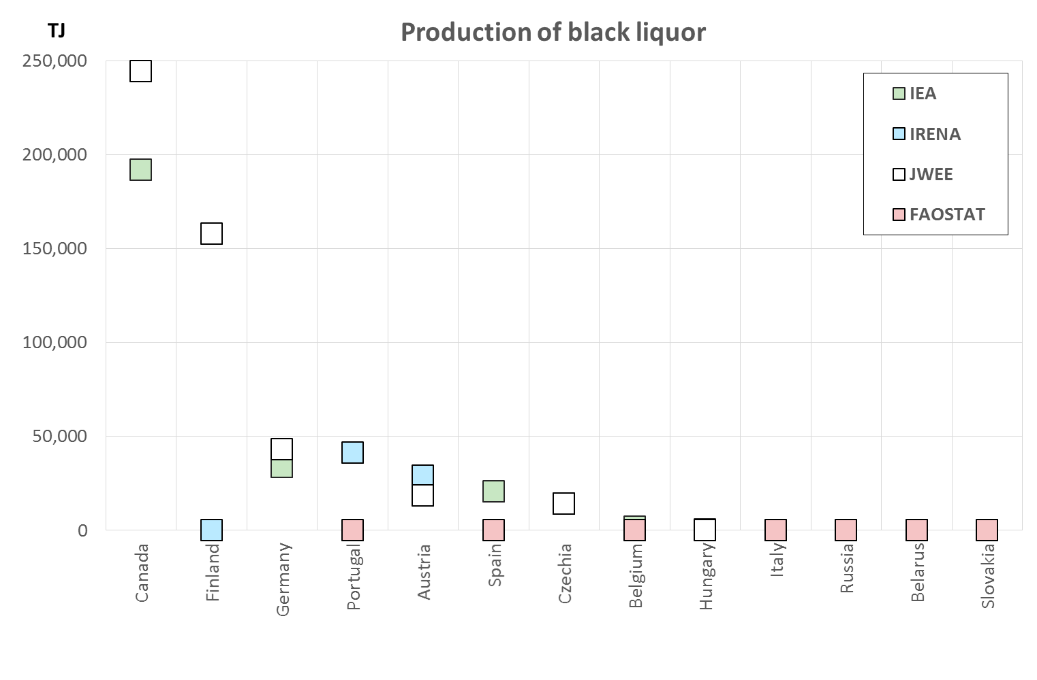
Differences: Production

Slide 13
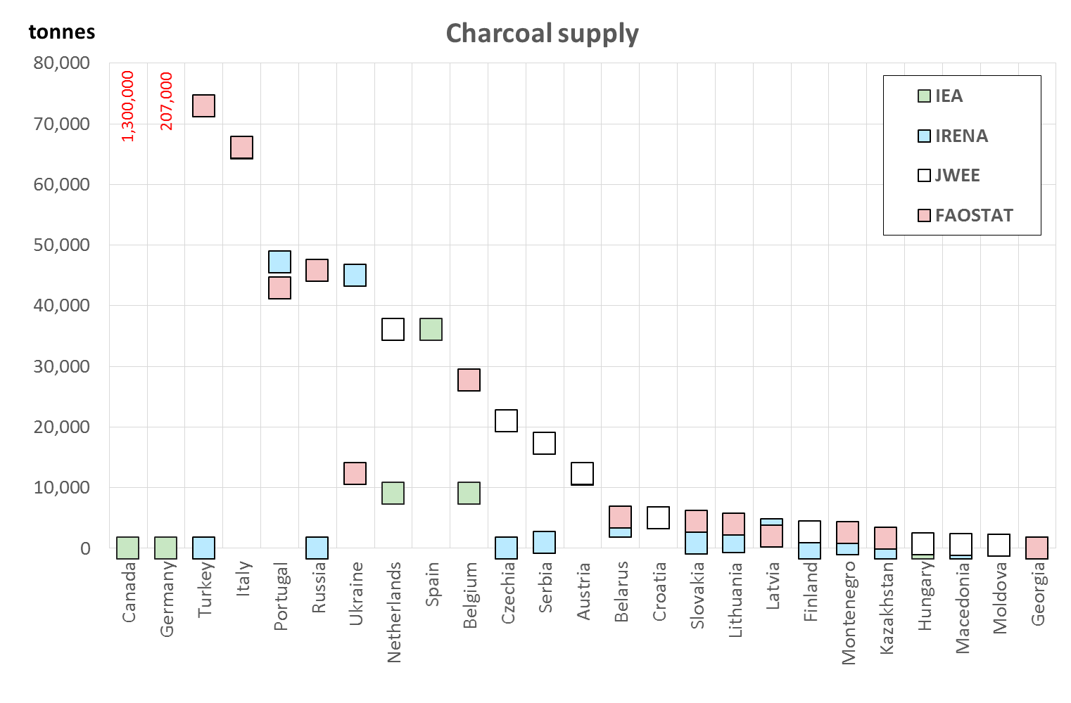
Differences: Charcoal supply

Slide 14
Summary
Energy figures > Forestry figures (mostly)
FAOSTAT almost always much lower
Some huge differences still (e.g. Ukraine)
Countries with most detail tend to be closest
Charcoal often missing in energy data
Trade data sometimes far apart

