Slide 1

National Statistical Committee of Kyrgyz Republic (NSC KR)
SPECA PWG on statistics
27-30 August, Issyk-kul, Kyrgyzstan
Kyrgyzstan’s Experience of implementing PC-Axis
(using modern means of dissemination of statistical data)
G. Mursabekova - Head of the Department of Agriculture Statistics and Census NSC KR

Slide 2

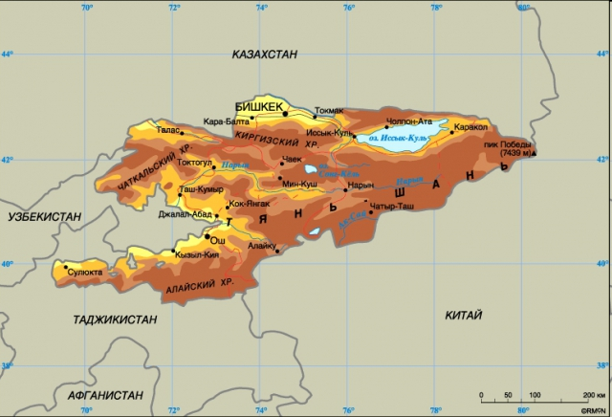
Technical and methodological assistance
To carry out the Population and Housing Census in 2009 and to disseminate its results:
United Nations Economic Commission for Europe (UNECE);
UN Population Fund in Kyrgyzstan (UNFPA);
Interstate Statistical Committee of CIS.

Slide 3

To provide users with timely census results
and to use modern means for dissemination of statistical data
NSC KR developed and approved a
“Schedule of issuance and distribution of publications"
The following were taken into account while developing the plan
The sequence of the publications
The confidentiality of data
The methods of distribution
Holding of presentations

Slide 4

To ensure effective interaction with users, the Agenda of publications and dissemination of census results was developed
Agenda of publications is based on national needs.
Content is published on paper and in electronic format in Kyrgyz, Russian and English languages, following the schedule.
Publications and summaries of aggregated data according to the selected indicators are available on the NSC web-site at www.stat.kg.
Provide 20% of the sample (census microdata) to Minnesota State University (USA).

Slide 5

Since 2009, publications and final census results are being developed and disseminated
The topics and the schedule of the publications were developed.
The publications on census were divided into several series:
T Series – on the results of the national level census
F Series – on the results of the regional level census (regions);
M Series - methodology.
During 2009-2011, 6 publications
(Series T), 9 publications (series P), one publication (series M) were published.
A Total of 16 publications on census’ results.
June 2012, the 17th publication was released by the NSC KR web-site on the initiative of the UN Population Fund in Kyrgyzstan (UNFPA) in order to disseminate the results of the 2009 population and housing census in Kyrgyzstan to the international community.

Slide 6

PC-Axis in NSC КR
NSC KR want to use information and communication technology more effectively, but also to disseminate statistical data for a wider range of users
Implementing PC-Axis software.
The Statistical Office of Sweden is the PC-Axis Software developer.

Slide 7

Why did we choose
PC-Axis?
simplicity thus high speed display of data;
dynamic output data;
sample of data;
showing data cubes in a tabular form, and reformatting them.
Technical assistance
to introduce the PC-Axis in the NSC KR
was provided by the Statistics Division of the UNECE.

Slide 8



PC-Axis Background
Update stat bank
Introducing and opening
Training and gathering of the team
Presentations PC-Axis
January2013
1st Quarter 2012
November 2011
July 2011
Geneva

Slide 9

The assistance of UNECE Statistical Division
for introducing the PC-Axis in the NSC KR
Installing the Russian versions of the software products: 1. PX-Edit. 2. PC-Axis 3. PX-Web
To create a directory and copy the updated files on the NSC KR Web-Server.
To configure IIS and bind the files to the NSC KR Web-site
To conduct trainings for the NSC KR staff on how converting Excel-files into PX-files.

Slide 10

Framework of future cooperation
with the UNECE Statistical Division
We are planning to introduce editing tools for data in order to automatically generate PC-Axis files, thus increase the productivity of the NSC KR employees

Slide 11

Steps of introducing the PC-Axis
Preparing the Web-server (Installing OS windows 2003 server, raising the IIS, installing the PX-Web software);
Preparing the PC (installing the PX-Edit and PC-Axis software );
Training of NSC KR employees.
November 2011: Seminar "Implementing PC-Axis for disseminating the population and housing censuses of 2009.".
Presenters of the seminar:
Members of the Statistical Division of UNECE and National Bureau of Statistics of the Republic of Moldova.

Slide 12

Training NSC KR employees on PX-file formatting
Terms of Reference - to create PX-files;
Structuring the chapters in the data bank
(creating a system of folders and subfolders);
Collecting PX-files from the offices’ branches;
Keep updating the data bank;
Monitoring the quality of produced files;
Disseminating the information in the data bank to a wide range of users.

Slide 13

PC-Axis supporting team
1. Branch departments of the NSC (creating PX files)
2. NSC departments of statistics and compilations (Collecting PX files from departments and placing them on the web-site www.stat.kg.)
3. Technical department of the MCC NSC
(maintenance of the web-site, its security and users access
Internet
Server

Slide 14
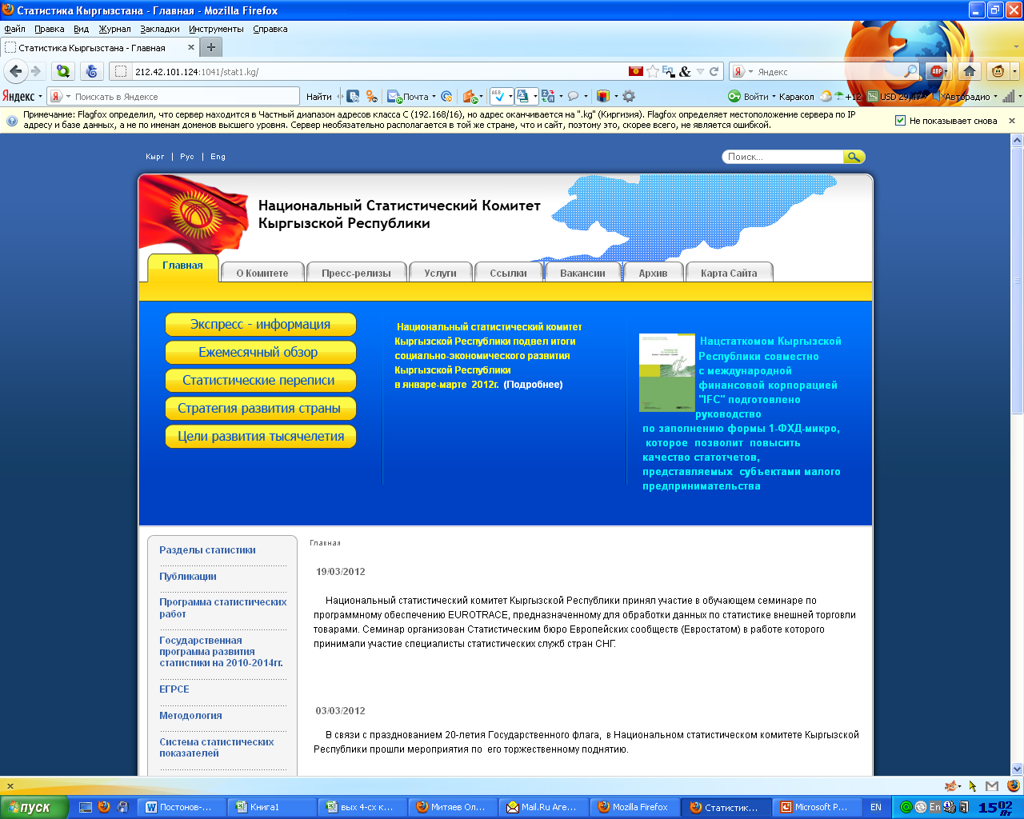

Slide 15
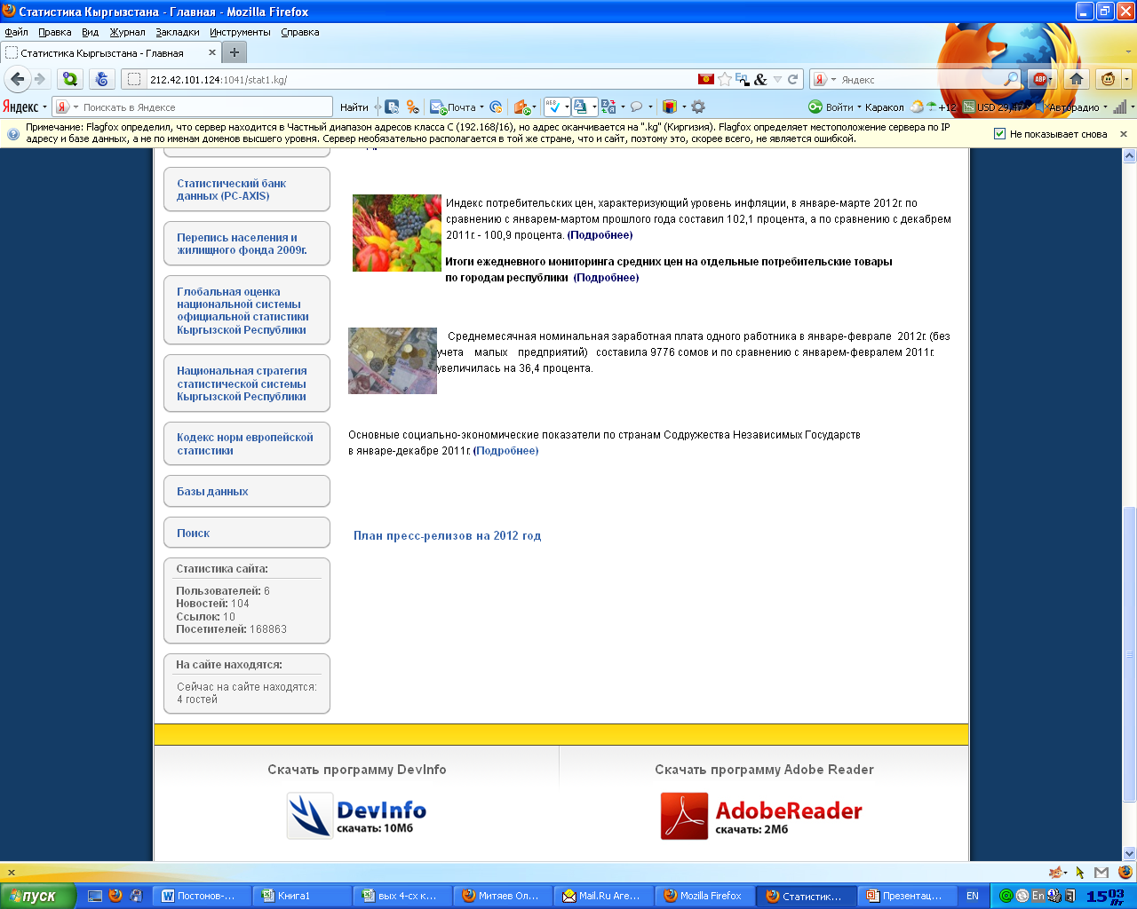

Slide 16
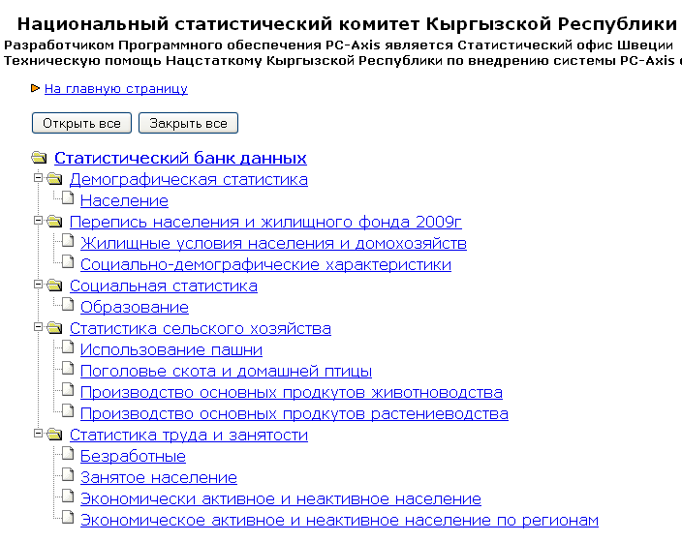

Slide 17
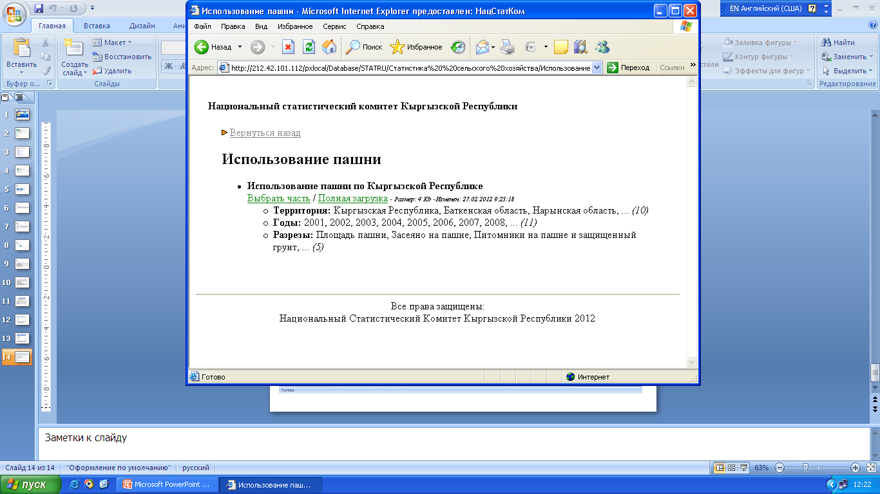

Slide 18
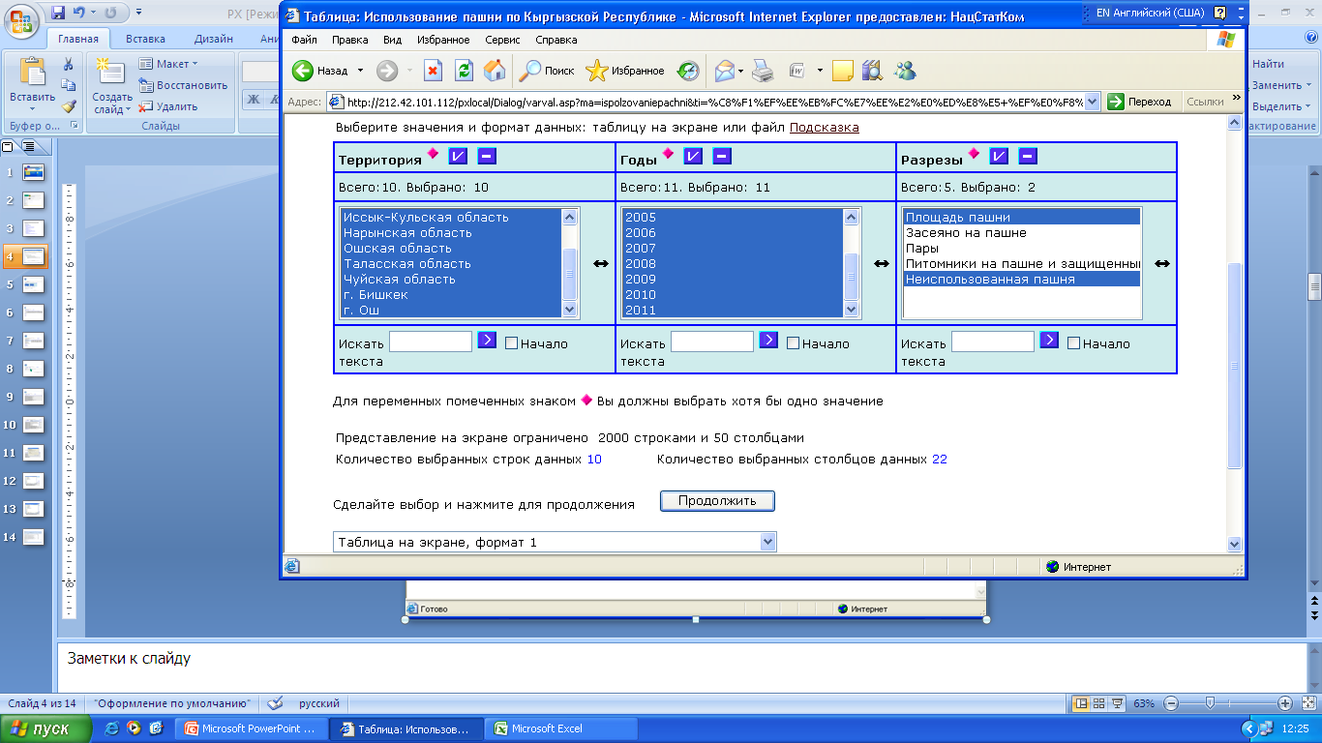

Slide 19
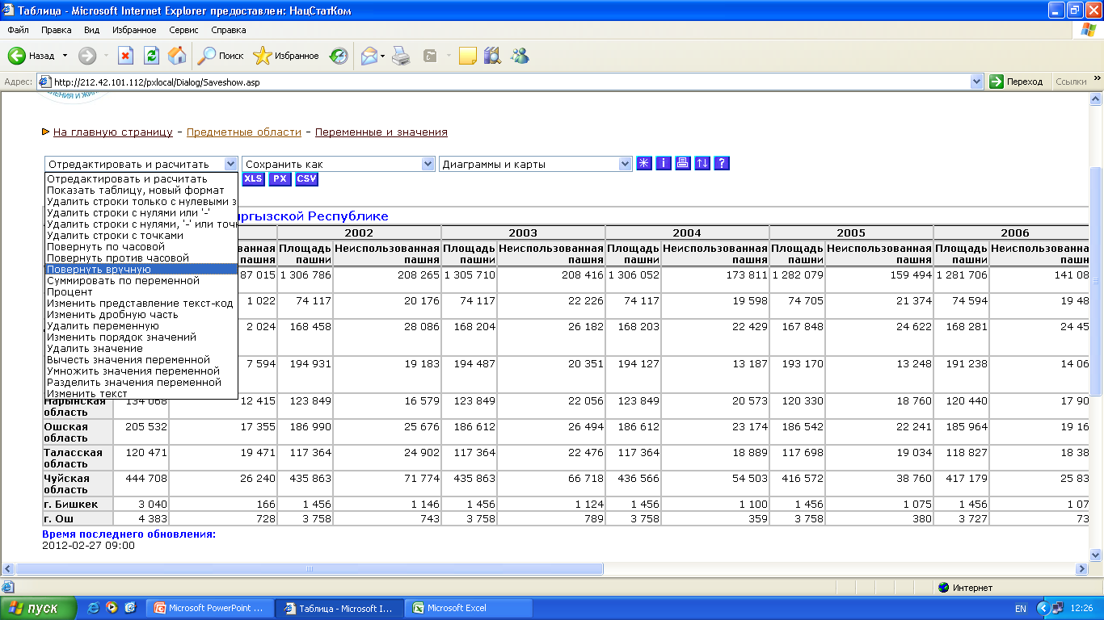

Slide 20
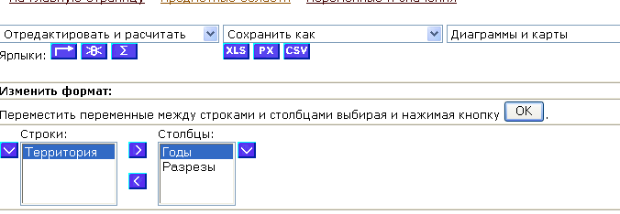
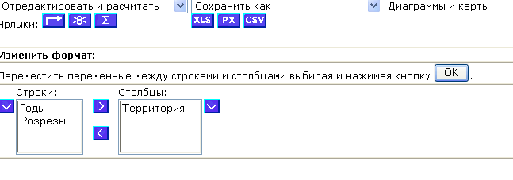
Adjustment or editing Windows
Changing the rows and columns for visualization

Slide 21
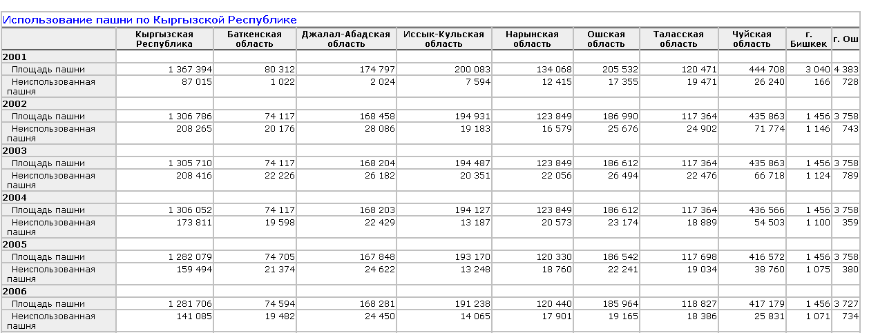
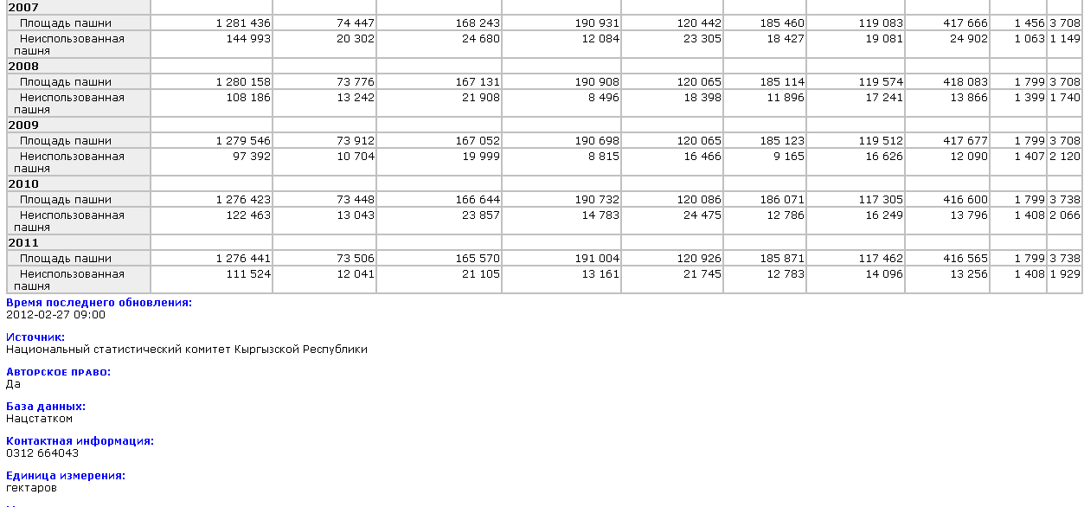

Slide 22
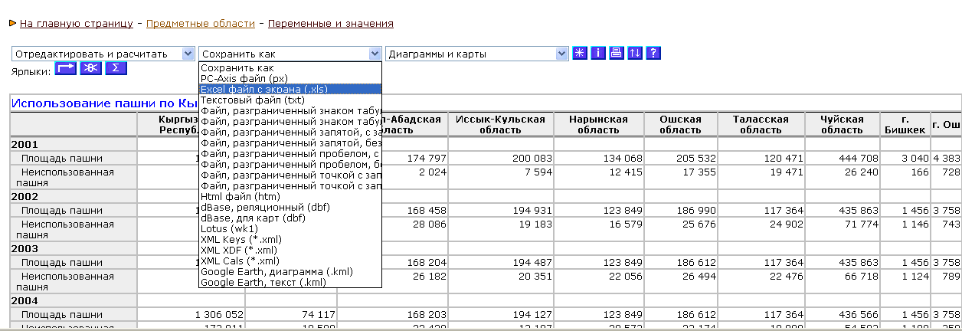

Slide 23
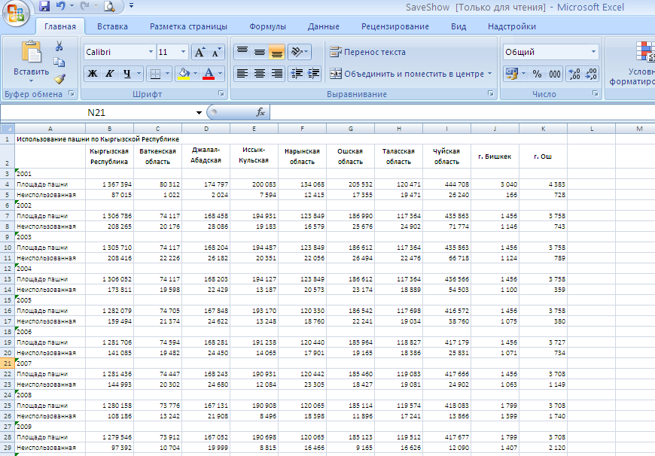

Slide 24
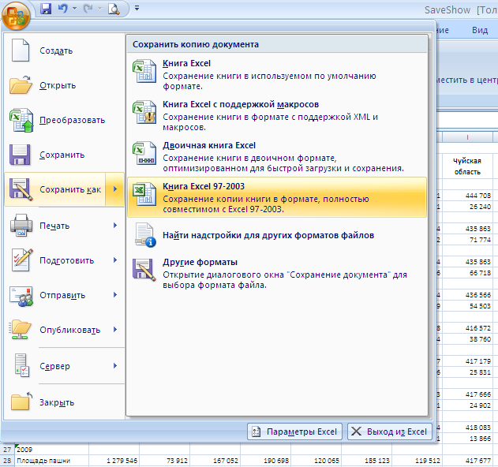

Slide 25
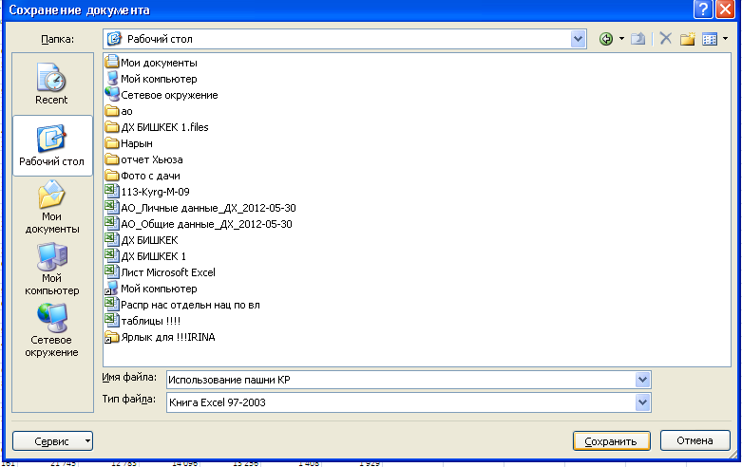

Slide 26
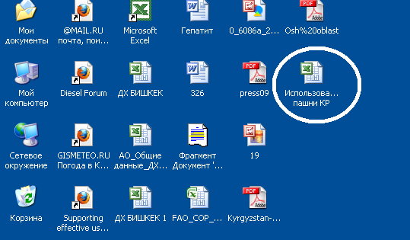

Slide 27

Thank-you for your attention!

