Slide 1
Optimizing Business Processes and Systems of National Accounts in Japan
Masashi Shigeno and Shigeru Hayashi
Department of National Accounts, Economic and Social Research Institute (ESRI), Japan

Slide 2
I. Introduction
Main Responsibilities of DNA
Compile and Publish estimates for GDP and other components in the System of National Accounts (SNA)
What is SNA?
Providing an overview of economic process, recording how production is distributed among consumers, business, government and foreign nations.

Slide 4
Ⅱ. About JSNA
A typical estimation flow in JSNA processed in each division/team is as follows;
Collect data from external entities, i.e. other ministries,
organizations, web pages, publications, etc.
(b) Collect data from other divisions and/or teams.
Proceed secondary estimation by using mainframe
legacy systems and/or PC Excel.
(d) Deliver processed data to other divisions/teams.
→ Organic collaborations are required!

Slide 5
Daily operational works:
Tight schedule of estimation and announcement of JSNA
 | Estimation Cycle | Public Announcement Timing
Quarterly Estimate 1 | Quarterly | 1 month and 2 weeks after the end of the quarter
Quarterly Estimate 2 |  | 2 months and 10 days after the end of the quarter
Annual Estimate 1 | Annual | 12 months after the end of the year
Annual Estimate 2 |  | 24 months after the end of the year
Benchmark Year Revision | Every 5 years | Comprehensive revision of estimation concept and methodology and Benchmark revision of every 5 years
Emerging Requirements:
Introduction of 08SNA such as R&D capitalization
First installation of Economic Census data in Japan

Slide 6
Ⅲ. Towards JSNA Statistical
Information Systems Innovation
A. Background
Information systems used currently in JSNA estimation are decades-old in silo systems mainly written in mainframe FORTRAN. Required improvements in
Performance, efficiency, usability, readability ,maintainability.
B. DNA has decided to take efforts towards
(1) Legacy Transformation from current mainframe
FORTRAN based systems to Excel/VBA based secure
and open End-User Computing (EUC) systems.
(2) Business Process Reengineering with Knowledge
Management

Slide 7
Legacy Transformation from MF FORTRAN
to Excel/VBA based EUC
Concepts of New Systems
Visibility: By visualizing
Data processed (what)
Estimation process logics and algorithms (how)
Meanings of the data and processes (why)
Accelerating the in-depth understanding and proficiency about JSNA statistical estimation.
Flexibility:
To promptly respond to the JSNA system enhancement requirements
To flexibly execute preliminary or trial estimations, simulations, hypothesis verifications and/or what-if analyses

Slide 8
(2)Business Process Reengineering with
Knowledge Management
A. Knowledge Management Framework for BPR
(a)To prepare more consolidated estimation manuals
and system design/specification documents.
To provide the data delivery plan and schedule on
a calendar and an intranet office collaboration tool.
(c) To automatically link to the delivered data by clicking
the specific plan item.

Slide 9
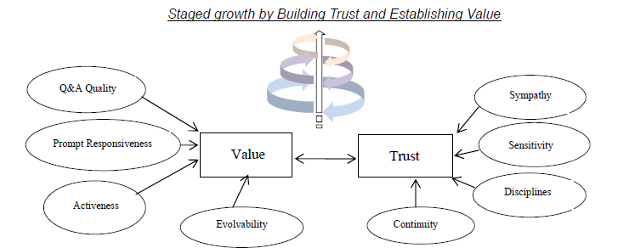
B. Knowledge Portal
Knowledge Base functions to share the information and
knowledge across divisions and teams.
(b) Communication functions intra departmental Community of
Practices (CoP) such as Q&A, Wiki or FAQs.

Slide 10
Ⅳ. Next Steps
On the right track towards goal?:
A series of estimation works, that take approximately two hours on the mainframe FORTRAN, now takes only one to two minutes by the Excel/VBA.
Only about three years left to complete this project:
Concurrently addressing challenges toward the implementation of 08SNA

