Slide 1
New Data Sources and Outputs of the Business Register in Japan
Masatsugu KITAHARA
Masao TAKAHASHI
Statistical Business Register Management Division, Statistics Bureau,
Ministry of Internal Affairs and Communications
Government of Japan
Notes:
Thank you Ms. Pierrette, Good morning, ladies and gentlemen. My name is Masatsugu Kitahara, I work in the Statistics Bureau at Ministry of Internal Affairs and Communications in Japan. I will present with Mr. Takahashi co-authored.
It is a great honor to be able to speak to you today.
Our presentation today is about the Economic Census, which is the main data source for the Business Register.

Slide 2
Contents
Introduction
The Outline of the Japanese Business Register
Use of New Data Sources
New Statistics by Using the Japanese Business Register
Notes:
The topic of our presentation today is the “Economic Census.” I’d like to talk about five main points: First, Introduction; Second, About the Economic Census; Third, Efforts to Enhance the Quality of the Economic Census for Business Activity. I call it ECBA; Fourth, Results of the Efforts; Fifth, For the Next Survey;
First of all, Introduction

Slide 3
Introduction
Various statistical surveys
Census of Manufacture
Census of Commerce
Economic Census
Business Frame (EC-BF)
Business Activity (EC-BA)
Administ-rative data sources
Commercial and Corporate Registration
Information of Labor Insurance etc.
Financial Statements Statistics of Corporations by Industry etc.
Recorded
Information
Business Register
(Establishment
Frame Database)
Base
Information
Information to
Update the Base
Information
Notes:
The Business Register in Japan, formally called the Establishment Frame Database, is developed by integrating the results of the Economic Census, various statistical surveys and administrative data sources. In this way, various data are stored in the Business Register. Among them, the main source is the Economic Census.

Slide 4
Contents
Introduction
The Outline of the Japanese Business Register
Use of New Data Sources
New Statistics by Using the Japanese Business Register
Notes:
The topic of our presentation today is the “Economic Census.” I’d like to talk about five main points: First, Introduction; Second, About the Economic Census; Third, Efforts to Enhance the Quality of the Economic Census for Business Activity. I call it ECBA; Fourth, Results of the Efforts; Fifth, For the Next Survey;
First of all, Introduction

Slide 5


The Outline of the JBR①
Japanese Business Register (JBR)
1. Developed by the Statistics Act (Act No. 53 in 2007).
2. Developed by integrating the results of the Economic Census, various
statistical surveys and administrative data sources.
3. The data of all establishments and enterprises in Japan is kept
updated on a regular basis.
4. The recorded items are based on that of the Economic Census.
Main Functions
・Provision of population information for various
statistical surveys
・Leveling the burden on survey objects when
providing population information
・Support for conducting various statistical surveys
,etc.
JBR
Notes:
The Business Register in Japan, formally called the Establishment Frame Database, is developed by integrating the results of the Economic Census, various statistical surveys and administrative data sources. In this way, various data are stored in the Business Register. Among them, the main source is the Economic Census.

Slide 6

The Outline of the JBR②
By developing the JBR…
1. The accuracy of various statistical surveys
conducted by the national and local
government will improve.
2. The accuracy of National Accounts (such
as GDP) will improve.
3. New statistics will be created by linking
the information of various statistical
surveys by using the common code.
Notes:
The Business Register in Japan, formally called the Establishment Frame Database, is developed by integrating the results of the Economic Census, various statistical surveys and administrative data sources. In this way, various data are stored in the Business Register. Among them, the main source is the Economic Census.

Slide 7
How to Update the JBR
1. Establishment / Enterprise Inquiry
“Establishment / Enterprise Inquiry” is mainly for establishments or enterprises that are considered to have newly opened and are not included in the JBR.
2. Confirmation of Business Implementation Status
“Confirmation of Business Implementation Status” confirms by telephone for the establishments and enterprises considered to have changed the activity status based on administrative data sources, etc.
The inquiry is made by mail and answered online or by mail.
Establishment / Enterprise Inquiry
Confirmation of Business Implementation Status
Updated
JBR
JBR

Slide 8
Data Sources of the JBR①
EC-BF and EC-BA（Base Information）
19 Statistical Survey（Recorded Information）
Administrative Data Resources
JBR
The selection criteria for the data stored in the JBR
Statistical surveys that have become complete survey (or almost the same) in a specific industry
Statistical surveys covering a wide range of industries and having complete survey in one part
Statistical surveys covering a wide range of industries and having a large number of survey objects
In addition to the above, statistical surveys that are expected to create new statistics in conjunction with administrative data sources, etc., and of the other general statistics surveys, statistical surveys that are considered to be particularly effective for the development of the JBR
Considering the above, the results of statistical surveys that are highly utilized in each ministry and that contribute greatly to the development of the JBR are preferentially stored.
8

Slide 9
Data Sources of the JBR②
Ministry of Internal Affairs and Communications (MIC)
Economic Census for Business Frame
Economic Census for Business Activity (Conducted jointly with METI)
Ministry of Finance (MOF)
Surveys for the Financial Statements Statistics of Corporations by Industry
Ministry of Education, Culture, Sports, Science and Technology (MEXT)
School Basic Survey
Ministry of Health, Labour and Welfare (MHLW)
Monthly Labour Survey
Ministry of Agriculture, Forestry and Fisheries (MAFF)
Census of Agriculture and Forestry
Ministry of Economy, Trade and Industry (METI)
Census of Commerce (Integrated into the Economic Conditions Survey in 2019)
Ministry of Land, Infrastructure, Transport and Tourism (MLIT)
Statistics on Construction Undertaken
Monthly Survey on Service Industries
Survey of Research and Development
Unincorporated Enterprise Survey
Economic Conditions Survey (Started in 2019 and conducted jointly with METI)
Basic Survey on Wage Structure
Survey of Medical Institutions
Census of Fisheries
Census of Manufacture (Conducted jointly with MIC in 2019)
Basic Survey of Japanese Business Structure and Activities
Current Survey of Selected Service Industries
Survey of Energy Consumption
Basic Survey on Small and Medium Enterprises
Current Survey of Commerce
Survey of Selected Service Industries (Integrated into the Economic Conditions Survey in 2019)

Slide 10
Contents
Introduction
The Outline of the Japanese Business Register
Use of New Data Sources
New Statistics by Using the Japanese Business Register
Notes:
The topic of our presentation today is the “Economic Census.” I’d like to talk about five main points: First, Introduction; Second, About the Economic Census; Third, Efforts to Enhance the Quality of the Economic Census for Business Activity. I call it ECBA; Fourth, Results of the Efforts; Fifth, For the Next Survey;
First of all, Introduction

Slide 11
Utilization of New Data Sources
Establishment / Enterprise Inquiry
Confirmation of Business Implementation Status
Updated
JBR
JBR
These updates alone cannot grasp all establishments in Japan.
Because
・Administrative data sources are limited to corporations or the like.
・Reports related to discontinuance of business are not necessarily done.
To resolve these problem,
we use the following
・Corporate Number
・New EC-BF

Slide 12


Utilization of the Corporate Number
What is the Corporate Number ?
The National Tax Agency designates a 13-digit Corporate Number to each corporation based on “Number Act.”
The Corporate Number is not assigned to individual proprietorship.
The Corporate Number has the purpose of creating a new value and the role of social infrastructure.
The corporations that fall under the designation of the Corporate Numbers are as follows.
Registered Corporations
National Government Organs
Local Public Entities
Other Corporations and Associations
In the 2019 EC-BF, the Corporate Number is used to try to identify the establishments that could not be grasped by enumerators until now.
1300936XXXXXX
5030916XXXXXX

Slide 13
Benefits by Using the Corporate Number
The Corporate Number is used as a key to link the results of statistical surveys and administrative data sources.
・Reduce the burden of filling in the survey objects
・Improve the accuracy of the statistical surveys
Establishments that the enumerator could not identify as an establishment until now is found by finding its existence from the Corporate Number.
・It is possible to grasp an establishment that
does not have a signboard or looks the same as
a private house.

Slide 14


New EC-BF conducted in FY2019①
New Idea
Introduction of the Appearance Survey.
The enumerators survey with the Tablet Terminals.
Establishments from the Corporate Number is additionally posted to the List.
Administrative Data Sources
Commercial and Corporate Registration, Labor Insurance, etc.
Economic Census
The latest Economic Census is the 2016 EC-BA.
Corporate Number
List of establishments for the 2019 EC-BF
New Addition
By using the List at the time of the investigation, I grasp the activity status based on the appearance of the establishments.
enumerator
Notes:
Next survey is New Economic Census for Business Frame, so-called New EC-BF.
It is conducted in 2019 fiscal year. Now, it’s conducting.
New idea in the New EC-BF, we put establishments obtained from the “Corporate Number” in the list of establishments.
Thereby, we try to cover all establishments throughout Japan.
A Corporate Number which is 13-digit is assigned by the National Tax Agency to each corporation, based on the “Act on the Use of Numbers to identify a Specific Individual in the Administrative Procedure,” which took effect on May 24th, 2013 (promulgated on May 31st, 2013), and after notifying the subject corporation, publishes the number with the trade name or name and address of head office or principle place of business.
国税庁は、平成25年5月24日に成立(平成25年5月31日公布)した「行政手続における特定の個人を識別するための番号の利用等に関する法律」（以下「番号法」といいます。）に基づき、法人に対して法人番号を指定し、対象の法人へ通知した後、商号又は名称、本店又は主たる事務所の所在地とともに公表しています。
また、以下のリンクに法人番号の利活用事例等についても掲載しておりますので、ご覧ください。
法人番号（ほうじんばんごう）とは、法人に対し日本の国税庁が指定する13桁の識別番号である。国税、地方税、社会保険などの手続に使われる。
行政手続における特定の個人を識別するための番号の利用等に関する法律（番号法、マイナンバー法）の規定に基づく。
And, by using tablet terminal with the data of List at the time of the investigation,
Enumerators grasp the activity status based on the appearance of the establishments, and distribute the questionnaires only to the newly grasped establishments.
Because the main aim of the New EC-BF is the maintenance of a list of establishments, enumerators are looking for newly built establishments.

Slide 15

New EC-BF conducted in FY2019②
New Idea
The survey period is leveled from 2 months to 10 months for administrative burden reduction. The survey period (Jun. 2019-Mar.2020) is divided into five periods, and one period is two months.
The questionnaires are distributed only to the newly grasped establishments.
Announcement
Preliminary Reports will be published by the end of June 2020.
Final Reports will be published by the end of December 2020.
Notes:
And more, the survey period will be leveled from 2 months to 10 months.
The period is divided into five periods, and one period is two months.
The survey keep conducting from Jun 2019 to March 2020.
This leveled the survey and reduced the burden on the investigators and the prefectures responsible for the survey.
The release date of the new EC-BF is that the preliminary report will be released by June 2020, and the final report will be released by October 2020.
これにより、調査の平準化が行われ、調査員や調査を担当する都道府県の業務負担が軽減された。
この新基礎調査の公表日は、速報が2020年の６月頃に公表、確報が２０２０年の１0月頃に公表ということになっている。
確報では数字を精査したものを公表している。
The final report announces the scrutiny of the figures.

Slide 16
Contributing to JBR by Conducting the EC-BF Using the Corporate Number
Corporate Number
Linking with other surveys is possible by using the Corporate Number as a key.
EC-BF
By surveying in the field, the enumerators confirm the establishments that were unknown in the administrative data sources.
Grasping establishments that are difficult to grasp through previous surveys is possible.
The activity status of establishments after the latest EC-BA is grasped by Appearance Survey, and that of all establishments in Japan is updated to the latest version.
Covering all establishments in Japan by storing the newly grasped establishments that have been difficult to grasp.
Existing data is updated to the latest activity status.
The latest data of the establishments can be provided as a list for the next EC-BA.
JBR

Slide 17
Contents
Introduction
The Outline of the Japanese Business Register
Use of New Data Sources
New Statistics by Using the Japanese Business Register
Notes:
The topic of our presentation today is the “Economic Census.” I’d like to talk about five main points: First, Introduction; Second, About the Economic Census; Third, Efforts to Enhance the Quality of the Economic Census for Business Activity. I call it ECBA; Fourth, Results of the Efforts; Fifth, For the Next Survey;
First of all, Introduction

Slide 18

Register Statistics
We will try to publish the “Register Statistics” covering all industries at the same point.
“Register Statistics” will be published in FY2020.
“Register Statistics” means the statistics aggregated by using the data extracted from the JBR.
JBR
2016 EC-BA
2019 EC-BF
Various statistics surveys
Admini-strative data sources
Notes:
After publishing New ECBF, we will try to publish the Register Statistics covering all industries at the same point.
We will publish it in 2020 fiscal year.
Register Statistics means the statistics aggregated by using the data extracted from the Business Register.
Also, the data will be updated by the other surveys, for making it at the same point of time in all.
Finally, by creating register statistics, it will be possible to estimate and publish the same level of results even in the year when economic census is not conducted.
最終的にはレジスター統計を作成することにより、経済センサスが実施されない年においても、それと同レベルの結果を推計し、公表することができるようになる。

Slide 19

The Idea of the Register Statistics
“Register Statistics” is created by updating the establishment-information stored in the JBR with the statistics surveys, etc. in the middle of the five-year EC-BA.
Japanese economic status will be grasped annually by “Register Statistics.”
EC-BA
Register Statistics
Register Statistics
Register Statistics
Register Statistics
5-year cycle
JBR
Update
the JBR
・Economic Conditions Survey
・Administrative Data Sources
・Various Statistical Survey ,etc.

Slide 20
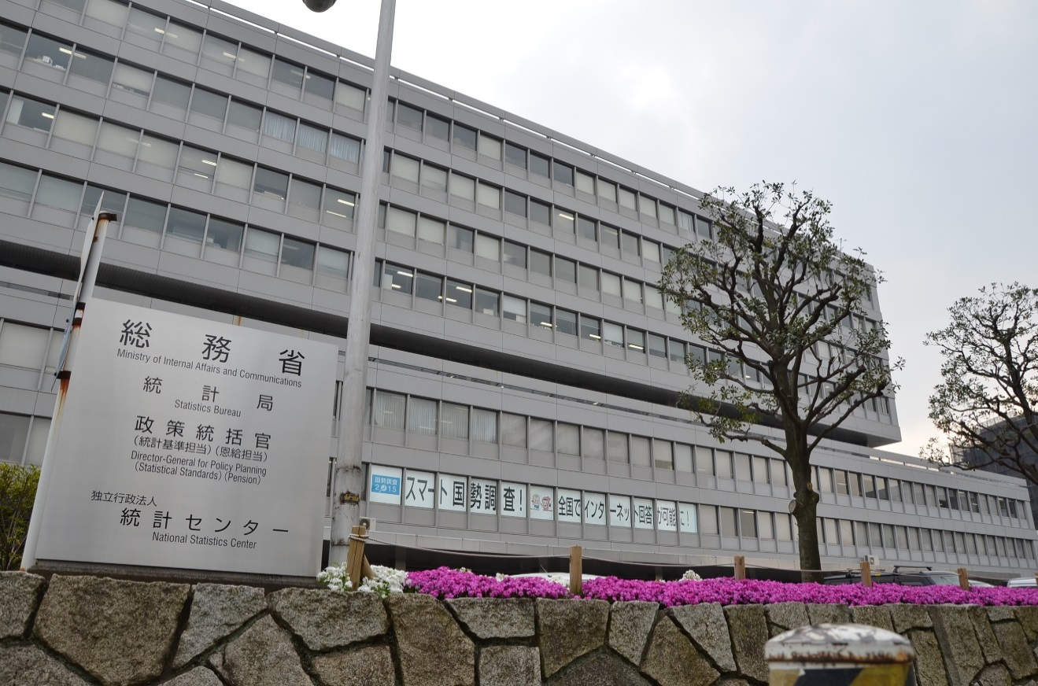
Thank you for your attention
Statistics Bureau,
the second government office of the Ministry of Internal Affairs and Communications,
19-1, Wakamatsu-cho, Shinjuku-ku, Tokyo 162-8668
Website on Statistics Bureau (http://www.stat.go.jp/english/index.html)
on the Economic Census (http://www.stat.go.jp/english/data/e-census.html)
Notes:
In our presentation, I explained the “Economic Census,” mainly for Business Activity.
I think we were able to achieve good results by having performed an action to various quality improvement in the ECBA of 2016.
For more information, please see our paper.
This photograph is our workplace “Statistics Bureau”
Please don’t hesitate to come here when you come to Japan.
Thank you very much for your attention.

