Slide 1
Use of administrative data Sources for Statistical
Business Registers
in Georgia
MANANA TELIA
Head of Business register Division
National Statistics Office of Georgia

Slide 2
Contents
Introduction
Significant changes in the business register in recent years
Data groups in the Business Register
Main administrative sources
Data Sources of SBR
Data received from NAPR and the Revenue Service
Variables in BR
Information produced on the basis of the Business Register
New statistical products within the scope of administrative data
What has been done
Application of administrative data
Advantages of using administrative data
Problems related to administrative sources
Problems
Quality of administrative data
Future plans

Slide 3
Statistical Business Register
Introduction
The main aim of BR is to contribute to the development of a sustainable statistical system in Georgia.
In order to implement state statistics, statistical reporting with modern methods and sample surveys, the maintenance of a statistical business register has started since 1995.
The overall goal of our division is to produce such statistics that will be able to meet national requirements, international regulations, established standards and enhance the possibilities to respond to new demands.
The register is the basis for organizing single statistical recording; at the same time, it provides an opportunity to observe the process of creation of new enterprises and jobs in the country, to group existing economic entities by economic activity, by owner, legal form, region, size of enterprises and by many other attributes.
For all of this Business Register should include all statistical units as well as all the possible (needed) characteristics of them, as it is required by international methodology. This information should be as accurate as possible, and it should be updated in a timely manner.
We can safely say, that today the Geostat’s Business Register meets all these requirements.

Slide 4
Significant changes in the business register in recent years
Transition from the File-Server System to the Client-Server System
New structure of the business register and a new model of database based on EU standards
Software (New software created)
Preparation of BR Documentation
Improved procedures for updating and maintenance of BR (Priority system - rules for updating variables from different sources established)
Very successful intensification of co-operation with administrative organs (e.g. MoF’s revenue service) to obtain additional sources of information (Sources of Business Register increased)

Slide 5
Statistical Business Register
The Business Register (BR) covers any type of economic entity (legal entities of private and public law and individual enterprises).
Commercial legal persons
Joint liability companies
Limited partnerships
Limited liability companies
Joint stock companies
Cooperatives
Non-commercial legal persons
Entities of public law
Individual entrepreneur
Other

Slide 6
Data groups in the Business Register
The BR contains the following groups of data:
Identification
(identification number, name, legal status)
Classification
(organisational legal form, ownership type, data on territorial belonging, on economic activities)
Reference
(address, telephone, fax, director ‘s full name, founders of enterprise)
Economic indicators
(“size" of entity, data on entity’s performance, kind of activity)
The Business Register, like other registers used for statistical purposes, is usually compiled using administrative data. Statistical data are obtained by combining data from registers of various administrative sources and direct studies

Slide 7
Main administrative sources
In Georgia, the principal administrative sources for updating the BR are :
National Agency of Public Registry (NAPR)
Revenue Service
Periodicity of receiving information: monthly
Presentation procedure: automated
The information provided by NAPR and the Revenue Service is used for:
Compiling the statistical business register
Compiling the statistical survey frame

Slide 8
Data Sources of SBR:
External
Internal
Administrative Sources
Statistical Sources
NAPR
Quarterly business surveys
Quarterly business surveys
Quarterly business surveys
Quarterly business surveys
Quarterly business surveys
Tax Office
SBR
Annual business surveys
Annual business surveys
Annual business surveys
Annual business surveys
Annual business surveys
CATI
Other business
surveys
Periodicity of receiving information: monthly
Presentation procedure: automated
All business surveys are based on SBR
GEOSTAT uses only one sampling frame for all business surveys

Slide 9
Data received from NAPR and the Revenue Service
The Business Register receives the following data from NAPR and the Revenue Service:
Identification number
Name of economic entity
Registered address
Telephone, fax, e-mail
Legal organisational form
Ownership type
First name and last name of the head
Date of registration with the state registration authority
Economic activities (principal and others)
Last name and first name of partners, positions, addresses, shares of statutory capital

Slide 10
Variables in BR
BR contains following variables by each entity:
Full name of enterprise
Registration data
Registration number
Statistical code
Tax code
Legal address
Actual address (only for limited number of entities)
Organizational-legal form
Ownership type
Phone and fax numbers
E-mail address and web page (only for limited number of entities)
Name, surname, address and phone number of director
Partners
Gender
Kind of economic activity by 5 digit of NACE rev. 1.1 and NACE rev.2
Size

Slide 11
Information produced on the basis of the Business Register
Based on the BR, users can get information on the number of registered and active entities by:
organizational- legal form
owner type
region and municipality
economic activity
gender of founders
founding country, etc.

Slide 12
New statistical products within the scope of administrative data
GEOSTAT has recently developed the following statistical products:
GIS analysis portal
Business demography
Births of enterprises
Survival of enterprises
Deaths of enterprises
(By organisational-legal form, by economic activity, by region)
On the recommendation of Eurostat we have started to produce approximately 30 demographic statistical indicators.
The tables of business demography (birth, survival, death and birth, survival , death rates) are available (in Georgian and English) on the Geosta web page.
The role of administrative data for the development of these products is crucial.

Slide 13
Statistical Business Register
What has been done
Thanks to improved access to the administrative source we added new variables to the database
In terms of completeness of characteristics:
Gender (New characteristic has been added for directors and partners)
Reorganization (The reorganization events (after May 2014) on the database has
been displayed)
Private number (Private number of persons has been added)
Size
Activity status
Factual address (Enterprise, Local unit)

Slide 14
Statistical Business Register
What has been done
Active/not active status (a methodology has been implemented to establish which companies are active or not
by using indicators on information from Revenue services primarily. this status is
determined monthly.)
Frozen Frame has been created
Enterprise group (The exploration program has been designed for the groups of
legal entities and these groups have been found)
Works of allocation of business register database on web page has been implemented
(Online business register is posted on the Geostat website. It is available for any interested users)

Slide 15
Statistical Business Register
What has been done
According to the existing charts the following interfaces have been created:
Parent-subsidiary (mother – daughter);
A Legal Unit - Enterprise Unit;
Enterprise Unit - Local unit;
The interface for data correction

Slide 16
Application of administrative data
For direct derivation of statistical data
For replacement of survey data (e.g. in case of non-response)
For estimation, editing, imputation
For creating a survey frame
For data analysis and validation
For timeliness improvement
For computing weights

Slide 17
Advantages of using administrative data
Coverage
Administrative sources ensure better coverage of target population and can make statistics more accurate:
No survey errors
No (or low) non-response
More detailed information
Timeliness
Obtaining of statistical data from administrative sources requires less time than conducting surveys

Slide 18
Advantages of using administrative data
Cost
A survey and a census are expensive, and data from administrative sources are often “free”
Processing of administrative data requires less personnel than conducting a survey
Reduction of the burden on respondents
Use of administrative sources:
Reduces the burden on data providers
Allows for collecting statistics more frequently, without additional burden

Slide 19
Problems related to administrative sources
It is necessary to know the limitations and problems of using administrative data
Inconsistent concepts, definitions
Doubtful values (Presence of implausible values or combinations of values for variables)
Redundancy (Presence of multiple registrations of entities. The source may include several registrations of one and the same entity)
Lack of target entities
Presence of non-target entities in the source. The source contains data on entities that are not referred to the target group
Missing values, etc.
Loss of relevance
Lack of control, lack of quality control

Slide 20
Quality of administrative data
In order to understand the quality of administrative sources, it is necessary to review:
The quality of incoming data
The quality of processing

Slide 21
Quality of incoming data
Incoming data are assessed according to the following parameters
Accuracy
The proximity of statistical estimates to the true values
Administrative sources can help improve the accuracy by rectifying survey errors
Clarity
Availability of additional materials (e.g. metadata, diagrams, etc.), so that users could better understand the results
Timeliness
Time lag between the provided data and events or phenomena described by them
Completeness – are there any missing values or variables?

Slide 22
Quality of incoming data
Relevance
Are the produced statistical data required?
Are the required statistical data produced?
Do the concepts, definitions and classifications meet user requirements?
Accessibility
Prices, format, location, language, etc.;
Comparability with other sources
Comparability over time
Spatial comparability (e.g., across countries / regions)
Punctuality
Difference between the actual date of supply and the promised date of supply
ACCURACY
TIMELINES
RELEVANCE
DATA
QUALITY
CLARITY
ACCESSEBILITY
COMPLETENESS

Slide 23
Quality of processing
Quality of matching / linking
Quality of data editing
Quality of automated data transfer procedures

Slide 24
Problems
Informational Problems
Due to the lack of administrative information, the following problems still remain:
Outward FATS (It is necessary to document information on the existence of foreign affiliates of
Georgian legal units in the business register)
Joint stock companies (We cannot determine ownership - Lack of information about shares)
Enterprise group (Since we do not know the owners of the shares, we can neither correctly identify the
group of enterprises, nor the group controller.)

Slide 25
Metodological Problems
Metodological Problems Metodological Problems
The method of assigning a NACE code according to its principal economic activity has to be refined;
Additional substitute criteria other (value added) than turnover should be used as proxie.
Reflect the data from NAPR (about activity) in the database
Other problems
Not sufficient financial recourses (Economic census has never been carried out in Georgia, because of not sufficient financial recourses)
There is no standardized addressing system in the country

Slide 26
FUTURE PLANS
Oure future plans are to solve above mentioned problems!
Continue active cooperation with administrative institutions
Search for other alternative administrative sources
Review and discuss data gaps
Prioritize non-produced indicators
Use more administrative data for the production of statistics
(to offer wider range of data to users)

Slide 27
FUTURE PLANS
Revise and improve the procedures of automatic presentation of the information received from administrative bodies in the BR database
working with data quality
Strengthen national statistical capacities and data collection system
Implementation of international standards and requirements
Active cooperation with international organizations and experts

Slide 28
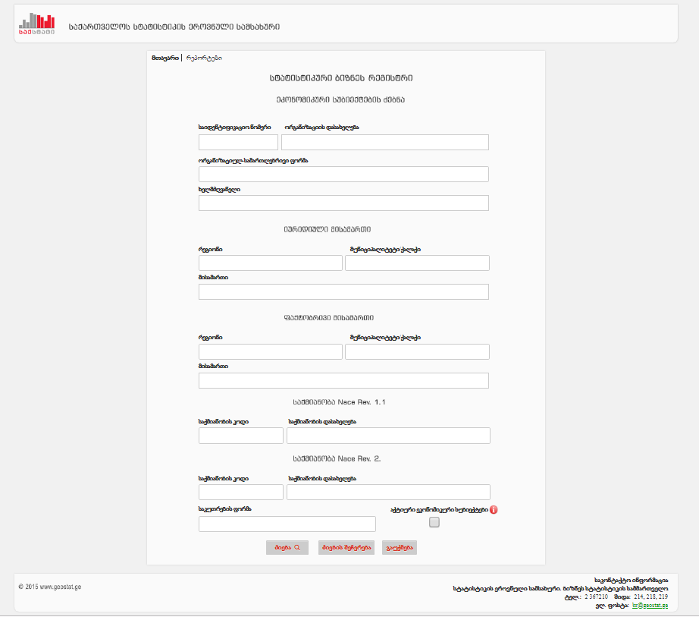
Website - Access to information

Slide 29
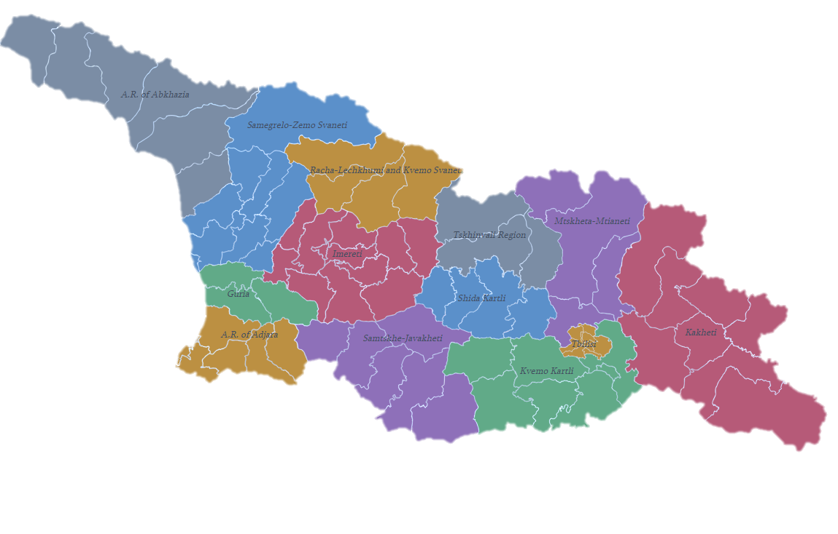

Slide 30
Thank you for your attention!
Manana Telia
Head of Business Register Division
Business Statistics Department
National Statistics Office of Georgia
mtelia@geostat.ge
www.geostat.ge

