Slide 1
Session on Gender Analysis of Census Data
Discussant Annemette Lindhardt Olsen

Slide 2
Census Data by Gender, Montenegro 2011 (a)
Note by Statistical office of Montenegro
Prepared by Snezana Remikovic
The paper describes some of the results from the census which was conducted in April 2011.
Includes a description of the population of Montenegro by age and sex. It is a relatively young population – in European context – middle age of 38 for women and 36 for men. Only 13 pct. are 65 years or more. Among this group – like in most countries – women dominate with 58 pct.
About 7 pct. of the population has a foreign citizenship and among those 59 pct. are women.

Slide 3
Census Data by Gender, Montenegro 2011 (b)
The Montenegrin census includes information that perhaps isn’t typical for censuses. There is information on computer literacy and the tables in the paper shows that even if the male population is a bit more literate than the female population, the differences are not big.
Information on foreign language is another variable in the census and here you can see that women generally have better knowledge of foreign languages than men – except for German where the men exceed the women.

Slide 4
Census Data by Gender, Montenegro 2011 (c)
The paper also mentions disability a variable which was voluntary in the census. The answers show that more women than men have disability problems, but of course it should be seen in the perspective that disability is most common among people over 65, where the women are more frequent.

Slide 5
Demography
Lower life expectancy for men
Increasing proportion of women 65+
Increasing proportion af women beginning at 29 (CIS-countries)
Decrease in population due to low birth rate, high death rate and emigration
Increase in population due to immigration
Increase in childlessness

Slide 6
Families and households
Divorces
Children in divorced families
Changes of family structures
Single person households
Registered partnerships
Skip-generational households
Reconstituted households

Slide 7
Education
Information and communication technology (ICT) positive effect on both girls and boys’ education
Rise in girls’ education/literacy
Decrease or stagnation in boys education
Gender segregation
Economic long term effect of girls education
Rural/urban differences
How to increase number in preschool education

Slide 8
Employment
Employment rates for men and women
Gender segregated labour market – influence on salary
Gender balanced job – influence on salary
Youth unemployment
Family workers and self-employed

Slide 9
Income/Pay
Pay gap
Pensions
Dependency on families
Financial independence

Slide 10
Geography
Distance from home to workplace
Distance between family member – e.g. divorced parents or older family members
Rural/urban

Slide 11
Other gender aspects of census data
Migration – country of birth, citizenship
Housing – homeless

Slide 12
Other aspects of census data regarding gender analysis
Migration – country of birth and citizenship
Housing - homeless
Longitudinal data – census every ten years

Slide 13
Open discussion
Examples
Experiences with new sources or new ways of using sources
Preschool attendance
Computer literacy
New family relations and geodata
Focus on gender segregation

Slide 14
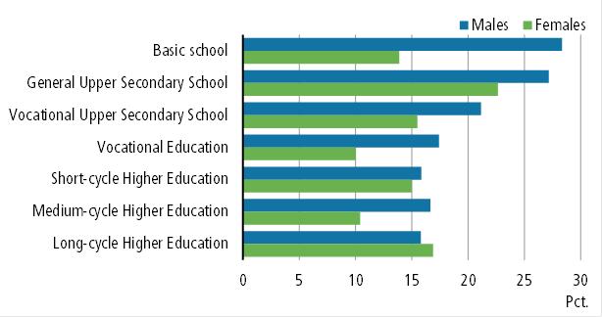
Percentage of 49-year-old without children by education. 2011

Slide 15
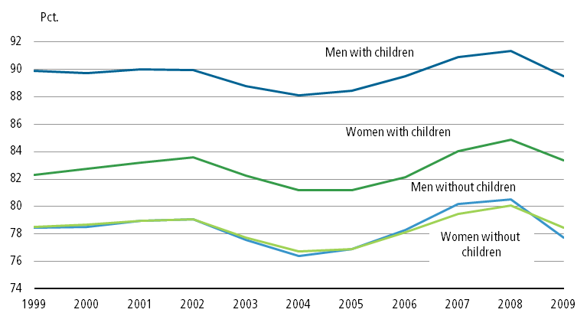
Employment rate for 30 – 49-year-old with or without children by. 2000-2009

Slide 16
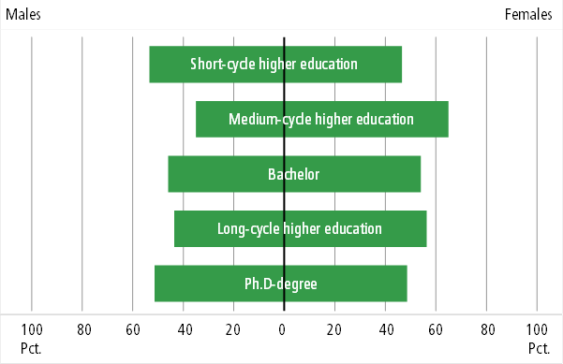
Students at higher education. 2010

Slide 17
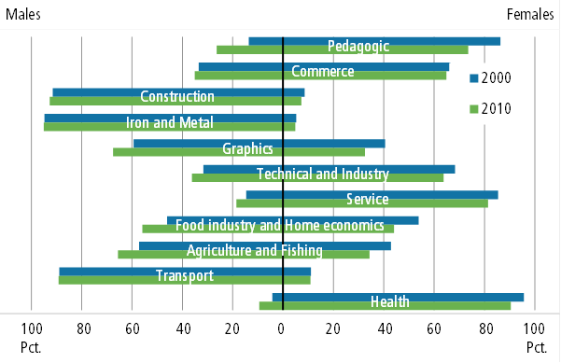
Students at vocational education by field. 2000 and 2010

Slide 18
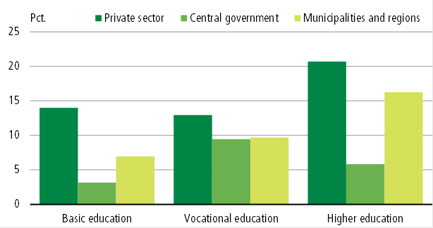
Pay gap by sector and education. 2009

