Slide 1
The approach to seasonal produce and missing observations September 11-13, 2019 Minsk
State Statistics Service of Ukraine
Nadezhda Profatskaya
Deputy Director, Price Statistics Department - Head of Consumer Price Statistics Division, State Statistics Service of Ukraine

Slide 2
The price index computation for fruit and vegetables
State Statistics Service of Ukraine
Comparable Replacement Method
Goods Rotation Method
Imputed Price
Method
Late and early varieties
product change
through double
price registration
⠀
⠀
⠀
Index computation by dividing the price of the month of the current year, when the product first appears on sale by the imputed price, obtained by multiplying the average price of the last month of the season by the CPI of the group that includes the product
⠀
⠀
The substitute product has a quality similar to the old product, and any price changes are not subject to quality changes.

Slide 3
Specifics of monitoring changes in prices for clothing and footwear
State Statistics Service of Ukraine
Diversity. Each product is characterized by a large number of models that are substantially different in style, raw material components, and processing type. In addition, this market is characterized by a significant stratification of goods in terms of prices
The behavior of the prices is formed under the determining influence of fashion trends
Variability of characteristics. The style of new garments and shoes coming to outlets at the beginning of the new season may be distinctly different from the style of products that disappeared at the end of last season
Large-scale promotion, discounts, and sales for the purpose of marketing new goods and the outdated range of stocks elimination

Slide 4
The main criteria for determining the equivalence of seasonal clothing and footwear
State Statistics Service of Ukraine
Trademark (brand). In many of the circumstances, the determining price factor is the "company name"
Raw material components. Products from natural raw materials belong to a higher segment of prices
Hallmark of style. The parameter that determines the style distinctive feature and allows you to uniquely identify the product

Slide 5
Procedure for calculating price indices for seasonal clothing and footwear
State Statistics Service of Ukraine
Seasonal and non-seasonal periods are defined for each product and can be revised
In the first month of product absence, the last registered regular price is imputed at the retail location.
In the second and subsequent months, the missing prices are calculated by multiplying the last registered regular price by the corresponding index.
After the season resumes, when the products are on sale again, their price registration is restored
In the absence of the same product in the new season as in the previous one, a substitute product, which according to its characteristics is as close as possible to the product that is to be replaced
In the future, throughout the season, the registration of prices for substitute products is carried out

Slide 6
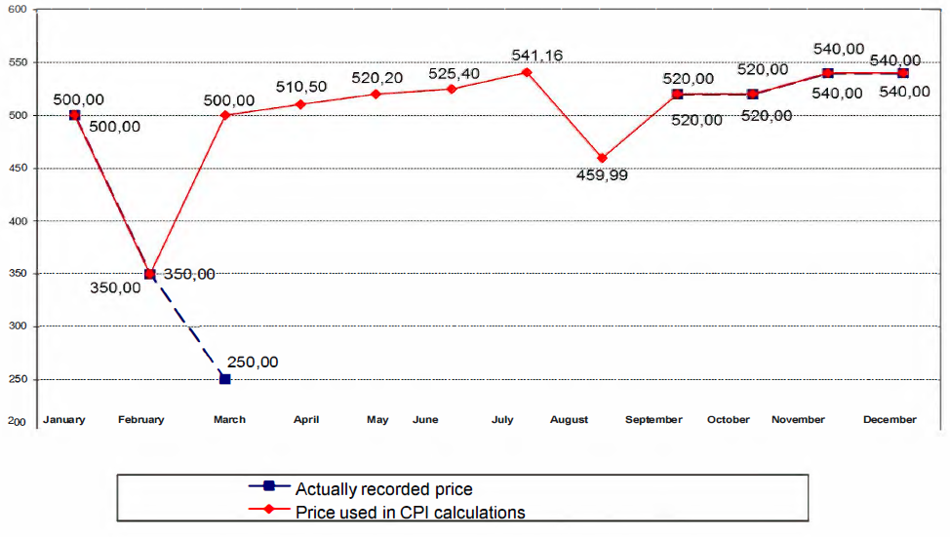
Sample calculations of price indices for seasonal goods
State Statistics Service of Ukraine

Slide 7
Thank you for your attention!
State Statistics Service of Ukraine

