Slide 1
Owner-occupied housing
Regional workshop on Consumer price indices
11 – 13 September 2019
Minsk, Belarus
Raj@ssb.no

Slide 2
Housing in a CPI
Housing in COICOP 04:
Rental survey (e.g. monthly, quarterly)
Actual rentals
Imputed rentals - Owner occupiers’ housing
Maintenance and minor repair
Materials (monthly)
Services (e.g. wage statistics)
Water, sewage and refuse (often yearly)
Energy (e.g. monthly)

Slide 3
Why housing is difficult
CPI’s restricted to consumer goods and services acquired in monetary transactions
Purchase of dwellings – investment or consumption?
Excluded from household consumption in national accounts
Fixed capital
Purchase of a dwelling – access to shelter services

Slide 4
Owner occupiers’ housing (OOH)
The costs of housing services associated with owning, maintaining and living in an owner-occupiers dwelling
Several approaches for measuring the “price development” in a CPI faced by owner-occupiers :
Payment approach
Use approach
Acquisition approach
The choice of the OOH approach depends on the purpose of the CPI

Slide 5
Purpose of the CPI
Cost-of living index
Monetary and non-monetary expenditures
Use
Payment
Inflation index
Strict monetary expenditures
Acquisition
Payment
Most common: “fixed basket index” with multiple use and not a strict purpose
Inflation
Compensation (wages, pensions)
Indexing contracts
Deflators in National Accounts

Slide 6
Payment approach
All payments that households make as owner occupiers when “consuming” the dwelling
Mortgage repayments, including the interests that are part of these repayments
Insurance of a dwelling
Maintenance and repair
Property rates and taxes
Estate agency fees and legal fees for newly purchased dwellings
Includes actually observed data

Slide 7
Use approach
Cost to owner-occupiers of using the dwelling
Two options:
User cost
Rental-equivalence

Slide 8
User cost
UC = rM + iE + D + RC – K
M and E represent mortgage debt and owners equity,
r and i is mortgages interest rate and rate of return on alternative assets
D is depreciation
RC other recurring costs
K is capital gains

Slide 9
User cost, cont.
Probably the most correct approach given cost of living/compensating purpose of the CPI
Difficult to calculate in practice
Capital gains may give negative costs
Look for a modified version

Slide 10
Rental-equivalence method
Rentals as an alternative cost to owner occupiers
Based on imputed prices (rentals)
Some requirements:
Significant markets for rented dwellings with characteristics similar to owner-occupiers dwellings
Competitive market, not regulated
Pure rental cost and not include services like electricity and insurance

Slide 11
(Net) Acquisition approach
Purchase of a dwelling that is part asset (the land) and part consumable (the dwelling)
In line with the treatment of other durables in a CPI
Changes in real transaction prices

Slide 12
Net acquisition approach
Transactions between households out of scope
In practice, the approach largely focuses on new dwellings
Existing dwellings new to the household sector are in scope
Dwellings purchased for investment purposes are out of scope
E.g. dwellings purchased for letting out
In principle, the land component is out of scope
In practice this principle may not be so easy to apply
Thus, asset price will be included

Slide 13
Appropriate method?
Depend on the purpose of your CPI
All approaches have advantages and disadvantages
Omit OOH from your CPI?
OOH represents a sizeable proportion of household expenditures
Omitting due to lack of appropriate data
E.g. house price index
Major repairs and maintenance as a proxy

Slide 14
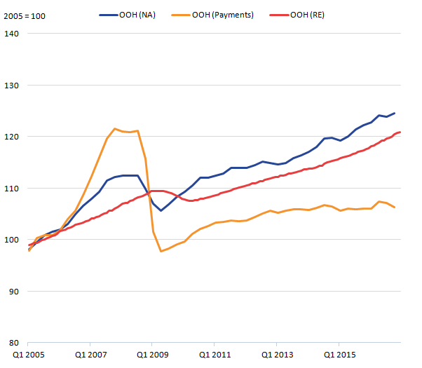
Different approaches, indices, 2005 = 100

