Slide 1
Index calculation
Regional workshop on Consumer price indices
11 – 13 September 2019
Minsk, Belarus
Raj@ssb.no

Slide 2
Overview
Elementary indices
Aggregate indices
  Laspeyres
  Young
  Lowe
Fixed base and chained indices

Slide 3
Some concept
Price reference period - the period of which the prices appear in the denominators of the price relatives
  Often December
The weight reference period - the period of which the expenditures serve as weights for the index
  Usually one year
The index reference period - the period for which the value of the index is set equal to 100, e.g. 2015=100

Slide 4
Elementary indices
Level before (explicit) weights enter calculations
  Going from current and price reference prices to a price index
    Current price, period t, item i:
    Price reference price, item i:
Elementary aggregate (EA):
  The smallest aggregate for which weights are available
  Consist of relatively homogeneous sets of goods or services.

Slide 5
Elementary indices, cont.
Dutot index: Ratio of arithmetic means of prices
Jevons index: Geometric mean of price relatives

Slide 6
Elementary indices, cont.
Carli index: Arithmetic mean of price relatives
  Does not satisfy time reversal test
  Not allowed in the HICP framework

Slide 7
Choice of formula
Axiomatic approaches: mathematical properties
  Time reversal, transitivity, additivity, proportionality test, commensurability test
Economic approach: behaviour of a rational economic agent
  Related to cost of living Index
  Capture substitution

Slide 8
Elementary indices, cont.
”Best” formula: Jevons
  Satisfies several axiomatic tests (see later slide)
  If cross-elasticities of demand are close to one (on average), it is also satisfy an economic approach (see later slide)
  Capture “substitution”
  Requires homogenous elementary aggregates
Dutot: Implicitly emphasise price observations with the highest price level
  Work well with homogenous elementary aggregates

Slide 9
From price observations to overall index
COICOP 4 …and further aggregation
COICOP 5
“Bed linen”
Fixed annual weights (retail trade turnover or expenditure shares) used to create a national index of each representative item
Representative item, national
“Blanket wool, approx. 140x200 cm”
EA: Geometric mean indices of each representative item within each region
Region 1
“Blanket wool, approx. 140x200 cm”
Region 2
“Blanket wool, approx. 140x200 cm”
Region 3
“Blanket wool, approx. 140x200 cm”
Region 4
“Blanket wool, approx. 140x200 cm”
Region 5
“Blanket wool, approx. 140x200 cm”
Region 6
“Blanket wool, approx. 140x200 cm”
Region 7
“Blanket wool, approx. 140x200 cm”
Region 8
“Blanket wool, approx. 140x200 cm”
Price offers from a representative sample of stores
“Blanket wool, approx. 140x200 cm”…..
Notes:
Turnover statistics of retail trade stratified by industry (for inst. retail sale of clothing, furniture, games and toys etc.)
Sampling plan in need of modernisation – remove regional stratification?
Price development differs less across regions
Not publishing regional indices

Slide 10
Aggregate indices
Combining price changes with explicit weights (expenditure shares)
  May be several levels of aggregation between the elementary and the all-item indices, but the computation is the same
Three main components:
  1) Current prices:
  2) Price reference prices:
  3) Weights (shares of expenditure):

Slide 11
Aggregate indices, cont.
Laspeyres: Weights are based on expenditure shares in period 0 – which is same as the price reference period
Paasche: Weights are based on expenditure shares in the current period

Slide 12
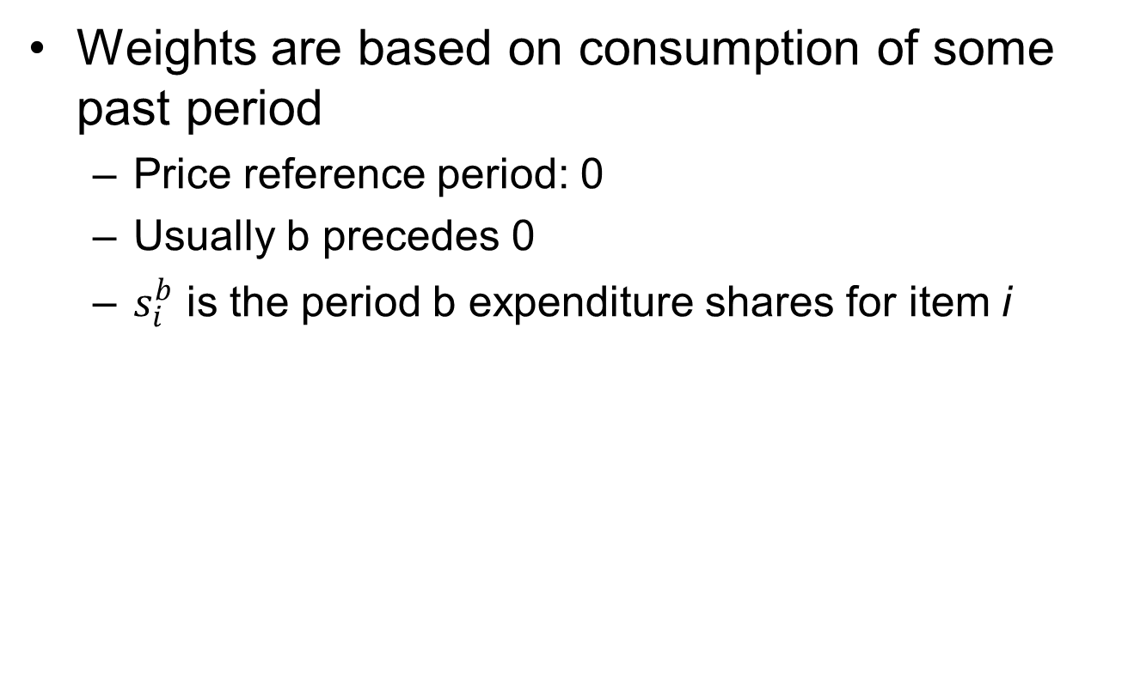
Young index

Slide 13
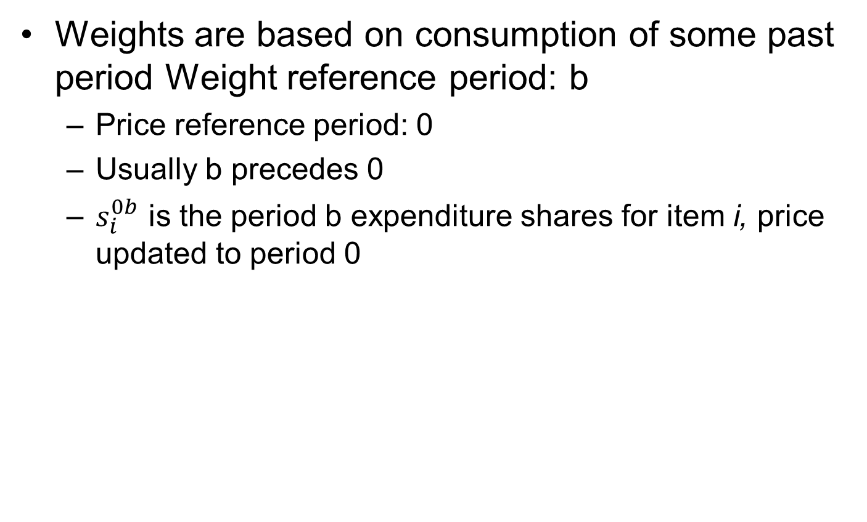
Lowe index

Slide 14
Young or Lowe index?
Young: expenditure shares combines both prices and quantities from period b
Lowe: expenditure shares combines prices from period 0 and quantities from period
Price updating or not?
  Keeping the consumption share fixed vs. keeping the implicit quantity structure fixed?
  An ongoing debate

Slide 15
Fixed base index
Fixed set of quantities used in weights
Prices compared directly with those of index reference period
Advantages:
  No need for updated weight information
  No path dependence
  Easy to explain to users
Disadvantages
  Weights become progressively out of date

Slide 16
Chain indices
A CPI is a (annually or less frequent) chain-linked Laspeyres-type price index
Chaining is a consequence of the (annual or less frequent) update of weights.
A month (often December) is used as the overlap month to link the series.
  Chaining must be performed at each level of aggregation.
  The technique of chaining implies that consistency in aggregation is lost

Slide 17
Chain indices, cont.
The index for May 2019 is compiled as follows:
Long term chained index (2015=100) in December 2018.
Short-term index based on prices in May 2019 compared with price reference prices in December 2018.

Slide 18
Further reading
The new draft consumer price index manual (work in progress): Particularly chapter 8
  https://www.imf.org/en/Data/Statistics/cpi-manual
System of national accounts (SNA) (UNSD, 2008)
  Particularly section 15.3
  https://unstats.un.org/unsd/nationalaccount/docs/SNA2008.pdf

