Slide 1
16 October 2012
WORKSHOP ON MIGRATION STATISTICS
Topic 5, “Albanian specific examples of migration survey”

Slide 2
Recent source of Migration
LSMS 2002, 2005, 2008, 2012
Census 2001, 2011

Slide 3
LSMS
The main objective of LSMS is to collect information for the construction of measuring welfare and identify factors that determine it. Welfare usually is measured by the aggregate consumer, providing information on the level and distribution of poverty in the country.
LSMS is also a powerful tool for assessing and determining the social costs.
It provides a baseline for monitored the progress in reducing poverty and achieving the Millennium Development Goals (MDG).
It provides a continuity of social indicators

Slide 4
Content of LSMS migration module
Module 6A→ Internal migration of household members
Module 6B→ International migration of household members
Module 6C→ Children living away migration history
Module 6D→ Siblings of head and spouse
Improvement from LSMS 2002 that have only one module and a reduction information about migration

Slide 5
Actually data source
LSMS improved migration data
3 modules with comparable data by years and in the line with Census questions
Module 6A→ Internal migration of household members
Module 6B→ International migration of household members
Module 6C→ Sons and Daughters living away migration history
Currently we have some questions from Census 2011

Slide 6
LSMS data on migration
Internal migration (ever lived in different municipality?)
Year of last migration
Place where have born
Reason of moving
Where live in 1990

Slide 7
LSMS data on migration
International migration (Migrate abroad for a total time of at least three months)
Last migration and first migration episode
Year of last migration
How long stayed abroad
Reason of migrated abroad
Country
Did you work
Information about partner or children
Reason of returning
Plans to migrate again
Other years migrated between first and last and how long stayed

Slide 8
LSMS data on migration
Sons and daughters living abroad
Include all hh members not living in hh (even hh head and partner)
Socio-Demographic (Age, Gender, Education, Employment, languages, )
Remittances in cash or kind
Information for children currently living in Albania

Slide 9
Pro… and cons…
LSMS collect detailed information about migration
Have comparable data by years
It creates the possibility of disaggregation with other social indicators
It have another purpose not migration
The level of disaggregation in country level and by 4-regions
It is difficult to have all migrant population, it can’t be interview hh that are all members abroad

Slide 10
Census 2011 on migration
Non-resident population
Persons live abroad for 12 months or more
Resident population (Detailed information for returns migrant)
Place of birth (Municipality or country abroad)
Place of usual residence
Place of last usual residence
Year
Reason

Slide 11
Future challenge
Making a new survey for migration
Incorporate a migration module in the existing household surveys
Keeping comparability with existing data sources

Slide 12
Internal migration

Slide 13
International migration
Fig. 2: Internal migration from rural area by area of destination (2008)
16,000
number
12,000
8,000
4,000
-
1
2
3
4
5
6
7
8
9
10
11
12
13
14
15
16
17
18
19
year first move
1 Tirana_urban
2 Other urbane
3 Rural

Slide 16
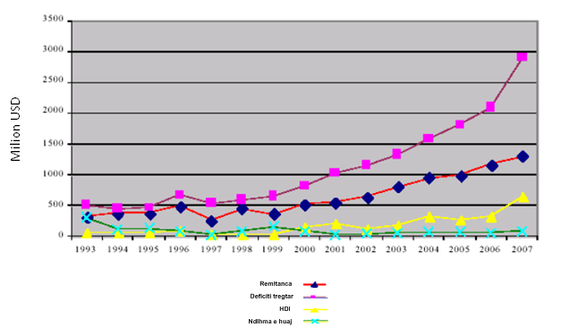
The volume of remittances compared to HDI, Trade deficit, foreign aid
Source: Bank of Albania (2008)

Slide 17
Thank you!

