Slide 1
OECD activities on PRTRs
4th PRTRs Protocol Working Group of the Parties
26 November 2015 / Madrid, Spain
Notes:
This session will discuss what the Pollutant Release and Transfer Registers are, how they operate and what they are used for (possible matters to be discussed: potential of integrating data of the registers with other data; use of data of the registers to estimate environmental impact of pollutant emissions; use of PRTR as a one-stop window for environmental reporting and compliance with international regulations; the role of PRTR in the collection of greenhouse gas emissions data, among others). The session will include how to integrate the registers in the procedures of the OECD and in the framework of the Kiev Protocol (Aarhus Convention)

Slide 2
Paradigm of OECD PRTR Activities
Setting up PRTRs
Improving PRTR
Harmonizing across the world
39 countries
(2009)
16 countries
(2006)
14 countries
(2003)
8 countries (2000)
Using PRTR data
US and Canada
(1996)
Notes:
39 countries have operational PRTR system
All 28 EU countries, 3 European Economic Area (EEA) countries and 9 other countries)
Roughly 55% are already including releases from diffuse sources, such as from transport, agriculture, etc.
Most PRTRs collect annual data on major greenhouse gas emissions.

Slide 3
Three pillars of OECD PRTR activities
Setting up PRTRs
Guidance Document on Elements of a PRTR (Part, Part II)
common elements that may be included in the design of a PRTR, and how to implement a PRTR
PRTR Module for the IOMC Toolbox
a problem-solving tool to identify the most appropriate and efficient actions to address specific national problems
Improving PRTRs
Release Estimation Techniques (point source, non-point source, off-site transfer and release from products):
techniques to estimate releases and other waste management quantities
Using PRTRs
PRTR Database
Application, Use and Presentation of PRTR Data

Slide 4
Setting up PRTRs – Elements of a PRTR
PRTR have been established throughout the world, but PRTRs vary across programs.
OECD has developed practical tools to help implement harmonized PRTRs.
Guidance Document on Elements of a PRTR
Part I: PRTR Design (2014)
Part II: PRTR Implementation (2015)
The documents provide key elements of a PRTR;
list of chemicals
list of sectors of economic activities reporting to PRTRs
thresholds trigger reporting

Slide 5
Setting up PRTRs – PRTR Module for the IOMC Toolbox*
A problem-solving tools to identify the most appropriate and efficient national actions to address specific national problems.
PRTR module was developed for setting up or improve their PRTR.
Inter-Organization Programme for the Sound Management of Chemicals (IOMC): IOMC Participating Organizations: FAO, ILO, UNDP, UNEP, UNIDO, UNITAR, WHO, World Bank and OECD

Slide 6
Improving PRTRs – Release Estimation Techniques
Series of documents compiling release estimation techniques;
point source (revised 2013)
non-point source (2003, revised 2016)
off-site transfer (2005, revised 2016)
release from products (2011, revised 2016)
Reporting Sectors Factory | Non-reporting sectors | House-hold
Factory
Mobile Source
(Thresholds)

Slide 7
Using PRTRs
- measure trends
- evaluate policy
- identify potential human health risks
- monitor progress of facilities’ efforts
- identify possible hot spots
- support socially responsible investments
- identify potential liabilities of firms and impacts on real estate prices
Emission
Government
Company A
Public/NGO
Company B
Company
PRTR
Database
Report
Disclose
Company C
Media
Researchers
Company D
Financial Sectors

Slide 8
Using PRTR data – On-going projects
exploring potential uses of PRTR information for measuring the impact of environmental policies
Illustrating the role of PRTR data as a practical means to assess progress towards global sustainability
Evaluating Best Available Techniques (BAT) policies by using PRTR data
Compiling good practices on application of PRTR data for local environmental management

Slide 9
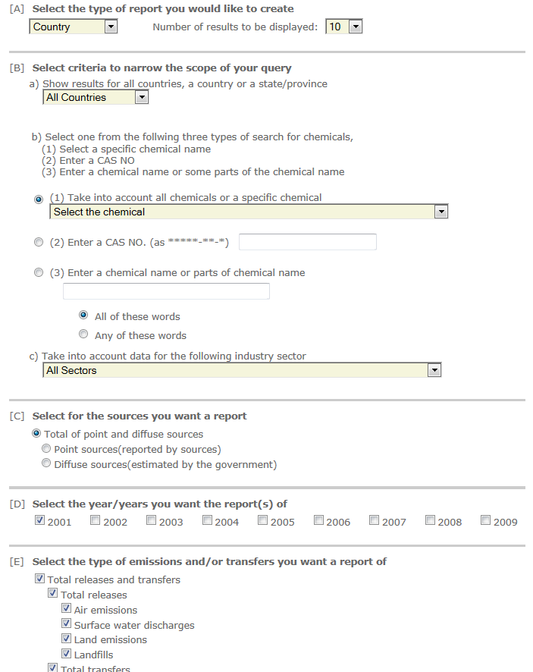
Using PRTRs – Databases on PRTRs
Centre for PRTR Data
Presenting national PRTR data at one Internet location
Resource Centre for Release Estimation Techniques
Providing information on available release estimation techniques, overarching documents and general information
PRTR.net
Providing a global portal to PRTR information and activities from countries and organisations around the world, cooperated by UNECE and UNEP
Centre for PRTR Data

Slide 10
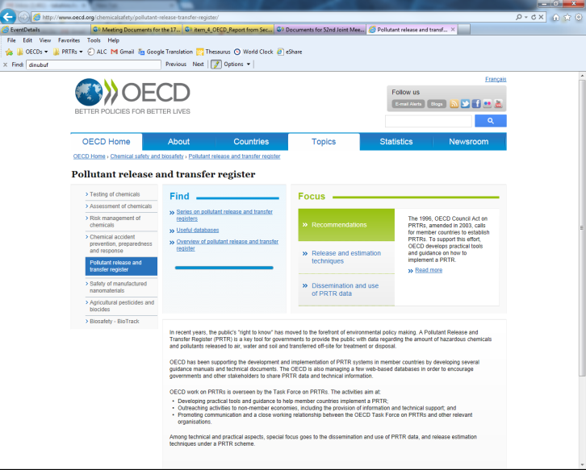
Website and Key Documents
Website
OECD website |  | http://www.oecd.org/env/prtr
Centre for PRTR Data |  | http://www.oecd.org/env_prtr_data/
Resource Centre for Release Estimation Techniques |  | http://www.oecd.org/env/prtr/rc
PRTR.net |  | http://www.prtr.net/
IOMC toolbox |  | http://iomctoolbox.oecd.org/
Document
1. Global PRTRs
 | Guidance document on element of a PRTR: Part 1 (2014)
 | Guidance document on element of a PRTR: Part 2 (2015)
2.PRTR data application
 | Application, Use and Presentation of PRTR Data
 | Uses of PRTR Data and Tools for their Presentation
3. Release Estimation Techniques
 | Resource Compendium of PRTR Part 1: Point Source
 | Resource Compendium of PRTR Part 2: Diffuse Source
 | Resource Compendium of PRTR Part 3: Off-site Transfers
 | Resource Compendium of PRTR Part 4: Releases from Products

