Slide 1
Regional agreement on access to information, participation and justice in environmental matters in Latin America and the Caribbean “Escazu Agreement”: the role of PRTRs
Economic Commission for Latin America and the Caribbean
Carlos de Miguel, Chief, Policies for Sustainable Development Sustainable Development and Human Settlements Division
Geneva – Global Round Table on PRTRs, 7-8 November 2018

Slide 2
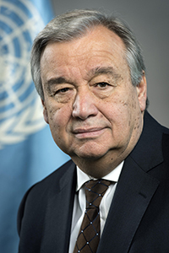
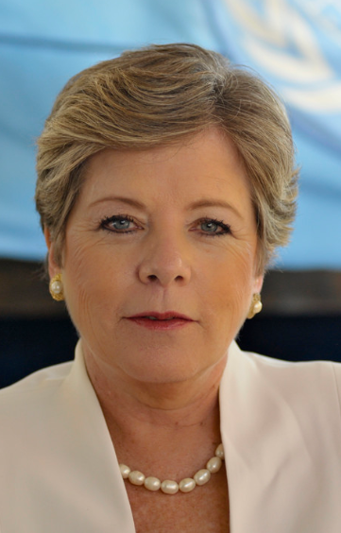
Relevance of the Escazú Agreement
Only treaty stemming from the United Nations Conference on Sustainable Development (Rio+20)
First regional environmental treaty of Latin America and the Caribbean
Specific provisions on environmental human rights defenders
First treaty concluded under the auspices of ECLAC
16 countries already signed: Antigua and Barbuda, Argentina, Bolivia, Brazil, Costa Rica, Dominican Republic, Ecuador, Guatemala, Guyana, Haiti, Mexico, Panama, Paraguay, Peru, Saint Lucia, Uruguay
“[The Escazú Agreement] affirms the value of the regional dimension of multilateralism for sustainable development.”
“Above all, this treaty aims to combat inequality and discrimination and to guarantee the rights of every person to a healthy environment and to sustainable development. In so doing, it devotes particular attention to persons and groups in vulnerable situations, and places equality at the core of sustainable development.”
António Guterres, Secretary-General of the United Nations
“The Regional Agreement is a ground-breaking legal instrument for environmental protection, but it is also a human rights treaty. ”
“Visionary and unprecedented, it is an agreement reached by and for Latin America and the Caribbean, reflecting the ambition, priorities and particularities of our region.”
Alicia Bárcena, Executive Secretary of ECLAC

Slide 3
Structure of the Escazú Agreement
First part Preamble Objective (art. 1) Definitions (art. 2) Principles (art. 3)
Operative part General provisions (art. 4)
Implementation, monitoring and evaluation
Resources
Rules of procedure
Institutional framework
Final provisions
First pillar
Access to environmental information (art. 5 and 6)
Second pillar
Public participation in the environmental decision-making process (art. 7)
Third pillar
Access to justice (art. 8)
Human rights defenders in environmental matters (art. 9)
Fourth pillar
Capacity-building and cooperation (art. 10 and 11) and clearing house (art.12)

Slide 4
Generation and dissemination of environmental information (art. 6)
6.4 Each Party shall take steps to establish a pollutant release and transfer register covering air, water, soil and subsoil pollutants, as well as materials and waste in its jurisdiction. This register will be established progressively and updated periodically.

Slide 5
Notes:
Y aprovecho también para invitarles a usar el observatorio del Principio 10 en América Latina y el Caribe que hemos creado en CEPAL. El Observatorio pone a disposición pública referencias destacadas sobre los derechos de acceso a la información, a la participación y a la justicia en asuntos ambientales contenidas en tratados internacionales de los que los Estados de la región son parte, así como en leyes, políticas, planes y estrategias. Incluye además jurisprudencia relevante sobre la materia. La información disponible en el Observatorio está organizada por países, derechos, temas, instrumentos de política, jurisprudencia y tratados, que se combinan en datos cruzados y se visualizan a través de mapas dinámicos. El Observatorio surge como iniciativa de la CEPAL para contribuir a un mejor conocimiento, difusión e implementación de los derechos de acceso a la información, la participación pública y el acceso a la justicia en asuntos ambientales consagrados en el Principio 10 de la Declaración de Río sobre el Medio Ambiente y el Desarrollo.

Slide 6
Technical Secretariat
Sustainable Development and Human Settlements Division United Nations, ECLAC
E-mail: principio10.lac@cepal.org
https://www.cepal.org/acuerdodeescazu
http://observatoriop10.cepal.org

