Slide 1
Current status of PRTRs Activities
Geneva, 7th November 2018

Slide 2
UNITAR PRTR Programme
Global project on the implementation of PRTR in 6 countries:
Timeframe: 2016-2019
Funded by: Global Environmental Facility
IA: UN Environment
EA: UNITAR
Belarus
Cambodia
Ecuador
Kazakhstan
Moldova
Peru

Slide 3
UNITAR/UNEP/GEF Global Project
Outcomes:
National PRTR Proposal guides the implementation of PRTRs
Development of country-specific PRTR legal instruments
Capacity for collecting and using PRTR data increased significantly in each country → Pilot test of the PRTR system
Improved public access to PRTR data and dissemination of information
Study on the feasibility to use PRTRs data to improve and streamline countries’ reporting to MEAs

Slide 4
UNITAR Study on MEAs and PRTRs reporting
Stockholm Convention on POPs
Article 10 acknowledge PRTRs for the collection and dissemination of POPs releases
Minamata Convention on Mercury
Article 18 acknowledge PRTRs for the collection and dissemination of Mercury releases
United Nations Framework Convention on Climate Change
PRTRs can provide consistent data on GHGs emissions
Basel Convention on Transboundary Movements of Hazardous Wastes and their Disposal
Notes:
Stockholm Convention:
Article 10:
Each Party shall give sympathetic consideration to developing mechanisms, such as pollutant release and transfer registers, for the collection and dissemination of information on estimates of the annual quantities of the chemicals listed in Annex A, B or C that are released or disposed of.
Minamata Convention:
Article 18:
Each Party shall use existing mechanisms or give consideration to the development of mechanisms, such as PRTRs where applicable, for the collection and dissemination of information on estimates of its annual quantities of mercury and mercury compounds that are emitted, released or disposed of through human activities.
UNFCCC:
Article 4
Participation of the public and availability of environmental information
Article 12:
Reporting to the secretariat the different sources of emission be sector

Slide 5
Current process for National reporting
Industry association
National statistics
Environmental authority
Transport authority
Old inventory
Convention Secretariat
Health authority
Old inventory
National
report
National Focal Point to the Convention
Water authority

Slide 6
Possible solution?
Point sources
Industry association
PRTR
Environmental authority
Water authority
Diffuse sources and
national stocks
Health authority
National
report
National Focal Point to the Convention
Transport authority

Slide 7
UNITAR PRTR Programme (cont.)
“Strengthening Capacities for Developing a National Pollutant Release and Transfer Register in Support of SAICM Implementation in Mongolia”
Timeframe: 12 months (2018)
Funded by: SAICM QSPTF
Beneficiary: Ministry of Environment and Tourism
EA: UNITAR

Slide 8
SAICM/UNITAR Project - Mongolia
PRTR Pilot Test
Trainings for industry on how to report
PRTR online software for reporting
National database of emissions
Geographic information system (GIS)
Outreach Campaign
National PRTR website
Free access to reported data
Public Awareness of PRTR
Outreach materials and media
Workshops & Trainings
National workshops
Face-to-face Trainings
Project Coordination Committee
Civil Society Planning Meeting
National Reports
PRTR Briefing Document
Infrastructure Assessment Report
Draft Key PRTR Features
PRTR Pilot Test Report
National PRTR Executive Proposal

Slide 9
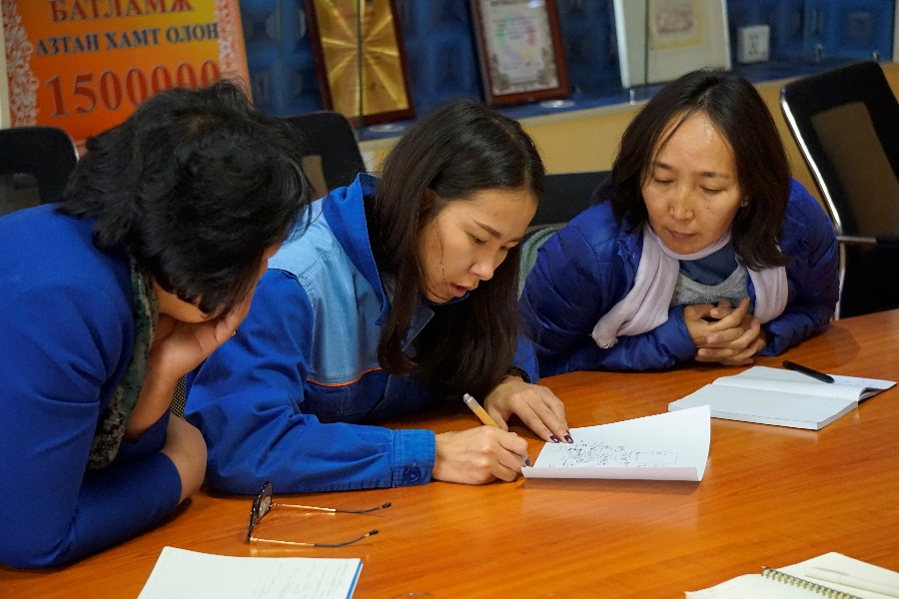
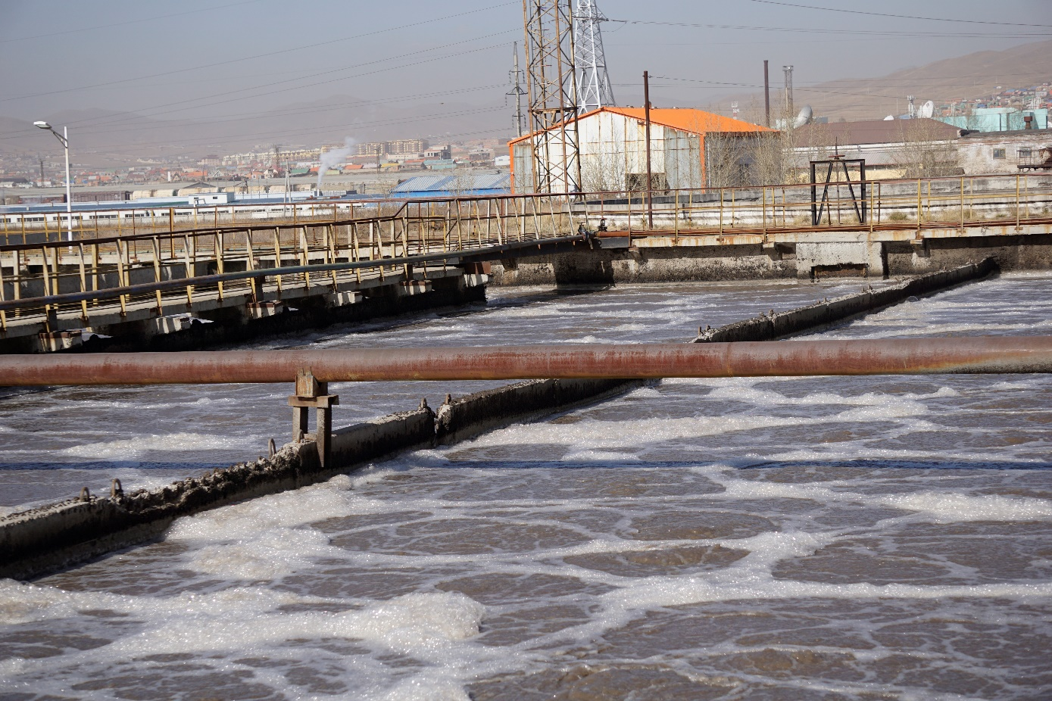
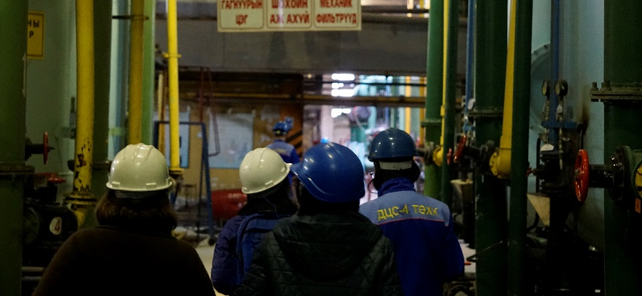
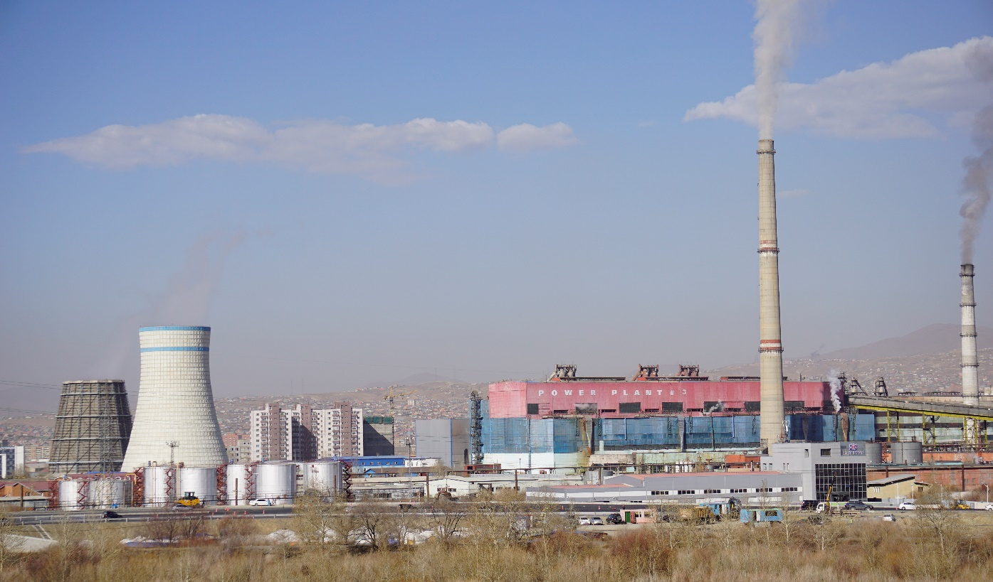
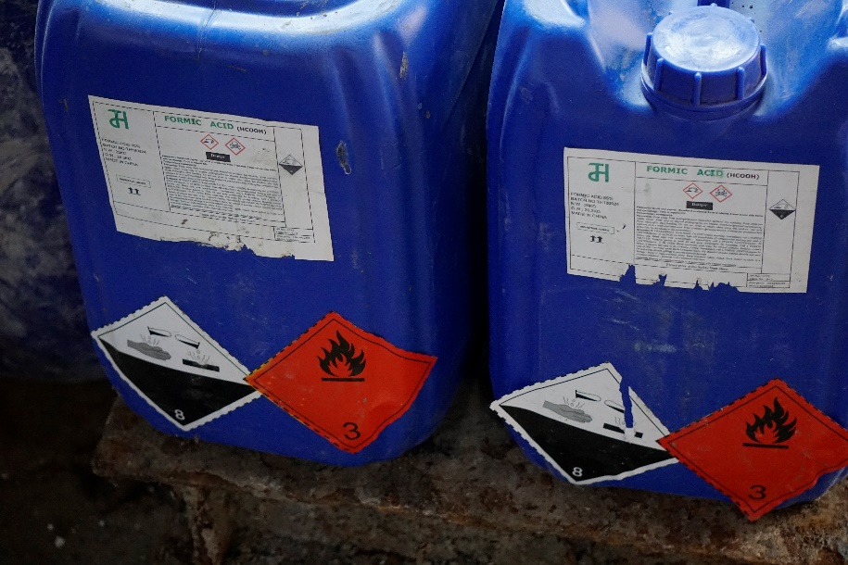
PRTR Pilot - Mongolia

Slide 10
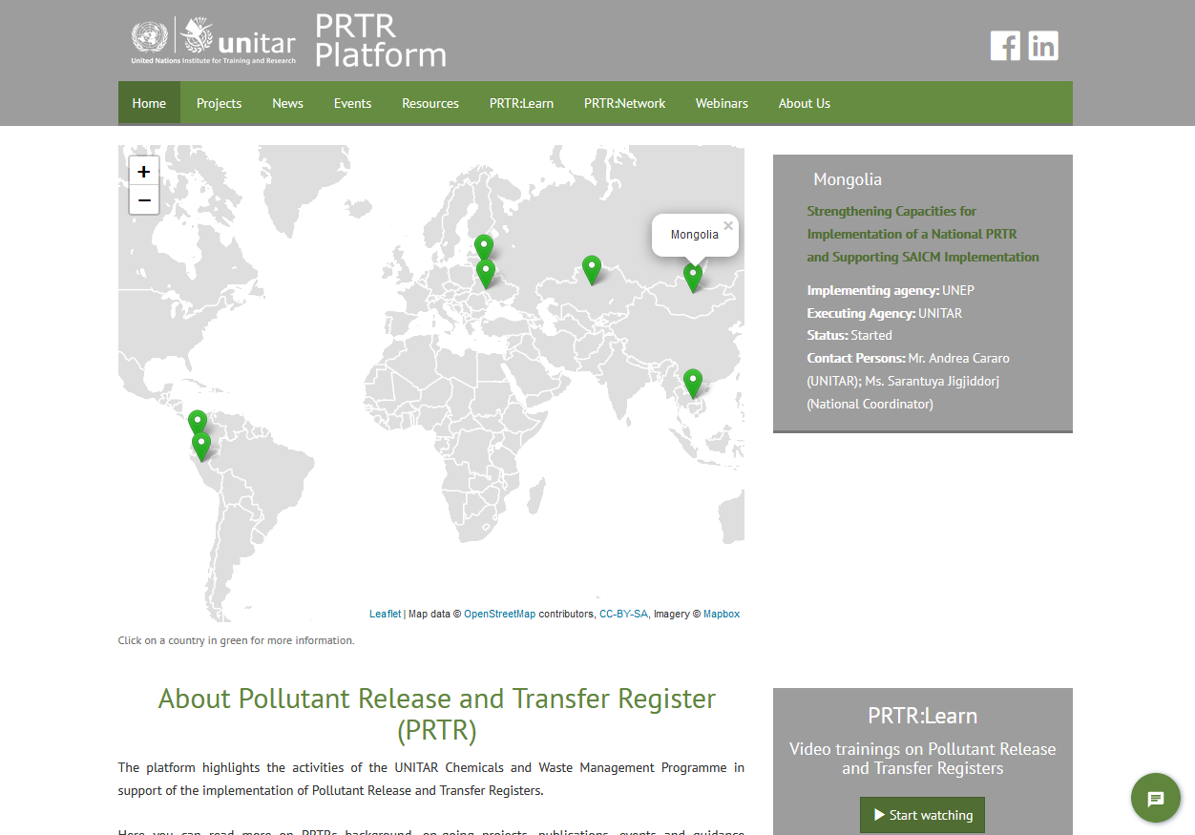
PRTR:Learn

Slide 11
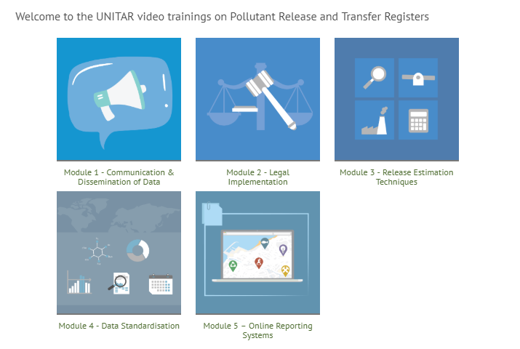
PRTRs Videos
Click on the icons
and
start learning!

Slide 12
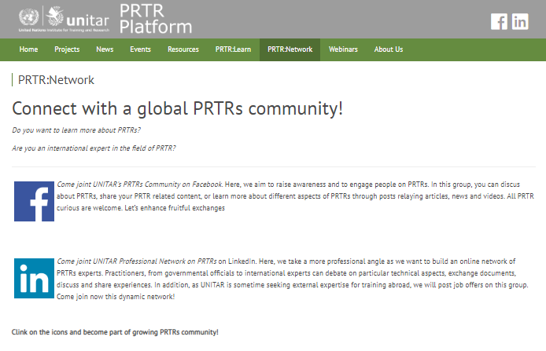
PRTR:Network

Slide 13
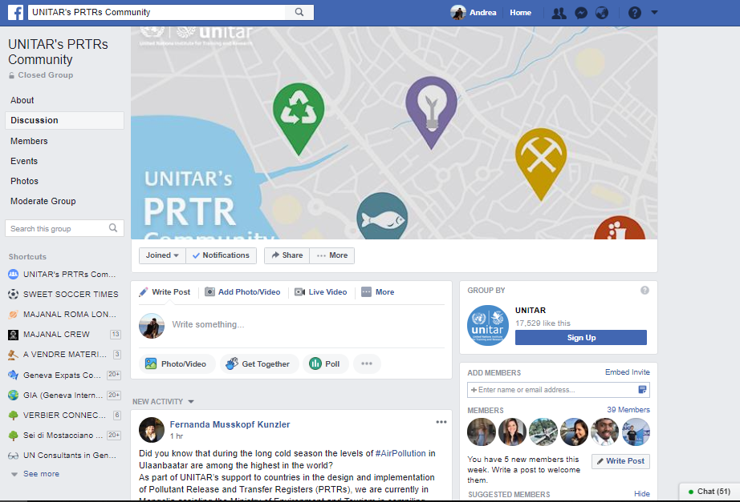
PRTR:Network | Facebook Group

Slide 14
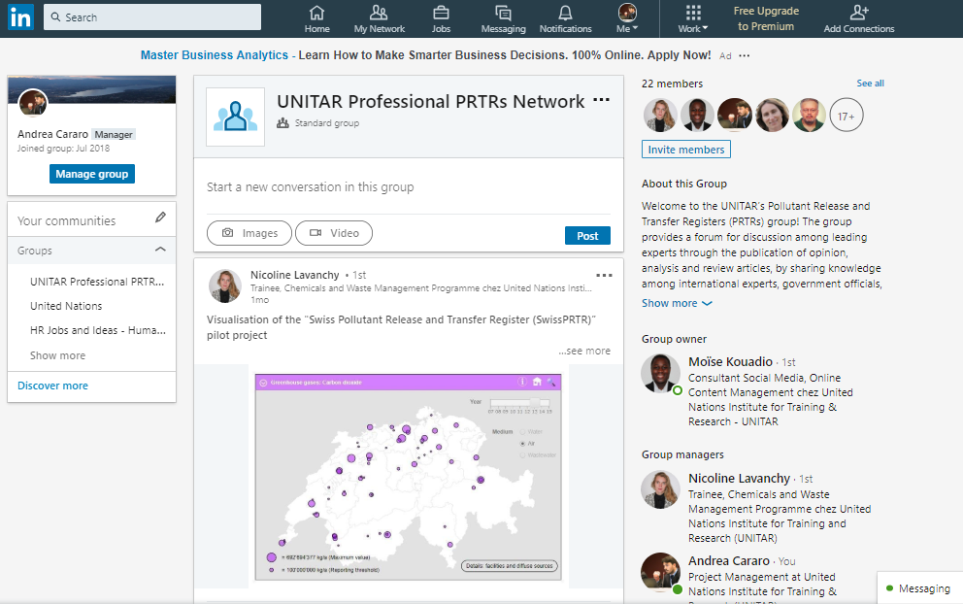
PRTR:Network | LinkedIn

Slide 15
Mr. Andrea Cararo
Projects Coordinator,
Chemicals and Waste Management Unit
+41 22 9178344
andrea.cararo@unitar.org
Thank You!

