Slide 1
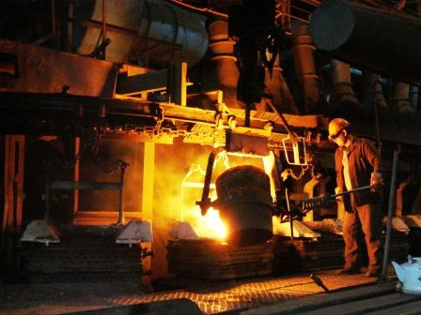
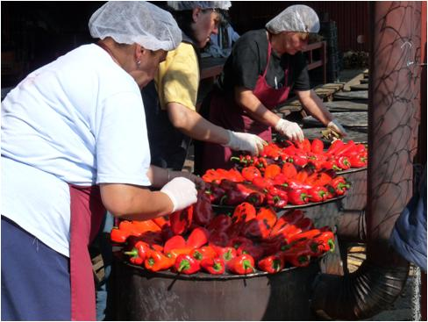
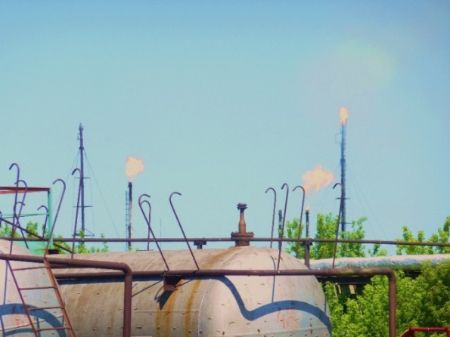
IFC Investment and Advisory Services in Eastern Europe and Central Asia (ECA)
“Environment for Europe” Astana, September 2011
Viera Feckova

Slide 2
International Finance Corporation (IFC)
Member of World Bank Group having a mission to promote sustainable private sector development via
Investment
Advisory services
ECA investment volume $6.5 bln. including $5.4 mld. IFC own resources
Key focus in ECA region – climate change and resource efficiency

Slide 3
IFC Active projects in Region
http://www.ifc.org/ifcext/spiwebsite1.nsf/$$MapView?openform

Slide 4
Climate change Advisory: Focus on private sector
IFC Advisory Services
Investment Climate
Access to Finance
Sustainable Business Advisory
Public-Private Partnerships
Partnerships &
AS Operations
Inclusive Business Models
Governments
Financial Intermediaries
Firms Sectors
Governments
Works with governments to create an enabling environment to increase the role of private sector in growth and development
Works with financial intermediaries to expand access to finance
Works at firm and sector level to develop inclusive, environmentally sustainable, and efficient markets
Works with governments to implement PPPs
Fosters partnerships, manages portfolio, trust funds operations, KM and learning for AS Business
Builds IFC’s brand and leadership in inclusive business by developing products that may integrate AS and IS.
Business Lines

Slide 5
Ahead: Advisory towards Performance Standards Uptake
Policy level
with regulators/IC
awareness, B2B
IFC’s business development
IFC’s portfolio
Sector level
Industry organizations
with BMOs
Capacity Building with Groups of Firms
Strategic Gap Analysis
Strategic Advice

Slide 6
Programmatic Approach
Resource Efficiency projects apply a programmatic approach that
engages at Firm, Sector, and Regulatory levels
Activities & Examples
Partners & Collaborators*
REF scoping and assessment across industries with IFC clients and through ‘lead firm/aggregators’ approaches - supply chain, utility DSM, private equity firms (e.g. cleaner product audit, water footprint assessment )
Note: Entry point for firm level engagement should be IFC portfolio or high probability pipeline client.
Firm
Sector
Standards & Practices
Public Policy &
Awareness
ATF BL (Sustainable Energy Finance product – works with partner financial institutions to scale up lending to Sustainable Energy projects)
CES specialists to be fully in the loop of client work, especially with IFC clients
Sector benchmarking of resource efficiency indicators (e.g. food processing benchmarking)
REF technologies scale-up (e.g. promotion of drip irrigation)
ATF BL (SE Finance product)
Clean Energy Product (coordinate and leverage technical expertise on energy)
Work with CES to identify barriers in sectors with high impact potential in the regions.
Promotion of good practice REF guides/cases (e.g. good practice guide for foundries)
Voluntary efficiency standards (e.g. Green buildings standards)
Coordinate with CES to ensure standards & practices are aligned with IFC performance standards
EST Standards Product and other International Development agencies (coordinate on promotion of voluntary standards)
Investment Climate BL (coordinate on development of mandatory standards)
Policy and regulatory support on energy/water efficiency and waste prevention/recycling ( e.g. fiscal incentives for energy efficient equipment/investment)
Investment Climate BL (any work with Governments as clients is done in partnership with IC)
World Bank and other International Development agencies (coordinate and leverage expertise)
* See appendix for detailed outline of key interfaces

Slide 7
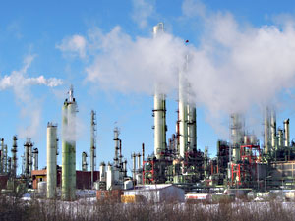
Resource Efficiency Product Overview
Objective: Increase investment flows into resource efficiency (i.e., the efficient use of energy, water, materials) by offering relevant business solutions to IFC investee clients and others in related sectors, combining firm-level interventions with broader engagement at the sector/market level
What We Do: Offer business solutions to IFC investee clients and other firms and sectoral stakeholders in related sectors (assessments, awareness, and regulatory advice)
Clients: IFC investee companies, sectoral organizations, vendors and service providers, relevant regulatory bodies
Impact: Climate Change → GHG avoidance (primary); Water use avoidance (secondary). Investments mobilized and related cost-savings (parallel to GHG and/or Water)
Russia CP program
Ukraine CP program
ECA CP program

Slide 8
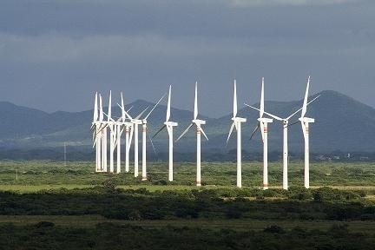
Clean Energy Product Overview
Overview
Objective: Increase investment flows into clean energy by demonstrating the commercial viability of and removing specific barriers to the scale-up of RE technologies that reduce GHG emissions and increase access to energy services for the poor.
What We Do: Focus on addressing specific gaps where other players are only partially active and where IFC’s skill set and corporate service offering are well suited. Take a programmatic approach to realize latent market opportunities that are hampered by 1) information asymmetry, 2) lack of proven business models and the capacity to implement them, 3) high first-mover costs, 4) lack of financing to grow companies, and 5) regulatory constraints to achieving scale.
Clients: 1) Renewable energy firms (project developers), industry associations, and regulatory bodies; 2) Manufacturers and suppliers of clean energy products and services. Clean Energy interventions for GHG and Energy Access impact have the same clients.
Impact: Multiple – Climate Change → GHG avoidance; Energy Access → Number of people with access to services; For both: investments mobilized

Slide 9
Current Renewable Energy projects in the region
Clean Energy projects in the ECA region addresses GHG reduction, RE regulatory framework improvement, and information and knowledge exchange.
Russian Renewable Energy
Reduce GHG emissions by overcoming barriers to the development of renewable energy (RE) by supporting development of policies, institutional capacity and market infrastructure
Geothermal Insurance
Reduce the risks associated with geothermal energy exploration and mitigate key barriers to geothermal energy investments in Turkey
RE in the Western Balkans
Create an online energy-hub for lessons learned, best practice, and business models for knowledge dissemination on investment and market opportunities in EMNA countries
Sustainable Energy Finance
Biomass Analysis
Stimulate energy investments in the Balkans using financial institutions as intermediaries to provide financing of energy efficiency (EE) and renewable energy (RE) investments
Establish a sustainable market for energy efficiency (EE) and renewable energy (RE) finance products in Armenia

Slide 10
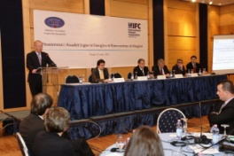
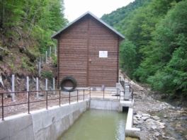
Example: Sustainable Business Advisory in Renewable Energy
Balkans: Renewable Energy (RE) Regulatory Framework Improvement
Clients: Ministries in Albania, Bosnia and Herzegovina and FYR Macedonia
Client benefit: Improvement of the existing RE regulatory framework; enabling development and construction of feasible RE power plants; support in EU integration
How: Drafting legal documents, encompassing all the stakeholder’s interests, supporting adoption process, promoting regulatory improvements.
Albania : Framework of Renewable Energy Law
Through partnerships with public sector, defined regulatory framework and renewable energy law in Albania
Purpose:
Promotion of energy (electricity and heat) generated from RES
Definition of incentive mechanisms
Definition of each public stakeholder obligations and responsibilities
Ensuring the compliance of national regulation with the EU RE rules
Key achievements:
Created link between REL and other strategic documents (RE National Action Plan, etc.)
Established controlling mechanism that will provide different incentives for different RE producers
Defined incentive mechanisms (feed-in tariff)
Introduced RE Fund to support RE project development
Introduced Grid System Quality Assessment
Introduced obligation of grid connection and energy off-take
Prepared list of secondary legislation required

Slide 11
Back up slides

Slide 12
Sustainable Business Advisory
Working at firm and sector level to develop inclusive, environmentally sustainable, and efficient markets
1
2
3
Transforming Firms & Sectors
→ Towards inclusive and environmentally sustainable growth
Three Focus Areas
Climate Change
Access to Markets
Access to Infrastructure (clean energy, ICT)
Partnering w/IS in Priority Areas
Eg, Agribusiness
Eg, Resource efficiency
Eg, Infra
Global Portfolio (FY11 Q1)
SBA Team
252 projects valued at $260m
43% in IDA
9% in FCAS
19% climate change related
227 staff
78% in the field
On the ground in 44 client countries, incl. 25 IDA & 5 FCAS.

Slide 13
IFC – investing in Emerging Markets since 1956
Largest multilateral source of loan/equity financing for the emerging markets private sector
Founded in 1956 with 182 member countries
AAA rated by S&P and Moody’s
Equity, quasi-equity, loans, risk management and local currency products
Takes market risk with no sovereign guarantees
Promoter of environmental, social, and corporate governance standards
Resources and know-how of a global development bank + flexibility of a merchant bank
Holds equity in over 800 companies worldwide
IFC FY10 Highlights
Portfolio $48.8 billion
Committed $12.7 billion
Mobilized $5.3 billion
# of companies 1,656
# of countries 120
Advisory services $859 million
Number of projects 736
Notes:
13

Slide 14
IFC Offers a Range of Products & Services for FIs
IFC Offers a Range of Products & Services for FIs
Senior
Debt
Structured
Finance
Mezzanine
Finance
Private
Equity
On-lending
Liquidity management
Acquisition financing
Warehousing facilities
Syndicated loans
Partial credit guarantees
Securitization
Bond underwriting
Convertible debt
Subordinated debt
Other Tier II instruments
Common shares
Preferred shares
Global Trade
Finance Program
Advisory
Services
Sustainable
Finance
$1 billion program
Guarantees to issuing banks
46 issuing banks in 24 countries
92 confirming banks in 62 countries
$579 million of issued guarantees in first 12 months
NPL & RM Advisory
Risk management
MF/SME banking
Housing finance
Energy efficiency finance
Financial Infrastructure
Agrifinance
Carbon finance
Renewable energy
Supply chain financing
Corporate governance financing
IFC serves 500+ financial institutions globally

Slide 15
How does Clean Energy Work?
Clean Energy projects generate impacts at the market level, leveraging collaborations with key firms to drive change at the sector level (e.g. knowledge dissemination, standards) and policy level (e.g. feed in tariffs, licensing, public private partnerships ).The program design is based on addressing the following barriers:
Lack of business Models
Develop and deploy business models through demonstration projects in target sectors
High first-mover costs
Provide cost-shared business development services and, where appropriate, concessional financing
Lack of financing
Catalyze IFC Investment and mobilize commercial funding sources
Information asymmetry
Regulatory constraints
Provide market intelligence on what opportunities exist and where
Feed back lessons from pilot projects to influence future regulations

Slide 16
Programmatic Approach
Clean Energy projects apply a programmatic approach that
engages at Firm, Sector, and Regulatory levels
Activities & Examples
Partners & Collaborators
Develop pilot projects and business models (e.g. GSMA, Gujarat Solar, Moser Baer, Lighting Africa)
Provide technical assistance to support company growth (e.g. Husk Power, Moser Baer, Lighting Africa)
Mobilization of concessional financing (e.g. Moser Baer, GeoFund)
A2F BL (SE Finance Product)
Finmech (leverage concessional financing)
PPP BL, Infrastructure Dept, Infraventures, PPIAF, PIDG, etc. (leverage expertise)
Firm
Provide market intelligence (e.g. Lighting Africa, GeoFund, GSMA, Moser Baer, Balkan RE)
Organize trainings as mean to information dissemination and capacity building (e.g. Lighting Africa, GSMA, Armenia RE)
Mobilization of commercial and concessional financing (e.g. Gujarat Solar)
Sector
A2F BL (SE Finance Product)
Infraventures , PPIAF, PIDG (leverage expertise)
Develop standards (e.g. Lighting Africa)
Develop Best Practices (e.g. GeoFund, GSMA, Moser Baer)
CES, EST Standards Product (coordinate regarding standards)
Infraventures and external entities e.g. PPIAF, PIDG (leverage expertise)
Standards & Practices
Support development of legislation for renewable energy (e.g. Russia RE, Balkans RE)
Develop national consumer education and communication programs(e.g. Lighting Africa)
WBG Clean Tech Pilot (leverage experience)
Investment Climate BL (Any work with Governments as clients is done in partnership with IC)
PPP BL (leverage expertise)
Public Policy & Awareness
NOTE: PPP BL coordination is on ad-hoc transactional basis initially focusing on Geothermal in Indonesia & Solar in India. CE product is contributing with energy expertise & market intelligence.

Slide 17
Firm level work is part of IS departments’ business development and portfolio management strategy on IDGs (example of REF for MAS in ECA)
Impact/
Business Driver
Focus
Sectors
Firm level
(examples)
Sector level
Benchmarking
KuAZ $20 mln; 115 K tCO2e
KZ $1 mln; 75 K tCO2e
UA [$70 mln]; 149 K tCO2e
Climate Change
High energy (material) intensive sectors
Waste to energy
Foundries
Food processing
Next:
Nitrogen Chemicals
Animal farming
Reduce costs
Improve competitiveness
Water
Ser: $0.8 mln ; CAPEX avoided - $2 mln; 170 mln m3
Cro: $2-8 mln ; CAPEX avoided – 40%; 100 k USD in water costs
Food processing
Metal processing
Pulp and Paper
Water Cases
Avoid CAPEX costs in water treatment
Reduce costs

Slide 18
Enterprises do not account for full costs of resources which can be 10 times higher than «nominal price»
Water:
A fee to utility per m3
Payment for transport and pumping, water treatment costs
Costs to heat or cool water
Pumping to WWTP, treatment of sewage, WWTP CAPEX and maintenance costs
Result : water costs at a well 0.50 UAH, full costs of water 5 UAH.
Energy
New equipment with old management
Energy efficiency in buildings is overlooked
Result: losses, comfort and sanitary conditions

